Slide 1
Deutsche Telekom Trial
October 19th, 2021 | 8-10am PDT
A deeper dive into the SD-RAN Project
Saurav Das
VP Engineering, ONF

Slide 2
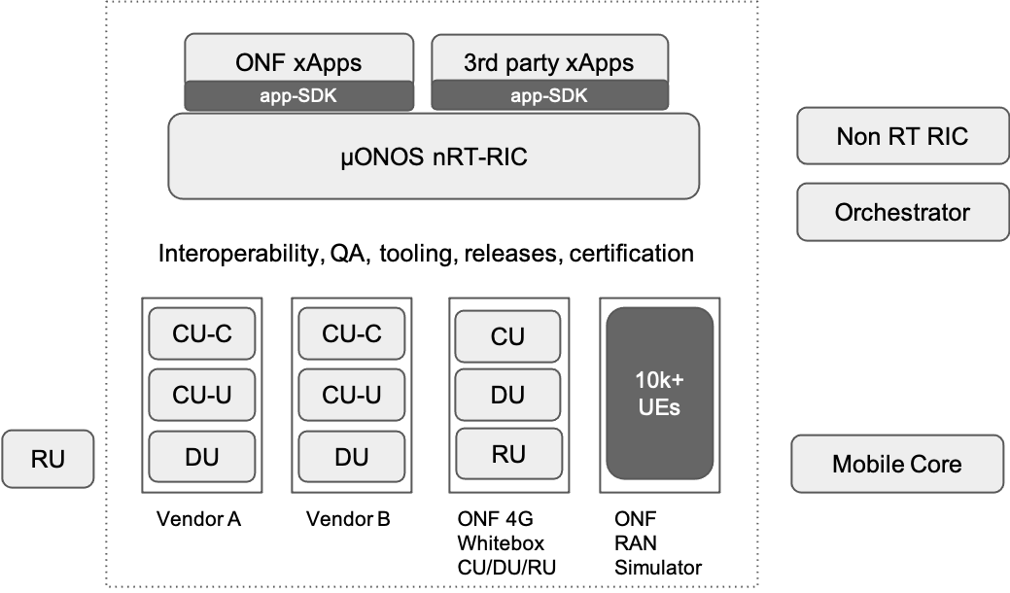
SD-RAN Project

Slide 3
SD-RAN’s µONOS-based nRT-RIC
cloud-native microservices architecture
app-SDKs are a collection of APIs and tools in different languages that allow xAPPs to interact with RIC platform services
Provides R-NIB functionality for RAN entities and their relations
(configured & discovered)
py-SDK
go-SDK
Transactional initial or runtime configuration of ‘targets’ - eg. xApps
onos-topo (R-NIB)
onos-config (O1t)
Tracks information associated with RAN User Elements
onos-uenib
μONOS-RIC
onos-exporter (O1t)
Scrapes, formats and exports metrics to backend TSDBs
Data structures and synchronization primitives for building distributed systems - backend databases, replication protocols, etc.
atomix
A1t*
onos-cli
onos-e2-sm
onos-e2t
onos-operator
Single CLI executable for multiple subcomponents
k8s
Intelligent proxy and adapter for managing the interactions between RIC components and RAN nodes
- Implements E2-AP southbound
- Coverts ASN ←→ Protobuf
Extends k8s API with custom resources
Helm
Deployed as a plugin to e2t, providing protobuf translations for O-RAN Service Models (SMs), and Go code for ASN.1 PER encoding

Slide 4
SD-RAN’s µONOS-based nRT-RIC
cloud-native microservices architecture
RIC platform & app-SDKs allow flexibility in xApp development
Multiple KPM apps
Apps can subscribe to multiple SMs
Apps can choose not to subscribe to any SM
AirHop eSON server^
MLB
xApp
^ used in DT-trial
FB- KPImon
xApp^
FB-SON
xApp^
KPImon xApp^
PCI
xApp
py-SDK
go-SDK
onos-topo (R-NIB)
onos-config (O1t)
onos-uenib
μONOS-RIC
onos-exporter (O1t)
atomix
A1t*
onos-cli
onos-e2-sm
onos-e2t
onos-operator
O-RAN E2AP v1.0.1, ASN.1/SCTP
O-RAN KPM 2.0.3 SM
RC-PRE 2.0 SM
k8s
Helm
4G nodes
5G nodes
RANSim

Slide 5
SD-RAN Project

Slide 6
RAN-Simulator Architecture
E2T
E2T
...
E2T
ASN.1/SCTP
E2 Agent
E2 Agent
E2 Agent
...
E2 Agent
RAN Model (nodes, locations, power, E2T bindings, etc.)
Nodes, locations, events
RAN Sim API
E2 Node
E2 Node
E2 Node
...
E2 Node
Cell
Cell
Cell
Cell
Cell
Cell
Cell
Cell
induce failures, events, etc.
RAN Simulation
Model (YAML)
Nodes, SM IDs
Locations
“Honeycomb Generator”
RRM Lib
Mobility Handler
KPM SM
Handler
Radio Emulation
RC-PRE SM
Handler
MHO SM
Handler
Loader
ONOS GUI
...
ONOS CLI
Prometheus
Metrics
UE
UE
UE
UE
UE
UE
UE
...
UE
UE Sim API
UEs & events
UE Model (UEs, RRC state, pCell, nCell, routes, RSRP, etc.
control UI counts
induce attach, movement, etc.
manage routes, etc.

Slide 7
RAN-Simulator Model and API for Mobile Handover
E2T
E2T
...
E2T
ASN.1/SCTP
E2 Agent
E2 Agent
E2 Agent
...
E2 Agent
Update Event A3 parameters
RAN Model (nodes, locations, power, E2T bindings, etc.)
RAN Sim API
Get/Watch Event A3 parameters
E2 Node
E2 Node
E2 Node
...
E2 Node
Cell
Cell
Cell
Cell
Cell
Cell
Cell
Cell
RAN Simulation
Model (YAML)
(“static”)
Nodes, SM IDs
Locations
RRM Lib
Mobility Handler
KPM SM
Handler
Radio Emulation
RC-PRE SM
Handler
MHO SM
Handler
Loader
ONOS GUI
...
ONOS CLI
onos-cli-594848b59d-k5qsp:~$ onos ransim get cells
ECGI #UEs Max UEs TxDB Lat Lng Azimuth Arc A3Offset TTT A3Hyst CellOffset FreqOffset Color Neighbors
343332707639810 0 99999 0.00 52.503 13.454 120 120 5 5 5 5 5 green 343332707639809,343332707639811,343332707639554
343332707639809 0 99999 0.00 52.503 13.454 0 120 4 4 4 4 4 green 343332707639553,343332707639810,343332707639811
343332707639553 0 99999 0.00 52.485 13.405 0 120 1 1 1 1 1 green 343332707639555,343332707639809,343332707639554
343332707639554 0 99999 0.00 52.485 13.405 120 120 2 2 2 2 2 green 343332707639553,343332707639555,343332707639810
343332707639555 0 99999 0.00 52.485 13.405 240 120 3 3 3 3 3 green 343332707639811,343332707639553,343332707639554
343332707639811 0 99999 0.00 52.503 13.454 240 120 6 6 6 6 6 green 343332707639555,343332707639809,343332707639810
onos-cli-594848b59d-k5qsp:~$ onos ransim set cell 343332707639554 --a3-offset 10 --a3-ttt 1024 --a3-hyst 1000 --a3-celloffset 1000 --a3-freqoffset 2000
Cell 343332707639554 updated
onos-cli-594848b59d-k5qsp:~$ onos ransim get cells
ECGI #UEs Max UEs TxDB Lat Lng Azimuth Arc A3Offset TTT A3Hyst CellOffset FreqOffset Color Neighbors
343332707639810 0 99999 0.00 52.503 13.454 120 120 5 5 5 5 5 green 343332707639809,343332707639811,343332707639554
343332707639809 0 99999 0.00 52.503 13.454 0 120 4 4 4 4 4 green 343332707639553,343332707639810,343332707639811
343332707639553 0 99999 0.00 52.485 13.405 0 120 1 1 1 1 1 green 343332707639555,343332707639809,343332707639554
343332707639554 0 99999 0.00 52.485 13.405 120 120 10 1024 1000 1000 2000 green 343332707639553,343332707639555,343332707639810
343332707639555 0 99999 0.00 52.485 13.405 240 120 3 3 3 3 3 green 343332707639811,343332707639553,343332707639554
343332707639811 0 99999 0.00 52.503 13.454 240 120 6 6 6 6 6 green 343332707639555,343332707639809,343332707639810
Prometheus
Metrics
UE
UE
UE
UE
UE
UE
UE
...
UE
UE Sim API
UEs & events
UE Model (UEs, RRC state, pCell, nCell, routes, RSRP, etc.
control UI counts
induce joins, movement, etc.
manage routes, etc.

Slide 8
Measurement and A3 Handover in RAN-Simulator
Measurement - every tick, per UE
UE: calculating RSRP every tick
  Moving on a path every tick
  Changing location → changing received signal strength
  ⇒ Updating RSRP of serving/neighbor cells every tick
RSRP calculation based on
  Directional antenna model
  Free space path-loss model
A3 Handover - per UE
Reporting measurement to “RRM Library” every tick
If A3 handover event is generated, then SM handler is informed
Depending on SM, A3 event parameters can be influenced
Measurement - Update every tick per UE
Candidate serving cells (neighbors)
Serving cell
Cell
Cell
Cell
Cell
Calculate RSRP
UE
RSRP
RSRP
RSRP
RSRP
Update serving cell
Route
REPORT (every tick)
RRM Library
SM handler
Indication
Control

Slide 9
SD-RAN Project

Slide 10


SD-RAN Whitebox LTE - CU/DU/RU & UE
OAI LTE UE
(Intel NUC)
RIC
E2
SD-Core
(4G)
USRP
B210
E2 Agent
F1-C
S1-C
RU
USRP
B210
OAI LTE DU
OAI LTE CU
(Container)
S1-U
F1-U
LTE
UE
(Intel NUC)

Slide 11
sdRan-in-a-Box (RiaB)
MLB
xApp
eSON srv
testsrv
KPImon xApp
PCI
xApp
FB- KPImon
xApp
FB-SON
py-SDK
go-SDK
onos-topo (R-NIB)
onos-config
onos-uenib
μONOS-RIC
onos-exporter
atomix
A1t*
onos-cli
onos-e2-sm
onos-e2t
onos-operator
k8s
E2AP 1.0.1 over
ASN.1/SCTP
Helm
KPM 2.0.3 SM
RC-PRE 2.0 SM
E2 Agent
ONF
SD-CORE
(4G)
E2 Agent(s)
KPM 2.0.3 SM
UE
sim
(OAI)
DU / CU (OAI)
RANSim
RRM library
Honeycombgenerator
pci GUI

Slide 12
SD-RAN Project

Slide 13
SD-RAN Commercial 5G RU/DU/CU Integration
Integration Labs
ONF, Menlo Park
  Radisys containerized CU, DU and UEsim + ONF RIC + ONF test-xApps + ONF 5G SD-Core
Radisys, Bangalore
  Radisys containerized CU, DU and UEsim + ONF RIC + ONF test-xApps + Radisys 5G core
Facebook, Menlo Park
  Foxconn indoor RUs, Radisys/Intel DU server (1st gen) + ONF RIC + FB xApps + AirHop’s eSON server + ONF/Radisys 5G core
Deutsche Telekom, Berlin
  Foxconn outdoor RUs, Radisys/Intel DU server (2nd gen) + ONF RIC + ONF & FB xApps + AirHop’s eSON server + ONF Aether (4G & 5G SD-Core + SD-Fabric - P4-UPF & Intel BESS-UPF)
eSON srv
testsrv
FB- KPImon
xApp
FB-SON
KPImon xApp
PCI
xApp
py-SDK
go-SDK
onos-topo (R-NIB)
onos-config
onos-uenib
μONOS-RIC
onos-exporter
atomix
A1t*
onos-cli
onos-e2-sm
onos-e2t
onos-operator
k8s
E2AP 1.0.1 over ASN.1/SCTP
Helm
KPM 2.0.3 SM
RC-PRE 2.0 SM
E2 Agent
ONF
SD-CORE(5G)
SD-Fabric
5G
phone
RU
DU
CU
Foxconn, Intel, Radisys

Slide 14
SD-RAN Project

Slide 15
SD-RAN Releases
SD-RAN v1.0 Released December, 2020
  Featured first e2e release consistent with O-RAN architecture
    RIC & KPM-xApp + RAN-hardware & software (E2 nodes) + Mobile-core
  Beginnings of the Go app-SDK
  Introduced sdRan-in-a-Box (RiaB) - completely virtualized e2e dev/test environment
SD-RAN v1.1 Released March, 2021
  Featured successful integration with commercial xApp - AirHop’s eSON server
  Introduced Python app-SDK contributed by Facebook
  Developed new use-case - PCI conflict resolution via pre-standard Service Model - RC-PRE
  Introduced O-RAN compliant RAN simulator (RANSim) with E2AP, SMs etc
SD-RAN v1.2 Released July, 2021
  Featured successful integration with commercial 5G-NR RAN software (CU/DU) from Radisys
  Introduced new use-case implementation - Mobility Load Balancing
  Addition of Radio and User-Element Network-Information-Bases (R-NIB & UE-NIB) to RIC platform
  Part of DT-Trial in Berlin
SD-RAN v1.3 coming Oct, 2021
  RAN Slicing (4G) & Mobile Handover - new use cases
  RIC e2T clustering for HA and Scale
  Upgrade to O-RAN E2AP 2.0

Slide 16
SD-RAN Community
Understanding Trailing Open-source Releases
  Every time SD-RAN publishes ONF member-only release, the previous member-only release is open-sourced (Apache license)
  SD-RAN Project moves from Incubation Phase into the Partner Commercialization Phase
  Blog post: https://opennetworking.org/news-and-events/blog/sd-ran-updates-software-licensing-policy-trailing-releases-will-be-released-open-source/
SD-RAN v1.1 Open Source Release (Sept, 2021)
  https://wiki.opennetworking.org/display/COM/SD-RAN+1.1+Release
  Key Takeaways
    Some open source repos are read-only
    Executable binaries are included
    Contributions accepted only on master (not in trailing releases)
SD-RAN Community calls and sdran-dev mailing list now open to everyone
  Community calls every 1st and 3rd Thursday of the month at 9am PDT
  Join sdran-dev mailing list to receive invite to Community call: https://groups.google.com/a/opennetworking.org/g/sdran-dev

Slide 17
Backup

Slide 18
What does the SDK include?
SDK APIs
RIC abstraction layer
  SDK APIs
  SDK Implementation
libraries (e.g. asyncio, Prometheus, HTTP …)
test framework
logging framework
code samples/guides
tools for ease of deployment/development
SDK implementation

