Slide 1
Telco Cloudification: From Open CORD to SDN Enabled Broadband Access (SEBA)
Saurav Das
VP of Engineering, ONF
OFC Tutorial
March 9th, 2020

Slide 2
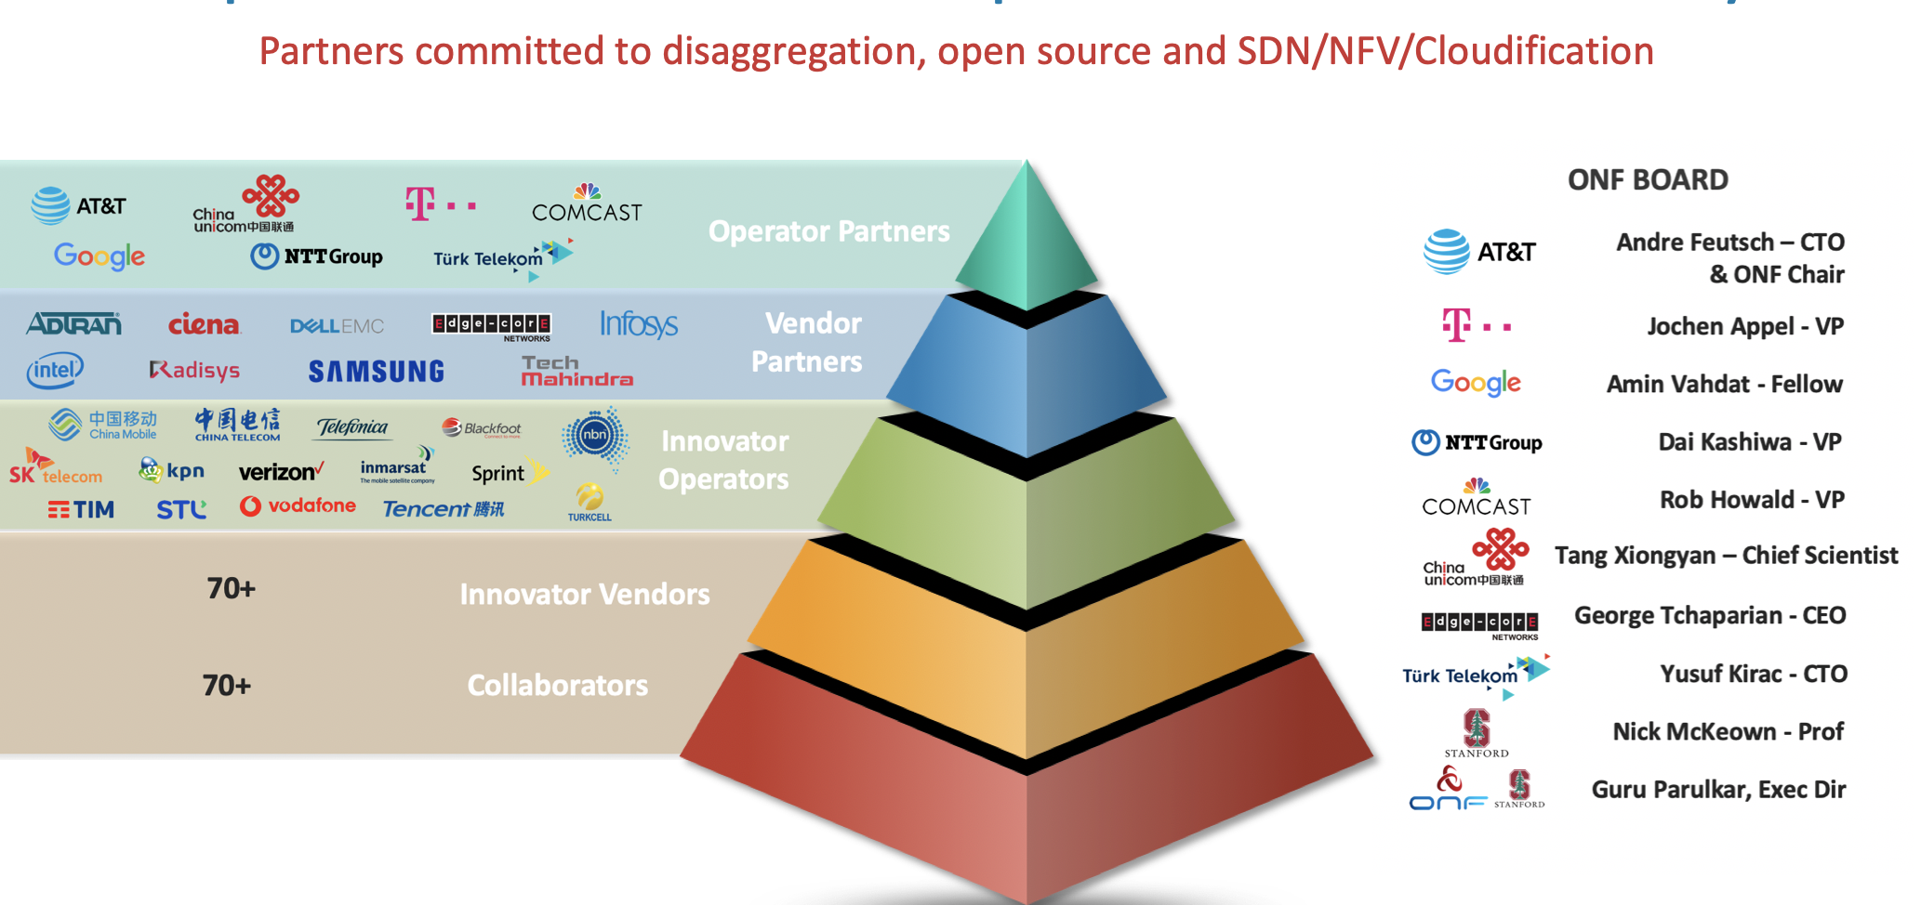
ONF: Operator Led, Curated Open Source Community

Slide 3
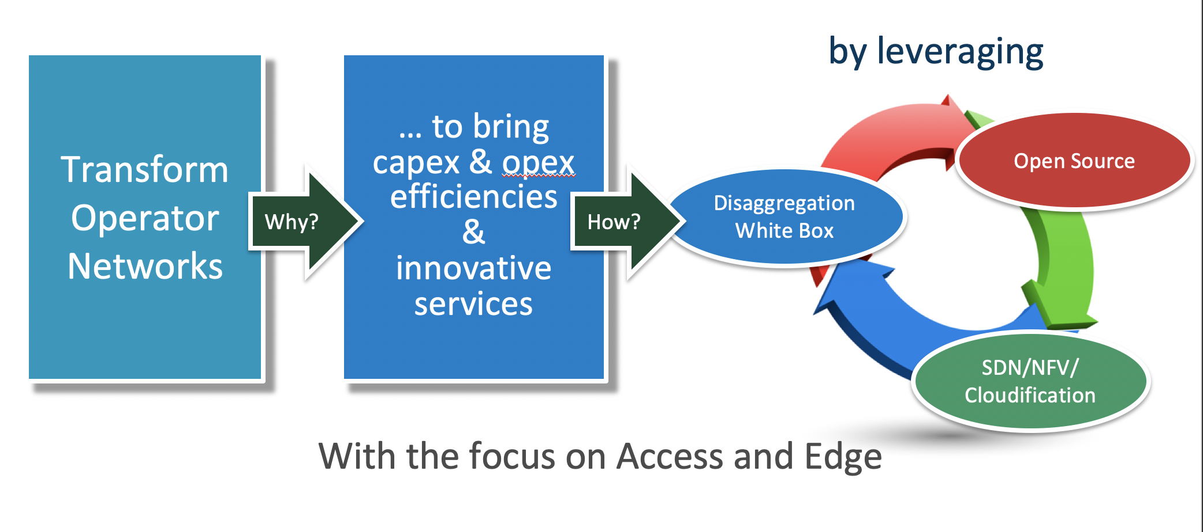
ONF’s Operator Led Mission
Notes:
ONF is an operator led industry consortium.
And our mission is to transform operator networks and to bring Capex and Opex efficiencies and enable operators to create innovative revenue generating services.
And we achieve our goals by leveraging or building on the architecture innovations such as SDN, NFV and Cloudification as well as Disaggregation and Open Source.
What is important to note is that we are not just about open source or just about SDN or NFV.
We believe if we have to achieve the transformation we all seek, we have to work with and emphasize all these together and that is only way we can succeed with our mission.
And we are very mission oriented in this pursuit.
You can contrast this with other communities that simply focus on open source or bringing developers together without a clear shared mission.

Slide 4
Traditional Broadband Access
Residence
Central Office
Backbone
Network
RG
ONU
ODN
OLT
ETH AGG
BNG
RG – Residential Gateway
OLT – Optical Line Termination
BNG – Broadband Network Gateway

Slide 5

SEBA: SDN Enabled Broadband Access
Residence
Central Office
Virtual OLT
manages and abstracts PON
Manages 1 or more switches
Virtual BNG
manages subscriber
services
VOLTHA
TRELLIS
SD-BNG
Backbone
Network
RG
ONU
ODN
OLT
ETH AGG
OLT MAC & PHY
Whitebox
Switch
BNG
Whitebox switch
with merchant silicon
RG – Residential Gateway
OLT – Optical Line Termination
BNG – Broadband Network Gateway
Notes:
The goal of SEBA is that of bringing the benefits of disaggregation and open source to the case of residential access.
We do this by using SDN principles and whitebox hardware.
To make this possible we first virtualize the PON network including the OLT and the ONU using VOLTHA
We abstract all the internal complexity of the PON network and instead offer an abstraction of an OpenFlow switch
Second, we disaggregate the ethernet aggregation stage using whitebox switches and Trellis, a set of SDN apps that control a fabric of 1 or more switches
Finally, the fabric can be extended to include more advanced functions such as BNG
Let’s have a closer look at each one of these 3 componenets

Slide 6
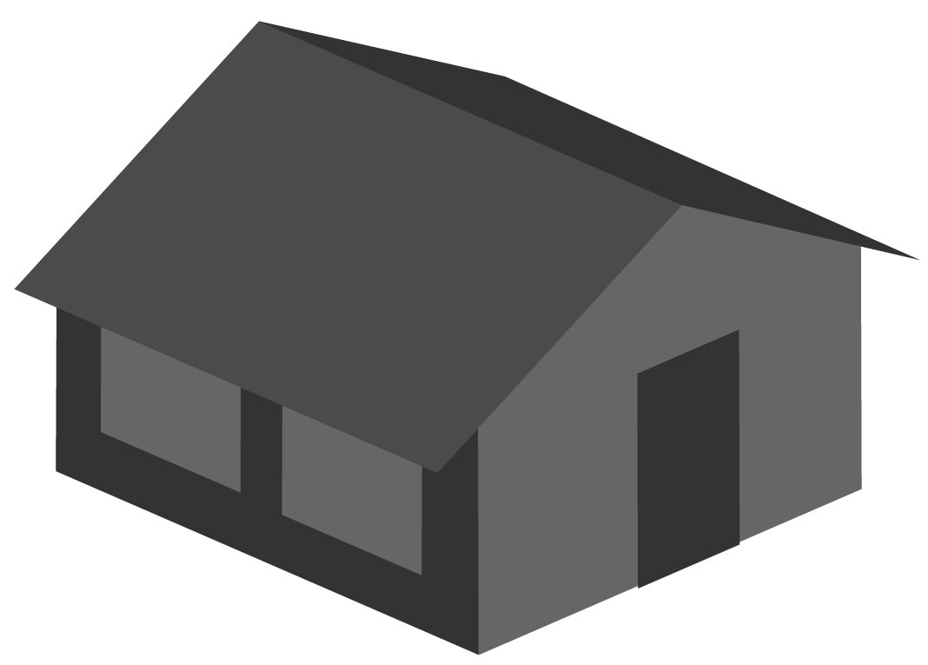



SEBA
ONAP
Op X OSS/BSS
SEBA POD
Abstract OLT
SDN
Enabled
Broadband
Access
Network Edge Mediator (NEM)
DockerK8s Helm
AAA
vlans
dhcp
mcast
bridging
routing
ACLs
SDN Controller - ONOS
VOLTHA
ONU
OLT
(Embedded BNG)
SWITCH
External BNG
SERVER

Slide 7
SEBA Components: VOLTHA

Slide 8
SEBA
ONAP
Op X OSS/BSS
SEBA POD
Abstract OLT
SDN
Enabled
Broadband
Access
Network Edge Mediator (NEM)
DockerK8s Helm
AAA
vlans
dhcp
mcast
bridging
routing
ACLs
SDN Controller - ONOS
VOLTHA
ONU
OLT
(Embedded BNG)
SWITCH
External BNG
SERVER
QuantaGrid
D51B-1U

Slide 9



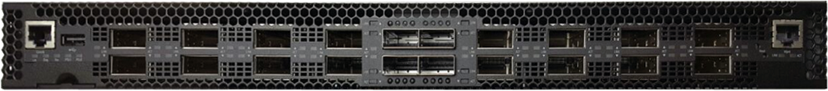
OLT disaggregation → VOLTHA
On path to production in 2020 at
AT&T, Deutsche Telekom, Türk Telekom
Backplane
VLANs
AAA
Mcast
…
EMS
ONOS: SDN Controller
VLANs, IGMP, 802.1x, Mcast …
OpenFlow
PON MAC blades
VOLTHA
SDNize
OpenFlow Agent
VOLTHA Core
OLT/ONU adaptors
Compute blades
VOLTHA: Virtual OLT Hardware Abstraction
gRPC
Traditional Chassis-based
Vendor OLT for PONs
(Passive Optical Networks)
EdgeCore ASXvOLT16
(and others)
Notes:
Traditional chassis-based OLT. Has PON mac blades, compute blades, backplane, management system.
Disagg -- SDNize -- OLT MACs pizza boxes, SW = Voltha manage not just the OLT but also the entire PON. Because OLT use to manage whole PON.
Because Voltha presents abstraction of PON, can run sdn controller (ONOS) on top

Slide 10
VOLTHA Architecture
Applications
ONOS SDN Controller
ONOS 1
ONOS 1
VOLTHA: Virtual OLT Hardware Abstraction
Common Control & Management framework shared by all OLTs and ONUs
Hides PON level details (T-CONTS, GEM, OMCI) from the SDN controller by abstracting each PON as a simple Ethernet switch
Client
(eg. OFAgent)
Etcd
VOLTHA core
kafka
OpenOLT
Adaptor
OpenONU
Adaptor
OpenONU
Adaptor
OpenONU
Adaptor
OMCI
Whitebox OLT
ONU
OpenOLT driver/agent
ONL
BAL
ONIE
SDK(s)
ONU
ONU

Slide 11
VOLTHA Operation
Bridging/Routing
VLANs
dhcp
mcast
ONOS
VOLTHA
Logical
switch
ONU
Switch
OLT
UNI
NNI
UNI

Slide 12



Industry’s First White-Box XGS-PON OLT
VOLTHA
core
White-Box =
Open-Hardware Specs (OCP)
+ Open-Source Software (ONF & OCP)
OpenOLT
Adaptor
Edgecore
ASFvOLT16
Whitebox OLT
OpenOLT
Whitebox OLT
OpenOLT Driver
ONL
Chip Driver
ONIE
SDK(s)

Slide 13
Why OpenOLT Adaptor?
Generic OLT adaptor - ease of onboarding for new vendors (including whitebox vendors)
VOLTHA
core
OpenOLT
Adaptor
VOLTHA CORE
OpenOLT
OpenOMCI ONU
Alpha ONU
Iskratel ONU
Arcadyan ONU
Whitebox OLT
OpenOLT Driver
CIG ONU
CIG
OLT
EdgeCore OLT
Iskratel
OLT
ONL
Chip Driver
Tellabs ONU
ONIE
SDK(s)
Tellabs
OLT

Slide 14
PON Management
Kafka
AAA
sadis
vOLT
dhcp
mcast
Speed Profile
ONOS
Per subscriber
up/down bw profile
cir/eir/cbs/ebs
VOLTHA
Logical
switch
Tech Profile
Access Tech type
# Gems/TCONTs
Sched policy
Pbit mapping
Discard policy
ONU
OLT
UNI
NNI
UNI

Slide 15
AT&T Technology Profile
RG
ONU
OLT
1TCONT,
4 GEM
(Stag.Ctag)
VLAN_0
UNI
3
0 → 10
UNI
7
0 → 15
100.10
VLAN_0
100.15
100.20
1TCONT,
4 GEM
VLAN_0
UNI
12
0 → 20

Slide 16
Deutsche Telekom FTTH Technology Profile
RG
ONU
OLT
1TCONT,
8 GEM
(Stag.Ctag)
VLAN_ANY
UNI
3
ANY → ANY
7.ANY (for UNI 3)
8.ANY (for UNI 12)
1TCONT,
8 GEM
VLAN_ANY
UNI
12
ANY → ANY

Slide 17
CPE
DPU with embedded ONU
OLT
g.fast
1TCONT, 8 GEM
(Stag.Ctag)
33.ANY
33.ANY
mgmt
12
1TCONT, 8 GEM
4090
UNI
12
48.ANY
33.ANY → 540.ANY
Up to 16
4090
1TCONT, 1 GEM
48.ANY
mgmt
48.ANY → 600.ANY
12
4090
VLAN_ANY
33.ANY → 840.ANY
1TCONT, 8 GEM
48.ANY → 900.ANY
g.fast
33.ANY
33.ANY
1TCONT, 8 GEM
UNI
12
48.ANY
Deutsche Telekom FTTB Technology Profile
Up to 16
4090
1TCONT, 1 GEM
48.ANY
mgmt
12
4090
VLAN_ANY

Slide 18
RG
ONU
OLT
T-CONTS
(Stag.Ctag)
HSIA
35
35 → 33
UNI
35 → 34
VoIP
65
7.33
7.34
7.133
65 → 63
65 → 63
VoD /
IPTV
55
HSIA
UNI
55 → 55
55 → 55
HSIA
35
550
1546.63
VoIP
VoIP
65
VoD /
IPTV
55
555.55
VoD
550
IPTV
HSIA
35
35 → 133
VoIP
65
65 → 63
VoD /
IPTV
55
55 → 55
Turk Telekom Technology Profile
550

Slide 19
VOLTHA Architecture
Applications
ONOS SDN Controller
ONOS 1
ONOS 1
VOLTHA: Virtual OLT Hardware Abstraction
Common Control & Management framework shared by all OLTs and ONUs
Hides PON level details (T-CONTS, GEM, OMCI) from the SDN controller by abstracting each PON as a simple Ethernet switch
Client
(eg. OFAgent)
Etcd
VOLTHA core
kafka
OpenOLT
Adaptor
OpenONU
Adaptor
OpenONU
Adaptor
OpenONU
Adaptor
OMCI
Whitebox OLT
ONU
OpenOLT driver/agent
ONL
BAL
ONIE
SDK(s)
ONU
ONU

Slide 20
SEBA Components: Trellis

Slide 21
SEBA
ONAP
Op X OSS/BSS
SEBA POD
Abstract OLT
SDN
Enabled
Broadband
Access
Network Edge Mediator (NEM)
DockerK8s Helm
AAA
vlans
dhcp
mcast
bridging
routing
ACLs
SDN Controller - ONOS
VOLTHA
ONU
OLT
(Embedded BNG)
SWITCH
External BNG
SERVER

Slide 22
Fabric disaggregation → TRELLIS
Carrier-grade SDN fabric for edge/NFV applications
Based on whitebox switches and merchant silicon
In production at Comcast
Extensive switch support
Vendors: EdgeCore, Delta, Inventec, Stordis, QCT
ASIC: Tomahawk, Tomahawk+, Trident2, Qumran, Tofino
Switch SW stack:
ONL, OF-DPA, Stratum
Trellis Apps
Bridging, vRouter, MPLS-SR, mcast, etc.
External router
(BGP, OSPF, etc.)
ONOS: SDN Controller
OpenFlow
P4Runtime
gNMI
Field office
metro/
core
Long-haul
Access
Leaf (ToR)
Spine
Spine
OLT
Base station
etc.
Compute
Leaf
Leaf
Leaf
Leaf
Compute
Compute
Central office
Single Leaf
Leaf-Spine Fabric
With ECMP and N-way redundancy
Multi-Stage Leaf-Spine
For distributed access/edge networking
SCALE
SCALE
Notes:
Trellis is a set of SDN apps running on top of ONOS that provide the control plane for a carrier-grade fabric made of whitebox switches running merchant silicon
It can be used to control only 1 switch, like in this example where a top of rack / leaf is used to forward traffic between some access devices, compute servers, and an upstream router. Trellis provide a set of API that let operators enable capabilities such as bridging, routing, multicast, etc. at the network level.
Indeed, the same API and apps can be used to control a full blown leaf-spine fabric, with ECMP and N-way redundancy
...or even a multi-stage fabric where multiple leaf-spines are connected with long-haul optics
What is more, Trellis supports a number of switches from different vendors, running different ASICs and software stacks. Many of these are OCP compliant.
Open APIs such as OpenFlow, P4runtime, and gNMI are used to interact with the devices

Slide 23


Trellis apps
IPv4/v6 unicast/multicast, vlans, MPLS SR, vRouter …
ONOS Cluster
Central Office
Spine
Spine
Metro/Core
Routers
Internet
Base station
Leaf
Leaf
Leaf
Leaf
Leaf
Leaf
R-PHY
2
Types of Switches
R-OLT
1
Types of Traffic
Optimized for Service Provider Access/Edge

Slide 24
Trellis apps
IPv4/v6 unicast/multicast, vlans, MPLS SR, vRouter …
ONOS Cluster
Spine
Spine
Field
Office
Leaf
Leaf
Spine
Spine
Metro/Core
Routers
Central
Office
Internet
3
Distributed
Fabric
Base station
Leaf
Leaf
Leaf
Leaf
R-PHY
R-OLT
Optimized for Service Provider Access/Edge
Notes:
USE CASE 1 – Distributed Fabric for Access/Edge Networking

Slide 25

Whitebox ToR Switching
Trellis Apps
White-Box =
Open-Hardware Specs (OCP)
+ Open-Source Software (ONF & OCP)
SDN Controller
Indigo OF Agent
BRCM OF-DPA
ONL
SDK
ONIE
BRCM ASIC
Edgecore
5712, 6712, 7712
OCP Bare Metal Switch

Slide 26
SEBA Components: SD-BNG

Slide 27
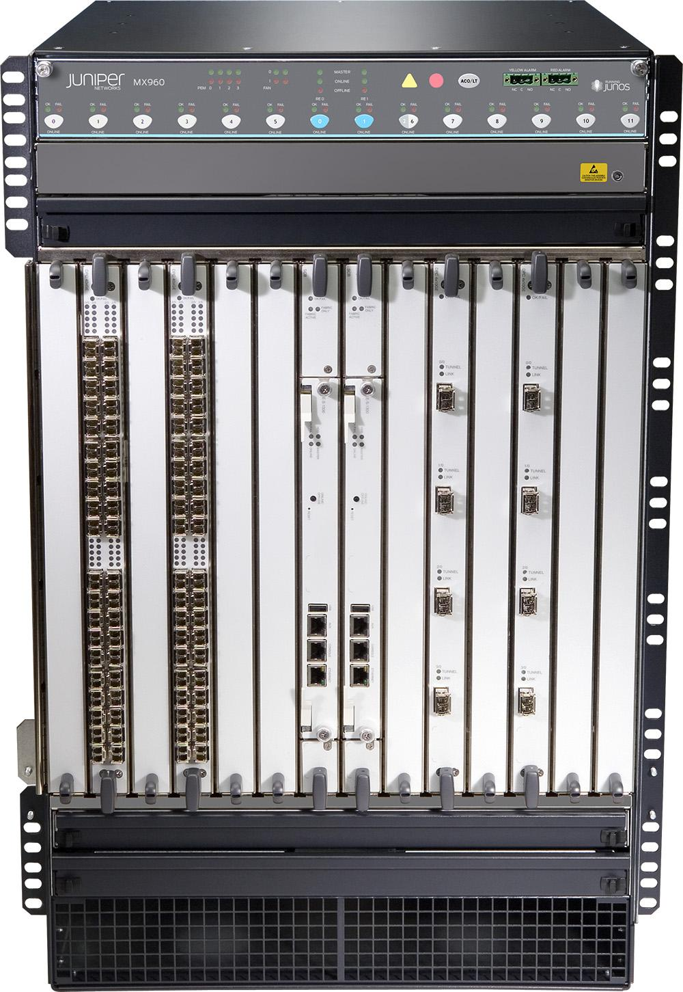
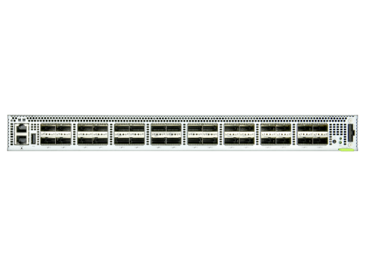
BNG disaggregation → SD-BNG
Specialized router:
Subscriber termination (QinQ, PPPoE)
Accounting
Hierarchical QoS
Lawful intercept
Wholesale tunnel relay (L2TP)
Multicast
Routing
Etc.
Control Plane Apps (BNG-CP)
Authentication, address assignment, accounting, etc.
ONOS: SDN Controller
SDNize
User Plane (BNG-UP)
Use merchant silicon available in fabric and OLT
OLT
FABRIC SWITCH
Broadcom Qumran (DNX)
300 Gbit/s, Deep Buffers, HQoS
Intel Barefoot Tofino
3.2 Tbit/s, P4-defined routing, PPPoE term, accounting, etc.
Traditional Chassis-based Vendor
Broadband Network Gateway (BNG)
Notes:
The BNG is a specialized type of router that is responsible of routing subscriber traffic to and from the operator core network. It performs many functions, such as…
Similarly to VOLTHA, we disaggregated the BNG black box in two logical pieces: the user plane and the control plane
For the user plane, which is responsible of processing subscriber data traffic, we re-use the same merchant silicon that is already available in the SEBA pod
We can use the Tofino ASIC in the fabric switch to perform functions such as routing, PPPoE termination, accounting, etc
While we can use the Qumran chip inside the OLT to perform Hierarchical QoS, since this chip is specifically designed for application that requires deep buffering
The control plane can run as an SDN apps on top of ONOS

Slide 28

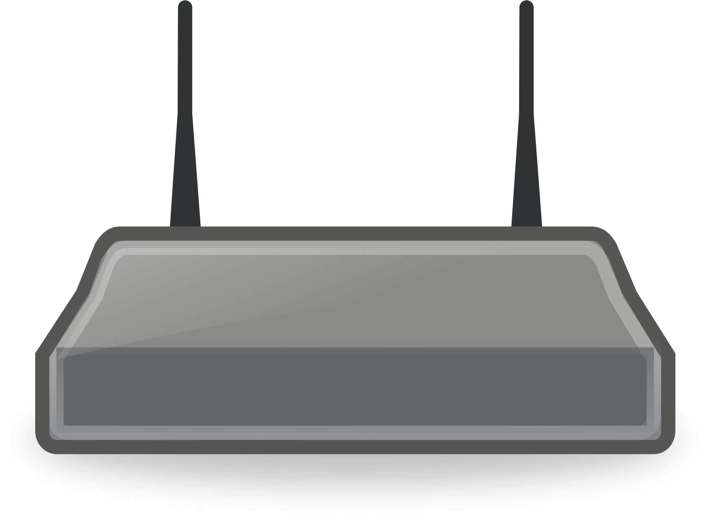
SEBA 2.0 Architecture
ONAP
Operator OSS/BSS
SEBA POD
Local adaptor
Network Edge Mediator (NEM)
Edge orchestration and FCAPS micro-services
Docker
Kubernetes
Helm
VOLTHA apps
PON/OLT control
TRELLIS apps
Fabric control
BNG-CP apps
Subscriber control
SOFTWARE STACK
SDN Controller - ONOS
OpenFlow
P4Runtime,
gNMI/OpenConfig
VOLTHA
BNG-UP
RG
ONU
Stratum
Whitebox OLT
whitebox switch
Core
PON
Whitebox OLT
whitebox switch
HARDWARE
Compute
servers

Slide 29
SD-BNG with user plane functional split
Control plane (BNG-c)
PPPoE Session Discovery
Authentication
Subscriber addressing
Routing
etc.
Classification
Policing
Double-VLAN termination
Anti-spoofing
PPPoE
term.
Routing
ACL
Accounting
Lawful intercept
UPSTREAM
Lawful intercept
Accounting
H-QoS
PPPoE
aggr.
Double-VLAN aggregation
Mcast
replication
ACL
Routing
Classification
DOWNSTREAM
Barefoot Tofino (fabric sw)
User/data plane (BNG-u)
Demonstrated today
Broadcom Qumran (OLT)
Work in progress

Slide 30
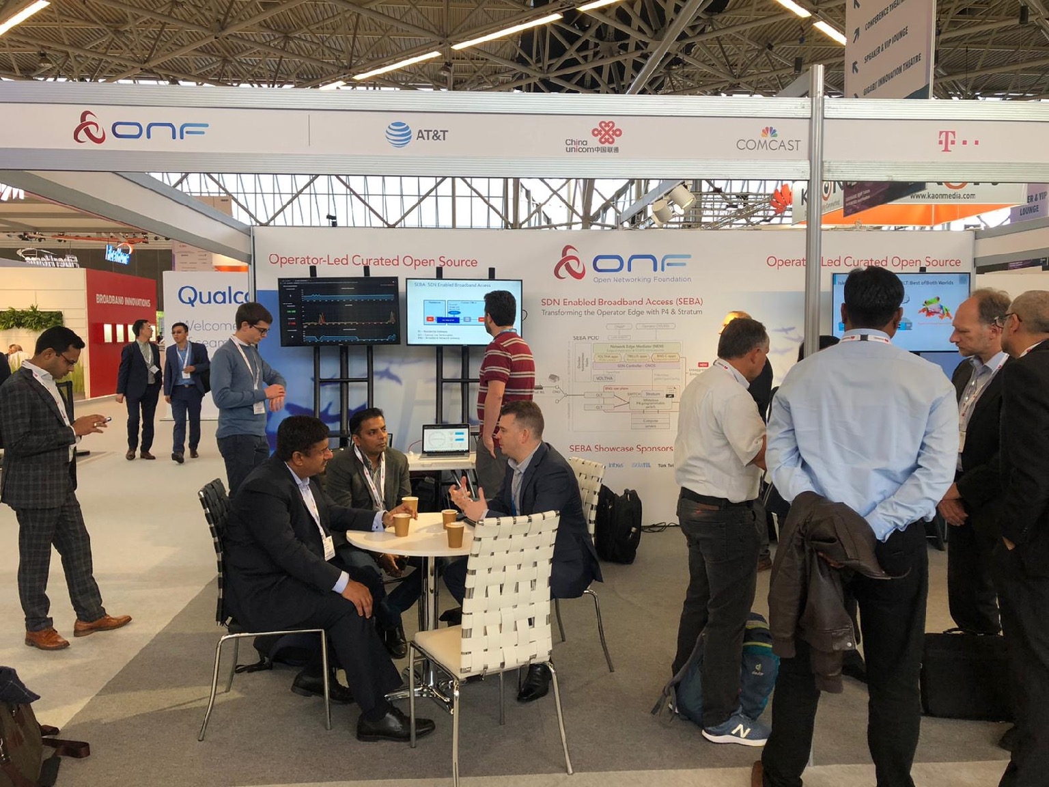

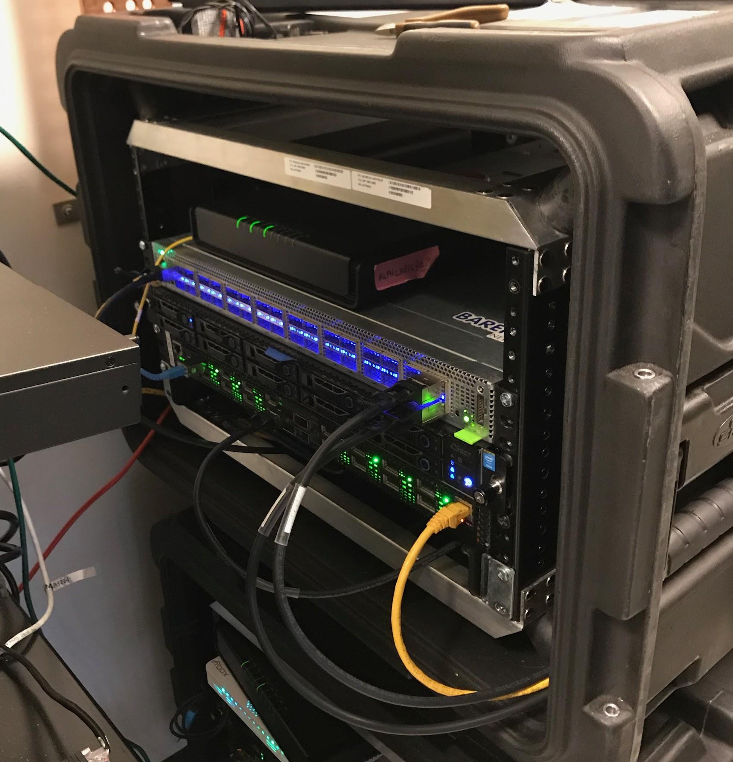
SEBA SD-BNG Demo at BBWF (Oct 2019)
Webpage
Slides
Subscriber with PPPoE client
ONU
P4 SWITCH
OLT
SERVER

Slide 31
SEBA Components: NEM

Slide 32
SEBA
ONAP
Op X OSS/BSS
SEBA POD
Abstract OLT
SDN
Enabled
Broadband
Access
Network Edge Mediator (NEM)
DockerK8s Helm
AAA
vlans
dhcp
mcast
bridging
routing
ACLs
SDN Controller - ONOS
VOLTHA
ONU
OLT
(Embedded BNG)
SWITCH
External BNG
SERVER

Slide 33
NEM Orchestration & NBI
Model based service definition
OLT,
ONU whitelist,
Subscriber
SEBA POD
NEM
XOS GUI
Chameleon
Tosca
XOS Core
Synchronizers
Database
vOLT
dhcp
mcast
SR
FPM
T3
ONOS Cluster
OF
OF
Redfish
Redfish
VOLTHA
TP
TP
TP
ONU
UNI
AGG Switch
OLT
NNI
AGG Switch
Compute

Slide 34
SEBA Subscriber Model
Location
ONU Serial num
OLT/PON port
ONU Whitelist
Tagging
C-tag
Subscriber
S-tag
SEBA 1.0
Upstream
cir, cbs, eir, ebs, air
Bandwidth Profile
Downstream
cir, cbs, eir, ebs, air
Num GEM/TCONT
Traffic priorities
Gem-port mappings
Queuing policy
Scheduling policy
Discard policy
Service Type
Tech Profile
Residential, Business,..

Slide 35
NEM Orchestration & SEBA Workflows
Different operators
==
Different workflows
SEBA POD
NEM
XOS GUI
Chameleon
Tosca
XOS Core
Synchronizers
Database
vOLT
dhcp
mcast
SR
FPM
T3
ONOS Cluster
BNG is a workflow option
External physical BNG
vBNG in compute
BNG in Agg switches
BNG in OLT boxes
Authentication is a workflow option
802.1x based
PPPOE based
DHCP based
OF
OF
Redfish
Redfish
VOLTHA
TP
TP
TP
ONU
Subscriber services are workflow options
HSIA
Voice
IPTV
Business services
Technology profiles
Speed profiles
UNI
AGG Switch
OLT
NNI
AGG Switch
Compute

Slide 36
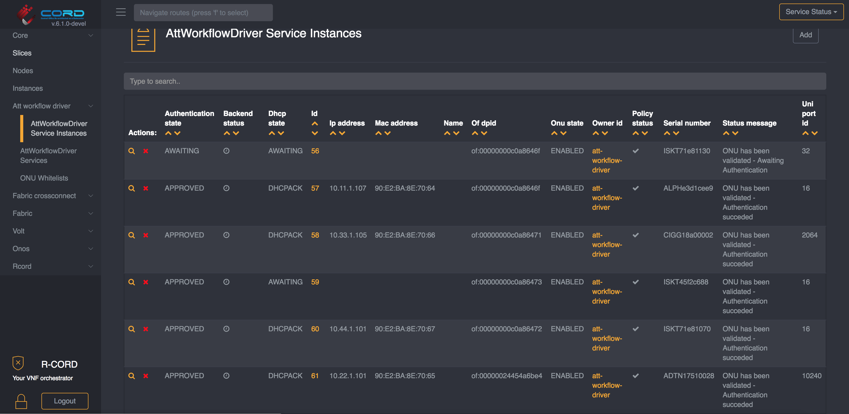
NEM Dashboards: XOS GUI
runtime service instantiation, inventory, workflow status

Slide 37
NEM Monitoring
Infrastructure
GRAFANA
KIBANA
XOS
PROMETHEUS
ELK STACK
NEM
Operator OSS
KAFKA
Alarms, events & stats
ONOS
Logs
VOLTHA
ONU
BNG
RG
UNI
OLT
AGG
NNI
Compute

Slide 38
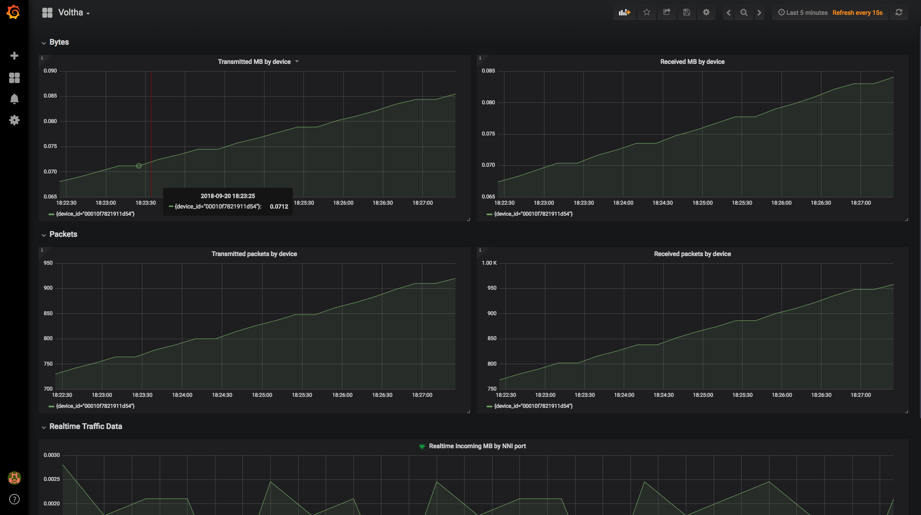
NEM Dashboards: Kibana, Grafana
stats, events, logs (FCAPS)

Slide 39
FCAPS from ONOS
Kafka
Prometheus
Bridging/Routing
Kafka
integration
AAA
sadis
vOLT
dhcp
l2relay
igmp
proxy
ONOS
Grafana

Slide 40
Redfish API Integration
Edgecore XGS
PON vOLT
HTTP/REST & REDFISH API
Redfish Agent
Kafka
Edgecore
GPON OLT
Prometheus
Redfish Agent
Redfish
Importer
Edgecore
Switch
Grafana
Redfish Agent
Server
Redfish Agent
XOS
NEM

Slide 41
SEBA 2.0 Architecture
ONAP
Operator OSS/BSS
SEBA POD
Local adaptor
Network Edge Mediator (NEM)
Edge orchestration and FCAPS micro-services
Docker
Kubernetes
Helm
VOLTHA apps
PON/OLT control
TRELLIS apps
Fabric control
BNG-CP apps
Subscriber control
SOFTWARE STACK
SDN Controller - ONOS
OpenFlow
P4Runtime,
gNMI/OpenConfig
VOLTHA
BNG-UP
RG
ONU
Stratum
Whitebox OLT
whitebox switch
Core
PON
Whitebox OLT
whitebox switch
HARDWARE
Compute
servers

Slide 42
SEBA Community

Slide 43


















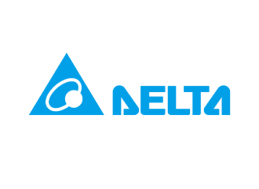

SEBA (and VOLTHA) Community
AT&T

Slide 44
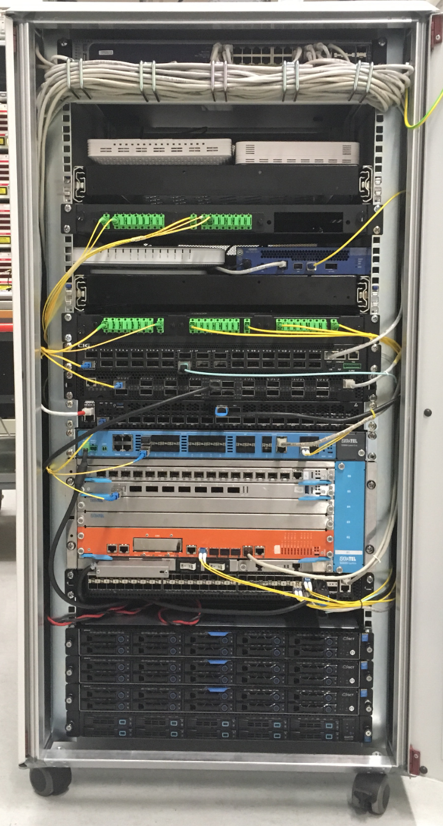
Demo setup BBWF 2018
ONUs: Arcadyan, Alpha, Adtran, CIG, Iskratel
OLTs: Adtran, CIG,
EdgeCore & Iskratel
AGG switch: EdgeCore
Servers: VOLTHA, ONOS, XOS, K8s, ELK, Docker, Prometheus, Grafana, Kibana

Slide 45

SEBA Surge: Brigades
Brigade | Stabilization | BAL 3.0 upgrade | VOLTHA FCAPS | ONOS FCAPS | Multicast & Multi-TCONT | BBSim & Scalability | Test Automation
ONF Mentor | David | Girish | Scott | Saurav | Saurav & Girish | Matteo | Suchitra
Contri-butors |  |  |  |  |  |  | And many others

Slide 46
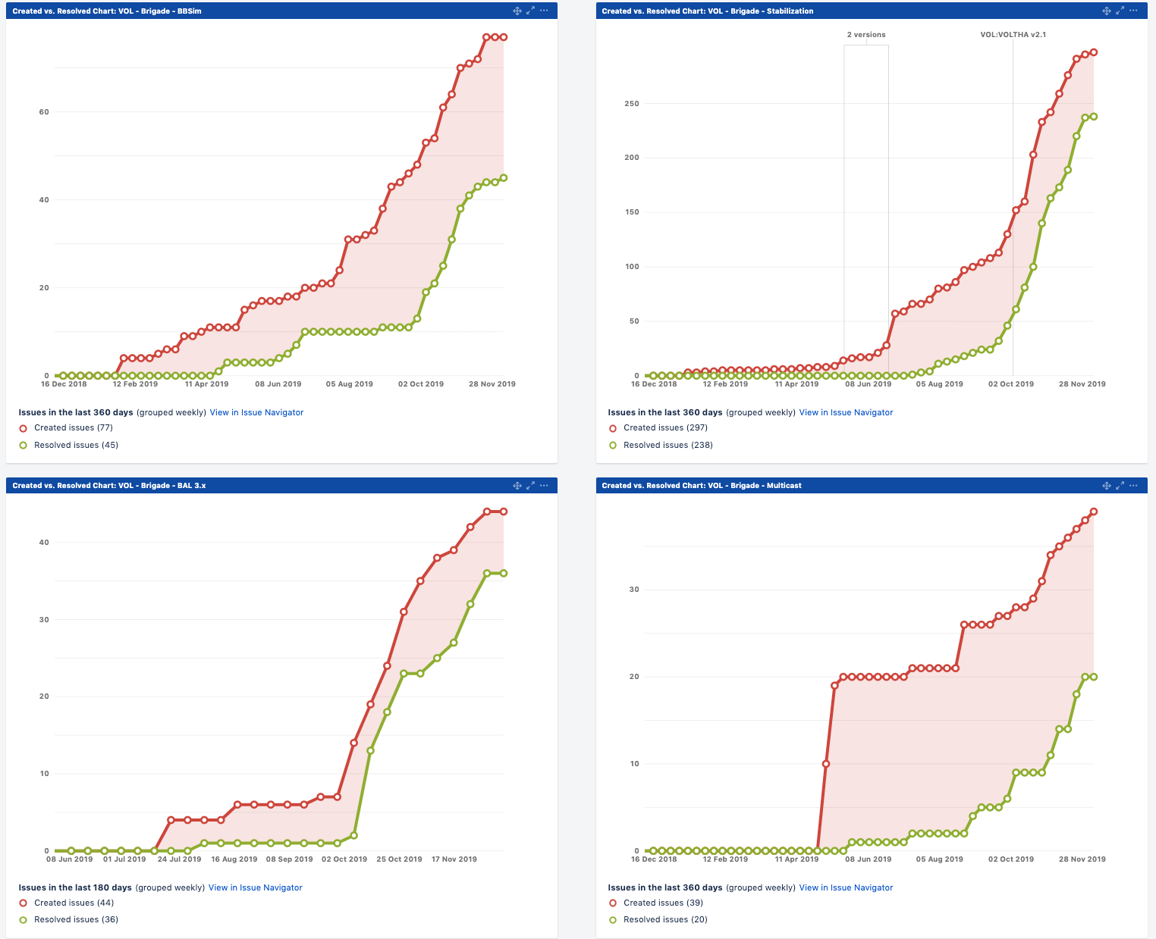
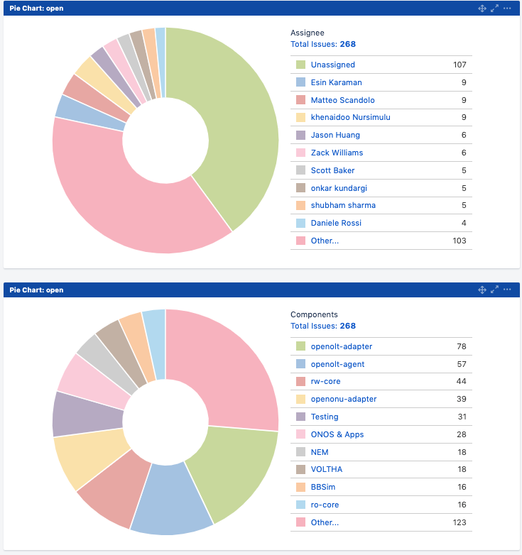
SEBA Surge: Brigade Dashboards
SEBA Surge
Started
SEBA Surge
Started
BBSim & Scalability Brigade
Stabilization Brigade
SEBA Surge
Started
SEBA Surge
Started
BAL
Brigade
Multicast Brigade

Slide 47
SEBA & CORD

Slide 48




CORD – Central Office Rearchitected as a Datacenter
Residential
vOLT, vSG, vRouter, vCDN
Mobile
vBBU. vMME, vSGW, vPGW, vCDN
Enterprise
vCarrierEthernet, vOAM, vWanEx, vIDS
Access Service Orchestration & Control
White-box Switches with
Merchant Silicon
Cloud
SDN
NFV
BBUs
PON OLTs
COTS (Off-the-Shelf) x86 Compute
ROADM (Core)
Economies of a datacenter, Agility of a cloud provider

Slide 49







SEBA: Built on CORD
SDN
Enabled
Broadband
Access
Mobile
Services
Enterprise
Services
Residential
Services
Mobile
Enterprise
Residential
NEM
Network Edge Mediator
OSS mediation & FCAPS support for operationalization
Leverages XOS project & toolchain
SEBA
Trellis
ONOS
ORAN
VOLTHA
Stratum
NEW
ODTN
Radio
Units
PON
OLTs
PON
OLTs
Shared Cloud Infrastructure
ROADM
(Core)
Notes:
SEBA is a platform that brings together a number of ONF projects to virtualize residential access
Today we demonstrate the integration of a new project, Stratum

Slide 50
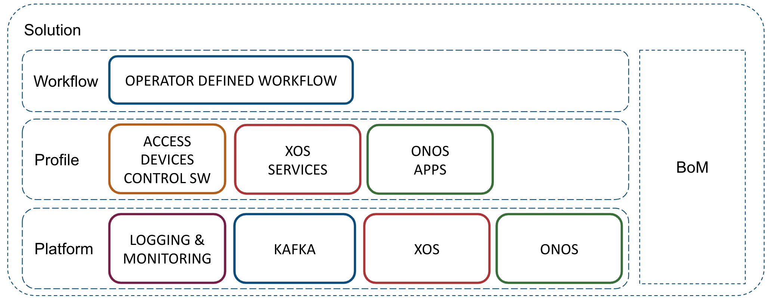
SEBA: Built on CORD
SEBA POD
AT&T
TT
DT
SEBA
profile
VOLTHA
Elasticsearch
Logstash
Kibana
Prometheus
Grafana
Hardware: Server, Switch, OLT, ONU etc
Network Edge Mediator (NEM)

Slide 51
Issues with the previous CORD platform
No distiniction between development vs deployment
  Most of the software built from source at “deploy time”
  Big scripts, scripts calling scripts, long process
  Monolithic: If something breaks, wipe and start from scratch
  Brittle: Small variations of hardware/connectivity could break build
Not flexible or modular
  Required specific versions of server OS
  Tightly coupled components – cannot exclude or replace components
  Required internet access for install
Hard to use
  Choose a profile at start; to change profiles reinstall
  No means for adding services at runtime
Notes:
As always, it’s important to translate the input coming from partners’ deployments into requirements, to make the platform better. I’d like to go through some fundamental challenges met with the previous platform, that gave the community some rationale to create the new one.
BULLET EXPLAINATION
* CORD wasn’t really able to distinguish between a deployment and a development workflow. Most of the time software was built as well during the deployment phases, which is unexpected and time consuming
* CORD was spawning VMs during the deployment phase, such requiring either physical machines or VMs
* CORD had to be installed on Ubuntu 16.04
* Offline installation was not officially supported, and anyway quite difficult -> problem for most of the SPs
* CORD installation was monolithic. It was installing OS, configure OS, install components (i.e. ONOS, OpenStack, XOS) and profiles, together in one step
As a user, you had to decide what “flavor” (use-case) of CORD to install, at the very beginning of the installation. Want to install R-CORD? Choose it at the beginning. Changed your mind and want to install M-CORD? You’ve to reinstall the entire platform
Over time, users (including developers and QA) asked to be able to run CORD in different environments. For example, on single machines for development vs full clusters for trials and production. The two workflows have diverged quite a lot over time and were considerably different from one each other
Many components were tightly coupled, at the point that it was very difficult to exclude them from the system. Classical example: many SPs use their own infra tools (DNS, system configurator like Puppet). CORD providing these services as well, and this was most of the time an issue
Having scripts to automate processes is important, but it’s also important to find the right balance between automation and make difficult for users what’s under the hood
CORD is an integration of effort, using many components. It has been traditionally released as a whole, even if these components have been historically released by different groups. Often it has been a problem to advance features separately

Slide 52
SEBA
ONAP
Op X OSS/BSS
SEBA POD
Abstract OLT
SDN
Enabled
Broadband
Access
Network Edge Mediator (NEM)
DockerK8s Helm
AAA
vlans
dhcp
mcast
bridging
routing
ACLs
SDN Controller - ONOS
VOLTHA
ONU
OLT
(Embedded BNG)
SWITCH
External BNG
SERVER

Slide 53
SEBA Modularity
NEM Orchestration (XOS)
NEM Monitoring
(Prom,Grafana, ELK)
Access
apps
Fabric
apps
ONOS
VOLTHA
Trellis
Kafka
K8s
OS
OS
OS
ONU
OLT
AGG
switch
Compute
Nodes
ONU

Slide 54

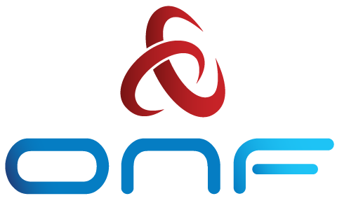
Issues with the previous R-CORD
CORD Head Node
VOLTHA
…
Radius
ONOS
XOS
Subscriber Traffic through vSG (virt. Service Gateway)
CORD Compute Node
CDN
OvS
vSG
Internet
Whitebox ToR Fabric Switch
EdgeCore 7712 (Tomahawk 32 x 100G)
Residential Subscribers
EdgeCore Whitebox OLT (ASFvOLT16)
BCM
ONU
RG
Central Office

Slide 55
SEBA
ONAP
Op X OSS/BSS
SEBA POD
Abstract OLT
SDN
Enabled
Broadband
Access
Network Edge Mediator (NEM)
DockerK8s Helm
AAA
vlans
dhcp
mcast
bridging
routing
ACLs
SDN Controller - ONOS
VOLTHA
ONU
OLT
(Embedded BNG)
SWITCH
External BNG
SERVER

Slide 56
Summary
ONF: Operator driven curated open source
  CORD is the flagship umbrella project
  SEBA – SDN Enabled Broadband Access, built on the CORD platform
SEBA
  Solution integrates several other ONF projects: VOLTHA, ONOS, Trellis, SD-BNG, XOS
  Current focus areas – VOLTHA productization & SD-BNG exploration
Community
  VOLTHA and SEBA have healthy active communities
  Brigades: a way to effectively manage community resources
  Many brigades in progress, more to come – get involved (CORD Calendar)
Learn More
  Community: https://wiki.opencord.org/display/cord/seba
  Release Documentation: https://guide.opencord.org/cord-7.0/profiles/seba/
  BoM: https://guide.opencord.org/cord-7.0/prereqs/hardware.html

