Slide 1
SDN in the Last Mile
SEBA & SD-RAN
Saurav Das
VP of Engineering, ONF
IEEE NFV-SDN Keynote
November 10th, 2020

Slide 2
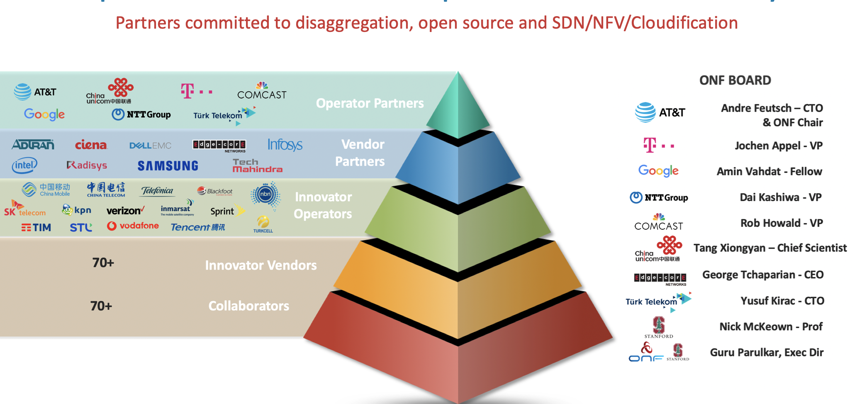
ONF: Operator Led, Curated Open Source Community

Slide 3
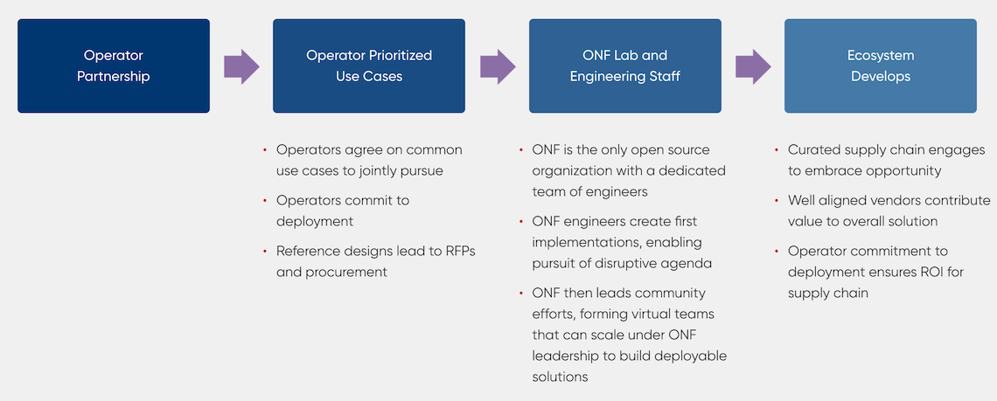
ONF’s Curated Open Source Model
Notes:
ONF is an operator led industry consortium.
And our mission is to transform operator networks and to bring Capex and Opex efficiencies and enable operators to create innovative revenue generating services.
And we achieve our goals by leveraging or building on the architecture innovations such as SDN, NFV and Cloudification as well as Disaggregation and Open Source.
What is important to note is that we are not just about open source or just about SDN or NFV.
We believe if we have to achieve the transformation we all seek, we have to work with and emphasize all these together and that is only way we can succeed with our mission.
And we are very mission oriented in this pursuit.
You can contrast this with other communities that simply focus on open source or bringing developers together without a clear shared mission.

Slide 4
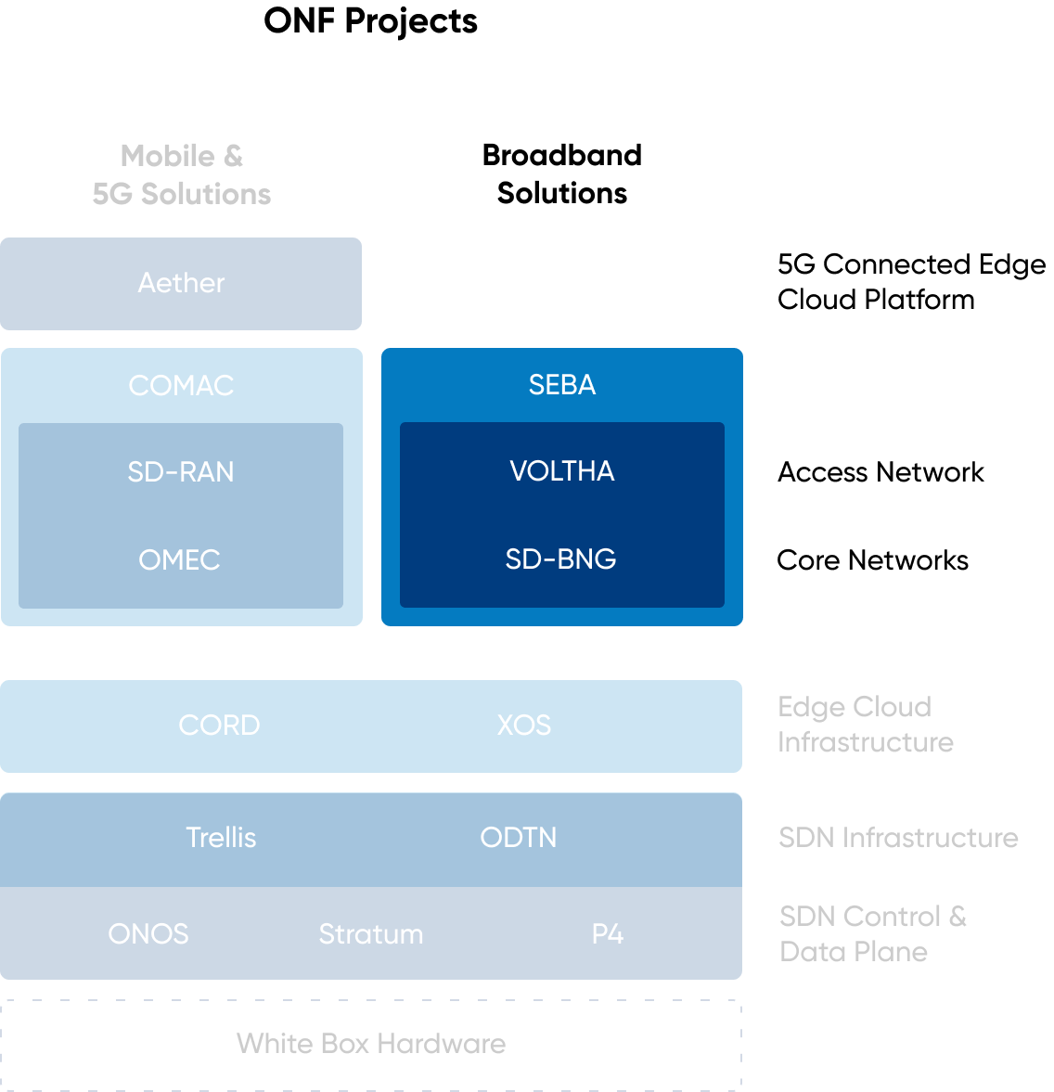
Agenda

Slide 5
Traditional Broadband Access
Residence
Central Office
Backbone
Network
RG
ONU
ODN
OLT
ETH AGG
BNG
RG – Residential Gateway
OLT – Optical Line Termination
BNG – Broadband Network Gateway

Slide 6

SEBA: SDN Enabled Broadband Access
Residence
Central Office
Virtual OLT
manages and abstracts PON
Manages 1 or more switches
Virtual BNG
manages subscriber
services
VOLTHA
TRELLIS
SD-BNG
Backbone
Network
RG
ONU
ODN
OLT
ETH AGG
OLT MAC & PHY
Whitebox
Switch
BNG
Whitebox switch
with merchant silicon
RG – Residential Gateway
OLT – Optical Line Termination
BNG – Broadband Network Gateway
Notes:
The goal of SEBA is that of bringing the benefits of disaggregation and open source to the case of residential access.
We do this by using SDN principles and whitebox hardware.
To make this possible we first virtualize the PON network including the OLT and the ONU using VOLTHA
We abstract all the internal complexity of the PON network and instead offer an abstraction of an OpenFlow switch
Second, we disaggregate the ethernet aggregation stage using whitebox switches and Trellis, a set of SDN apps that control a fabric of 1 or more switches
Finally, the fabric can be extended to include more advanced functions such as BNG
Let’s have a closer look at each one of these 3 componenets

Slide 7

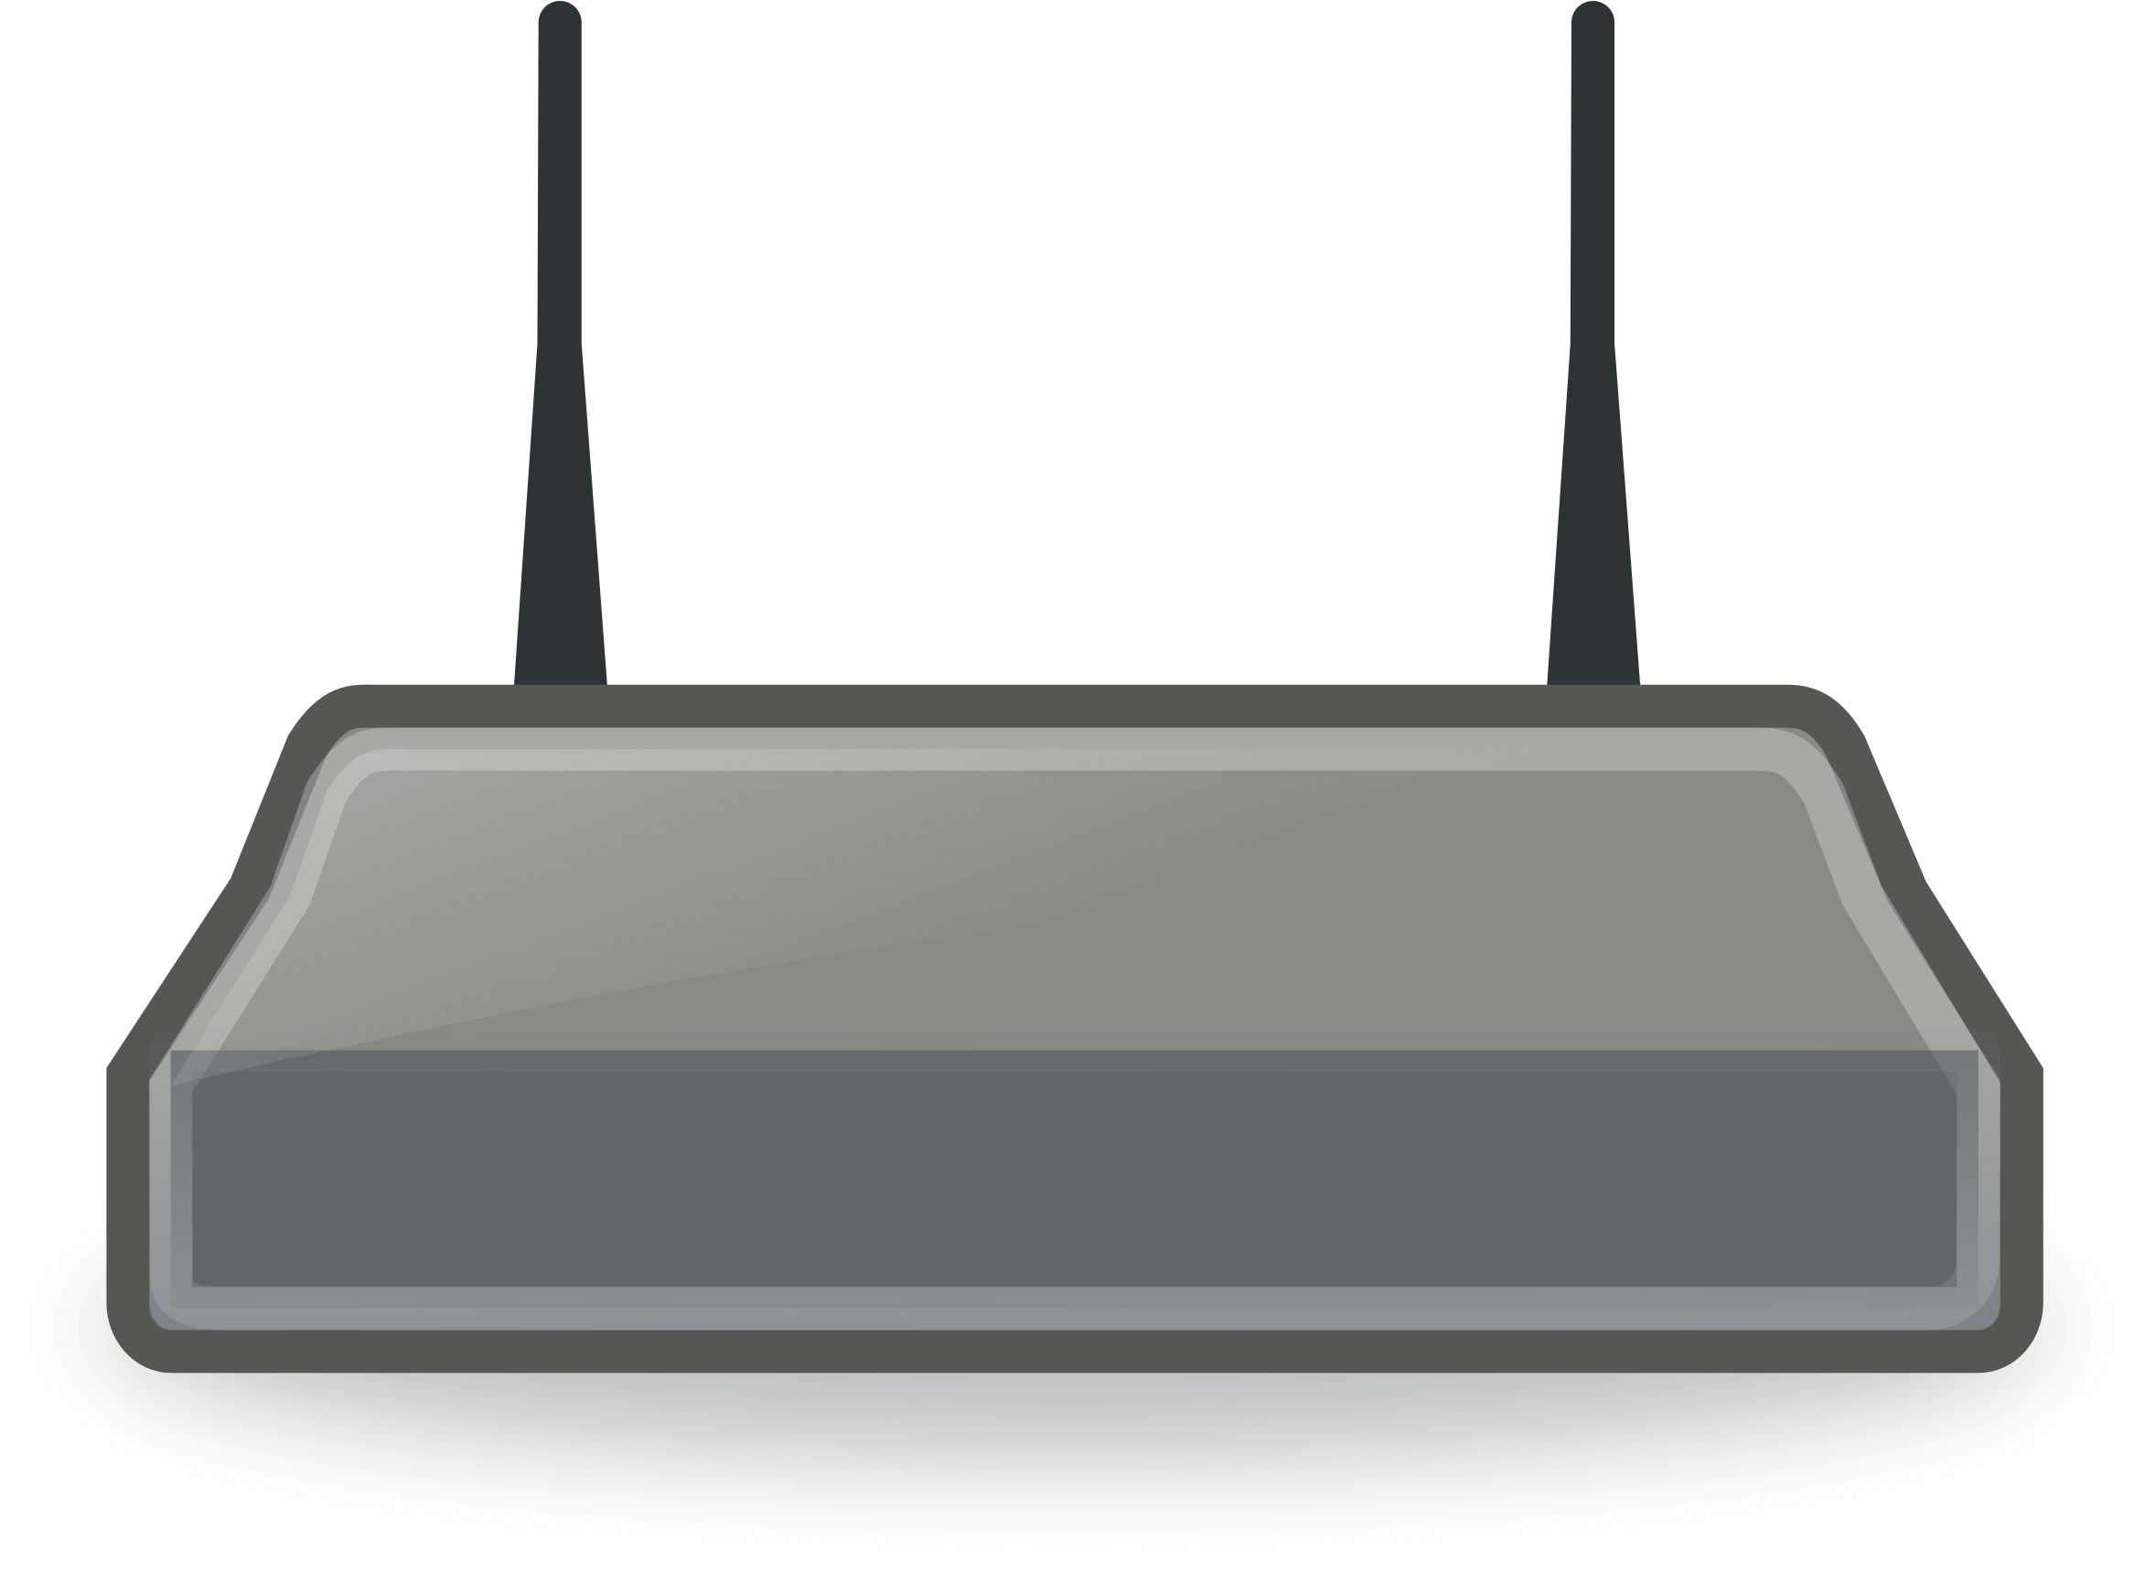

SEBA
ONAP
Operator OSS/BSS
SEBA POD
Local adaptor
SDN
Enabled
Broadband
Access
Network Edge Mediator (NEM)
Edge orchestration and FCAPS micro-services
Docker
Kubernetes
Helm
VOLTHA apps
PON/OLT control
TRELLIS apps
Fabric control
SD-BNG apps
Subscriber control
SOFTWARE STACK
SDN Controller - ONOS
OpenFlow
P4Runtime,
gNMI/OpenConfig
VOLTHA
BNG-UP
RG
ONU
Stratum
Whitebox OLT
whitebox switch
Core
PON
Whitebox OLT
whitebox switch
HARDWARE
Compute
servers

Slide 8
SEBA
ONAP
Operator OSS/BSS
SEBA POD
Local adaptor
SDN
Enabled
Broadband
Access
Network Edge Mediator (NEM)
Edge orchestration and FCAPS micro-services
Docker
Kubernetes
Helm
VOLTHA apps
PON/OLT control
TRELLIS apps
Fabric control
SD-BNG apps
Subscriber control
SOFTWARE STACK
SDN Controller - ONOS
OpenFlow
P4Runtime,
gNMI/OpenConfig
VOLTHA
BNG-UP
RG
ONU
Stratum
Whitebox OLT
whitebox switch
Core
PON
Whitebox OLT
whitebox switch
HARDWARE
Compute
servers

Slide 9



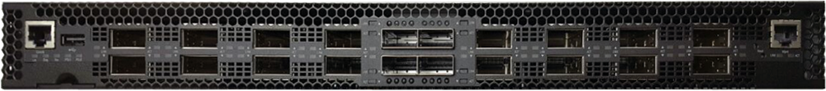
OLT disaggregation → VOLTHA
On path to production in 2021
Backplane
VLANs
AAA
Mcast
…
EMS
ONOS: SDN Controller
VLANs, IGMP, 802.1x, Mcast …
OpenFlow
PON MAC blades
VOLTHA
SDNize
OpenFlow Agent
VOLTHA Core
OLT/ONU adaptors
Compute blades
VOLTHA: Virtual OLT Hardware Abstraction
gRPC
Traditional Chassis-based
Vendor OLT for PONs
(Passive Optical Networks)
EdgeCore ASXvOLT16
(and others)
Notes:
Traditional chassis-based OLT. Has PON mac blades, compute blades, backplane, management system.
Disagg -- SDNize -- OLT MACs pizza boxes, SW = Voltha manage not just the OLT but also the entire PON. Because OLT use to manage whole PON.
Because Voltha presents abstraction of PON, can run sdn controller (ONOS) on top

Slide 10
VOLTHA
Bandwidth profiles
Applications
ONOS SDN Controller
ONOS 1
ONOS 1
Virtual
OLT
Hardware
Abstraction
voltctl
Technology
profiles
Common Control & Management framework shared by all OLTs and ONUs
Hides PON level details (T-CONTS, GEM, OMCI) from the SDN controller by abstracting each PON as a simple Ethernet switch
OF Agent
gRPC NBI
Etcd
VOLTHA core
VOLTHA
stack
Kafka
OpenOLT
Adaptor
OpenONU
Adaptor
OpenONU
OMCI
openolt api (gRPC)
Whitebox OLT
ONU
OpenOLT agent
ONL
BAL
ONIE
SDK(s)
ONU
ONU
Notes:
Not independent of what comes above and below
Common c & m not just for whitebox but vendor olts as well

Slide 11
VOLTHA Operation
Bridging/Routing
VLANs
dhcp
mcast
ONOS
VOLTHA
Logical
switch
ONU
Switch
OLT
UNI
NNI
UNI

Slide 12

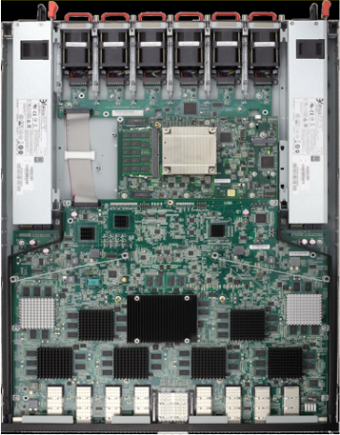


Industry’s First White-Box XGS-PON OLT
VOLTHA
core
White-Box =
Open-Hardware Specs (OCP)
+ Open-Source Software (ONF & OCP)
OpenOLT
Adaptor
Edgecore
ASFvOLT16
Whitebox OLT
OpenOLT
Whitebox OLT
OpenOLT Driver
ONL
Chip Driver
ONIE
SDK(s)

Slide 13
Why OpenOLT Adaptor?
Generic OLT adaptor - ease of onboarding for new vendors (including whitebox vendors)
VOLTHA
core
OpenOLT
Adaptor
VOLTHA CORE
OpenOLT
OpenOMCI ONU
Alpha ONU
Iskratel ONU
Arcadyan ONU
Whitebox OLT
OpenOLT Driver
CIG ONU
CIG
OLT
EdgeCore OLT
Iskratel
OLT
ONL
Chip Driver
Tellabs ONU
ONIE
SDK(s)
Tellabs
OLT

Slide 14
PON Management
Kafka
AAA
sadis
vOLT
dhcp
mcast
Speed Profile
ONOS
Per subscriber
up/down bw profile
cir/eir/cbs/ebs
VOLTHA
Logical
switch
Tech Profile
Access Tech type
# Gems/TCONTs
Sched policy
Pbit mapping
Discard policy
ONU
OLT
UNI
NNI
UNI

Slide 15
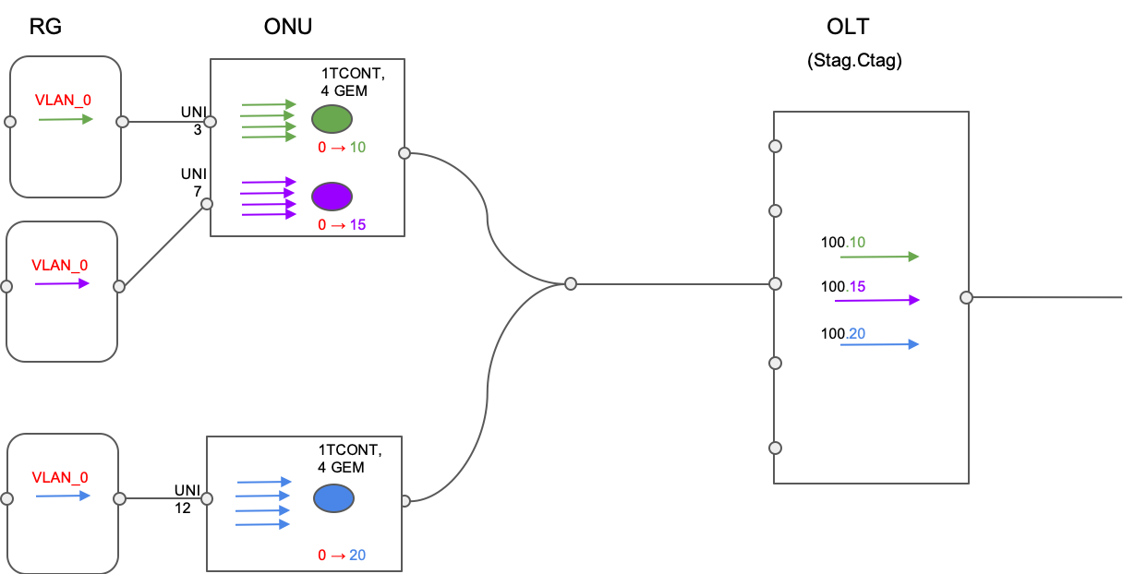
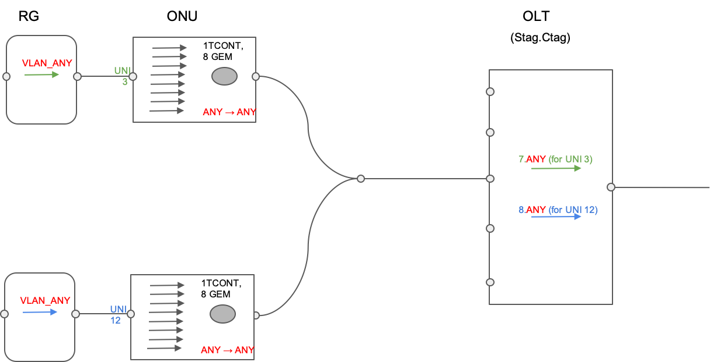
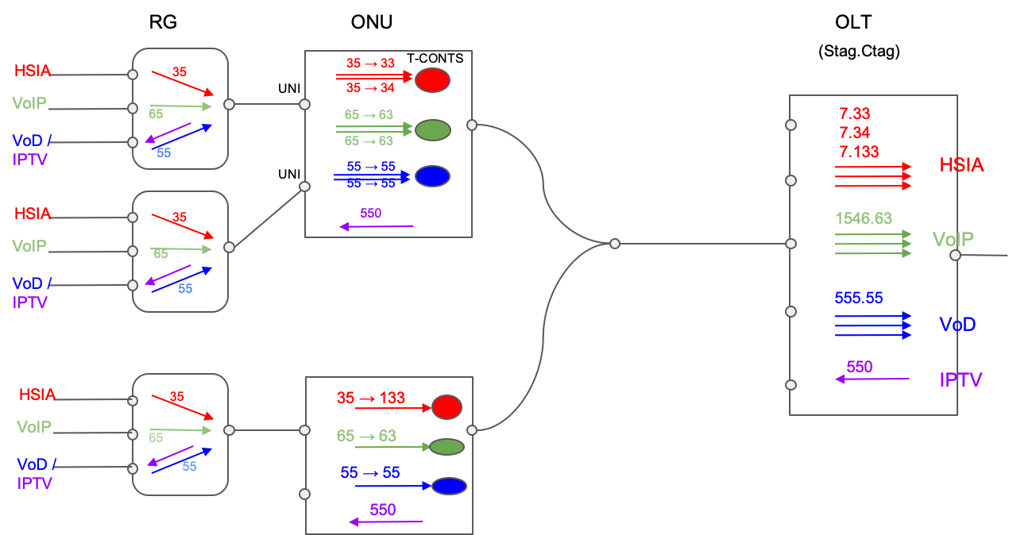
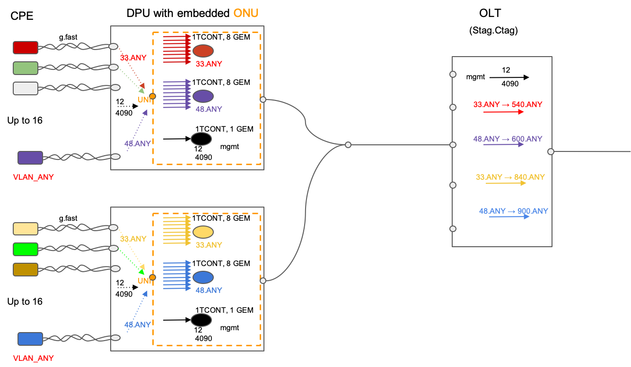
SEBA Operator Workflows
AT&T workflow
DT FTTH workflow
TT workflow
DT FTTB workflow

Slide 16
SEBA
ONAP
Operator OSS/BSS
SEBA POD
Local adaptor
SDN
Enabled
Broadband
Access
Network Edge Mediator (NEM)
Edge orchestration and FCAPS micro-services
Docker
Kubernetes
Helm
VOLTHA apps
PON/OLT control
TRELLIS apps
Fabric control
SD-BNG apps
Subscriber control
SOFTWARE STACK
SDN Controller - ONOS
OpenFlow
P4Runtime,
gNMI/OpenConfig
VOLTHA
BNG-UP
RG
ONU
Stratum
Whitebox OLT
whitebox switch
Core
PON
Whitebox OLT
whitebox switch
HARDWARE
Compute
servers

Slide 17
Fabric disaggregation → TRELLIS
Carrier-grade SDN fabric for edge/NFV applications
Based on whitebox switches and merchant silicon
In production at Comcast
Extensive switch support
Vendors: EdgeCore, Delta, Inventec, Stordis, QCT
ASIC: Tomahawk, Tomahawk+, Trident2, Qumran, Tofino
Switch SW stack:
ONL, OF-DPA, Stratum
Trellis Apps
Bridging, vRouter, MPLS-SR, mcast, etc.
External router
(BGP, OSPF, etc.)
ONOS: SDN Controller
OpenFlow
P4Runtime
gNMI
Field office
metro/
core
Long-haul
Access
Leaf (ToR)
Spine
Spine
OLT
Base station
etc.
Compute
Leaf
Leaf
Leaf
Leaf
Compute
Compute
Central office
Single Leaf
Leaf-Spine Fabric
With ECMP and N-way redundancy
Multi-Stage Leaf-Spine
For distributed access/edge networking
SCALE
SCALE
Notes:
Trellis is a set of SDN apps running on top of ONOS that provide the control plane for a carrier-grade fabric made of whitebox switches running merchant silicon
It can be used to control only 1 switch, like in this example where a top of rack / leaf is used to forward traffic between some access devices, compute servers, and an upstream router. Trellis provide a set of API that let operators enable capabilities such as bridging, routing, multicast, etc. at the network level.
Indeed, the same API and apps can be used to control a full blown leaf-spine fabric, with ECMP and N-way redundancy
...or even a multi-stage fabric where multiple leaf-spines are connected with long-haul optics
What is more, Trellis supports a number of switches from different vendors, running different ASICs and software stacks. Many of these are OCP compliant.
Open APIs such as OpenFlow, P4runtime, and gNMI are used to interact with the devices

Slide 18

Whitebox ToR Switching
Trellis Apps
White-Box =
Open-Hardware Specs (OCP)
+ Open-Source Software (ONF & OCP)
SDN Controller
Indigo OF Agent
BRCM OF-DPA
ONL
SDK
ONIE
BRCM ASIC
Edgecore
5712, 6712, 7712
OCP Bare Metal Switch

Slide 19
SEBA
ONAP
Operator OSS/BSS
SEBA POD
Local adaptor
SDN
Enabled
Broadband
Access
Network Edge Mediator (NEM)
Edge orchestration and FCAPS micro-services
Docker
Kubernetes
Helm
VOLTHA apps
PON/OLT control
TRELLIS apps
Fabric control
SD-BNG apps
Subscriber control
SOFTWARE STACK
SDN Controller - ONOS
OpenFlow
P4Runtime,
gNMI/OpenConfig
VOLTHA
BNG-UP
RG
ONU
Stratum
Whitebox OLT
whitebox switch
Core
PON
Whitebox OLT
whitebox switch
HARDWARE
Compute
servers

Slide 20
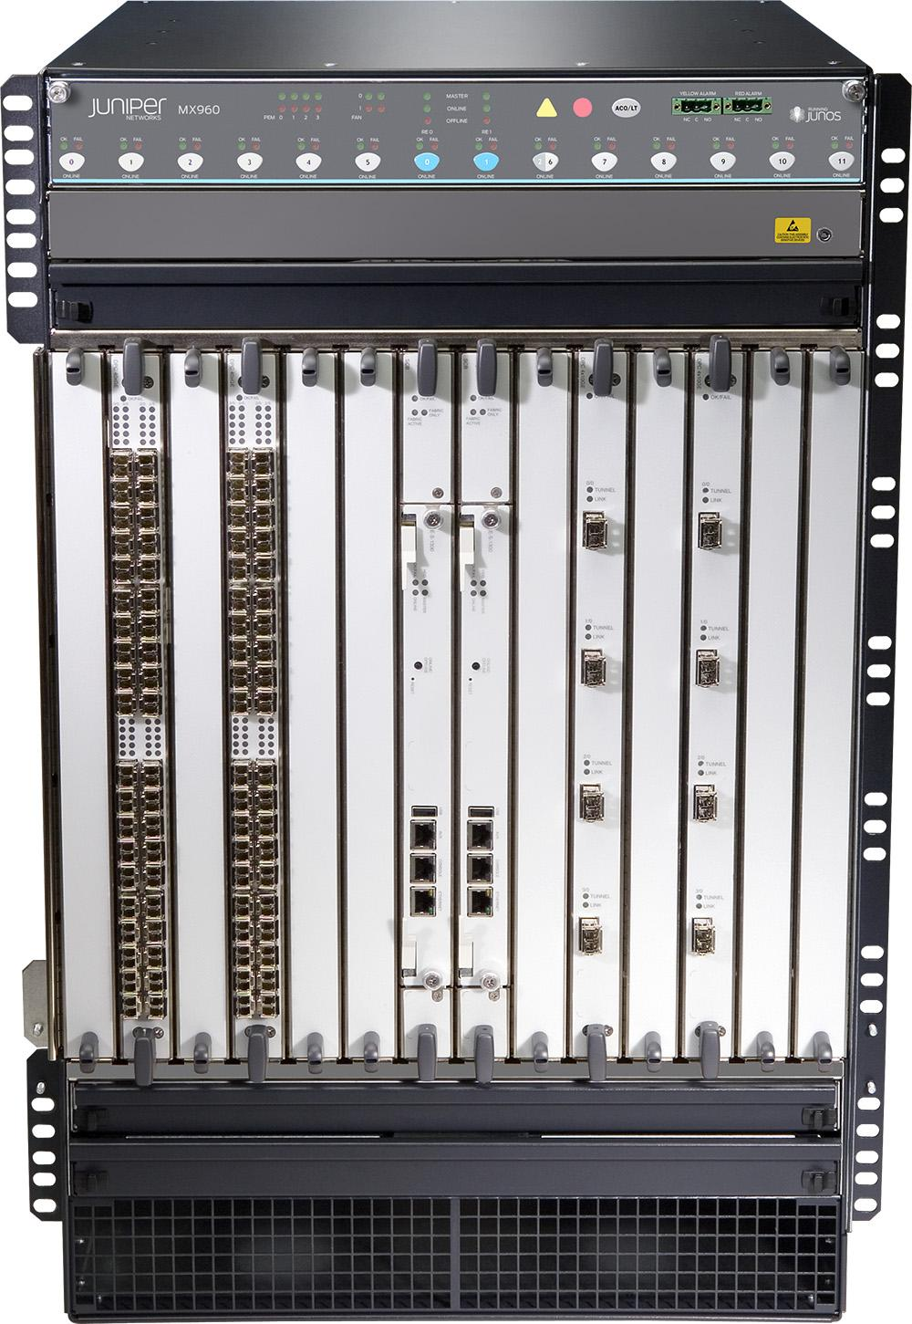
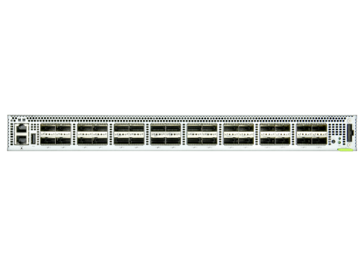
BNG disaggregation → SD-BNG
Specialized router:
Subscriber termination (QinQ, PPPoE)
Accounting
Hierarchical QoS
Lawful intercept
Wholesale tunnel relay (L2TP)
Multicast
Routing
Etc.
Control Plane Apps (BNG-CP)
Authentication, address assignment, accounting, etc.
ONOS: SDN Controller
SDNize
User Plane (BNG-UP)
Use merchant silicon available in fabric and OLT
OLT
FABRIC SWITCH
Broadcom Qumran (DNX)
300 Gbit/s, Deep Buffers, HQoS
Intel Barefoot Tofino
3.2 Tbit/s, P4-defined routing, PPPoE term, accounting, etc.
Traditional Chassis-based Vendor
Broadband Network Gateway (BNG)
Notes:
The BNG is a specialized type of router that is responsible of routing subscriber traffic to and from the operator core network. It performs many functions, such as…
Similarly to VOLTHA, we disaggregated the BNG black box in two logical pieces: the user plane and the control plane
For the user plane, which is responsible of processing subscriber data traffic, we re-use the same merchant silicon that is already available in the SEBA pod
We can use the Tofino ASIC in the fabric switch to perform functions such as routing, PPPoE termination, accounting, etc
While we can use the Qumran chip inside the OLT to perform Hierarchical QoS, since this chip is specifically designed for application that requires deep buffering
The control plane can run as an SDN apps on top of ONOS

Slide 21
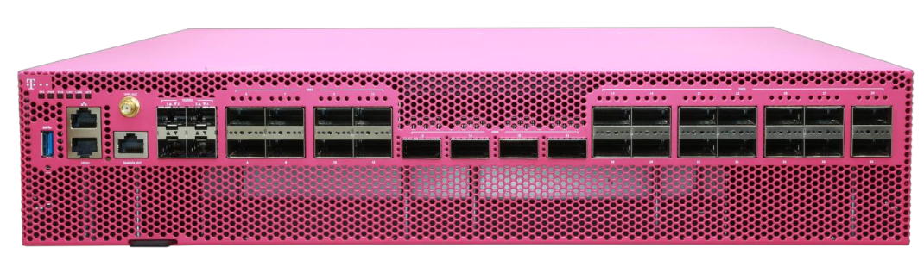
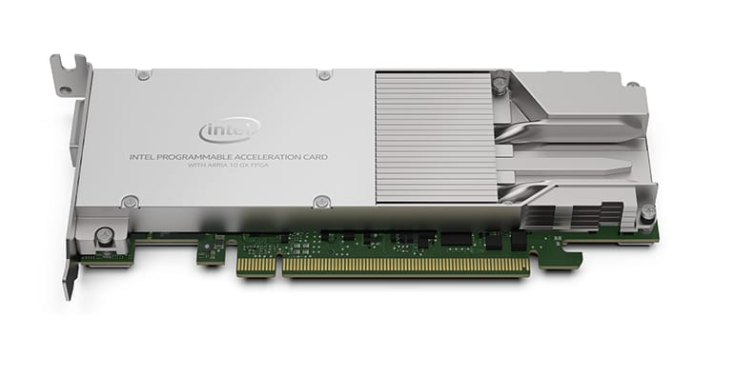
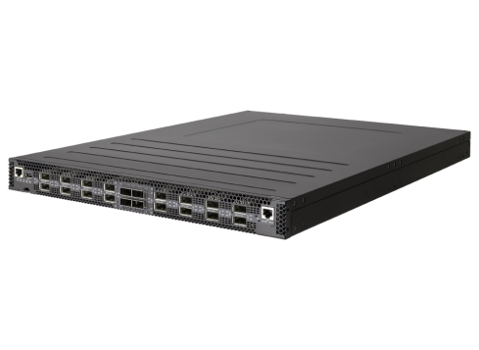
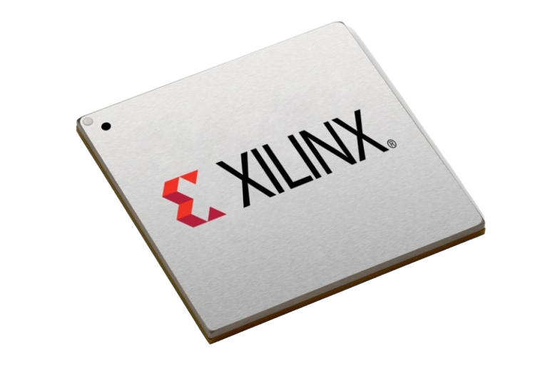
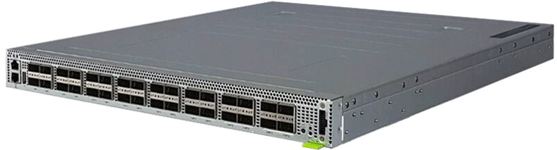
BNG CUPS API
BNG-CP → Intelligence
Choice of programming language and architecture
Tassen → BNG CUPS API
Provides silicon-independence
& facilitates interoperability
BNG-UP → High-speed forwarding
Choice of merchant silicon and port configuration
Magenta Switch
Single-chip Qumran 2C
SmartNIC
Single-chip FPGA
Deutsche Telekom
Dell, Intel, Benu
Tofino + Qumran AX
Dual-chip, HQoS in OLT (WIP)
Tofino + FPGA
Dual-chip, HQoS in FPGA
OLT (QAX)
FPGA
Leaf switch (Tofino)
ONF
TU Darmstadt
Examples of HW-based implementations existing today.
Others are possible, including SW-based processing.
“Tassen: Towards a Next-Generation BNG CUPS API”
- Carmelo Cascone (ONF), Mario Kind (DT), Craig Stevens (Dell)
ONF Broadband Spotlight On-Demand Content

Slide 22
SEBA
ONAP
Operator OSS/BSS
SEBA POD
Local adaptor
SDN
Enabled
Broadband
Access
Network Edge Mediator (NEM)
Edge orchestration and FCAPS micro-services
Docker
Kubernetes
Helm
VOLTHA apps
PON/OLT control
TRELLIS apps
Fabric control
SD-BNG apps
Subscriber control
SOFTWARE STACK
SDN Controller - ONOS
OpenFlow
P4Runtime,
gNMI/OpenConfig
VOLTHA
BNG-UP
RG
ONU
Stratum
Whitebox OLT
whitebox switch
Core
PON
Whitebox OLT
whitebox switch
HARDWARE
Compute
servers

Slide 23
SEBA Modularity
NEM Orchestration (XOS)
NEM Monitoring
(Prom,Grafana, ELK)
Access
apps
Fabric
apps
ONOS
VOLTHA
Trellis
Kafka
K8s
OS
OS
OS
ONU
OLT
AGG
switch
Compute
Nodes
ONU

Slide 24


















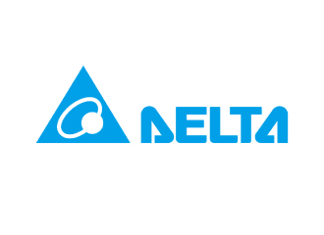

SEBA (and VOLTHA) Community
AT&T

Slide 25
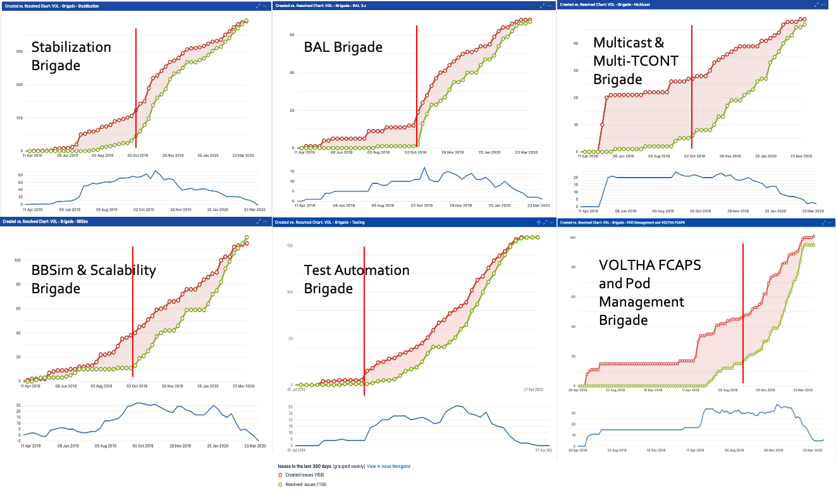

SEBA Surge Brigade Dashboards

Slide 26
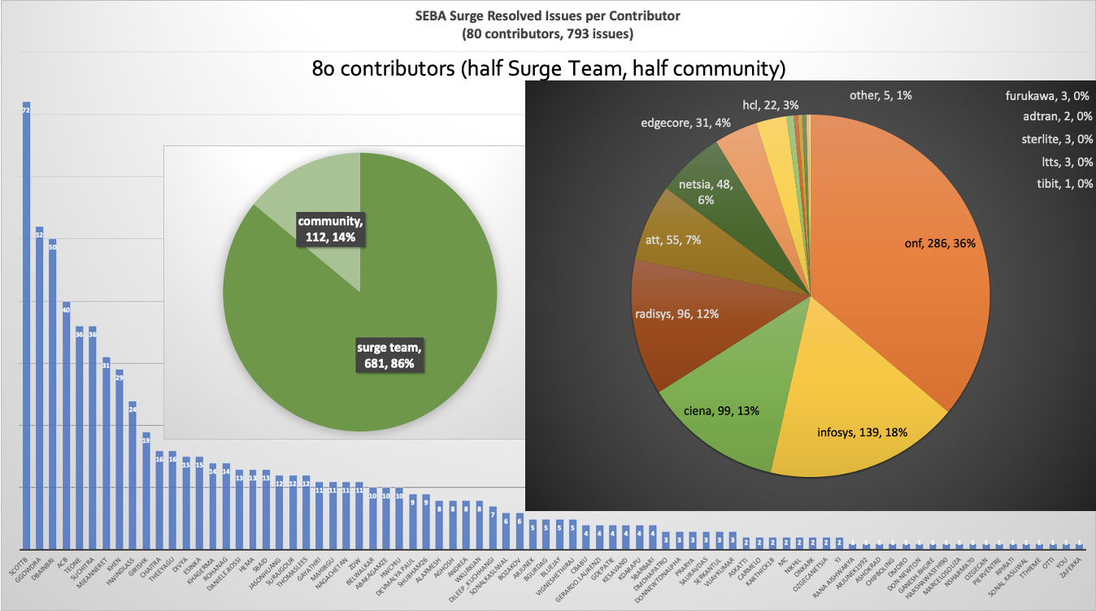
SEBA Surge Contributions

Slide 27
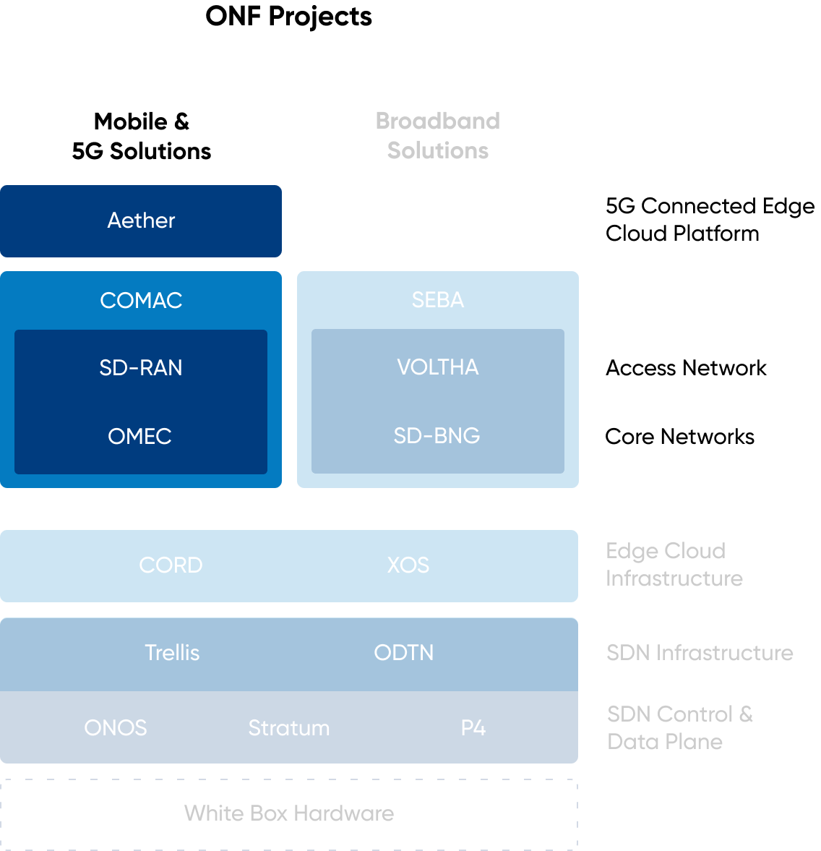
Agenda

Slide 28


RAN transformation: Starting point
OSS/BSS
SON
Vendor Specific
Vendor Specific
Monitoring/Logging/
Config/Control Portal
RRU
Vendor Specific
Vendor Specific
Mobile Core
eNB
S1
BBU

Slide 29

RAN disaggregation
Step I: Horizontal disaggregation
PHY
Option 7.2x
Scheduling
MAC
RLC
Option 2
PDCP
RRC
Mobile Core CP
N2
DU
CU
RU
Mobile Core UP
PHY-LO
PHY-HI
PDCP
N3
Scheduling
RRC
MAC
RLC

Slide 30
Joint RAN Disaggregation
Step II: Vertical disaggregation: CUPS
CU-C
N2
Mobile Core CP
F1-C
N2
DU
CU
RU
CU-U
N3
Mobile Core UP
F1-U
N3

Slide 31
Joint RAN Disaggregation
Step III: Vertical disaggregation with SDN
Non-RT-RIC
xApps
A1
SON xApps
RRM xApps
Policy xApps
Near RT Ran Intelligent Controller (nRT-RIC)
E2
E2
E2
CU-C
N2
Mobile Core CP
F1-C
DU
Open
Fronthaul
RU
F1-U
CU-U
N3
Mobile Core CP

Slide 32
O-RAN Architecture
SMO
Non-RT-RIC
O1
xApps
A1
SON xApps
RRM xApps
Policy xApps
Near RT Ran Intelligent Controller (nRT-RIC)
E2
E2
E2
CU-C
N2
Mobile Core CP
F1-C
DU
RU
F1-U
CU-U
N3
Mobile Core CP

Slide 33
ONF’s SD-RAN Project → nearRT-RIC
SMO
Non-RT RIC
nRT-RIC
O1 Termination
A1 Termination
Conflict Mitigation
Security
Based on
µONOS
SDN Controller
Subscription Mgmt
xApp
SDL
Open APIs
E2 Termination
E2 Node
E2 Node
E2 Node
E2 Node
E2 Node
E2 Node
E2 Node
E2 Node
E2 Node
E2 Node
E2 Node
E2 Node

Slide 34
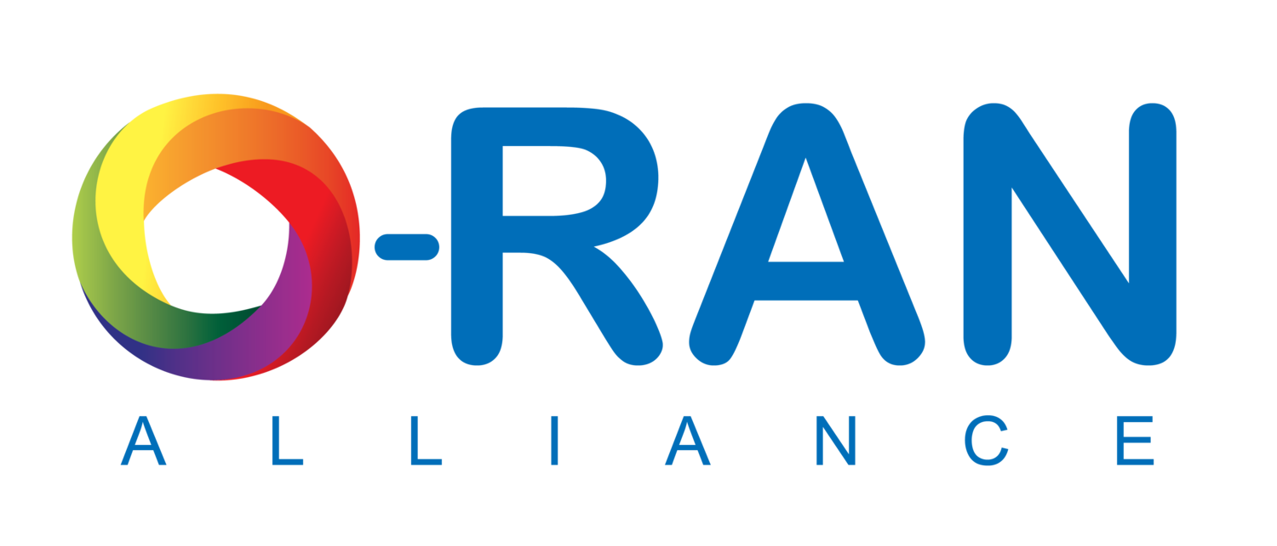

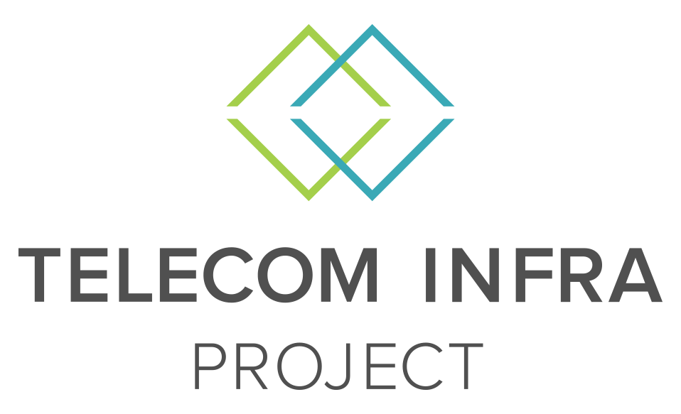

Shared Goals, Shared Journey
Long Journey With Open Specifications and Open Source
C-RAN
O-RAN
Software Community
https://opennetworking.org/uncategorized/onf-commits-to-supporting-o-ran-alliance/

Slide 35
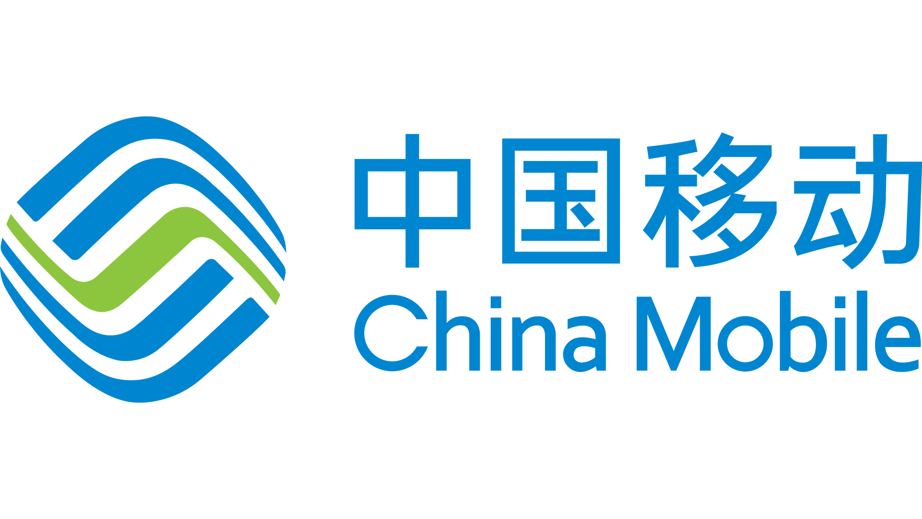








SD-RAN Ecosystem
https://opennetworking.org/news-and-events/press-releases/onf-announces-new-5g-sd-ran-project/

Slide 36
Summary
ONF: Operator driven curated open source
  Many projects, solutions that build on top of individual projects
  SEBA – SDN Enabled Broadband Access, built on the CORD platform
  SD-RAN – Software Defined - Radio Access Network
SEBA
  Solution integrates several other ONF projects: VOLTHA, ONOS, Trellis, SD-BNG, XOS
  Current focus areas – VOLTHA productization & SD-BNG exploration
  Production deployments in two Tier-1 operator networks in 2021
SD-RAN
  Development of O-RAN compliant, micro-ONOS based, nearRT-RIC
  Focus on new xAPPs (RRM/SON), SDKs and interoperability
Learn More
  SEBA: https://wiki.opencord.org/display/cord/seba
  SD-RAN: https://opennetworking.org/sd-ran/

