Slide 1

Saurav Das
VP Engineering
ONF

Slide 2
Trellis apps
Tenets
SDN-based
White-boxes
Open-source
Production-ready
Multi-purpose
leaf-spine fabric
ONOS Cluster
(SDN Controller)
Spine
Spine
Spine
Leaf (ToR)
Access
Nodes
Upstream Routers
…
Leaf (ToR)
Compute
Nodes
Legend:
Trellis Software Component
Trellis Compliant Bare-metal Hardware
Notes:
Overview section

Slide 3
System Components
Completely
open-source
(Apache licensed)
Trellis apps
ONOS Cluster
Open source
Indigo OF Agent
BRCM OF-DPA
Labs/Trials: Community Edition
Binary available from ONF
ONL
SDK
ONIE
BRCM ASIC
Production: Commercial Edition
Binary available from Broadcom
OCP Bare Metal Switch
Notes:
System Components

Slide 4

Trellis
Redundancy
Trellis apps
Trellis apps
Trellis apps
ONOS 1
ONOS 2
ONOS 3
SPINE 1
SPINE 2
ECMP groups
Paired Leaves
(Dual-ToRs)
LEAF 1
LEAF 3
LEAF 2
LEAF 4
Pair-link
Dual-homed servers
SERVER
Linux bonding
active-active
SERVER
External
Routers

Slide 5
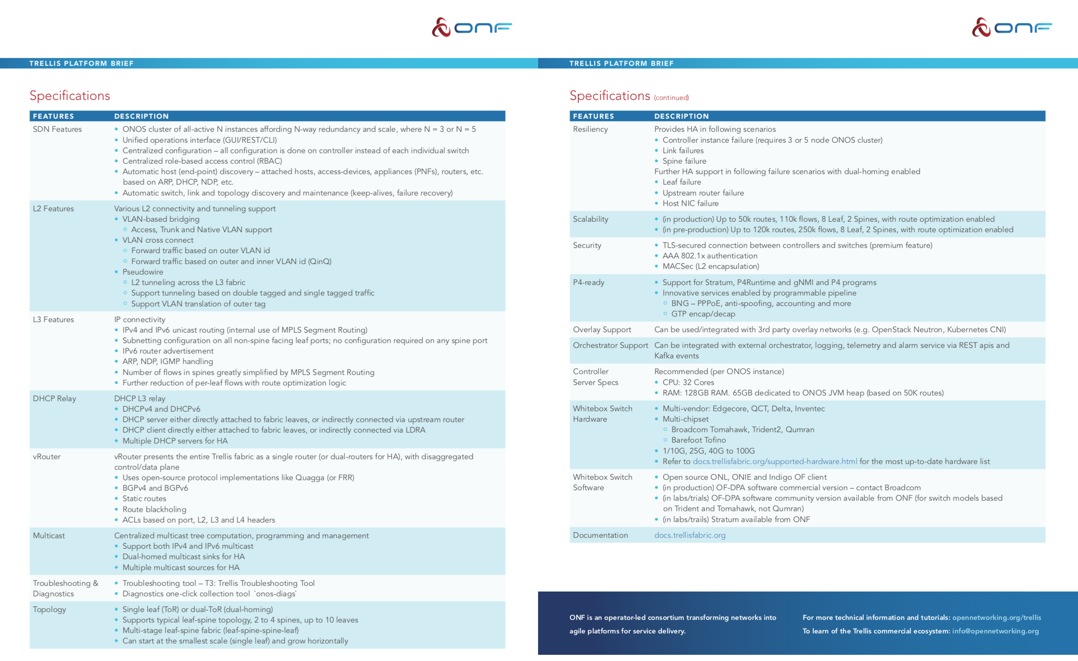
https://www.opennetworking.org/trellis/

Slide 6
Why Trellis?
Trellis is designed for service provider access/edge

Slide 7

Trellis apps
IPv4/v6 unicast/multicast, vlans, MPLS SR, vRouter …
ONOS Cluster
Central Office
Spine
Spine
Metro/Core
Routers
Internet
Base station
Leaf
Leaf
Leaf
Leaf
Leaf
Leaf
R-PHY
2
Types of Switches
R-OLT
1
Types of Traffic
Optimized for Service Provider Access/Edge

Slide 8
Trellis apps
IPv4/v6 unicast/multicast, vlans, MPLS SR, vRouter …
ONOS Cluster
Spine
Spine
Field
Office
Leaf
Leaf
Spine
Spine
Metro/Core
Routers
Central
Office
Internet
3
Distributed
Fabric
Base station
Leaf
Leaf
Leaf
Leaf
R-PHY
R-OLT
Optimized for Service Provider Access/Edge
Notes:
USE CASE 1 – Distributed Fabric for Access/Edge Networking

Slide 9
Why Trellis?
Trellis is designed for service provider access/edge
  Traffic types/encapsulations, topologies, ASICs
SDN simplifies and optimizes features

Slide 10
Trellis apps
IPv4/v6 unicast/multicast, vlans, MPLS SR, vRouter …
ONOS Cluster
Spine
Spine
Field
Office
Leaf
Leaf
Spine
Spine
Metro/Core
Routers
Central
Office
Internet
Base station
Leaf
Leaf
Leaf
Leaf
R-PHY
R-OLT
Notes:
USE CASE 1 – Distributed Fabric for Access/Edge Networking

Slide 11
Why Trellis?
Trellis is designed for service provider edge
  Traffic types/encapsulations, topologies, ASICs
SDN simplifies and optimizes existing features
  Learn more at Trellis booth
SDN & P4 switches enable new features

Slide 12



Trellis enhanced with embedded & disaggregated BNG using P4, supporting ONF’s SDN Enabled Broadband Access (SEBA) platform
SEBA POD
Network Edge Mediator (NEM)
Docker K8s Helm
VOLTHA apps
Trellis apps
BNG-control
SDN Controller - ONOS
VOLTHA
TRELLIS
P4Runtime, gNMI, gNOI
ONU
OLT
Embedded BNG
P4-SWITCH
STRATUM
ONU
STRATUM
SERVERS
Upstream Routers
Notes:
USE CASE 2 – SEBA with Embedded BNG

Slide 13
Why Trellis?
Trellis is designed for service provider edge
  Traffic types/encapsulations, topologies, ASICs
SDN simplifies and optimizes existing features
  Learn more at Trellis booth
SDN & P4 switches enable new features
  Learn more at SEBA BNG booth
Open-source -> ownership & customizability

Slide 14
Trellis apps
IPv4/v6 unicast/multicast, vlans, MPLS SR, vRouter …
ONOS Cluster
Spine
Spine
Field
Office
Leaf
Leaf
Spine
Spine
Metro/Core
Routers
Central
Office
Internet
Base station
~ 10k
routes
Leaf
Leaf
Leaf
Leaf
R-PHY
R-OLT
120k+ routes
Notes:
USE CASE 1 – Distributed Fabric for Access/Edge Networking

Slide 15
Why Trellis?
Trellis is designed for service provider edge
  Traffic types/encapsulations, topologies, ASICs
SDN simplifies and optimizes existing features
  Learn more at Trellis booth
SDN & P4 switches enable new features
  Learn more at SEBA BNG booth
Open-source -> ownership & customizability
  Learn more at Comcast booth

Slide 16
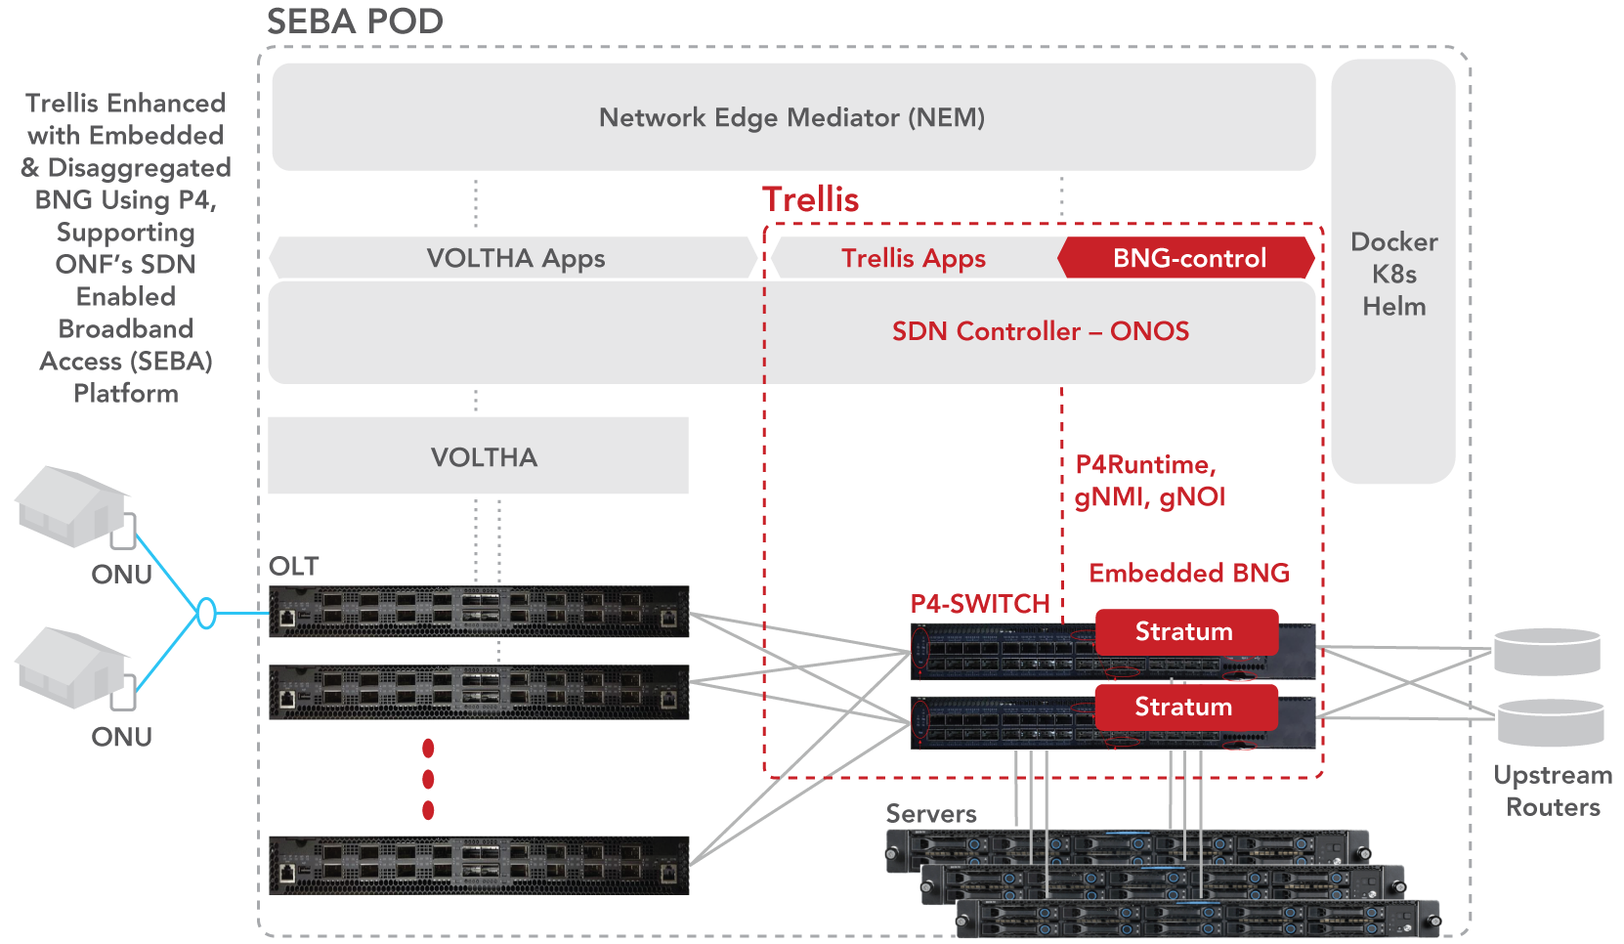
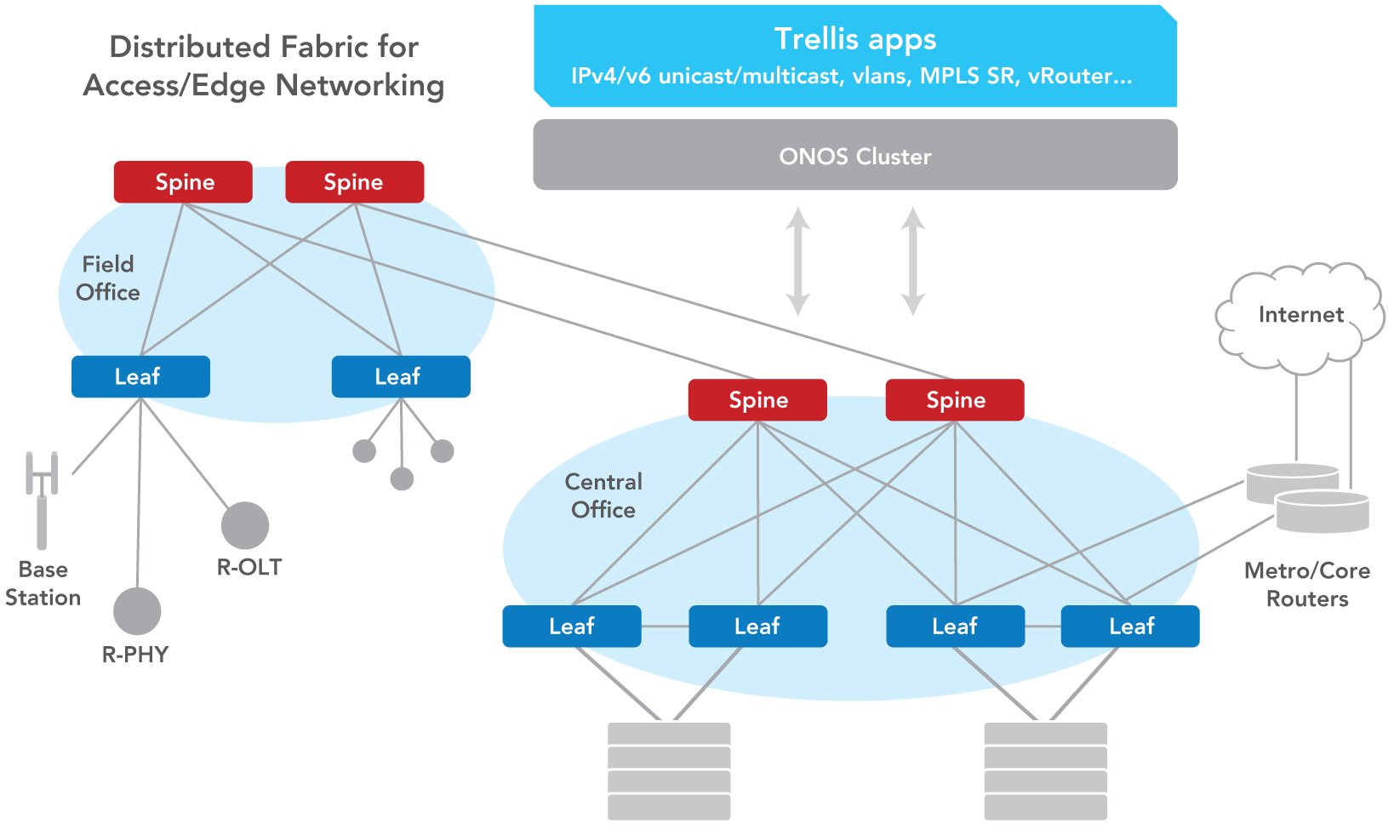
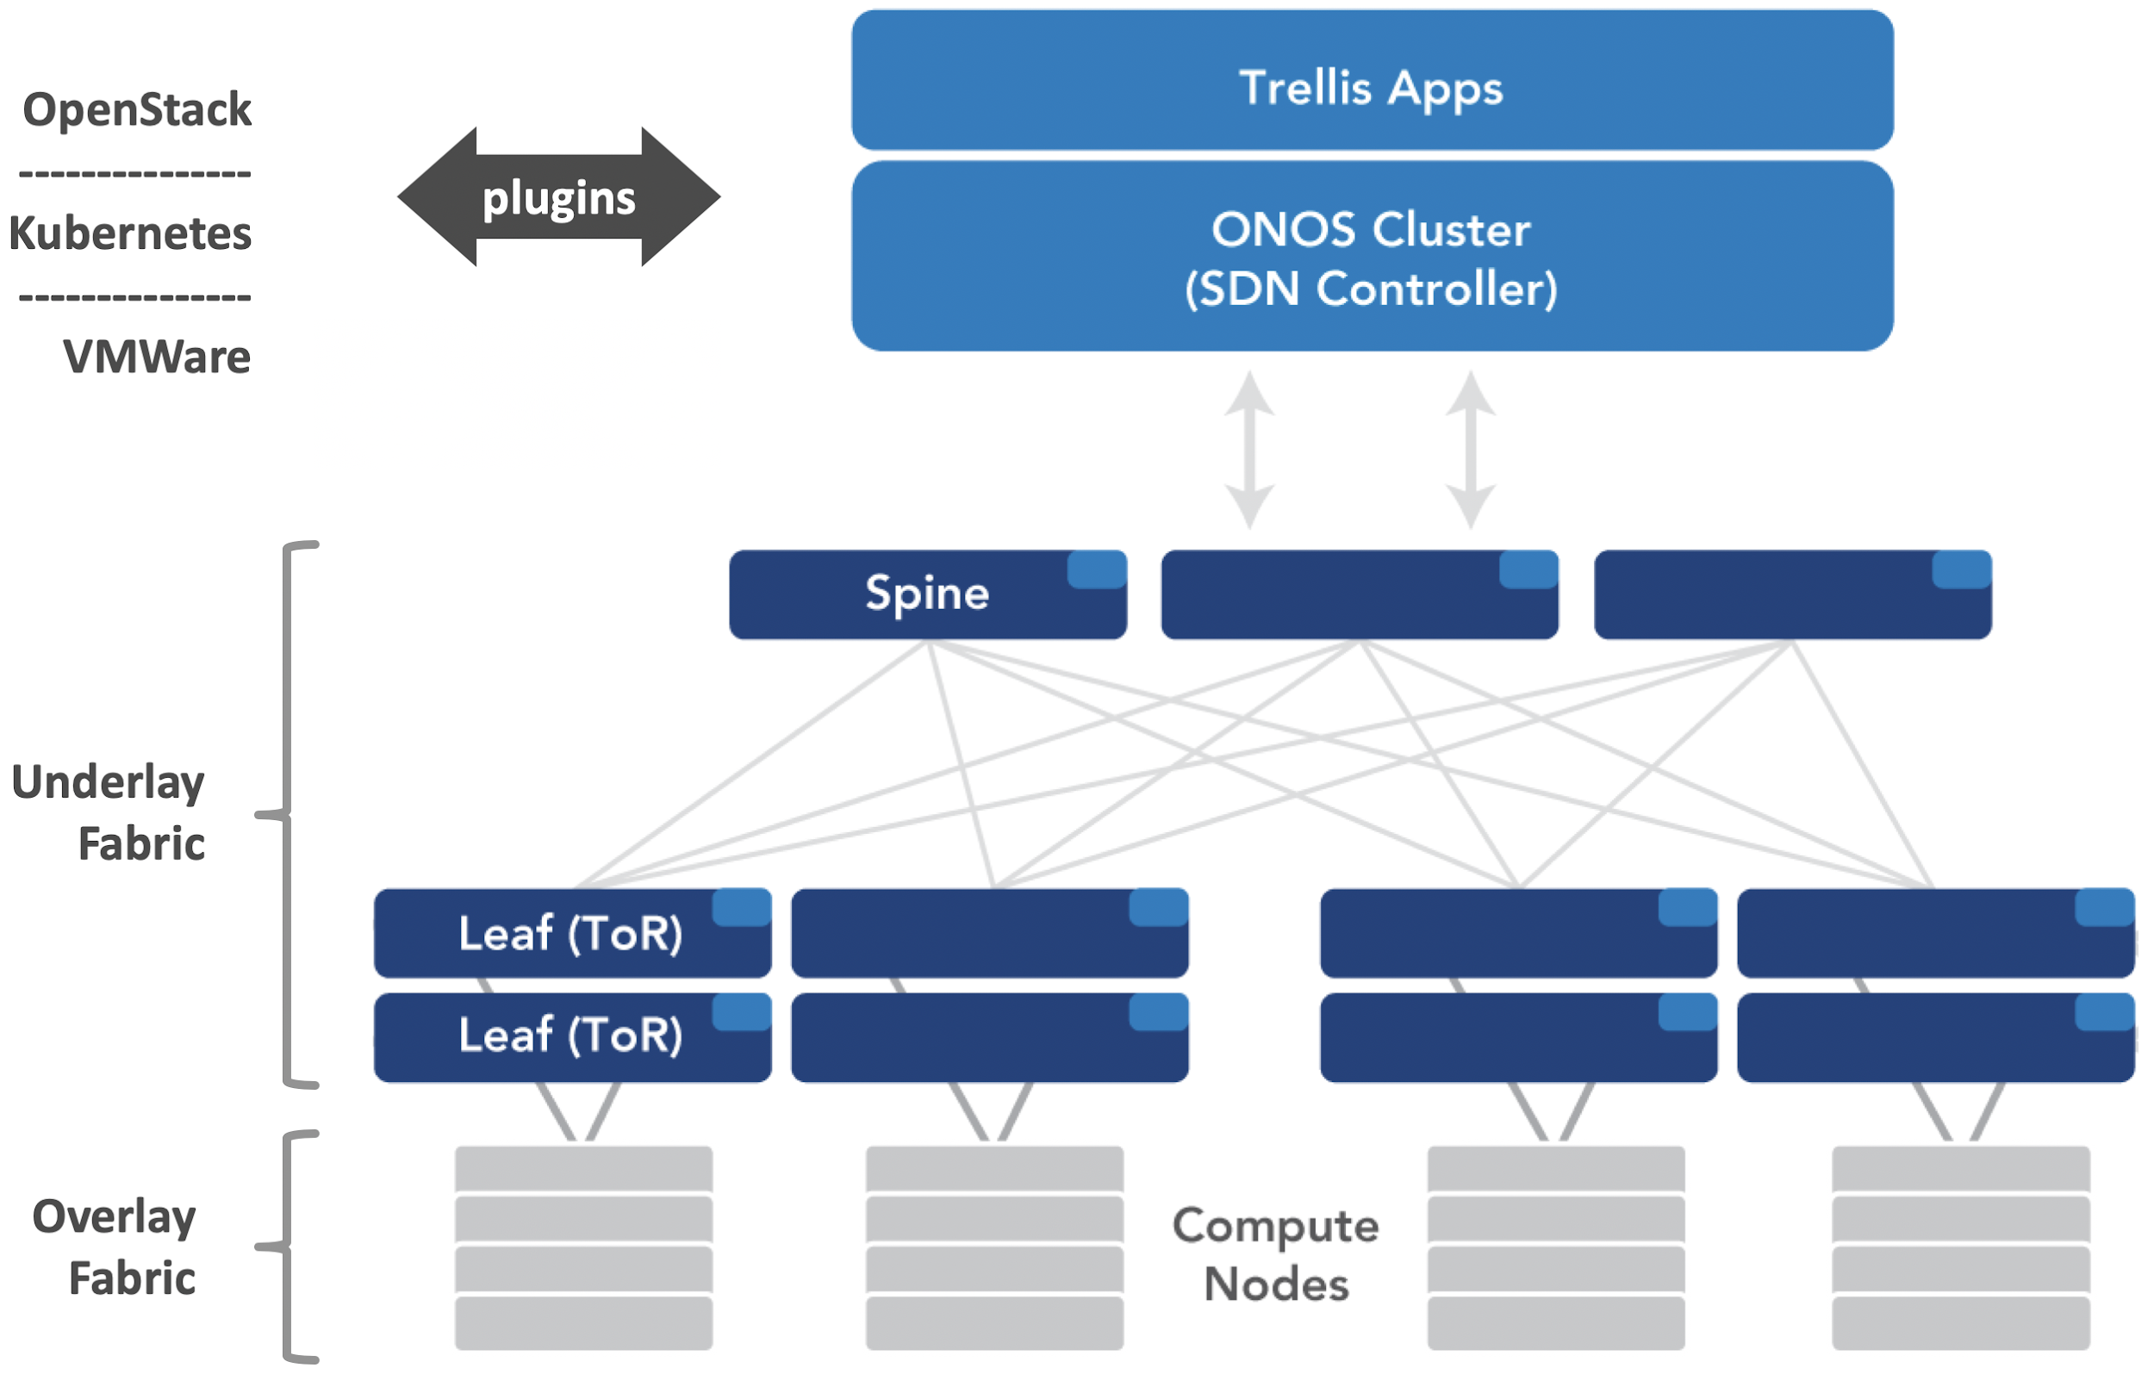
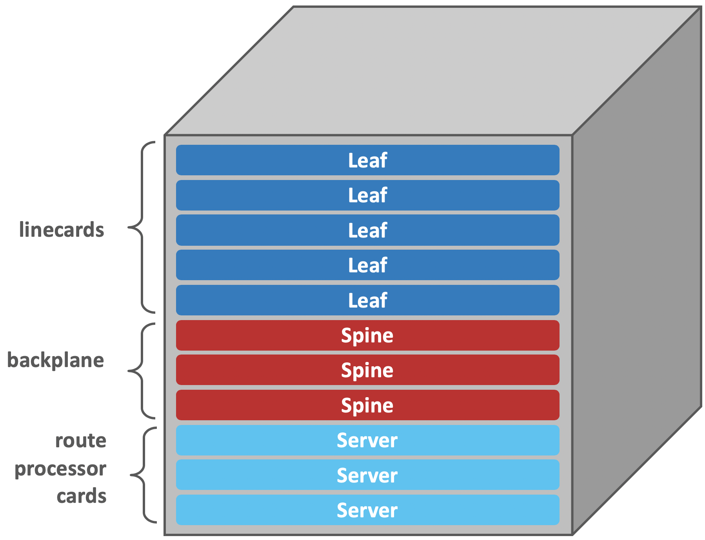
Use Cases
Distributed Fabric for
Access/Edge Networking
SEBA with
Embedded BNG
using P4
Enterprise
DC Fabric
Chassis Router
Notes:
SEBA BNG: Trellis is managing switch and enhanced by P4 adding new features
Enterprise DC: point out the benefits of integrating Underlay/Overlay. Mention SONA

Slide 17
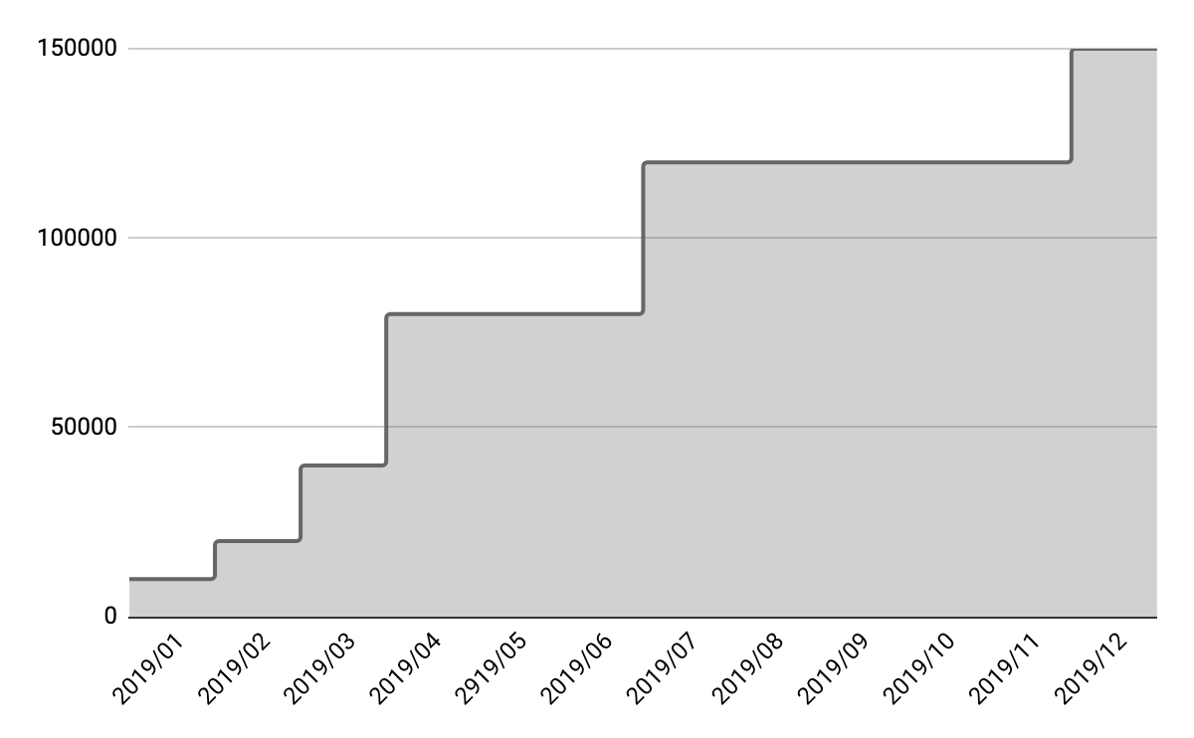
Trellis Continues to Scale
# routes
120k

Slide 18























https://www.opennetworking.org/trellis/
https://docs.trellisfabric.org
and more…

Slide 19
Bringing Trellis into Production Deployments
George Tchaparian
Edgecore Networks

Slide 20






Accton Technology and Edgecore Networks
Accton Technology
Leading Network ODM: Systems, networking, and OEM customers (Tier 1 OEMS)
Founded 1988, IPO Taiwan 1995
4,000 + employees worldwide, > 700 network engineers, R&D Centers
Volume manufacturing in China and Taiwan (TAA Compliant)
One Stop Shop!
Edgecore Networks
Brand Business; wholly owned subsidiary of Accton
Go-to-market business to network operators – Data Center, Telecom, and Enterprise
Manages customer, partner and open community relationships
Leading contributor of network designs to OCP, TIP and LF Active participant
ONF – Charter Partner and leading ONF Strategic Initiative – Building Reference Designs (HW and SW).
> 10M Ports Shipped 2018
© 2019 Edgecore Networks. All rights reserved | www.edge-core.com

Slide 21


Open Networking Evolution
Edgecore Investment and Leadership in each Segment & Use Case
Next Gen
10G Rack 10G/25G Rack DCI 50G Rack Switch-Optical Photonics
40G Spine 100G Spine 400G Spine Integration Switching
Data Center
Broadband
CORD, SEBA
PON, CMTS Services
Mobile Network
Backhaul Aggregation
Cell Site Gwys -> Xhaul
Core
SP Routing
Open Optical
Monitor,
Packet
Broker
Data Center
-> Edge
Compute
Internet
Exchange
Service Providers
PoE & Access Switches
Open
Wi-Fi
uCPE
Enterprise
or
Managed Services
MDU Services
Retail Stores
Distribution Centers
HotSpot
Managed Services
© 2019 Edgecore Networks. All rights reserved | www.edge-core.com
Notes:
This show us having leadership in Open Networking in each segment

Slide 22
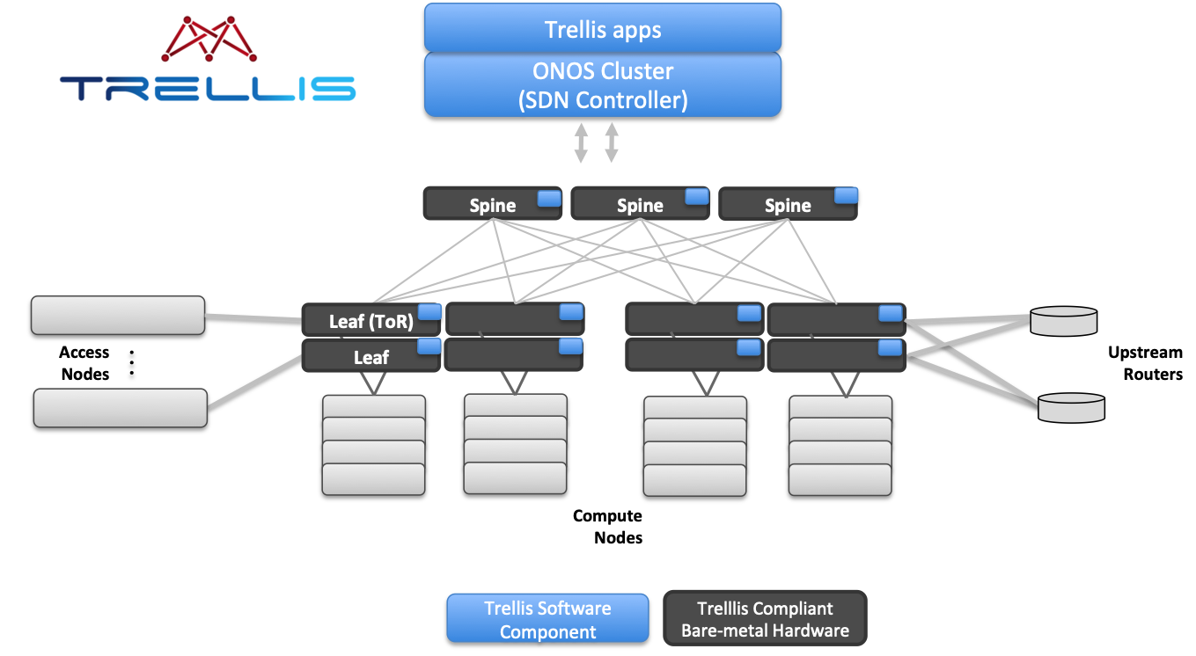
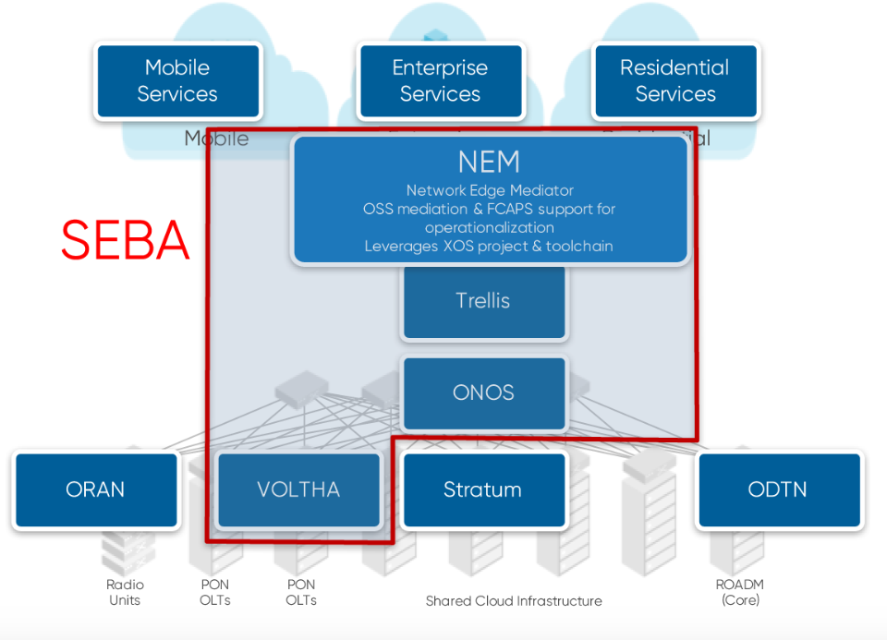
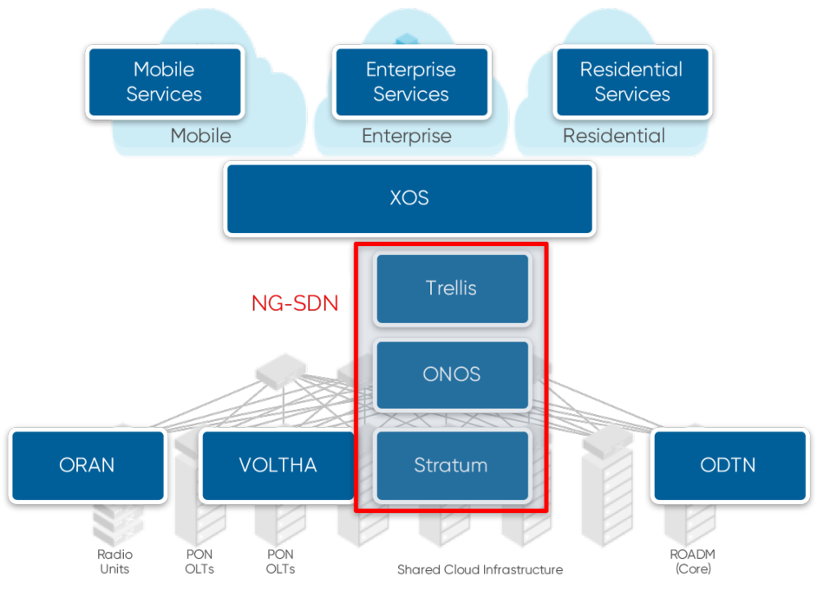
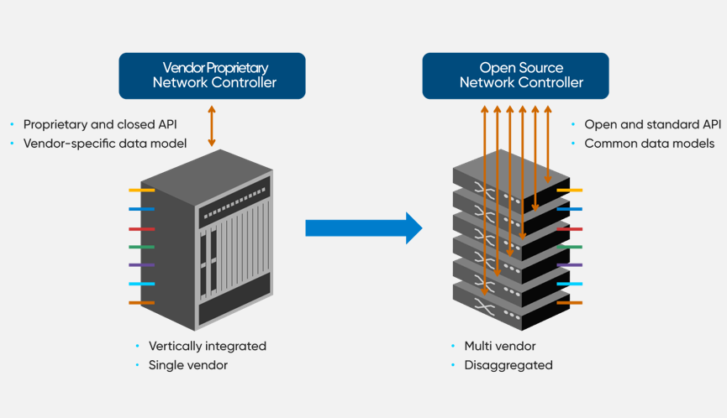
Edgecore Contributions in ONF Exemplar Designs and Solutions
Trellis
SEBA
NG-SDN
ODTN
Notes:
This shows the four ONF projects that Edgecore is active in . Mention that we have been active in SEBA for many ( ~4) years and that we supply the NOS which runs on the Leaf/Spiine switches

Slide 23
ONF Trellis building block
Trellis is common in most ONF reference exemplar designs
Trellis contains generic Leaf/Spine fabric, Compute nodes, Controller, and networking functions

Slide 24
Most Network Design Contributions to Open Source
Industry Firsts: 10G to 400G Data Center, Telco /MSO Switches
OCP-AcceptedTM Designs & Products
1G Rack Mgmt Switch Helix4
10G TOR Switch Trident II
40G Spine Switch Trident II
100G TOR & Spine Switch Tomahawk
100G TOR & Spine Switches Trident3
64 x 100G Spine Switch Tomahawk II
32 x 400G Tomahawk III
10G/100G Edge Switch Qumran
Open Rack Switch Adapter
Partner Designs, Edgecore OCP-InspiredTM Product
Wedge40-16X Facebook
Wedge100-32X Facebook
Wedge100BF-32X Barefoot
Wedge100BF-65X Barefoot
Accepted Design Contribution
Cassini Packet Transponder
OCP Telco Working Group
ASXvOLT16 10G OLT BCM Qumran & Maple
AS7316-26XB Cell Site Gateway QumranAX
AS7926-40XK and -80XK Aggregation Routers Jericho2 in OCP Review
Designs in Process
DCSG Cell Site Gateway
Design Contributions in OCP Review
100G OMP800 Chassis Tomahawk
100G OMP1600 Chassis Tomahawk
25G TOR Switch Tomahawk
MiniPack AS8000 Tomahawk III
OCP-AcceptedTM Access Products
1G PoE Switch Helix4
802.11ac Wave1 Wi-Fi APs BCM
802.11ac Wave2 Wi-Fi APs QCA
© 2019 Edgecore Networks. All rights reserved | www.edge-core.com

Slide 25

Software Paths in Open Networking
Open Network Hardware: whitebox, bare metal, disaggregated
Open Source Software
Commercial Software
Packaged NOS
Platforms
ONF Trellis
ONF Stratum
ONF VOLTHA/SEBA
Etc…
Software Components
ONL
OFDPA
Open BMC
P4
ONF Other
Etc…
Software Components
Aggregating
the Disaggregated
© 2019 Edgecore Networks. All rights reserved | www.edge-core.com

Slide 26
Proven Benefits of Open Networking
Open Technology
SDN Software Control
Open “Whitebox” Hardware
Freedom Automation Innovation
Capex/Opex Reduction
Disaggregation - Modularity
Feature and velocity of deployment
© 2019 Edgecore Networks. All rights reserved | www.edge-core.com
Notes:
Whey are we active in Open Source and Trellis. The points listed here and emphasize customers are asking us for this as this is what is required for them to scale out their next generation networks

Slide 27
GTM: Edgecore Open Networking
27
Open Hardware Leadership
Open Software Value / Enablement Leadership
(Ecosystem Partnership)
Integration
(Ecosystem Partnership)
© 2019 Edgecore Networks. All rights reserved | www.edge-core.com

Slide 28



Partnerships / Ecosystem Bringing Trellis to Market
Leading SDN design – ONF Trellis
Leading Open Networking Infra Supplier - Edgecore
Leading System Integration partner- Infosys
© 2019 Edgecore Networks. All rights reserved | www.edge-core.com
Notes:
Slide showing the key partnerships to bring Trellis into the market for others to consume

Slide 29

Thank You
www.edge-core.com

Slide 30

Trellis
ONF Production Ready Solution
Nitesh Bansal
SVP and Global Head, Engineering Services

Slide 31

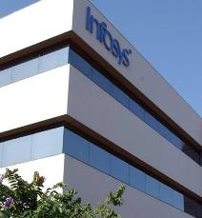
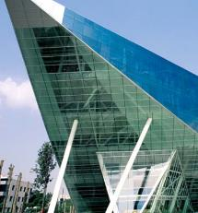
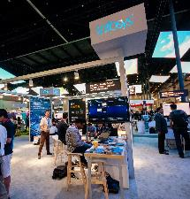



Who are we?
A next-generation
technology services
company
$11.8B
Revenues
228,000+
People Globally
1,000+ Clients
45 Countries
8 out of top 10
Telecom companies have chosen
Infosys as Strategic Partner
We help our clients:
DESIGN
next-generation
Networks
TRANSFORM
OSS, BSS, Digital and Telecom Networks
BUILD
new-age solutions for
Telecom Networks
OPERATE
across the value-chain
by enabling the ‘digital thread’

Slide 32

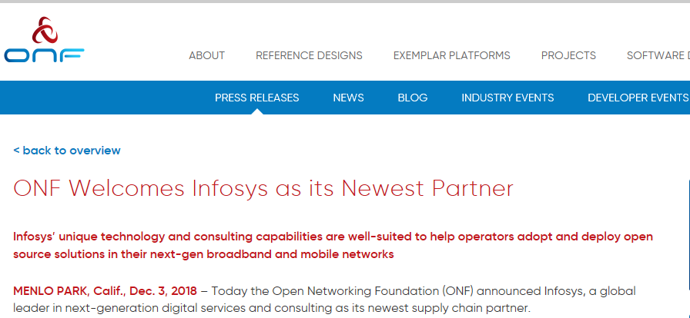

Infosys is invested & committed to Open Networking Software
Infosys was the first SI to become the supply chain partner of ONF
Infosys brought ONF to Asia in July 2019
Accelerating Open Networking Software Deployment Leading to Digitization and Transformation of Networks
20+
Industry Visionaries
70+
Companies
400+
Attendees
30+
Showcases
80+
Thought Leadership
Contributing R&D efforts to Open-source projects in ONF
Trellis
SEBA
STRATUM
CoMAC
100+
Engineers enabled on ONF Platforms
Notes:
Press Release: https://www.opennetworking.org/news-and-events/press-releases/onf-welcomes-infosys-as-its-newest-partner/

Slide 33

Infosys Contributions to Trellis
System Up Time
10x
Hardening and Production Ready
New feature commits: 25
Code Commits: 70
Bug Fix commits: 45
Complex Features: 10
Scale
Infosys has partnered with ONF to address some of the key performance and reliability issues
~ 120k Routes
250k flows
Test Automation
200+ Automated Test-cases
Service outages
80% Reduction

Slide 34



Infosys is Productizing Trellis
Infosys is partnering with eco-system partners to offer a Production-ready commercial grade SDN Controller based on Trellis
Infosys Network Controller
ONOS
SDN-M
Apps
ONOS Core
Commercial grade
Support Model
Adaptors / Plugins
Open NOS
Open NOS
Open NOS

Slide 35


Infosys Network Controller: Roadmap
Release 2 – Dec 2020
Hitless Upgrades
P4, Stratum Integration
Automated Regression suite
Release 1 – Jun 2020
Performance and Scale Optimization
Fully Integrated Support Model
Metro-Ethernet Capabilities
MVP – Dec 2019
SDN Management Plane
Unified Dashboard

Slide 36
THANK YOU

