Slide 1
State of ONF
Saurav Das, Guru Parulkar, Oğuz Sunay, ONF

Slide 2

ONF’s Operator Led Mission
by leveraging
Transform
Operator Networks
… to bring
capex & opex
efficiencies
&
innovative services
Open Source
Why?
How?
Disaggregation White Box
SDN/NFV/
Cloudification
With the focus on Access and Edge
Notes:
ONF is an operator led industry consortium. I will explain later why and what it means.
And our mission is to transform operator networks and to bring Capex and Opex efficiencies and enable operators to create innovative revenue generating services.
And we achieve our goals by leveraging or building on the architecture innovations such as SDN, NFV and Cloudification as well as Disaggregation and Open Source.
What is important to note is that we are not just about open source or just about SDN or NFV.
We believe if we have to achieve the transformation we all seek, we have to work with and emphasize all these together and that is only way we can succeed with our mission.
And we are very mission oriented in this pursuit.
You can contrast this with other communities that simply focus on open source or bringing developers together without a clear shared mission.

Slide 3
ONF Unique Approach – Operator Led Curated Open Source
Operator prioritized use cases
  Operators first agree on common Use Cases to jointly pursue
  Operators commit to deployment
Operator
Partnerships
7+ Years
Lab & Engineering Staff @ ONF
  “Small & mighty” independent engineering team
  Dedicated to the mission with no legacy to protect
Keiretsu Ecosystem Develops
  Curated supply chain engages to embrace opportunity
  Well aligned vendors each contribute value to overall solution
  Operator commitment to deployment ensures ROI
Notes:
So let me explain how our curated open source model and community work.
Consider network operators such as AT&T, Comcast, China Unicom, DT, Google, NTT and Turk Telekom.. They own and operate largest infrastructure and services. And they are committed to transforming their networks and they know the best their priorities and how they want to approach it.
These operators specify and help define the use cases and solutions they want to pursue and commit to deployment.
Then we have a small engineering team of 20-25 architect and developers that some times our board members describe as “small and mighty ” – because we don’t have any legacy to protect and we pursue innovative architecture and solutions with a passion. On many occasions, industry folks have said we are crazy or pursuing things that will not work and our team has proven them wrong.
Then we have a list of supply-chain partners who are committed to this vision/mission of creating SDN and NFV with disaggregation and open source. These supply-chain partners get to work closely with operators on platforms and solutions they want deploy. Thus these supply-chain partners don’t have to do guess work and can significantly cut their R&D costs and reduce time to market.
And together we have created some amazing open source platforms and solutions – I will talk about them in just a minute.

Slide 4


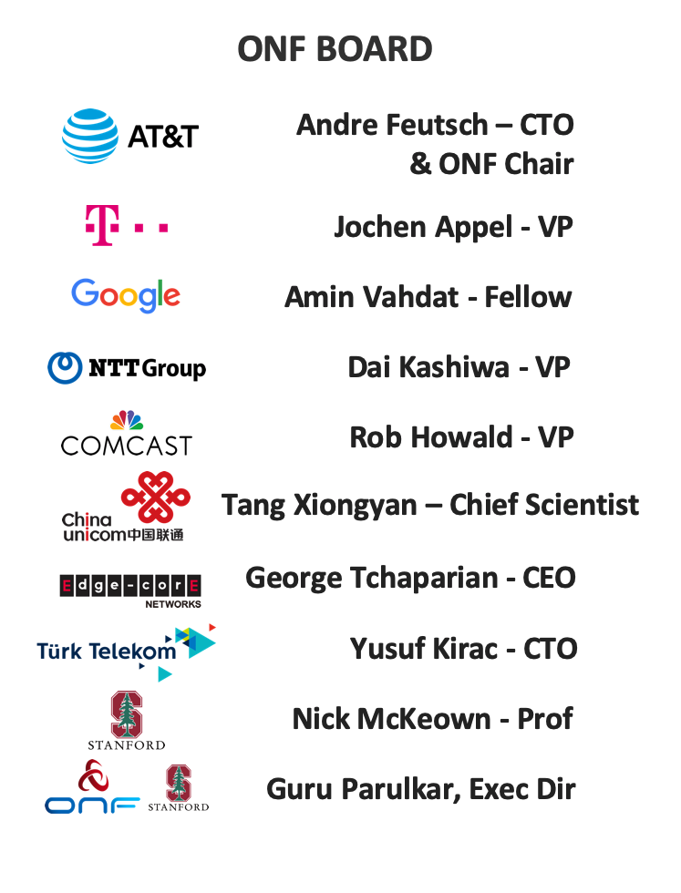







Operator Led - Curated Open Source Community
Partners committed to disaggregation, open source and SDN/NFV/Cloudification

Slide 5
Highlights
All pieces coming together for wireline and mobile access and edge
Key platforms and solution proven in a tier-1 production setting
  Trellis: ONOS and leaf-spine fabric with ”real” SDN and white boxes
Other platforms and solutions proven and quickly moving to production readiness
  SEBA: VOLTHA, ONOS, NEM (AT&T, DT, TT, …)
  OMEC: Open source CUPS compliant EPC (DT, Sprint)
  SD-RAN and Mobile Edge Cloud (China Unicom)
Exciting forward looking roadmap
  Next Gen SDN offering: top-down programming, zero-touch operation, network verification, fine-grained measurement, closed loop control
  COMAC: convergence of access and core
Notes:
Overall ONF mission
Specific platforms and solutions
Deployments

Slide 6
Transforming Wireline and Mobile Access and Edge
Access and Edge Network Substrate: Trellis Fabric
Wireline
Mobile
SEBA
Access
Wireline Core: BNG
RAN
Mobile Core: EPC
VOLTHA
SD-BNG
SD-RAN
OMEC
SDN Control Plane: ONOS
White boxes: Servers, Switches, OLT, RAN

Slide 7


Production-ready
Multi-purpose leaf-spine fabric
Trellis apps
IPv4/v6 unicast/multicast, vlans, MPLS SR, vRouter …
ONOS Cluster
SDN-based
White-boxes
Open-source
Tenets
Central Office
Spine
Spine
Metro/Core
Routers
Internet
Base station
Leaf
Leaf
Leaf
Leaf
Leaf
Leaf
R-PHY
2
Types of Switches
R-OLT
1
Types of Traffic
Optimized for Service Provider Access/Edge

Slide 8
Production-ready
Multi-purpose leaf-spine fabric
Trellis apps
IPv4/v6 unicast/multicast, vlans, MPLS SR, vRouter …
ONOS Cluster
Spine
Spine
Field
Office
Leaf
Leaf
Spine
Spine
Metro/Core
Routers
Central
Office
Internet
3
Distributed
Fabric
Base station
Leaf
Leaf
Leaf
Leaf
R-PHY
R-OLT
Optimized for Service Provider Access/Edge
Notes:
USE CASE 1 – Distributed Fabric for Access/Edge Networking

Slide 9



Learn more about Trellis – Friday
George Tchaparian
President & CEO
EdgeCore Networks
Saurav Das
VP Engineering
ONF
Nitesh Bansal
SVP & Global Head Engineering Services
Infosys

Slide 10
Transforming Wireline and Mobile Access and Edge
Access and Edge Network Substrate: Trellis Fabric
Wireline
Mobile
SEBA
Access
Wireline Core: BNG
RAN
Mobile Core: EPC
VOLTHA
SD-BNG
SD-RAN
OMEC
SDN Control Plane: ONOS
White boxes: Servers, Switches, OLT, RAN

Slide 11

Traditional Wireline Access
RG – Residential Gateway
OLT – Optical Line Termination
BNG – Broadband Network Gateway
Residence
Central Office
Backbone
Network
RG
ONU
OLT
ETH AGG
BNG
Each device closed, proprietary, and not programmable
Source of high capex and opex for operators
Opportunity to bring SDN, disaggregation, and open source as operators deploy next gen broadband with GPON, XGS-PON, G.Fast, …

Slide 12
SEBA: SDN Enabled Broadband Access
Residence
Central Office
Virtual OLT
manages and abstracts PON
Manages 1 or more switches
VOLTHA
Trellis
Backbone
Network
RG
ONU
OLT
ETH AGG
BNG
OLT MAC
WhiteBox
Switch
RG – Residential Gateway
OLT – Optical Line Termination
BNG – Broadband Network Gateway

Slide 13



SEBA: SDN Enabled Broadband Access
ONAP
Op X OSS/BSS
SEBA POD
Local Adaptor
Network Edge Mediator (NEM)
DockerK8s Helm
VOLTHA apps
Trellis apps
SDN Controller - ONOS
VOLTHA
ONU
OLT
SWITCH
External BNG
SERVER

Slide 14

SEBA Update
SEBA 3.0 & Beyond
VOLTHA 2.x
Embedded BNG
DT/TT Workflows
SEBA 2.1 (Sept/Oct 2019)
BAL 3.1
ONF operators AT&T, DT, and TT are committed to taking SEBA to production
SEBA 2.0 alpha (July 3rd 2019)
Technology & Speed Profile
AT&T workflow, HSIA service
VOLTHA 1.7, BAL 2.6
SEBA 1.0 (Jan 7th 2019)
HSIA service
AT&T workflow
VOLTHA 1.6
New CORD platform (6.1)

Slide 15
SEBA: SDN Enabled Broadband Access
Many functions (Closed Integrated Device):
Subscriber tunnel termination (QinQ, PPPoe)
Accounting
Hierarchical QoS
Lawful intercept (wiretap)
Wholesale tunnel relay (e.g. L2TP)
Multicast
Routing
Residence
Central Office
Virtual OLT
manages and abstracts PON
Manages 1 or more switches
VOLTHA
Trellis
Backbone
Network
RG
ONU
OLT
ETH AGG
BNG
OLT MAC
WhiteBox
Switch
RG – Residential Gateway
OLT – Optical Line Termination
BNG – Broadband Network Gateway

Slide 16
SEBA with SD-BNG
Residence
Central Office
Virtual OLT
manages and abstracts PON
Manages 1 or more switches
SD-BNG
VOLTHA
Trellis
BNG-c
Backbone
Network
RG
ONU
OLT
ETH AGG
BNG
OLT MAC
P4 based WhiteBox
Switch with BNG-user plane
RG – Residential Gateway
OLT – Optical Line Termination
BNG – Broadband Network Gateway

Slide 17
SEBA with SD-BNG
SEBA POD
Network Edge Mediator (NEM)
Docker K8s Helm
1
BNG-c app on ONOS
VOLTHA apps
Trellis apps
BNG-control
SDN Controller - ONOS
VOLTHA
P4Runtime, gNMI, gNOI
2
BNG-u
Func distribution
ONU
OLT
Embedded BNG
P4-SWITCH
STRATUM
ONU
STRATUM
SERVERS
Upstream Routers
PPPoE server
1
Integrate existing control software
Notes:
Our plan is to split the BNG black box in two pieces, user plane and control plane
The control plane, responsible of functions like authentication, IP address assignment, routing, etc. can be implemented as a mix of SDN apps running on top of ONOS, integrated with existing control software when possible
The user plane, responsible of processing data traffic, can be implemented as part of the existing fabric of SEBA, using P4 and merchant silicon. We plan to use different chipsets for disfferent fiunctions

Slide 18



SD-BNG Integration with SEBA
Demo at ONF Connect
Kubernetes cluster (compute node)
NEM
PPPoE Server
SEBA Apps
Trellis
BNG-c Relay
ONOS
Handles authentication, address assignment (IPCP), keep-alive, etc.
VOLTHA
Subscriber with PPPoE client
Stratum
Internet
OLT
Switch (P4)
Upstream router
ONU
Notes:
Traditional SEBA deployment augmented with new components:
Subscriber device configured to act as a PPPoE client
External PPPoE server
BNG-c Relay app

Slide 19
Transforming Wireline and Mobile Access and Edge
Access and Edge Network Substrate: Trellis Fabric
Wireline
Mobile
SEBA
Access
Wireline Core: BNG
RAN
Mobile Core: EPC
VOLTHA
SD-BNG
SD-RAN
OMEC
SDN Control Plane: ONOS
White boxes: Servers, Switches, OLT, RAN

Slide 20



Mobile Network Evolution Towards 5G
3GPP
RAN STACK
UEs
UEs
DISAGGREGATED, CUPS
3GPP CORE VNFS
eNB/gNB
OTT APPS
Public
Cloud
IMS
APPS
eNB/gNB
Telco Cloud
UEs
eNB/gNB

Slide 21


Mobile Network Evolution Towards 5G
Pieces Coming Together
RU
2
OMEC: Open Source
Disaggregated Mobile Core
3GPP CORE
3GPP
RAN STACK
UEs
CU
RU
Edge
DISAGGREGATED, CUPS
3GPP CORE VNFS
UEs
APPS
DU
eNB/gNB
OTT APPS
CU
Edge
OTT APPS
RU
Public
Cloud
DU
IMS
APPS
eNB/gNB
SDN CONTROL
Telco Cloud
UEs
1
SD-RAN: Near Real-Time
Control of RAN with ONOS
DU
eNB/gNB
3
Mobile Edge Cloud Platform
with Hybrid Cloud Connectivity

Slide 22
RAN Evolution: Towards SD-RAN
SD-RAN Controller can also control non-disaggregated eNBs/gNBs
PHY
Scheduling
MAC
RU
PHY-LO
All-In-One
eNB/gNB
RLC
PDCP
DISAGGREGATION
+
SD-CONTROL
DISAGGREGATION
PHY-HI
DU
Scheduling
RRC
MAC
E2
RLC
CU-U
E2
PDCP-U
ONOS SD-RAN
(O-RAN RIC)
SDAP
E1
CU
PDCP
E2
PDCP-U
E2
RRC
CU-C
RRC
E1 & E2 to be specified by O-RAN
Demo to use an interim E2 interface inspired by O-RAN
Packet & Signal Processing
Radio Resource Management Control

Slide 23



ONOS-Based SD-RAN Controller
O-RAN COMPLIANT NB - A1
RAN APPS
(Radio Connection Mgmt, Mobility Mgmt, QoS Mgmt, Interference Mgmt, 3rd Party Apps, Trained Model)
NB CORE API
(R-NIB, Flow Objectives, Intents)
DISTRIBUTED RIC NEAR-RT CORE
(R-NIB management, Notifications, High-availability & Scale-out)
O-RAN COMPLIANT SB - E2
INTERIM E2:
ASN.1 OVER SCTP

Slide 24
ONOS SD-RAN Features
Can we drop this slide?
ONOS-Based SD-RAN controller supporting an interim E2 southbound
ONOS maintaining and displaying the Mobile Network State over the entire geography
A simple handover application running on ONOS SD-RAN conducting near real-time control
A simple radio channel emulation platform distributing SD-RAN compliant base stations and mobile handsets over a geography

Slide 25


ONOS SD-RAN Demo at ONF Connect
GUI
Handover App
R-NIB
4. R-NIB is exposed to the RAN handover application. When necessary, this app triggers handovers
3. ONOS SD-RAN maintains and displays time-varying mobile network state in near-real-time
5. When handover is triggered, ONOS SD-RAN orders the serving and target base stations to execute it using E2
2. Base stations transmit time-varying mobile network state information to ONOS SD-RAN every 5ms using the interim E2 interface
1. Mobile Handsets transmit mobile channel quality info to their serving base station every 1ms following 3GPP standards
6. Handover takes place. The updated mobile network state is transmitted up to ONOS SD-RAN

Slide 26

OMEC: Pieces Moving Towards Productization
CI/CD: Automated standards compliancy testing and heavy RAN traffic performance testing
  Architectural improvements are underway. The goal is to develop an architecture that makes it easy to migrate to: i. 5G ii. Cloud-native.
CUPS compliant SGW and PGW user and control planes have been hardened towards production deployments
HSS
Subscriber
Database
PCRF
MME
SGW-C
PGW-C
Billing & Charging
SGW-U
PGW-U

Slide 27



OMEC Field Trials
Operator: T-Mobile Poland
Use Case: Fixed-Mobile Substitution
Trial with Live Customers
Beginning: August/September 2019
Operator: Sprint USA
Use Case: Local Break-Outs
Field Trials
By: End of 2019

Slide 28
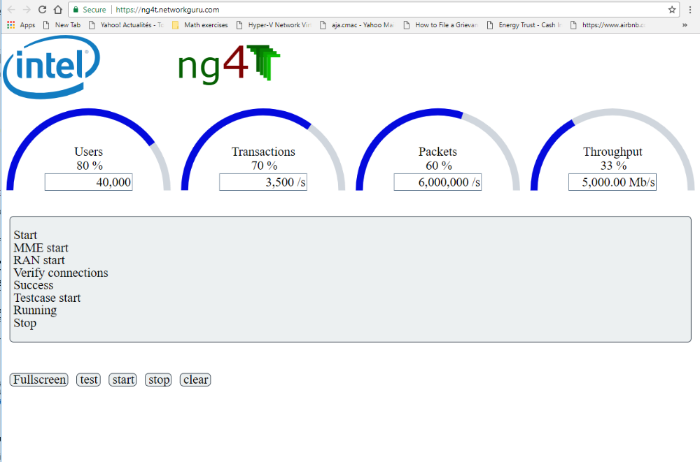
OMEC Gateways Perform at Scale
(Demo at ONF Connect)
Showcasing OMEC can securely run on high volume servers and deliver operational capacity
Capacity ➔ 13+ VNFs ➔ 100 Cores 256GB 1TB HDD 8x10GbE ➔ 250K Flows / 1000TPS / 2MPPS

Slide 29


Mobile Edge Cloud with Hybrid Cloud Connectivity
MOBILE
EDGE CLOUD
MENLO PARK
VPN
RU+DU
+CU-U
SDN
FABRIC
SANTA CLARA
INTERNET

Slide 30
Mobile Edge Cloud with Hybrid Cloud Connectivity
Demo at ONF Connect
MOBILE
EDGE CLOUD
MENLO PARK
ONOS RAN
PROGRAN
HSS-DB
HSS
CU-NATS
CU-L3
NEM
KUBERNETES
MME
SR-IOV
CU-RADIS
KUBERNETES
RU+DU
+ CU-U
VPN
SPGW-C
SPGW-U
SR-IOV
CDN-LOCAL
SR-IOV
CDN-REMOTE
SDN
FABRIC
SANTA CLARA
ONOS
INTERNET

Slide 31


Mobile Edge Cloud Software Stack
Piecing SD-RAN, OMEC and Hybrid Cloud Connectivity Together
Multi-Access Edge Cloud Stack
Telco Central Cloud
Inter-Cloud
Connectivity
Mobile Edge Cloud Profile
Edge State Data
Inter-Cloud Connectivity
PROFILES
INTERFACES
NEM
Trellis
Core VNFs
Core VNFs
Apps
RAN Apps
RAN VNFs
Apps
ONOS SD-RAN
ONOS
Kubernetes

Slide 32
ONF’s First Official Mobile Edge Cloud Release
Graduating from Demo Quality To Field Trial Quality Towards Production Readiness
China Unicom will use this platform in its field trials for SD-RAN and MAEC
OMEC dev follows the same processes that other ONF projects use
Gateway components hardened for deployment
MME component is being enhanced towards deployment
Mobile subscriber state for FCAPS is OMEC based and
uses OMEC processes for dev
Prometheus / Grafana
Mobile Subscriber State
NEM
Trellis Apps
RAN Apps*
OMEC
ONF Mobile Edge Cloud Platform
Official Release Date:
September 20, 2019
ONOS
ONOS
SD-RAN*
Kubernetes
M-CORD has conducted very successful demonstrations
Focus has been on showcasing cutting-edge technology
Leverages the latest SEBA platform which is
hardened for deployment
SD-RAN controller is based on ONOS which has been hardened for Trellis
Further development will be in synch with μONOS processes
RAN Apps development will follow the same processes that other ONF projects use
* Will not be part of v1.0 release, but subsequent releases

Slide 33
Mobile Edge Cloud Features
COMAC-EP V1.0 Release Platform: Mobile Edge Cloud with SDN-Programmable Access
OMEC: Production grade, open source, CUPS compliant 3GPP core with SR-IOV accelerated user plane
Multi-Cloud Connectivity Supporting Distributed
OMEC VNFs
Real-Time Monitoring of Mobile Edge State, including infrastructure state, fabric traffic, container traffic and mobile subscriber state
OTT Services Support allowing for multi-cloud distribution of service components
COMAC Dev-as-a-Service: COMAC pod running on public cloud and capable of running E2E tests

Slide 34
Journey to Next-Gen SDN
Taking a leap forward
Top-Down Programmability
Hardware Independence
Cloud-like lifecycle
Verifiability
New Technologies
Programmable Silicon
P4, P4Runtime
Cloud Dev Models
Bold SDN vision established
Separation of Ctrl & Dataplane
Centralized Control
OpenFlow
Google
SDN implementation
Next-Gen SDN
Enabling
Simpler forwarding devices
Faster innovation
Reduced capex/opex
Lessons
Learned
Enabling
Rapid Network Innovation
Zero Touch Operation
Robust Hardware Ecosystem
SDN
Open Source SDN
Enters Production
Value
SDN- -
Vendors responded with software configuration tools:
Traditional switching & routing using conventional embedded control protocols
Time

Slide 35

Nick’s Keynote

Slide 36




Overview: Next-Gen SDN Stack
Nate Foster
Associate Professor
of Computer Science, Cornell University
Timon Sloane
VP, Marketing & Ecosystem, ONF
Brian O'Connor
MTS, ONF
Thomas Vachuska
Chief ONOS Architect, ONF

Slide 37











Stratum Going Open Source on the Following Devices
Switch Vendor
Switching ASIC
Wedge100BF-32X
32 x 100 Gbps
Wedge100BF-65X
65 x 100 Gbps
AG9064v1
64 x 100 Gbps
D5054
32 x 100 Gbps +
48 x 25 Gbps
BF6064X
64 x 100 Gbps
Tofino
Up to 6.5 Tbps
Z9100
32 x 100 Gbps
AS7712
32 x 100 Gbps
D7032
32 x 100 Gbps
T7032-IX1
32 x 100 Gbps
Tomahawk
Up to 3.2 Tbps
Near-term future platforms:
Additional platforms for existing targets (ONLPv2 porting)
  Existing vendors + Asterfusion, ...
Mellanox Spectrum / SN2700 via PINode and ONLPv2
Trident 2 platforms via BCM SDK6 wrapper
Datacom platforms (PowerPC-based)

Slide 38
Final Takeaways
ONF and its community are on the path to transforming wireline and mobile access and edge
Our platforms are rapidly maturing and getting ready for production deployment
Our operator partners are committed more than ever

