Slide 2

How ONF Builds on OCP Products for Telco/Cableco Broadband Access
Saurav Das
VP of Engineering, ONF
Telco & OpenEdge

Slide 3

































The ONF Ecosystem
Vibrant Operator Led Consortium
160+ Members Strong
Operator Partners
www.opennetworking.org
Vendor Partners
Innovator Operators
70+
Innovator Vendors
70+
Collaborators

Slide 4







CORD
Central
Office
Rearchitected as a
Datacenter
Mobile
Services
Enterprise
Services
Residential
Services
Mobile
Enterprise
Residential
XOS
Economies of a Datacenter
Agility of a Cloud Provider
Trellis
ONF Open Source Software Stack for Access and Edge
ONOS
RAN
VOLTHA
Stratum
OMEC
ODTN
Disaggregated
Radio Units
Disaggregated
PON OLTs
Shared Virtualized Servers: VMs & Containers
ROADM
(To Core)

Slide 5
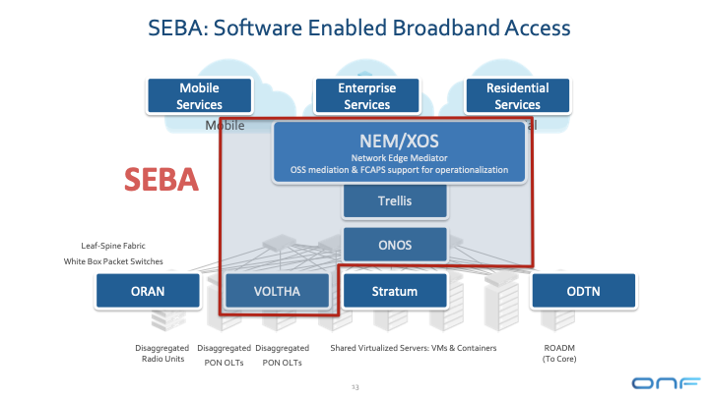
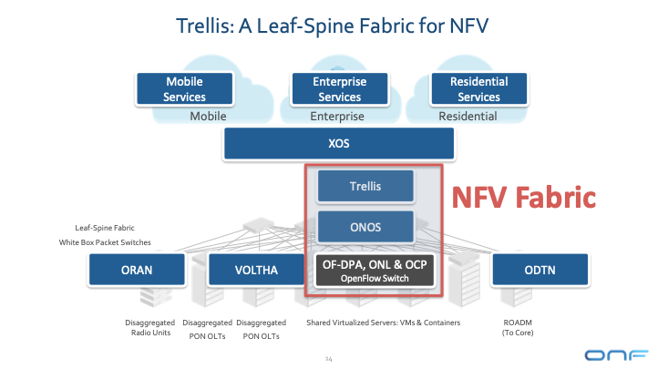
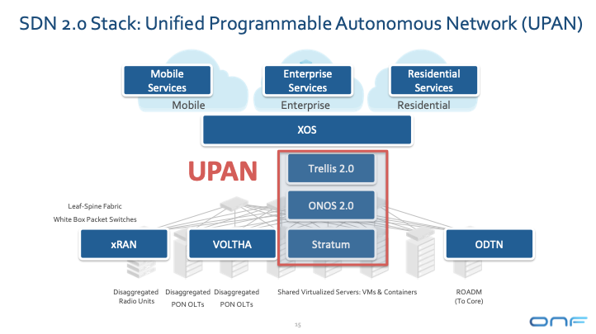
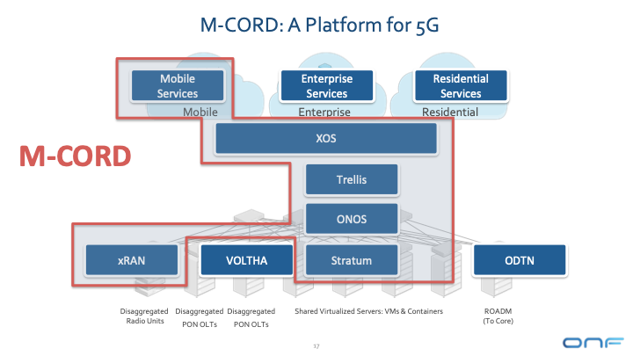
ONF Curated Solutions
ONF helps operators and supply-chain assemble these projects into Deployable Access and Edge Solutions

Slide 6



OLT Disaggregation
VLANs
AAA
Mcast
…
ONOS: SDN Controller
EMS
OpenFlow
NetConf
VLANs, IGMP, 802.1x, Mcast …
Backplane
VOLTHA
SDNize
OpenFlow Agent
NetConf
PON MAC blades
OLT API
OMCI Stack
Compute blades
VOLTHA: Virtual OLT Hardware Abstraction
OLT
Traditional Chassis based Vendor OLT for PONs (Passive Optical Networks)

Slide 7






SEBA
ONAP
Op X OSS/BSS
SEBA POD
Abstract OLT
SDN
Enabled
Broadband
Access
Network Edge Mediator (NEM)
DockerK8s Helm
AAA
vlans
dhcp
mcast
bridging
routing
ACLs
SDN Controller - ONOS
VOLTHA
OLT
EdgeCore
7712
ONU
SWITCH
External BNG
SERVER
EdgeCore
ASFvOLT16
QuantaGrid
D51B-1U

Slide 8


White-Box XGS-PON OLT
VOLTHA
core
White-Box =
Open-Hardware Specs (OCP)
+ Open-Source Software (ONF & OCP)
OpenOLT
Adaptor
Edgecore
ASFvOLT16
Whitebox OLT
OpenOLT
Whitebox OLT
OpenOLT Driver
ONL
Chip Driver
ONIE
SDK(s)

Slide 9

White-Box ToR Switching
Fabric Control
White-Box =
Open-Hardware Specs (OCP)
+ Open-Source Software (ONF & OCP)
SDN Controller
Indigo OF Agent
BRCM OF-DPA
ONL
SDK
ONIE
BRCM ASIC
Edgecore
5712, 6712, 7712
OCP Bare Metal Switch

Slide 10
OF-DPA
Multi-
cast Routing Table
Abstracts underlying switching ASIC
MPLS
Label
Group
Phy Port
L3 ECMP
Group
Unicast
Routing
Table
MPLS
Label
Group
Phy Port
Ingress
Port Table
Vlan Table
Termin-ation MAC
Table
ACL
Policy
Table
L3
Mcast
Group
Phy Port
L2 Interface
Group
Phy Port
L2 Interface
Group
Phy Port
MPLS
Table
Vlan 1 Table
MPLSL2 Port
Table
L2 Flood
Group
L2 Interface
Group
Phy Port
Bridging
Table
L2 Interface
Group
Phy Port

Slide 11
OLT+ToR Operation
Bridging/Routing
VLANs
dhcp
mcast
ONOS
VOLTHA
Logical
switch
ONU
OF-DPA
ToR
Switch
OLT
NNI
UNI
UNI

Slide 12
SEBA
ONAP
Op X OSS/BSS
SEBA POD
Abstract OLT
SDN
Enabled
Broadband
Access
Network Edge Mediator (NEM)
DockerK8s Helm
AAA
vlans
dhcp
mcast
bridging
routing
ACLs
SDN Controller - ONOS
VOLTHA
ONU
OLT
SWITCH
External BNG
SERVER

Slide 13

Trellis
Trellis
IPv4/v6 unicast/multicast, vlans, MPLS SR, vRouter …
Open-Source Leaf-Spine Fabric
ONOS
Spine
Spine
Field
Office
Leaf
Leaf
Spine
Spine
Metro/Core
Routers
Central Office
Internet
Leaf
Leaf
Leaf
Leaf
Base station
R-PHY
R-OLT

Slide 14
How to get involved
SEBA
  Community: https://wiki.opencord.org/display/cord/seba
  Release: https://guide.opencord.org/cord-6.1/
  BOM: https://guide.opencord.org/cord-6.1/prereqs/hardware.html
VOLTHA
  Community: https://wiki.opencord.org/display/cord/voltha
Trellis
  Community: https://wiki.opencord.org/display/CORD/Trellis%3A+CORD+Network+Infrastructure
OCP Telco/OpenEdge
  Wiki: https://www.opencompute.org/wiki/Telcos/openEDGE
  Mailing list: https://ocp-all.groups.io/g/OCP-Open-Edge

