Slide 1
Virtualized Broadband Access: SEBA
Saurav Das
VP of Engineering, ONF
Open Networking Conference Asia 2019
July 22nd, 2019

Slide 2
Outline
How to virtualize broadband access?
Who’s working on it?
What’s coming next?

Slide 3
SEBA: SDN Enabled Broadband Access

Slide 4
Traditional Residential Access
Residence
Central Office
Backbone
Network
RG
ONU
OLT
ETH AGG
BNG
RG – Residential Gateway
OLT – Optical Line Termination
BNG – Broadband Network Gateway

Slide 5




OLT Disaggregation → VOLTHA
Backplane
VLANs
AAA
Mcast
…
EMS
ONOS: SDN Controller
VLANs, IGMP, 802.1x, Mcast …
OpenFlow
NetConf
PON MAC blades
VOLTHA
SDNize
OpenFlow Agent
NetConf
Compute blades
OLT API
OMCI Stack
VOLTHA: Virtual OLT Hardware Abstraction
Traditional Chassis based Vendor OLT for PONs (Passive Optical Networks)

Slide 6
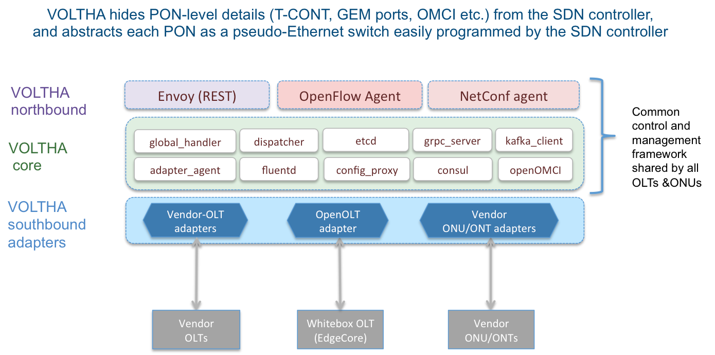
VOLTHA Architecture
TP
TP
Tech
Profiles

Slide 7
VOLTHA Operation
Bridging/Routing
VLANs
dhcp
mcast
ONOS
VOLTHA
Logical
switch
ONU
Switch
OLT
UNI
NNI
UNI

Slide 8






SEBA
ONAP
Op X OSS/BSS
SEBA POD
Abstract OLT
SDN
Enabled
Broadband
Access
Network Edge Mediator (NEM)
DockerK8s Helm
AAA
vlans
dhcp
mcast
bridging
routing
ACLs
SDN Controller - ONOS
VOLTHA
OLT
(Embedded BNG)
EdgeCore
7712
ONU
SWITCH
External BNG
SERVER
EdgeCore
ASFvOLT16
QuantaGrid
D51B-1U

Slide 9
SEBA
ONAP
Op X OSS/BSS
SEBA POD
Abstract OLT
SDN
Enabled
Broadband
Access
Network Edge Mediator (NEM)
DockerK8s Helm
AAA
vlans
dhcp
mcast
bridging
routing
ACLs
SDN Controller - ONOS
VOLTHA
OLT
(Embedded BNG)
EdgeCore
7712
ONU
SWITCH
External BNG
SERVER
EdgeCore
ASFvOLT16
QuantaGrid
D51B-1U

Slide 10


Industry’s First White-Box XGS-PON OLT
VOLTHA
core
White-Box =
Open-Hardware Specs (OCP)
+ Open-Source Software (ONF & OCP)
OpenOLT
Adaptor
Edgecore
ASFvOLT16
Whitebox OLT
OpenOLT
Whitebox OLT
OpenOLT Driver
ONL
Chip Driver
ONIE
SDK(s)

Slide 11
Why OpenOLT Adaptor?
March 2018
VOLTHA
core
Generic OLT adaptor - ease of onboarding for new vendors (including whitebox vendors)
OpenOLT Adaptor
Py GRPC client
VOLTHA CORE
OpenOLT
OpenOMCI ONU
GRPC
(generic
protobufs)
Alpha ONU
Iskratel ONU
Arcadyan ONU
CIG ONU
CIG
OLT
EdgeCore OLT
Iskratel
OLT
Tellabs ONU
Whitebox OLT
(including EdgeCore)
C++ GRPC srv
Chip Driver
Tellabs
OLT
SDK(s)

Slide 12
SEBA
ONAP
Op X OSS/BSS
SEBA POD
Abstract OLT
SDN
Enabled
Broadband
Access
Network Edge Mediator (NEM)
DockerK8s Helm
AAA
vlans
dhcp
mcast
bridging
routing
ACLs
SDN Controller - ONOS
VOLTHA
OLT
(Embedded BNG)
EdgeCore
7712
ONU
SWITCH
External BNG
SERVER
EdgeCore
ASFvOLT16
QuantaGrid
D51B-1U

Slide 13

Trellis
Trellis
IPv4/v6 unicast/multicast, vlans, MPLS SR, vRouter …
Open-Source Leaf-Spine Fabric
ONOS
Spine
Spine
Field
Office
Leaf
Leaf
Spine
Spine
Metro/Core
Routers
Central Office
Internet
Leaf
Leaf
Leaf
Leaf
Base station
R-PHY
R-OLT

Slide 14

Whitebox ToR Switching
Trellis Apps
White-Box =
Open-Hardware Specs (OCP)
+ Open-Source Software (ONF & OCP)
SDN Controller
Indigo OF Agent
BRCM OF-DPA
ONL
SDK
ONIE
BRCM ASIC
Edgecore
5712, 6712, 7712
OCP Bare Metal Switch

Slide 15
SEBA
ONAP
Op X OSS/BSS
SEBA POD
Abstract OLT
SDN
Enabled
Broadband
Access
Network Edge Mediator (NEM)
DockerK8s Helm
AAA
vlans
dhcp
mcast
bridging
routing
ACLs
SDN Controller - ONOS
VOLTHA
OLT
(Embedded BNG)
EdgeCore
7712
ONU
SWITCH
External BNG
SERVER
EdgeCore
ASFvOLT16
QuantaGrid
D51B-1U

Slide 16
NEM Orchestration & NBI
Model based service definition
OLT,
ONU whitelist,
Subscriber
SEBA POD
NEM
XOS GUI
Chameleon
Tosca
XOS Core
Synchronizers
Database
vOLT
dhcp
mcast
SR
FPM
T3
ONOS Cluster
OF
OF
Redfish
Redfish
VOLTHA
TP
TP
TP
ONU
UNI
AGG Switch
OLT
NNI
AGG Switch
Compute

Slide 17
Subscriber Model
Location
ONU Serial num
OLT/PON port
ONU Whitelist
Tagging
C-tag
Subscriber
S-tag
SEBA 1.0
Upstream
cir, cbs, eir, ebs, air
Bandwidth Profile
Downstream
cir, cbs, eir, ebs, air
Num GEM/TCONT
Traffic priorities
Gem-port mappings
Queuing policy
Scheduling policy
Discard policy
Service Type
Tech Profile
Residential, Business,..

Slide 18
NEM Orchestration & SEBA Workflows
Different operators
==
Different workflows
SEBA POD
NEM
XOS GUI
Chameleon
Tosca
XOS Core
Synchronizers
Database
vOLT
dhcp
mcast
SR
FPM
T3
ONOS Cluster
BNG is a workflow option
External physical BNG
vBNG in compute
BNG in Agg switches
BNG in OLT boxes
Authentication is a workflow option
802.1x based
PPPOE based
DHCP based
OF
OF
Redfish
Redfish
VOLTHA
TP
TP
TP
ONU
Subscriber services are workflow options
HSIA
Voice
IPTV
Business services
Technology profiles
Speed profiles
UNI
AGG Switch
OLT
NNI
AGG Switch
Compute

Slide 19
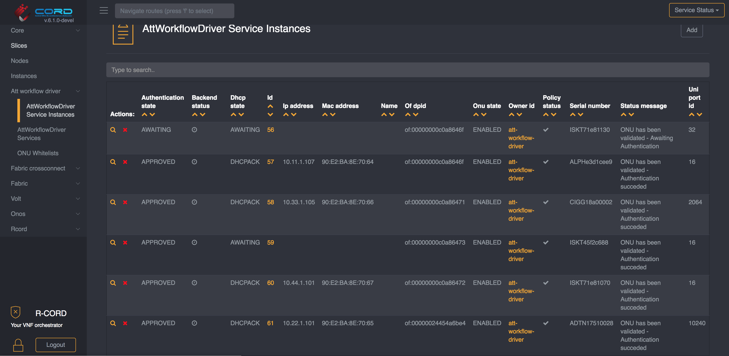
NEM Dashboards: XOS GUI
runtime service instantiation, inventory, workflow status

Slide 20
NEM Monitoring
Infrastructure
GRAFANA
KIBANA
XOS
PROMETHEUS
ELK STACK
NEM
Operator OSS
KAFKA
Alarms, events & stats
ONOS
Logs
VOLTHA
ONU
BNG
RG
UNI
OLT
AGG
NNI
Compute

Slide 21
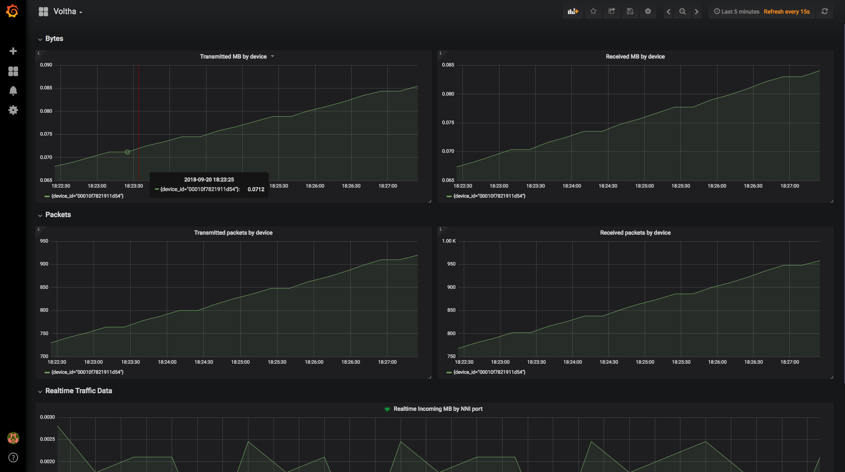
NEM Dashboards: Kibana, Grafana
stats, events, logs (FCAPS)

Slide 22
SEBA
ONAP
Op X OSS/BSS
SEBA POD
Abstract OLT
SDN
Enabled
Broadband
Access
Network Edge Mediator (NEM)
DockerK8s Helm
AAA
vlans
dhcp
mcast
bridging
routing
ACLs
SDN Controller - ONOS
VOLTHA
OLT
(Embedded BNG)
EdgeCore
7712
ONU
SWITCH
External BNG
SERVER
EdgeCore
ASFvOLT16
QuantaGrid
D51B-1U

Slide 23
SEBA Modularity
ONAP/OSAM
Abstract OLT
NEM Orchestration (XOS)
NEM Monitoring
(Prom,Grafana, ELK)
Access
apps
Fabric
apps
ONOS
VOLTHA
Trellis
Kafka
K8s
OS
OS
OS
ONU
OLT
AGG
switch
Compute
Nodes
ONU

Slide 24
Demo setup BBWF 2018
SEBA Peripheral/PNF/Pod
Radius Server
Network Edge
Mediator (NEM)
Elasticsearch
Grafana/Kibana
Kafka
XOS GUI
Chameleon
Tosca
Logstash
Prometheus
Exporter
XOS Core
Synchronizers
Database
Configuration
vOLT
dhcp
aaa
sadis
kafka-i
SR
ONOS
Software Stack
VOLTHA
BBSim
ONU
DHCP Server (subscriber RG addressing)
Alpha
RG
Iskratel
EdgeCore OLT
RG
BNG
Arcadyan
RG
Adtran OLT
Hardware
Adtran
Public Internet
RG
EdgeCore AGG Switch
CIG
CIG OLT
RG
Iskratel
Iskratel OLT (X)
RG
Iskratel
Compute
Nodes
RG
Iskratel OLT (G)

Slide 25
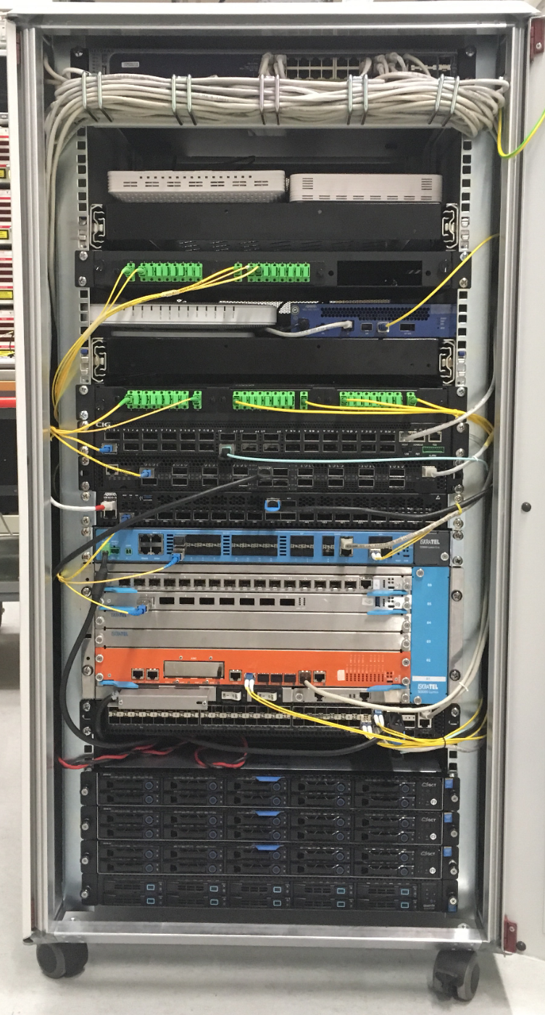
Demo setup BBWF 2018
ONUs: Arcadyan, Alpha, Adtran, CIG, Iskratel
OLTs: Adtran, CIG,
EdgeCore & Iskratel
AGG switch: EdgeCore
Servers: VOLTHA, ONOS, XOS, K8s, ELK, Docker, Prometheus, Grafana, Kibana

Slide 26
SEBA Community

Slide 27




















SEBA (and VOLTHA) Community
AT&T

Slide 28


SEBA/VOLTHA Brigades
Brigade | Technology Profiles | BAL 3.0 upgrade | VOLTHA FCAPS | ONOS FCAPS | Multicast | BBSim | Certification
ONF Mentor | Saurav/ Matteo | Shad | Scott | Saurav | Saurav | Shad | Suchitra
Contri-butors |  |  |  |  |  |  | And many others

Slide 29
Technology Profile Brigade(s)
Contributors
Bridging/Routing
Kafka
AAA
sadis
vOLT
dhcp
mcast
Speed Profile
ONOS
Per subscriber
up/down bw profile
cir/eir/cbs/ebs
VOLTHA
Logical
switch
Tech Profile
Access Tech type
# Gems/TCONTs
Sched policy
Pbit mapping
Discard policy
ONU
OF-DPA
AGG
OLT
UNI
NNI
UNI

Slide 30
BAL 3.0 Brigade
VOLTHA
core
White-Box =
Open-Hardware Specs (OCP)
+ Open-Source Software (ONF & OCP)
OpenOLT
Adaptor
Edgecore
ASFvOLT16
Whitebox OLT
OpenOLT
Whitebox OLT
OpenOLT Driver
ONL
Chip Driver
ONIE
SDK(s)
BAL
Contributors

Slide 31
SEBA Pod Management & VOLTHA FCAPS Brigade
Edgecore XGS
PON vOLT
HTTP/REST & REDFISH API
Redfish Agent
Kafka
Edgecore
GPON OLT
Prometheus
Redfish Agent
Redfish
Importer
Edgecore
Switch
Grafana
Redfish Agent
Server
Redfish Agent
XOS
NEM
Contributors

Slide 32
ONOS FCAPS Brigade
Kafka
Prometheus
Bridging/Routing
Kafka
integration
AAA
sadis
vOLT
dhcp
l2relay
igmp
proxy
ONOS
Grafana
Contributors

Slide 33
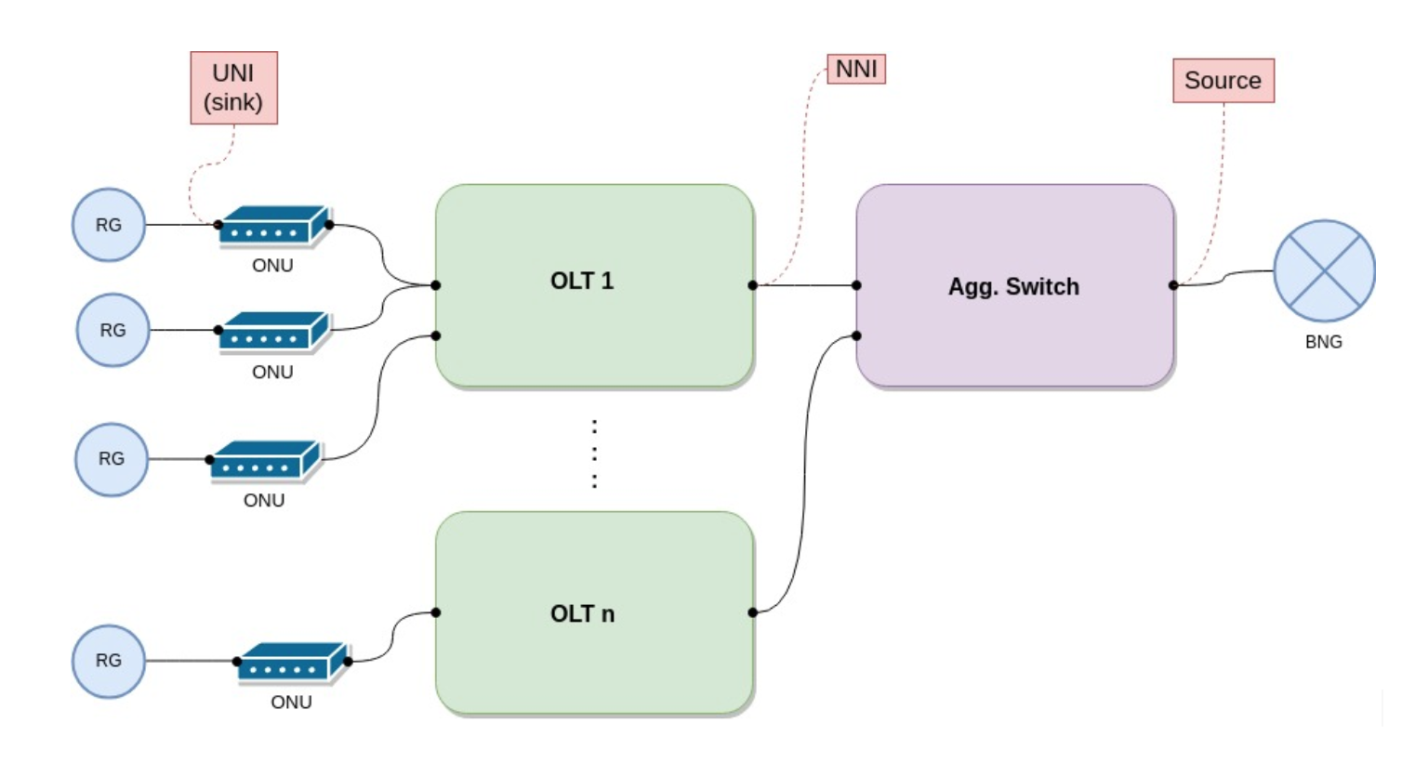
Multicast Brigade
Contributors

Slide 34
BBSim Brigade
SEBA POD
Network Edge Mediator (NEM)
DockerK8s Helm
Contributors
AAA
vlans
dhcp
mcast
bridging
routing
ACLs
SDN Controller - ONOS
VOLTHA
BBSim
BBSim
BBSim
BBSim

Slide 35
Related Work
VOLTHA 2.0 Core
Adaptor Containerization
For VOLTHA 2.0
Service Upgrades
Micro-OLTs
Certification Brigade

Slide 36
SEBA Distributed DevOps – ONF Responsibilities
Joint Development
with AT&T Foundry
Support
VOLTHA/SEBA Community
Deliver
New
Features
SEBA/VOLTHA Stability & Scale
Tooling
QA
Weekly SEBA public meetings
JIRA issues – kanban methodology
Mailing lists, Slack community support
VOLTHA meetings, TST, architectural guidance
ONF team resposible for all ONOS and NEM feature development
FCAPS features – kpis, alarms & logs in SEBA monitoring infrastructure
AT&T workflow development
Integrate with new ONU and OLT vendors
AGG switch features
Focus on stability of VOLTHA – robustness and repeatability
Investigate scalability and performance of full SEBA system
BBSim – Work with NTT in the development of PON simulator for scale testing
SEBA-in-a-BOX: Complete end to end emulation of SEBA system with ponsim & mininet
Developing automated feature tests
Extending framework for hardware based end-to-end tests
Work with community to develop test automation and certification procedures
Daily scrum
Bugs - issue analysis; root-cause;
Design discussions for new features
Documentation
Recommend best-practices/training

Slide 37
SEBA Roadmap

Slide 38

Roadmap
SEBA 3.0 (Dec 20th 2019)
VOLTHA 2.x
Embedded BNG
Experimental support for other Access technologies
SEBA 2.1 (Sept 30th 2019)
Multicast
Turk Telecom Workflow
BAL 3.0
ONOS & VOLTHA FCAPS
SEBA 2.0 (July 3rd 2019)
Technology & Speed Profile
AT&T workflow, HSIA service
VOLTHA 1.7, BAL 2.6
SEBA 1.0 (Jan 7th 2019)
HSIA service
AT&T workflow
VOLTHA 1.6
New CORD platform (6.1)

Slide 39
Traditional Residential Access
Residence
Central Office
Backbone
Network
RG
ONU
OLT
ETH AGG
BNG
RG – Residential Gateway
OLT – Optical Line Termination
BNG – Broadband Network Gateway

Slide 40
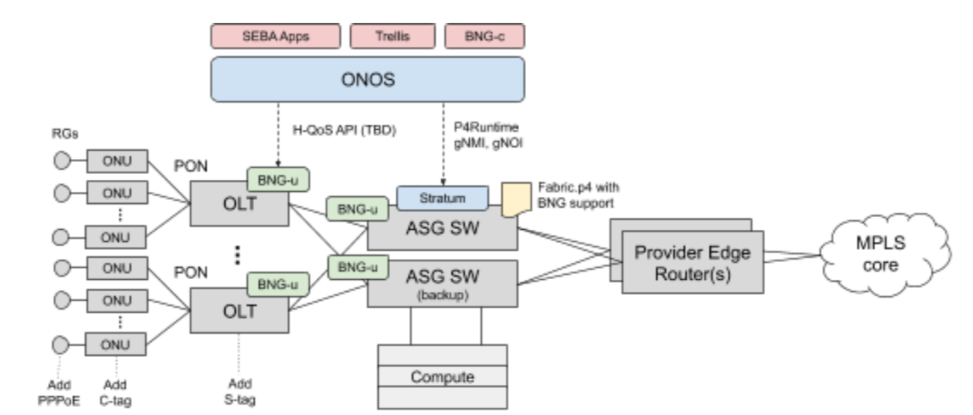
Disaggregating the BNG

Slide 41
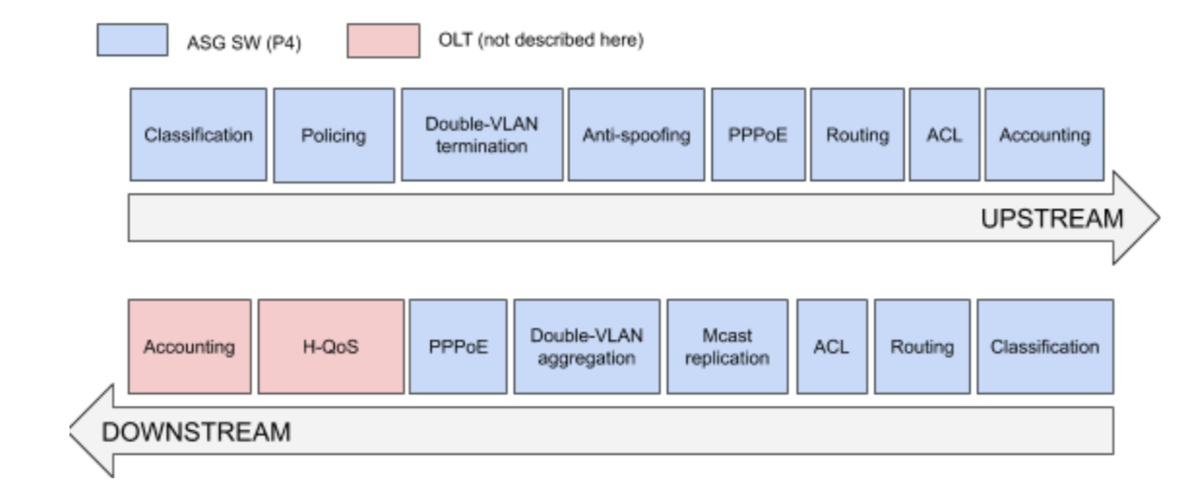
Fabric-BNG.p4

Slide 42




CORD – Central Office Rearchitected as a Datacenter
Residential
vOLT, vSG, vRouter, vCDN
Mobile
vBBU. vMME, vSGW, vPGW, vCDN
Enterprise
vCarrierEthernet, vOAM, vWanEx, vIDS
Access Service Orchestration & Control
White-box Switches with
Merchant Silicon
Cloud
SDN
NFV
BBUs
PON OLTs
COTS (Off-the-Shelf) x86 Compute
ROADM (Core)
Economies of a datacenter, Agility of a cloud provider

Slide 43







SEBA: Built on CORD
Mobile
Services
Enterprise
Services
Residential
Services
Mobile
Enterprise
Residential
NEM
Network Edge Mediator
OSS mediation & FCAPS support for operationalization
Leverages XOS project & toolchain
SEBA
Trellis
ONOS
OMEC
VOLTHA
Stratum
P4
ODTN
Radio
Units
PON
OLTs
PON
OLTs
Shared Cloud Infrastructure
ROADM
(Core)

Slide 44
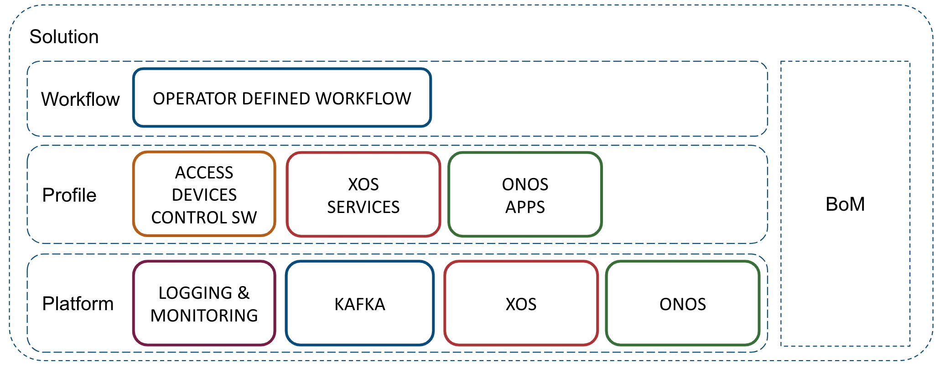
SEBA: Built on CORD
SEBA POD
AT&T
TT
DT
SEBA
profile
VOLTHA
Elasticsearch
Logstash
Kibana
Prometheus
Grafana
Hardware: Server, Switch, OLT, ONU etc
Network Edge Mediator (NEM)

Slide 45

Multi-Access CORD
OMEC
HSS
Demo @ MWC Barcelona 2019
MME
PCRF
Subscriber
Database
3GPP RAN RU
Option 2
F1 interface
SGW-C
PGW-C
3GPP RAN
DU
SGW-U
PGW-U
CU
Internet
Trellis (with embedded BNG)
OLT
ONU

Slide 46
Fronthaul F1 over PON
OMEC
HSS
MME
PCRF
Subscriber
Database
3GPP RAN RU
Option 2
F1 interface
SGW-C
PGW-C
3GPP RAN
DU
SGW-U
PGW-U
CU
Internet
OLT
Trellis (with embedded BNG)
ONU

Slide 47
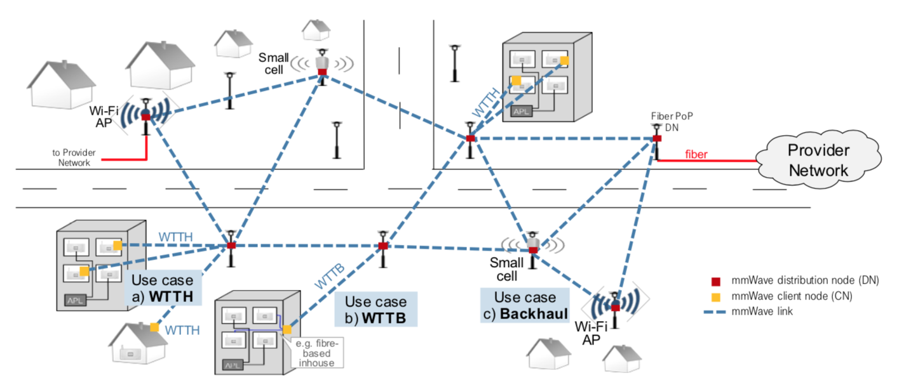
mmWave Backhaul
Courtesy: Frank Geilhardt, DT
Facebook Terragraph: 60GHz

Slide 48
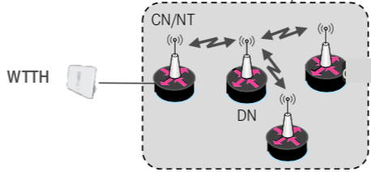
SEBA + Terragraph
ONAP
Op X OSS/BSS
SEBA POD
Abstract OLT
Network Edge Mediator (NEM)
DockerK8s Helm
AAA
vlans
dhcp
mcast
bridging
routing
ACLs
SDN Controller - ONOS
VOLTHA
ONU
OLT
SWITCH
External BNG
Terragraph
SERVER
TG Termination
under discussion

Slide 49
Summary
ONF: Operator driven curated open source
  CORD is the flagship umbrella project
  SEBA – SDN Enabled Broadband Access, built on the CORD platform
Community
  VOLTHA and SEBA have healthy active communities
  Brigades: a way to effectively manage community resources
  Many brigades in progress, more to come – get involved (CORD Calendar)
Roadmap
  2nd release of SEBA July 2019 – Tech & Speed profiles a big step forward
  Big focus areas 2nd half 2019 – Embedded BNG & VOLTHA 2.x integration
Learn More
  Community: https://wiki.opencord.org/display/cord/seba
  Release: https://guide.opencord.org/cord-7.0/profiles/seba/BoM
  https://guide.opencord.org/cord-7.0/prereqs/hardware.html

