Slide 1
SEBA: Community & Roadmap Update
Saurav Das
VP of Engineering, ONF
June 5th, 2019

Slide 2
Outline
Introduction to SEBA & CORD
SEBA Community Update
SEBA Roadmap

Slide 3





CORD – Central Office Rearchitected as a Datacenter
Residential
vOLT, vSG, vRouter, vCDN
Mobile
vBBU. vMME, vSGW, vPGW, vCDN
Enterprise
vCarrierEthernet, vOAM, vWanEx, vIDS
Access Service Orchestration & Control
White-box Switches with
Merchant Silicon
Cloud
SDN
NFV
BBUs
PON OLTs
COTS (Off-the-Shelf) x86 Compute
ROADM (Core)
Economies of a datacenter, Agility of a cloud provider

Slide 4







SEBA: Built on CORD
Mobile
Services
Enterprise
Services
Residential
Services
Mobile
Enterprise
Residential
NEM
Network Edge Mediator
OSS mediation & FCAPS support for operationalization
Leverages XOS project & toolchain
SEBA
Trellis
ONOS
OMEC
VOLTHA
Stratum
P4
ODTN
Radio
Units
PON
OLTs
PON
OLTs
Shared Cloud Infrastructure
ROADM
(Core)

Slide 5






SEBA
ONAP
Op X OSS/BSS
SEBA POD
Abstract OLT
SDN
Enabled
Broadband
Access
Network Edge Mediator (NEM)
DockerK8s Helm
AAA
vlans
dhcp
mcast
bridging
routing
ACLs
SDN Controller - ONOS
VOLTHA
OLT
(Embedded BNG)
EdgeCore
7712
ONU
SWITCH
External BNG
SERVER
EdgeCore
ASFvOLT16
QuantaGrid
D51B-1U

Slide 6
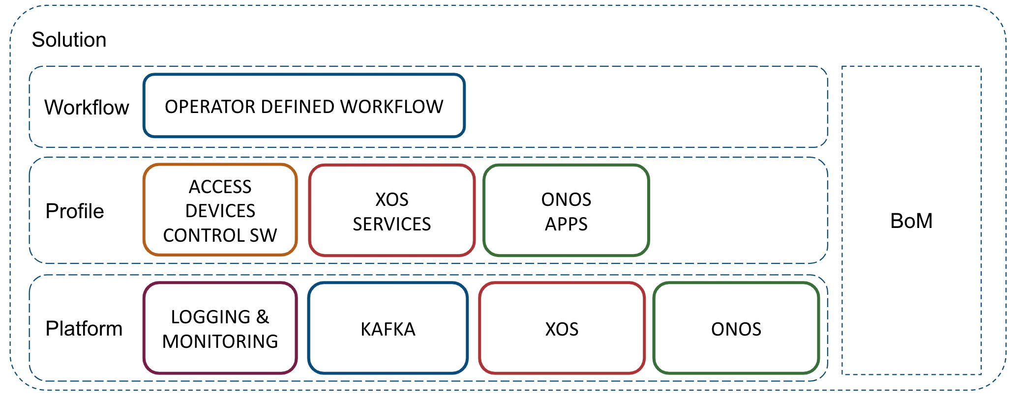
SEBA: Built on CORD
SEBA POD
AT&T
TT
DT
SEBA
profile
VOLTHA
Elasticsearch
Logstash
Kibana
Prometheus
Grafana
Hardware: Server, Switch, OLT, ONU etc
Network Edge Mediator (NEM)

Slide 7
SEBA Community Update

Slide 8





















SEBA (and VOLTHA) Community
AT&T

Slide 9
Technology Profile Brigade(s)
Contributors
Bridging/Routing
Kafka
AAA
sadis
vOLT
dhcp
mcast
Speed Profile
ONOS
Per subscriber
up/down bw profile
cir/eir/cbs/ebs
VOLTHA
Logical
switch
Tech Profile
Access Tech type
# Gems/TCONTs
Sched policy
Pbit mapping
Discard policy
ONU
OF-DPA
AGG
OLT
UNI
NNI
UNI

Slide 10


BAL 3.0 Brigade
VOLTHA
core
White-Box =
Open-Hardware Specs (OCP)
+ Open-Source Software (ONF & OCP)
OpenOLT
Adaptor
Edgecore
ASFvOLT16
Whitebox OLT
OpenOLT
Whitebox OLT
OpenOLT Driver
ONL
Chip Driver
ONIE
SDK(s)
BAL
Contributors

Slide 11
SEBA Pod Management & VOLTHA FCAPS Brigade
Edgecore XGS
PON vOLT
HTTP/REST & REDFISH API
Redfish Agent
Kafka
Edgecore
GPON OLT
Prometheus
Redfish Agent
Redfish
Importer
Edgecore
Switch
Grafana
Redfish Agent
Server
Redfish Agent
XOS
NEM
Contributors

Slide 12

ONOS FCAPS Brigade
Kafka
Prometheus
Bridging/Routing
Kafka
integration
AAA
sadis
vOLT
dhcp
l2relay
igmp
proxy
ONOS
Grafana
Contributors

Slide 13
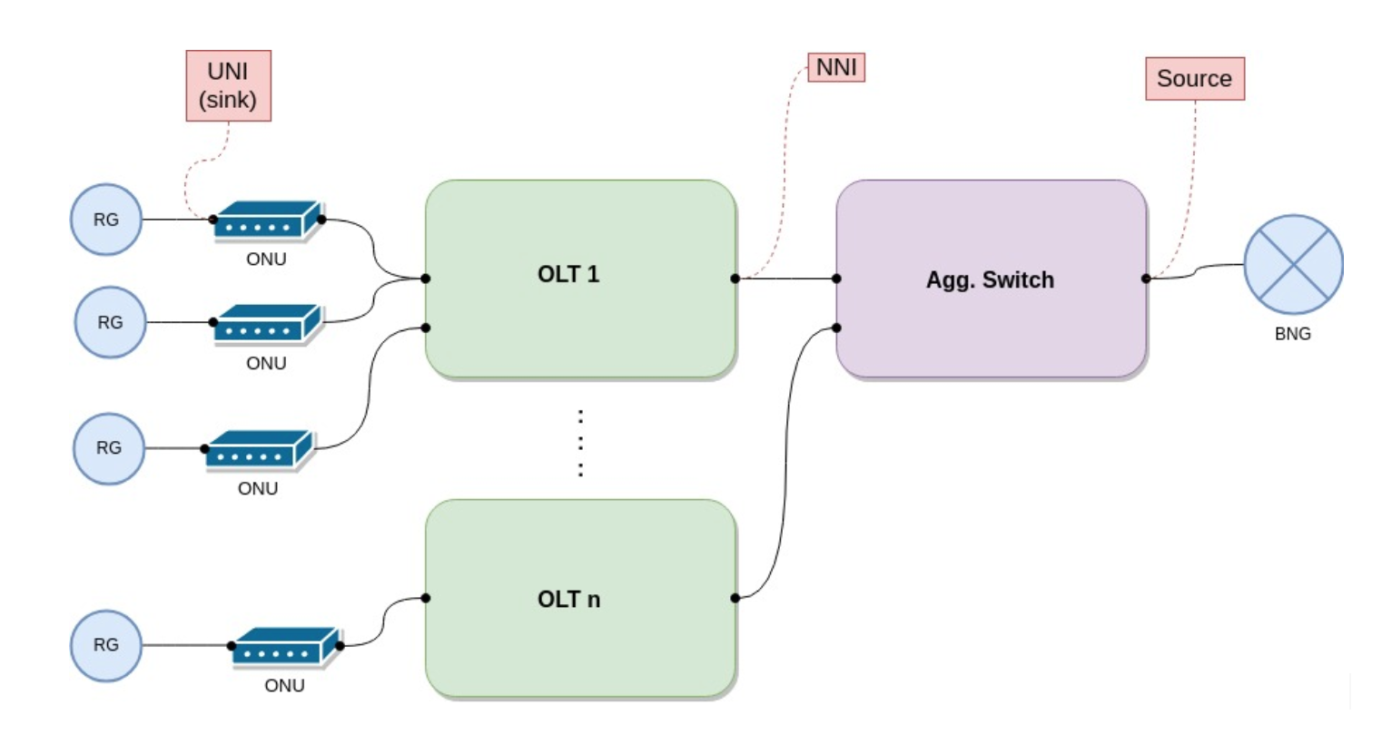
Multicast Brigade
Contributors

Slide 14
BBSim Brigade
SEBA POD
Network Edge Mediator (NEM)
DockerK8s Helm
Contributors
AAA
vlans
dhcp
mcast
bridging
routing
ACLs
SDN Controller - ONOS
VOLTHA
BBSim
BBSim
BBSim
BBSim

Slide 15
Related Work
VOLTHA 2.0 Core
Adaptor Containerization
For VOLTHA 2.0
Service Upgrades
Micro-OLTs
Certification Brigade

Slide 16
SEBA Roadmap

Slide 17

Roadmap
SEBA 3.0 (Dec 20th 2019)
VOLTHA 2.x
Embedded BNG
Experimental support for other Access technologies
SEBA 2.1 (Sept 30th 2019)
Multicast
Turk Telecom Workflow
BAL 3.0
ONOS & VOLTHA FCAPS
SEBA 2.0 (June 30th 2019)
Technology & Speed Profile
AT&T workflow, HSIA service
VOLTHA 1.7, BAL 2.6
SEBA 1.0 (Jan 7th 2019)
HSIA service
AT&T workflow
VOLTHA 1.6
New CORD platform (6.1)

Slide 18
Summary
ONF: Operator driven curated open source
  CORD is the flagship umbrella project
  SEBA – SDN Enabled Broadband Access, built on the CORD platform
Community
  VOLTHA and SEBA have healthy active communities
  Brigades: a way to effectively manage community resources
  Many brigades in progress, more to come – get involved (CORD Calendar)
Roadmap
  2nd release of SEBA coming soon – Tech & Speed profiles a big step forward
  Big focus areas 2nd half 2019 – Embedded BNG & VOLTHA 2.x integration
Learn More
  Community: https://wiki.opencord.org/display/cord/seba
  Release: https://guide.opencord.org/cord-6.1/
  BoM: https://guide.opencord.org/cord-6.1/prereqs/hardware.html

Slide 19
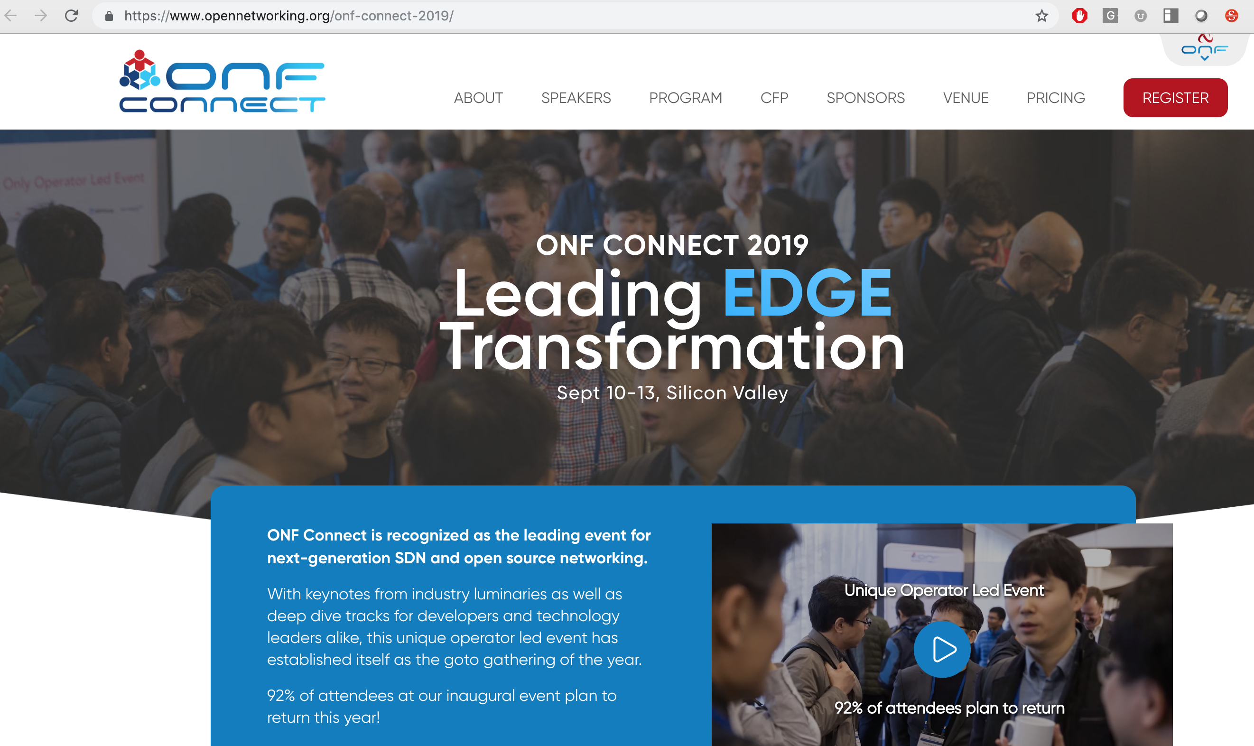
One more thing …

