Slide 2
OCP Adoption in Telco Ecosystem
Abdellah Tazi, Director, AT&T
Christopher Winslow, SVP, Flex Cloud Solutions
Saurav Das, VP of Engineering, ONF

Slide 3
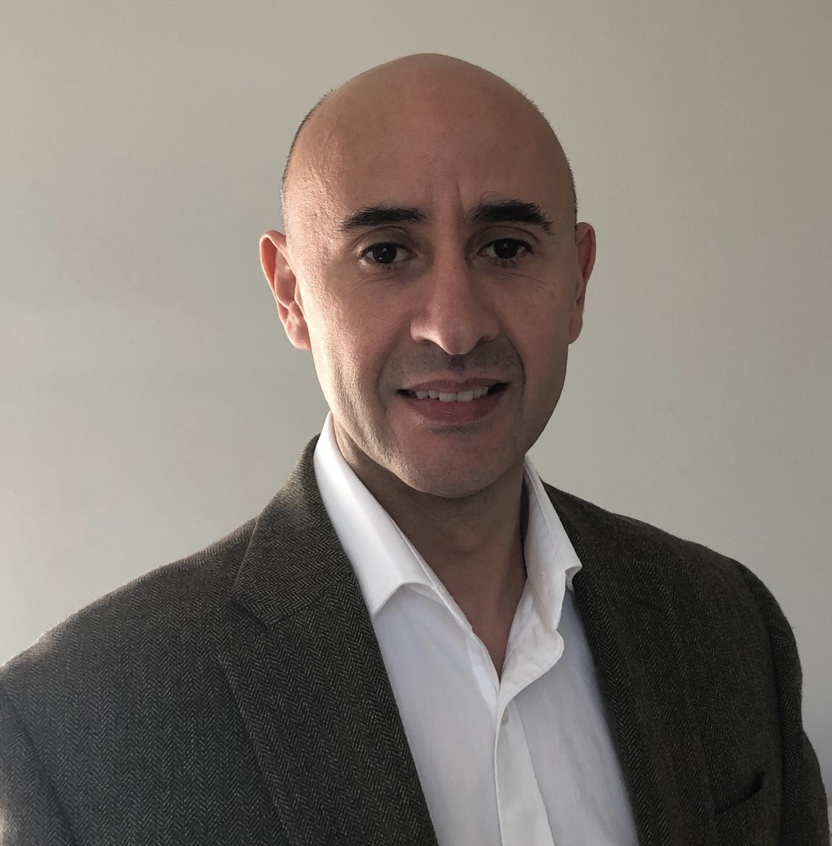


Abdellah Tazi
Director Member of Technical Staff,
Converged Access and Device Technology, AT&T

Slide 4
Open Access of Tomorrow
DISAGGREGATE
Software/Hardware
Control /Data Plane
Network Functions
OPEN
Open Hardware
Open Access Software
Open Interfaces/APIs
AUTOMATION
Zero Touch, SON, CI/CD
Analytics – AI, ML
Access Technology
xPON, G.fast, xHaul
Technology Standards
ITU-T, 3GPP, IEEE,
BBF, FSAN
Open Standards Community
AKRAINO, OCP, ONF, ORAN,
ONAP-Linux Foundation

Slide 5



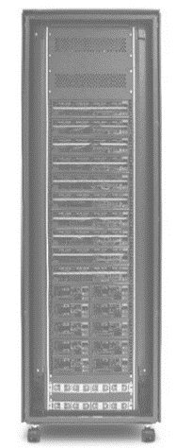



What’s Driving AT&T’s Whitebox Strategy?
Access Aggregation
Central Office/HUB
Regional DC
MTSO
Central DC
Core
LTE / 5G Macro
5G mmW
Micro
Fronthaul Wireline Access Transport
Midhaul/Backhaul
Backhaul
eCPRI
LTE / 5G mmW
Pico
CPRI and eCPRI
OCP White Box
xPON
CAS
Cell Site Gateway Router
Fiber Distribution Hub
G.Fast DPU
GPON OLT
XGS-PON OLT
Universal CPE
OCP Volume
Closer to Edge
NEW
$ CAPEX / OPEX

Slide 6
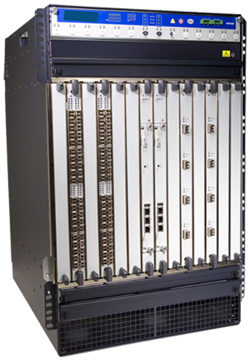


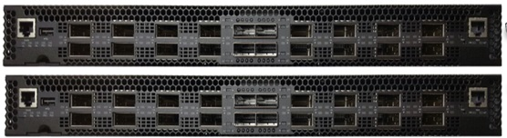




AT&T Transformation Journey
Software
Software
DISAGGREGATE
Closed Solution
Rigid Model

Slide 7




Open Solution - Broadband Service
Disaggregated PON OLT Solution
OCP based PON OLT, ToR, Compute
SEBA
Open Source Software - SEBA from ONF
Operators
ODM
Orchestration and Management
SI
Community Collaboration
JOIN THE COMMUNITY!

Slide 8


Saurav Das
Vice President of Engineering,
Open Networking Foundation

Slide 9







SEBA
ONAP
Op X OSS/BSS
SEBA POD
Abstract OLT
SDN
Enabled
Broadband
Access
Network Edge Mediator (NEM)
DockerK8s Helm
AAA
vlans
dhcp
mcast
bridging
routing
ACLs
SDN Controller - ONOS
VOLTHA
OLT
EdgeCore
7712
ONU
SWITCH
External BNG
SERVER
EdgeCore
ASFvOLT16
QuantaGrid
D51B-1U
Notes:
Thanks Abdellah and Hello everyone – as Abdellah mentioned At&T’s focus and the focus of a number of operators worldwide is in the last mile, and that is where SEBA comes in. SEBA stands for SDN enabled broadband access, and when we talk about broadband access, we mean FTTH networks also known as Passive Optical networks or PONs. And they come in different varieties GPON, which is gigabit XGS-PON , GE-PON and so on .. But the concept is the same – at the Telco central office there is an OLT – fiber distribution network – ONT – in our pods we use OCP accepted hardware – can be sa many as 16 of these

Slide 10















SEBA: Open. Together.
AT&T

Slide 11


White-Box XGS-PON OLT
VOLTHA
core
White-Box =
Open-Hardware Specs (OCP)
+ Open-Source Software (ONF & OCP)
OpenOLT
Adaptor
Edgecore
ASFvOLT16
Whitebox OLT
OpenOLT
Whitebox OLT
OpenOLT Driver
ONL
Chip Driver
ONIE
SDK(s)

Slide 12

White-Box ToR Switching
Fabric Control
White-Box =
Open-Hardware Specs (OCP)
+ Open-Source Software (ONF & OCP)
SDN Controller
Indigo OF Agent
BRCM OF-DPA
ONL
SDK
ONIE
BRCM ASIC
Edgecore
5712, 6712, 7712
OCP Bare Metal Switch

Slide 13

Trellis
Trellis
IPv4/v6 unicast/multicast, vlans, MPLS SR, vRouter …
Open-Source Leaf-Spine Fabric
ONOS
Spine
Spine
Field
Office
Leaf
Leaf
Spine
Spine
Metro/Core
Routers
Central Office
Internet
Leaf
Leaf
Leaf
Leaf
Base station
R-PHY
R-OLT

Slide 14




Trellis: Open. Together.

Slide 15
































The ONF Ecosystem
Vibrant Operator Led Consortium
160+ Members Strong
Operator Partners
www.opennetworking.org
CORD
Vendor Partners
SEBA Trellis
VOLTHA ONOS
XOS Stratum
OMEC COMAC
ODTN P4
Innovator Operators
70+
Innovator Vendors
70+
Collaborators

Slide 16

[Rack & Power]
Chris Winslow
Senior Vice President & General Manager,
Global Cloud & Data Center Business Unit, Flex

Slide 17





















Across the Entire Network
Edge Data Center and Central Office
Open Standard Mechanical Racks
Open19 Compute & Networking Modules
CRAN Optical Systems
Edge Router Modules
Cellular
Microwave & RF
4G/4.5G Radio Modules
PTP Backhaul Units
Cloud Data Center
Custom Compute Motherboards
Open Standard Mechanical Racks
OCP Storage Systems
Storage Appliances
Edge Compute
IoT Edge Computing Platforms
Automotive Network Switch Modules
Enterprise Data Center
Systems, Storage and Networking
SOHO

Slide 18


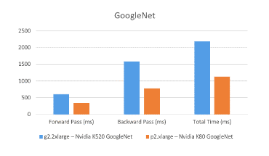

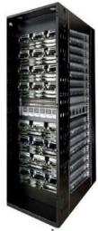



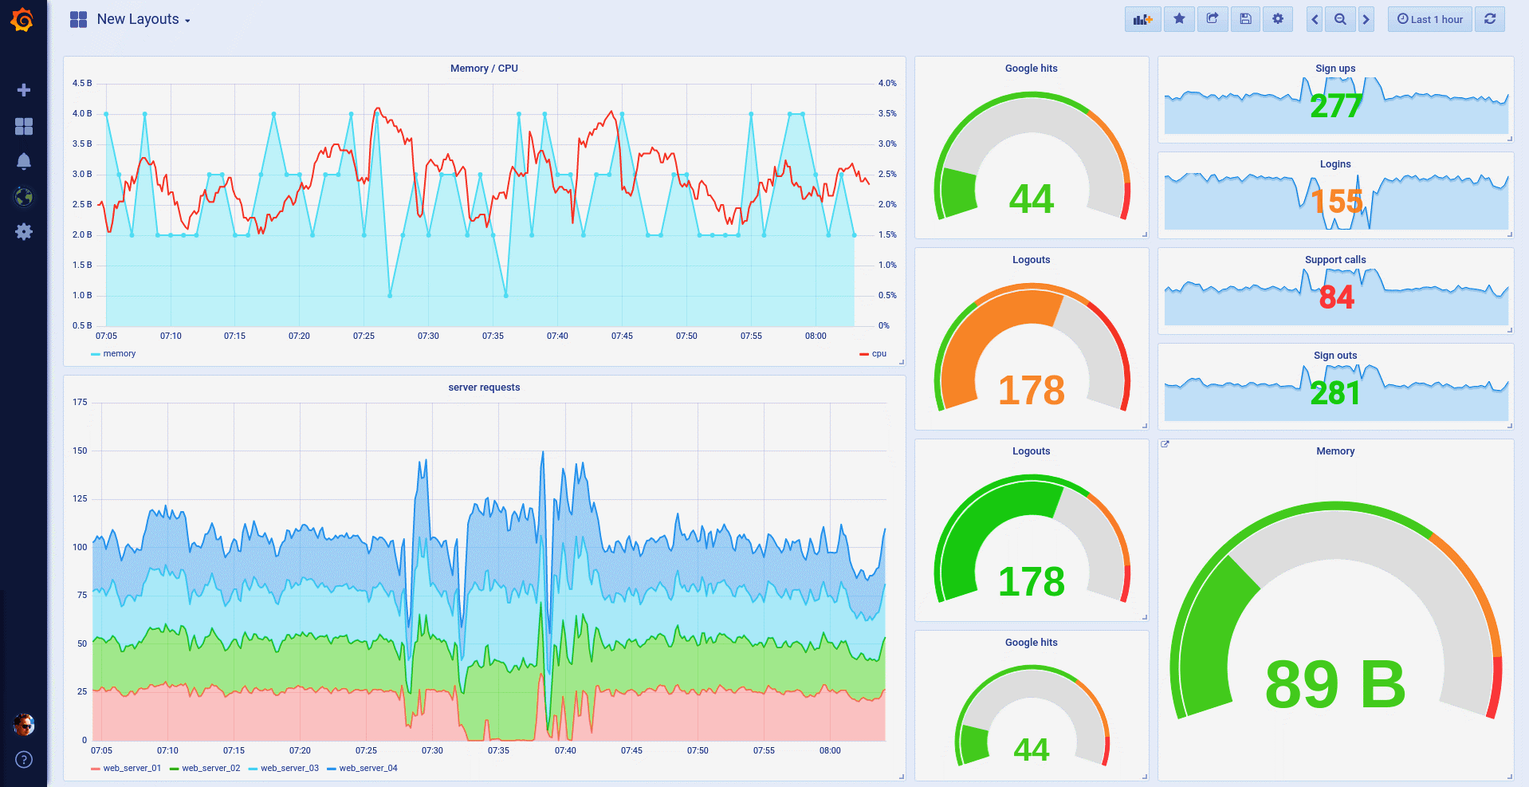
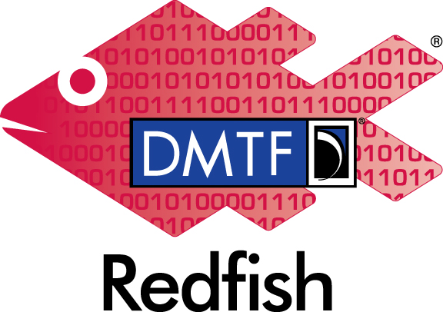

Open Ecosystem Initiatives
Build Open Hardware
Validate Open Software Platforms
Deliver Integrated Solutions
Participate in open hardware foundations by contributing designs and providing spec feedback.
Collaborate with software consortium partnerships to test SDDC solutions driven by customer requirements.
Combine HW / SW design experience with automated validation framework to deliver robust platform solutions.

Slide 19

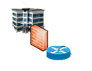

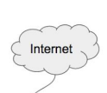
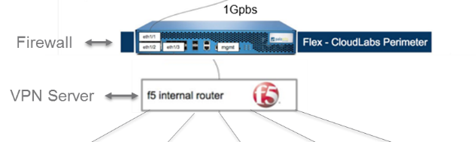

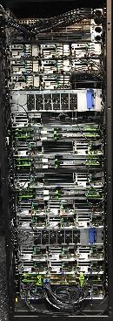

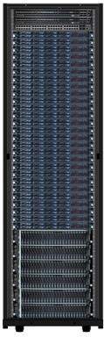
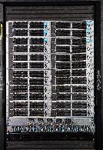
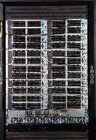

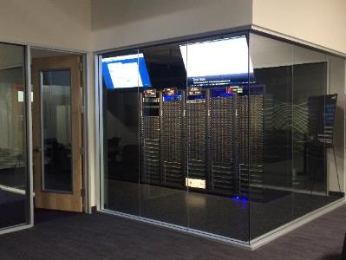


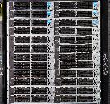
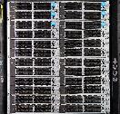
Open Standards Engagement Lab
Customers
Community
Integration Requirements
Partners
Users
Multiple technology Partners
Established worldwide supply chain
Sketch-to-Scale technology enablement
Distribution, service, repair, and reverse logistics
Validation Requirements
POD 4
POD5
AUTO
POD 1
POD 2
Stack Validation
Performance Testing
Latency reduction
No Vendor Lock-In
New applications
POD6
POD 3
POD
n
https://flexcloudlabs.com

Slide 20


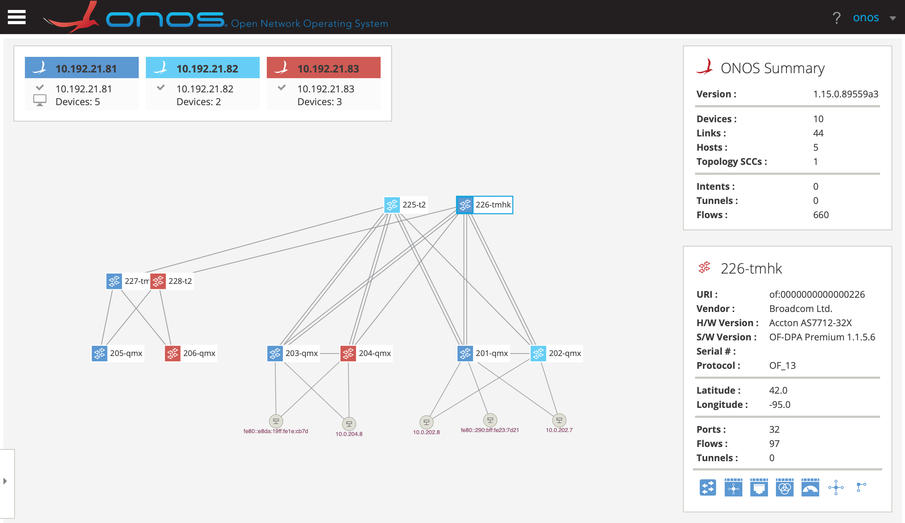
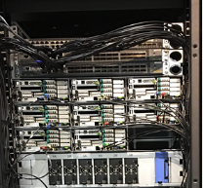
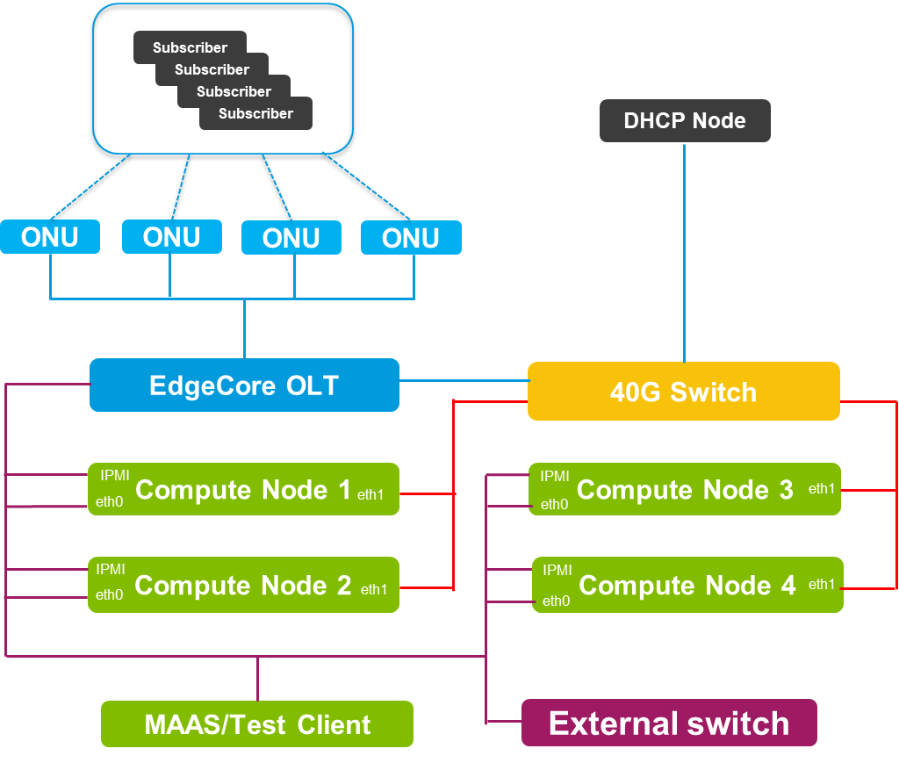
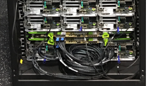
ONF Reference Designs Validation on OCP Platforms
Flex currently deploying multiple integrated stacks for telco use cases
Running on multi-vendor OCP hardware
Validating with partner tools & Flex FAST
Flex Engagement Lab
For more details:
Friday @ 2pm in 212 CD
Telco & openEdge Validation of SEBA CORD
            Siddharth Gogar
Trellis open SDN platform
CORD SEBA POD on OCP

Slide 21




Open.Together - Foster Open Ecosystem
Reference Design
Open Source Software
Operators
Suppliers
OPEN
TOGETHER
Suppliers
Operators
Management/Orchestration
Open Hardware

