Slide 1
SEBA & 5G Backhaul/Fronthaul
Saurav Das
VP Engineering, ONF
May 5th, 2019
OCP/ONF/LFN Workshop @ Big 5G Event
Denver, Colorado

Slide 2
Outline
Introduction to SEBA & CORD
SEBA Component: VOLTHA
SEBA Component: Trellis
SEBA & 5G

Slide 3





CORD – Central Office Rearchitected as a Datacenter
Residential
vOLT, vSG, vRouter, vCDN
Mobile
vBBU. vMME, vSGW, vPGW, vCDN
Enterprise
vCarrierEthernet, vOAM, vWanEx, vIDS
Access Service Orchestration & Control
White-box Switches with
Merchant Silicon
Cloud
SDN
NFV
BBUs
PON OLTs
COTS (Off-the-Shelf) x86 Compute
ROADM (Core)
Economies of a datacenter, Agility of a cloud provider

Slide 4







SEBA: Built on CORD
Mobile
Services
Enterprise
Services
Residential
Services
Mobile
Enterprise
Residential
NEM
Network Edge Mediator
OSS mediation & FCAPS support for operationalization
Leverages XOS project & toolchain
SEBA
Trellis
ONOS
ORAN
VOLTHA
Stratum
ODTN
Radio
Units
PON
OLTs
PON
OLTs
Shared Cloud Infrastructure
ROADM
(Core)

Slide 5






SEBA
ONAP
Op X OSS/BSS
SEBA POD
Abstract OLT
SDN
Enabled
Broadband
Access
Network Edge Mediator (NEM)
DockerK8s Helm
AAA
vlans
dhcp
mcast
bridging
routing
ACLs
SDN Controller - ONOS
VOLTHA
OLT
EdgeCore
7712
ONU
SWITCH
External BNG
SERVER
EdgeCore
ASFvOLT16
QuantaGrid
D51B-1U

Slide 6
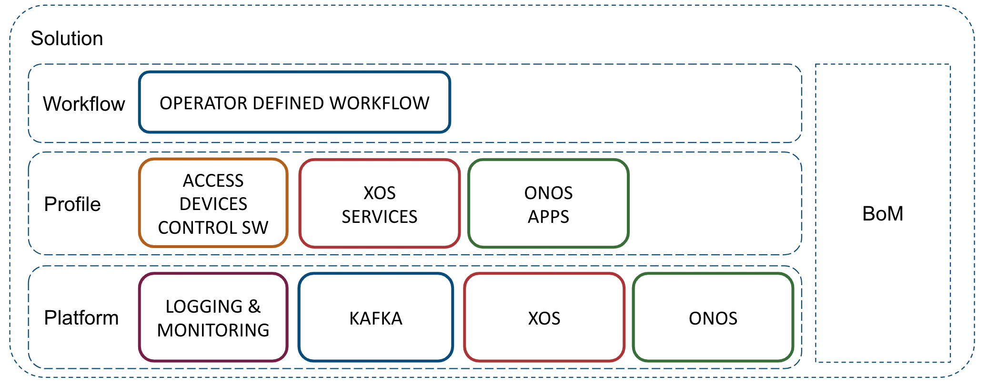
SEBA: Built on CORD

Slide 7















SEBA Community
AT&T

Slide 8
VOLTHA: Disaggregated OLTs

Slide 9


OLT Disaggregation → VOLTHA
VLANs
AAA
Mcast
…
ONOS: SDN Controller
EMS
OpenFlow
NetConf
VLANs, IGMP, 802.1x, Mcast …
Backplane
VOLTHA
SDNize
OpenFlow Agent
NetConf
PON MAC blades
OLT API
OMCI Stack
Compute blades
VOLTHA: Virtual OLT Hardware Abstraction
OLT
Traditional Chassis based Vendor OLT for PONs (Passive Optical Networks)

Slide 10


Industry’s First White-Box XGS-PON OLT
VOLTHA
core
White-Box =
Open-Hardware Specs (OCP)
+ Open-Source Software (ONF & OCP)
OpenOLT
Adaptor
Edgecore
ASFvOLT16
Whitebox OLT
OpenOLT
Whitebox OLT
OpenOLT Driver
ONL
Chip Driver
ONIE
SDK(s)

Slide 11
VOLTHA Operation
Bridging/Routing
VLANs
dhcp
mcast
ONOS
VOLTHA
Logical
switch
ONU
Switch
OLT
UNI
NNI
UNI

Slide 12
SEBA
ONAP
Op X OSS/BSS
SEBA POD
Abstract OLT
SDN
Enabled
Broadband
Access
Network Edge Mediator (NEM)
DockerK8s Helm
AAA
vlans
dhcp
mcast
bridging
routing
ACLs
SDN Controller - ONOS
VOLTHA
OLT
EdgeCore
7712
ONU
SWITCH
External BNG
SERVER
EdgeCore
ASFvOLT16
QuantaGrid
D51B-1U

Slide 13
Trellis: Multi-purpose leaf-spine fabric

Slide 14

Trellis
Trellis
IPv4/v6 unicast/multicast, vlans, MPLS SR, vRouter …
Open-Source Leaf-Spine Fabric
ONOS
Spine
Spine
Field
Office
Leaf
Leaf
Spine
Spine
Metro/Core
Routers
Central Office
Internet
Leaf
Leaf
Leaf
Leaf
Base station
R-PHY
R-OLT

Slide 15




Trellis Community

Slide 16

Whitebox ToR Switching
Fabric Control
White-Box =
Open-Hardware Specs (OCP)
+ Open-Source Software (ONF & OCP)
SDN Controller
Indigo OF Agent
BRCM OF-DPA
ONL
SDK
ONIE
BRCM ASIC
Edgecore
5712, 6712, 7712
OCP Bare Metal Switch

Slide 17
Fabric ASIC Pipeline* (BRCM’s OF-DPA)
* Simplified view
Why OF-DPA?
Multi-
cast Routing Table
Abstracts underlying ASIC
Enables programming of all
flow-tables & port-groups
L3 ECMP
Group
MPLS
Label
Group
Phy Port
Unicast
Routing
Table
MPLS
Label
Group
Phy Port
Ingress
Port Table
Vlan Table
Termin-ation MAC
Table
ACL
Policy
Table
L3
Mcast
Group
Phy Port
L2 Interface
Group
Phy Port
L2 Interface
Group
Phy Port
MPLS
Table
Vlan 1 Table
MPLSL2 Port
Table
L2 Flood
Group
L2 Interface
Group
Phy Port
Bridging
Table
L2 Interface
Group
Phy Port
Notes:
Talk about data plane scale

Slide 18
Trellis
& P4
Enhanced with P4 program deployment and pipeline configuration
Same set of Trellis applications on ONOS
Segment Routing
DHCP L3 Relay
vRouter
Multicast
SPGW-app
P4
ONOS Cluster
OF-DPA driver
fabric.p4 driver
Allowing new functionality on hardware (demo at MWC ‘18)
OpenFlow
NetConf
P4Runtime
gNMI
Brcm Qumran
Barefoot Tofino
P4
capable hardware
Brcm Tomahawk
Cavium Xpliant
Brcm Trident2
Mellanox

Slide 19
SEBA & 5G

Slide 20

SPGW-U in Trellis
3GPP CORE-CP
HSS
Demo @ MWC Barcelona 2018
MME
PCRF
Subscriber
Database
Option 1
Backhaul
SGW-C
PGW-C
SGW-U
PGW-U
3GPP eNB
3GPP CORE-UP
Aggregation
Trellis + P4

Slide 21
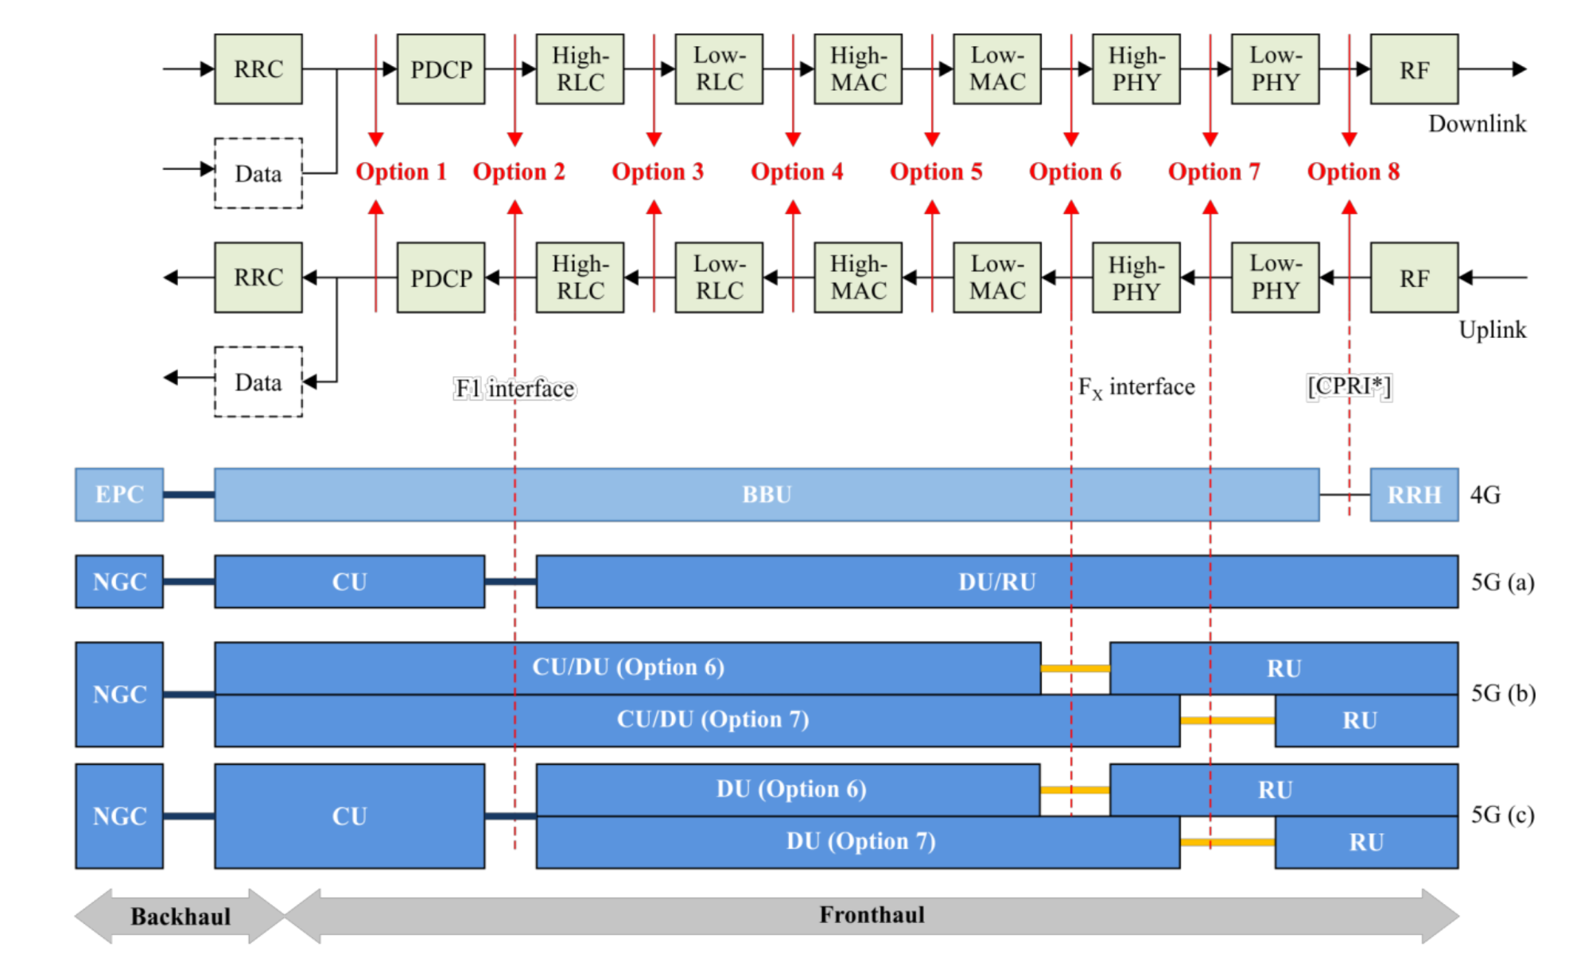
5G RAN Split Options
Source: ITU G66(18)_F6-2

Slide 22
Multi-Access CORD
OMEC
HSS
Demo @ MWC Barcelona 2019
MME
PCRF
Subscriber
Database
3GPP RAN RU
Option 2
F1 interface
SGW-C
PGW-C
3GPP RAN
DU
SGW-U
PGW-U
CU
Trellis
OLT
ONU
BNG

Slide 23
Fronthaul F1 over PON
OMEC
HSS
MME
PCRF
Subscriber
Database
3GPP RAN RU
Option 2
F1 interface
SGW-C
PGW-C
3GPP RAN
DU
SGW-U
PGW-U
CU
OLT
Trellis
ONU
BNG

Slide 24
5G RAN Split Options
Source: ITU G66(18)_F6-2

Slide 25
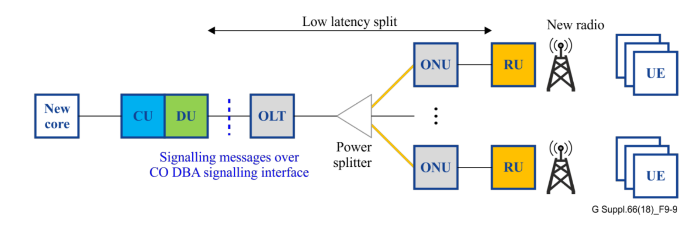
CO-DBA for Fronthaul Fx over PON
Source: ITU G66(18)_F6-2
Ongoing collaboration between ITU-T and O-RAN
Courtesy: Kent Mccammon, AT&T

Slide 26
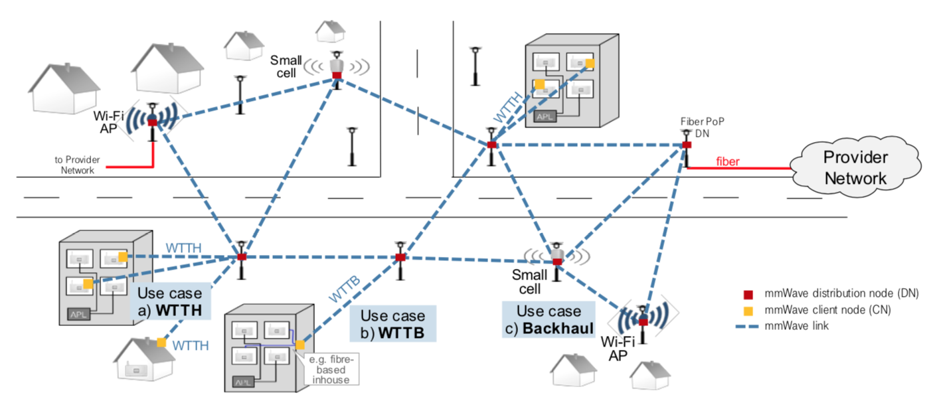
mmWave Backhaul
Courtesy: Frank Geilhardt, DT
Facebook Terragraph: 60GHz

Slide 27
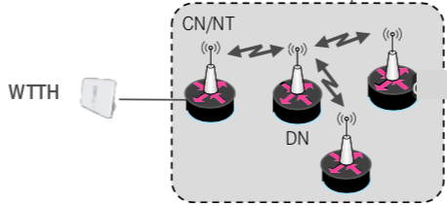
SEBA + Terragraph
ONAP
Op X OSS/BSS
SEBA POD
Abstract OLT
Network Edge Mediator (NEM)
DockerK8s Helm
AAA
vlans
dhcp
mcast
bridging
routing
ACLs
SDN Controller - ONOS
VOLTHA
ONU
OLT
SWITCH
External BNG
Terragraph
SERVER
TG Termination
under discussion

Slide 28
Summary
ONF: Operator driven curated open source
  CORD is the flagship umbrella project
  SEBA – SDN Enabled Broadband Access built on the CORD platform
Modular Components:
  VOLTHA abstracts the PON as a quasi-Ethernet switch to the SDN controller
  Trellis manages a multi-purpose leaf-spine fabric
SEBA & 5G
  MWC Barcelona 2018: SPGW in hardware using Trellis + P4
  MWC Barcelona 2019: SEBA + OMEC + 5G high-split RAN
  5G low-split RAN on PON discussed by ORAN and ITU-T – a few years away
  SEBA + Terragraph – mmWave backhaul – more near term

Slide 29
































The ONF Ecosystem
Vibrant Operator Led Consortium
160+ Members Strong
Operator Partners
www.opennetworking.org
CORD
Vendor Partners
SEBA Trellis
VOLTHA ONOS
XOS Stratum
OMEC COMAC
ODTN P4
Innovator Operators
70+
Innovator Vendors
70+
Collaborators

Slide 30
How to get involved
SEBA
  Community: https://wiki.opencord.org/display/cord/seba
  Release: https://guide.opencord.org/cord-6.1/
  BOM: https://guide.opencord.org/cord-6.1/prereqs/hardware.html
VOLTHA
  Community: https://wiki.opencord.org/display/cord/voltha
Trellis
  Community: https://wiki.opencord.org/display/CORD/Trellis%3A+CORD+Network+Infrastructure
OCP Telco/OpenEdge
  Wiki: https://www.opencompute.org/wiki/Telcos/openEDGE
  Mailing list: https://ocp-all.groups.io/g/OCP-Open-Edge

