Slide 1
Trellis 2.0
Saurav Das
Director of Engineering, ONF
December 5th, 2018

Slide 2
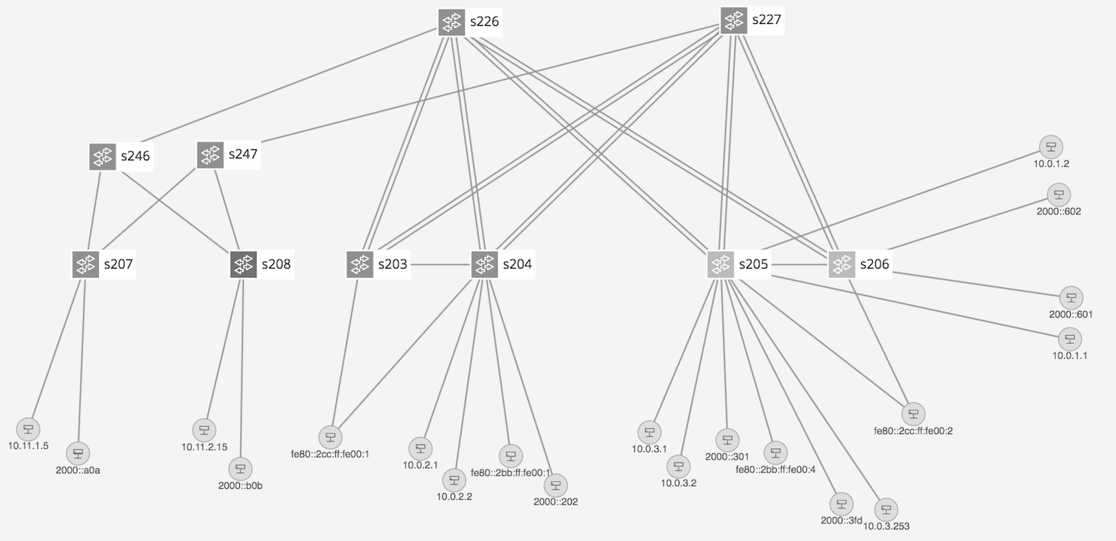
Trellis Overview
Multi-purpose leaf-spine
fabric designed for NFV
Bare-metal hardware
Open-source software
SDN-based (built on ONOS)
Spine
Spine
Paired
Leaves
Leaf
Access
Devices
Upstream
Routers
Dual homed hosts
Single homed hosts
Field Office (2nd stage)
Central Office (1st stage)
Appliances
Metro/Core

Slide 3
Trellis Evolution
bridging/routing
dhcp
relay
mcast
pseudowires
Flow objectives
ONOS cluster
ofdpa driver
sw X
driver
openflow
netconf
OF-DPA Based Switch
Switch X
Trident, Tomahawk, Qumran ASICs

Slide 4
Trellis Evolution
bridging/routing
dhcp
relay
mcast
pseudowires
bridging/routing
dhcp
relay
mcast
pseudowires
Flow objectives
ONOS cluster
ONOS 2.0/NG cluster
ofdpa driver
p4
driver
openflow
p4RT
p4RT
p4RT
netconf
GNMI
GNMI
GNMI
local agents
OF-DPA Based Switch
P4 Based Switch
Stratum
Based Switch
Stratum Based Switch
Trident, Tomahawk, Qumran ASICs
Tofino, Xpliant ASICs
Trident, Tomahawk, Qumran ASICs
Tofino, Xpliant ASICs

