Slide 1
SEBA, VOLTHA & Residential CORD
Saurav Das
Director of Engineering, ONF
October 29, 2018

Slide 2





CORD: Central Office Re-Architected as a Datacenter
Residential
vOLT, vSG, vRouter, vCDN
Mobile
vBBU. vMME, vSGW, vPGW, vCDN
Enterprise
vCarrierEthernet, vOAM, vWanEx, vIDS
Access Service Orchestration & Control
White-box Switches with
Merchant Silicon
Cloud
SDN
NFV
BBUs
PON OLTs
COTS (Off-the-Shelf) x86 Compute
ROADM (Core)
Economies of a datacenter, Agility of a cloud provider

Slide 3
Outline
CORD platform changes
R-CORD & VOLTHA changes
So what is SEBA?
SEBA development & roadmap

Slide 4
CORD platform changes

Slide 5
CORD platform & build-process (before mid-2018)
1
Install OS, Virt
profile
2
Head node
ONOS
VOLTHA
Head
Node
3
Switch/Access s/w
XOS
OpenStack
vSG
vSG
4
Connectivity
OS
OS
OS
OvS
OvS
OvS
5
Configuration
Bare metal
Bare metal
Bare metal
6
User workflow
Management network
Access
Node
Upstream
Leaf
Leaf
OS
OS
OS
Dataplane network
Spine
Spine
OS
OS

Slide 6
Issues with the previous CORD platform & build
No distiniction between development vs deployment
  Most of the software built from source at “deploy time”
  Big scripts, scripts calling scripts, long process
  Monolithic: If something breaks, wipe and start from scratch
  Brittle: Small variations of hardware/connectivity could break build
Not flexible or modular
  Required specific versions of server OS
  Tightly coupled components – cannot exclude or replace components
  Required internet access for install
Hard to use
  Choose a profile at start; to change profiles reinstall
  No means for adding services at runtime
Notes:
As always, it’s important to translate the input coming from partners’ deployments into requirements, to make the platform better. I’d like to go through some fundamental challenges met with the previous platform, that gave the community some rationale to create the new one.
BULLET EXPLAINATION
* CORD wasn’t really able to distinguish between a deployment and a development workflow. Most of the time software was built as well during the deployment phases, which is unexpected and time consuming
* CORD was spawning VMs during the deployment phase, such requiring either physical machines or VMs
* CORD had to be installed on Ubuntu 16.04
* Offline installation was not officially supported, and anyway quite difficult -> problem for most of the SPs
* CORD installation was monolithic. It was installing OS, configure OS, install components (i.e. ONOS, OpenStack, XOS) and profiles, together in one step
As a user, you had to decide what “flavor” (use-case) of CORD to install, at the very beginning of the installation. Want to install R-CORD? Choose it at the beginning. Changed your mind and want to install M-CORD? You’ve to reinstall the entire platform
Over time, users (including developers and QA) asked to be able to run CORD in different environments. For example, on single machines for development vs full clusters for trials and production. The two workflows have diverged quite a lot over time and were considerably different from one each other
Many components were tightly coupled, at the point that it was very difficult to exclude them from the system. Classical example: many SPs use their own infra tools (DNS, system configurator like Puppet). CORD providing these services as well, and this was most of the time an issue
Having scripts to automate processes is important, but it’s also important to find the right balance between automation and make difficult for users what’s under the hood
CORD is an integration of effort, using many components. It has been traditionally released as a whole, even if these components have been historically released by different groups. Often it has been a problem to advance features separately

Slide 7
New CORD 6.0 platform (July-2018)
CORD control software → set of Docker containers deployed on Kubernetes using standard tools like Helm charts
ONOS
VOLTHA
OpenStack
XOS
profile
Kubernetes
OS
OS
OS
Bare metal
Bare metal
Bare metal
Management network
Access
Node
Upstream
Leaf
Leaf
OS
OS
OS
Dataplane network
Spine
Spine
OS
OS
Notes:
No distinction between head-node and compute node
Offline install – local docker registry
Modularity - install what you need – choose helm chart, your own fabric, your own DNS
1 switch/ 1 server – expand as you wish

Slide 8
R-CORD & VOLTHA changes

Slide 9
Traditional Residential Access
Residence
Central Office
Backbone
Network
RG
ONU
OLT
ETH AGG
BNG
RG – Residential Gateway
OLT – Optical Line Termination
BNG – Broadband Network Gateway

Slide 10
Residential CORD – Disaggregated Services
vSGs per sub provide
VLAN termination,
QoS
DHCP, NAT
Virtual OLT
manages and abstracts PON
Residence
Central Office
vSG
vSG
vSG
AAA
VOLTHA
Backbone
Network
RG
ONU
OLT
ETH AGG
BNG
OLT MAC
Leaf-Spine Fabric
Fabric provides
Eth aggregation
Routing
+ the ability to introduce other edge-compute services per subscriber

Slide 11
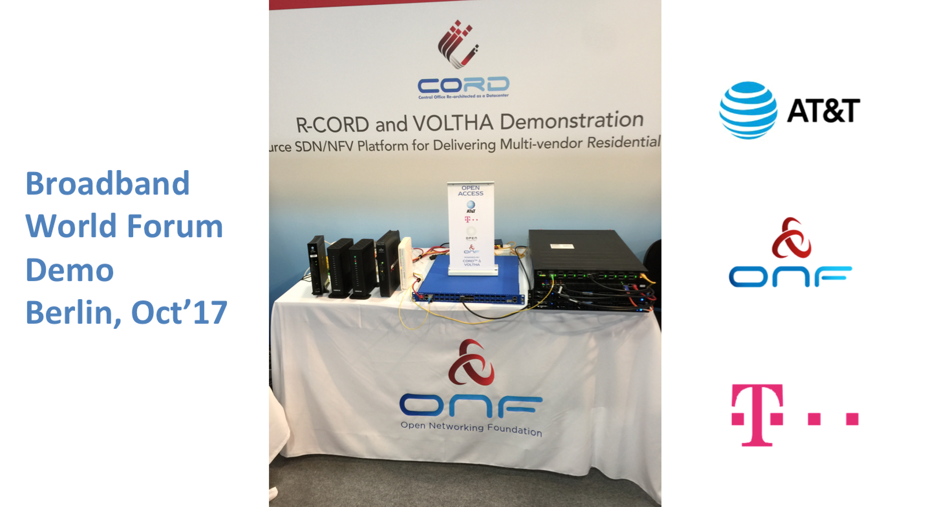

Slide 12



R-CORD & VOLTHA Demo BBWF 2017
CORD Head Node
…
MAAS
ONOS
XOS
VOLTHA
CORD Compute Node
OvS
vSG
Internet
Whitebox ToR Fabric Switch
EdgeCore 7712 (Tomahawk 32 x 100G)
Residential Subscribers
EdgeCore Whitebox OLT (ASFvOLT16)
BCM
ONU
RG
Central Office
Nokia SD-OLT
(LightSpan CF-24W)
Nokia
ONU
RG

Slide 13


OLT Disaggregation → VOLTHA
VLANs
AAA
Mcast
…
ONOS
VLANs, IGMP, 802.1x, Mcast …
Backplane
OpenFlow
NetConf
PON MAC blades
vOLT Agent
OpenFlow Agent
NetConf
Compute blades
OLT API
OMCI Stack
GPON OLT
GPON OLT MAC (Celestica)

Slide 14
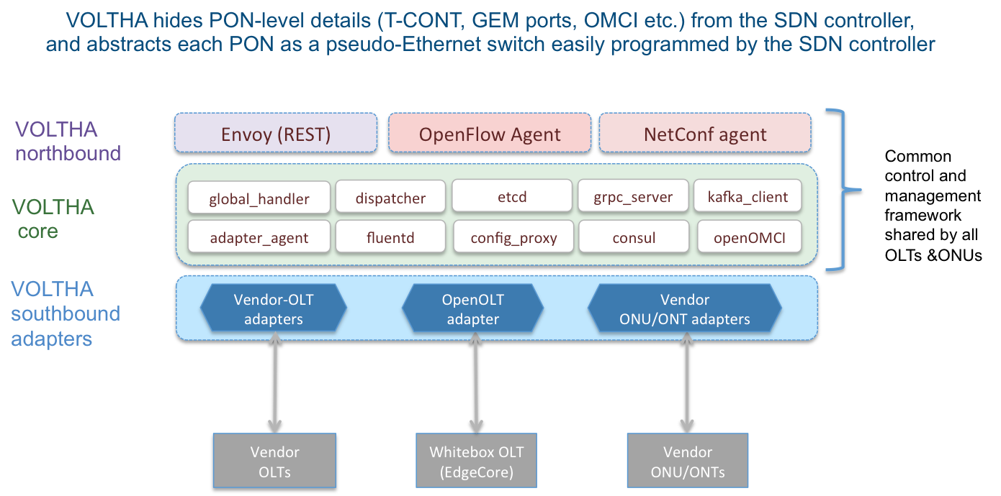
VOLTHA Overview

Slide 15
preprovision_olt -t asfvolt16_olt -H <olt_mgmt_ip>:59991
enable 0001f6f4595fdc93
channel_group create -n "Manhattan" -d "Channel Group for Manhattan" -a up -p 100 -s 000000 -r raman_none
channel_partition create -n "WTC" -d "Channel Partition for World Trade Center in Manhattan" -a up -r 20 -o 0 -f false -m false -u serial_number -c "Manhattan"
channel_pair create -n "PON port" -d "Channel Pair for Freedom Tower in WTC" -a up -r down_10_up_10 -t channelpair -g "Manhattan" -p "WTC" -i 0 -o class_a
ONOS
traffic_descriptor_profile create -n "TDP 1" -f 100000 -a 500000 -m 1000000 -p 1 -w 1 -e additional_bw_eligibility_indicator_none
VOLTHA
Logical
device
channel_termination create -i 0001bb590711de28 -n "PON port" -d "Channel Termination for Freedom Tower" -a up -r "PON port" -c "AT&T WTC OLT"
# Wait for 5 sec for PON interface up
vont_ani create -n "ATT Golden User" -d "ATT Golden User in Freedom Tower" -a up -p "WTC" -s "BRCM12345678" -r "PON port" -o 1
# Wait for 5 Sec for ONT to come up
ont_ani create -n "ATT Golden User" -d "ATT Golden User in Freedom Tower" -a up -u true -m false
ONU
OLT
UNI
NNI
tcont create -n "TCont 1" -r "ATT Golden User" -t "TDP 1”
#Wait for 5 sec for scheduler configuration to finish.
v_enet create -n "Enet UNI 1" -d "Ethernet port - 1" -a up -r "ATT Golden User"
gem_port create -n "Gemport 1" -r "Enet UNI 1" -c 2 -a true -t "TCont 1"
UNI

Slide 16
May 2017
Sept 2017
March 2018
VOLTHA
core
VOLTHA
core
VOLTHA
core
Maple Adaptor
EdgeCore Adaptor
OpenOLT
Adaptor
Twisted RPC
VM-in-the-middle
GRPC
(BRCM-BAL based protobufs)
GRPC
(generic
protobufs)
Closed/Proprietary
EdgeCore OLT
EdgeCore OLT
Whitebox OLT
(including EdgeCore)

Slide 17
Why OpenOLT Adaptor?
March 2018
VOLTHA
core
Generic OLT adaptor - ease of onboarding for new white-box vendors
OpenOLT Adaptor
Py GRPC client
VOLTHA CORE
OpenOLT
OpenOMCI ONU
GRPC
(generic
protobufs)
Alpha ONU
Iskratel ONU
Arcadyan ONU
CIG ONU
CIG
OLT
EdgeCore OLT
Iskratel
OLT
Tellabs ONU
Whitebox OLT
(including EdgeCore)
C++ GRPC srv
Chip Driver
Tellabs
OLT
SDK(s)

Slide 18
Subscriber Traffic through vSG (virt. Service Gateway)
CORD Head Node
VOLTHA
…
Radius
ONOS
XOS
CORD Compute Node
CDN
Video
Source
OvS
vSG
Internet
Whitebox ToR Fabric Switch
EdgeCore 7712 (Tomahawk 32 x 100G)
Residential Subscribers
EdgeCore Whitebox OLT (ASFvOLT16)
BCM
ONU
RG
Central Office
Nokia SD-OLT
(LightSpan CF-24W)
Nokia
ONU
RG

Slide 19
So what is SEBA?

Slide 20
SEBA Exemplar
ONAP
Legacy OSS
Built on the new CORD platform
OSAM-Central
OSAM-Local
EMS/NMS-adaptor
SEBA POD
Providing FCAPS
& Inventory
Network Edge Mediator (NEM)
All control software deployed as containers on compute nodes using Kubernetes
vOLT
dhcp
mcast
SR
FPM
T3
ONOS Cluster
REST
Kafka
OF
OF
Redfish
Redfish
VOLTHA
TP
TP
TP
ONU
UNI
AGG Switch
Subscriber traffic
‘fast-path’ to Internet
OLT
NNI
AGG Switch
Compute

Slide 21
NEM Monitoring
Infrastructure
GRAFANA
KIBANA
XOS
PROMETHEUS
ELK STACK
NEM
Operator OSS
KAFKA
Alarms, events & stats
ONOS
Logs
VOLTHA
TP
TP
TP
ONU
BNG
RG
UNI
OLT
AGG
NNI
Compute

Slide 22
NEM Workflows
SEBA POD
Providing FCAPS
& Inventory
Network Edge Mediator (NEM)
BNG is a workload option
External physical BNG
vBNG in compute
BNG in Agg switches
BNG in OLT boxes
All control software deployed as containers on compute nodes using Kubernetes
vOLT
dhcp
mcast
SR
FPM
T3
ONOS Cluster
OF
OF
Redfish
Redfish
VOLTHA
TP
TP
TP
ONU
UNI
AGG Switch
Subscriber traffic
‘fast-path’ to Internet
OLT
NNI
AGG Switch
Compute

Slide 23
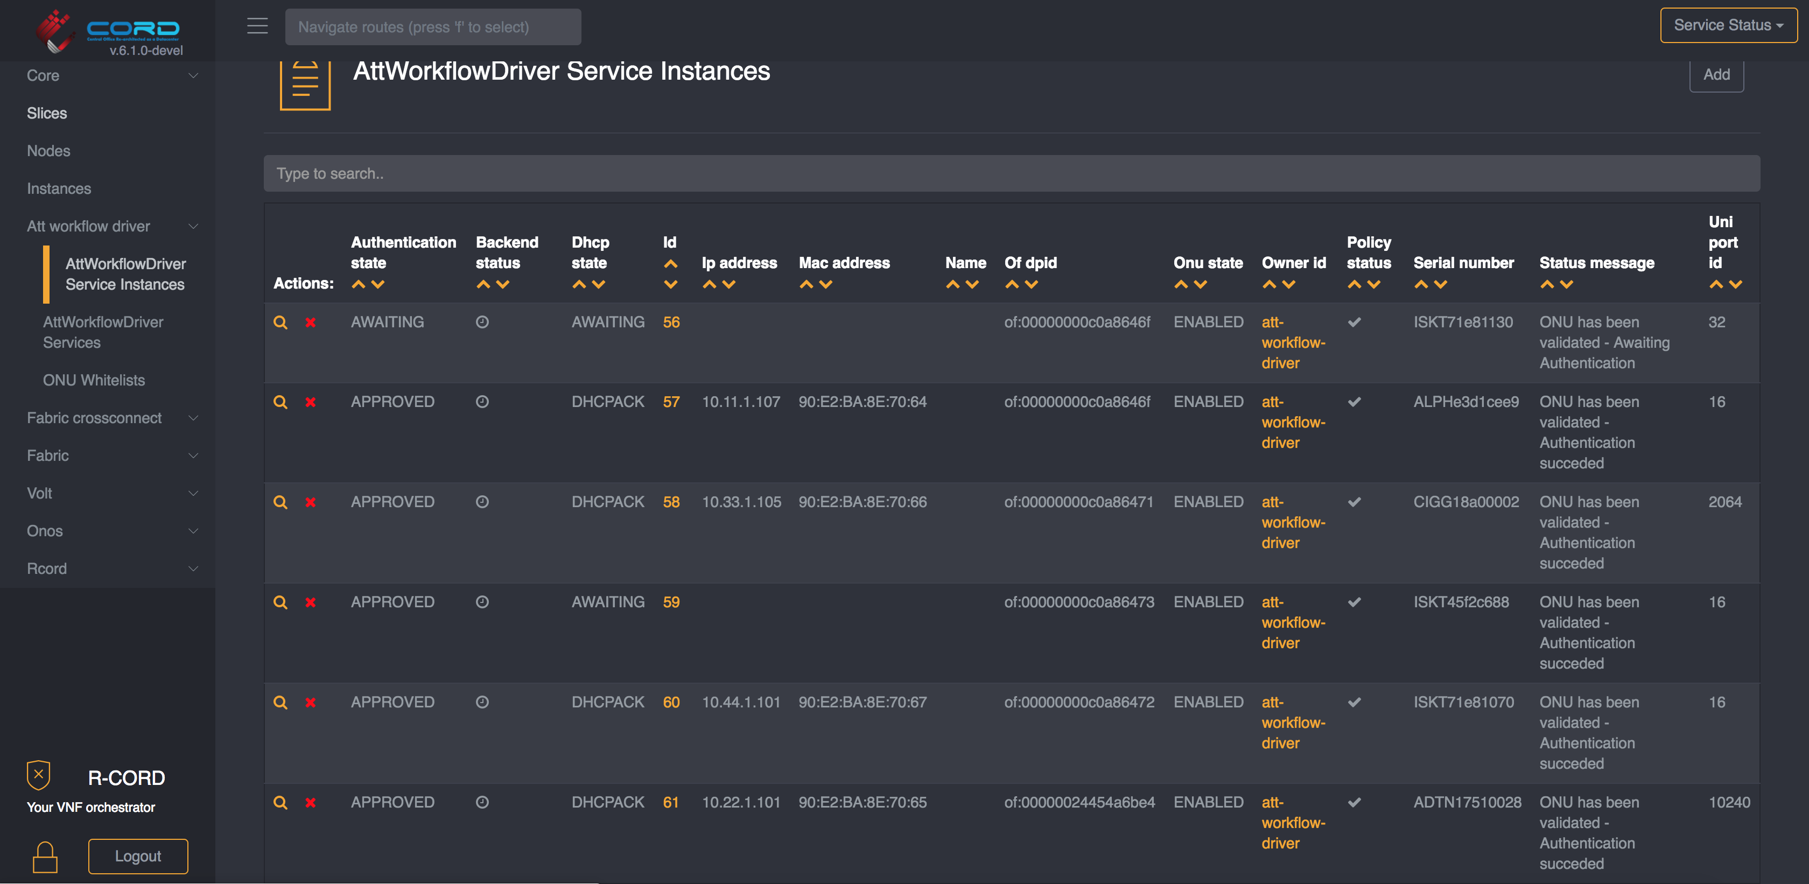
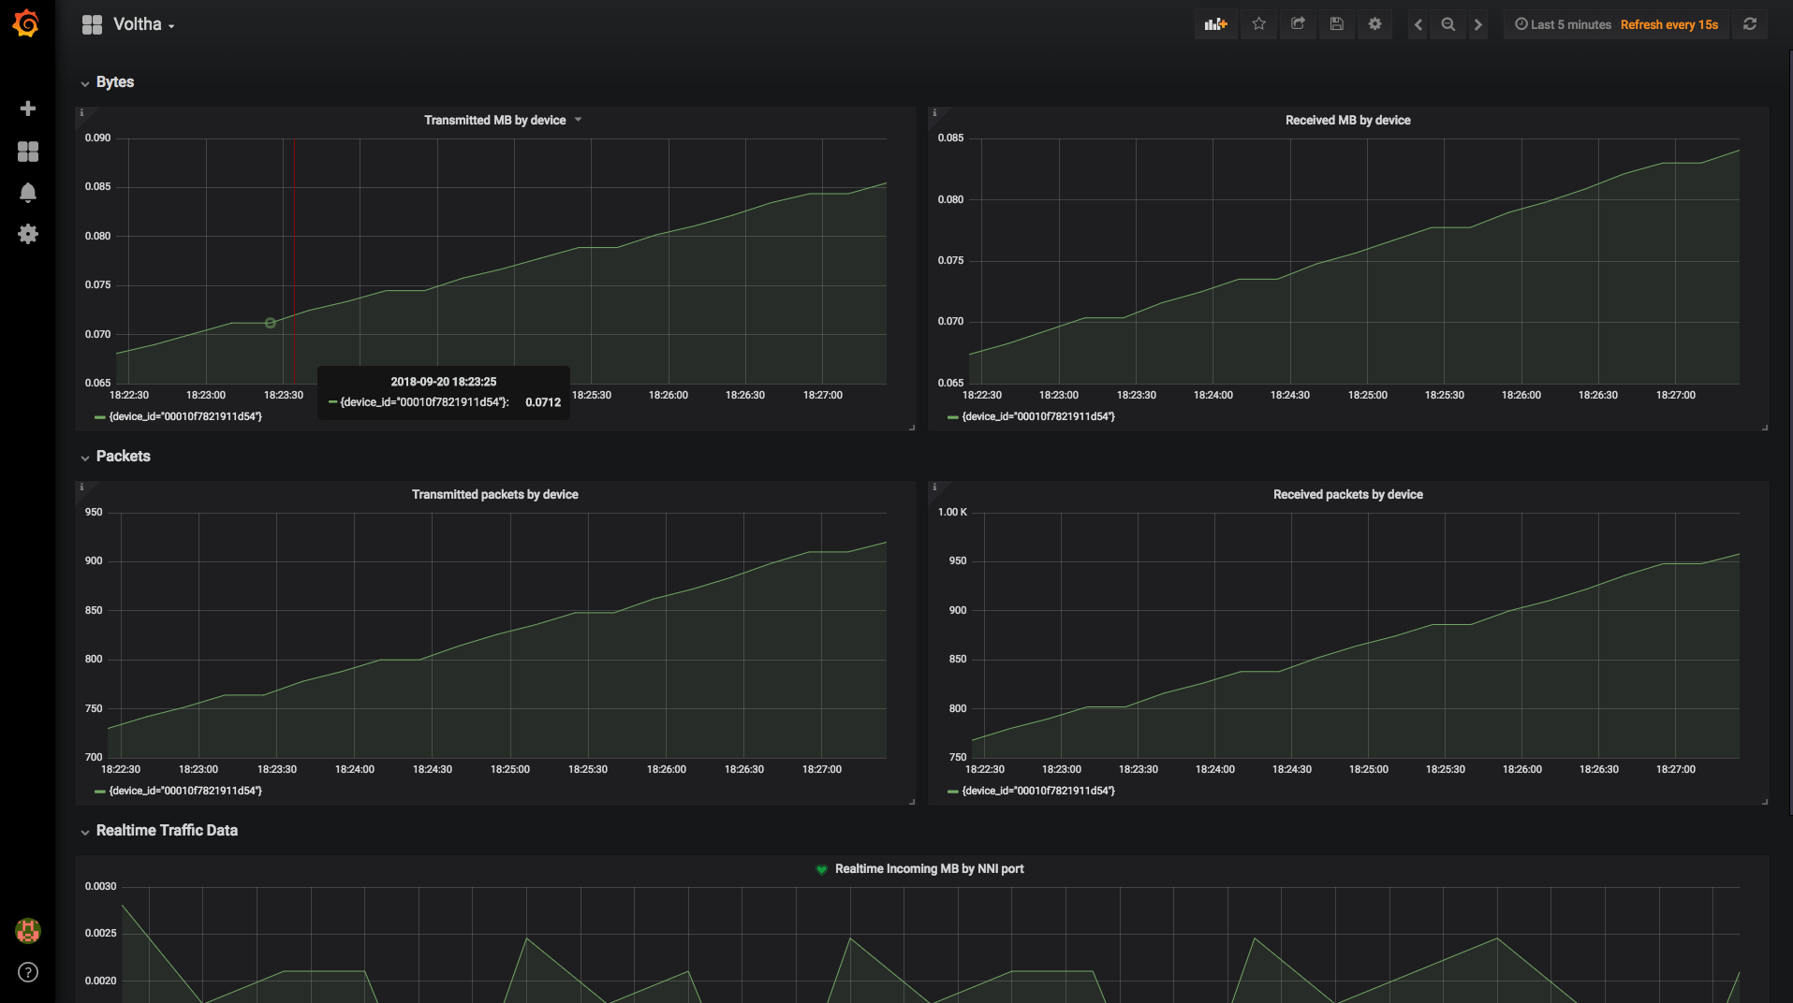
Demo setup BBWF 2018
ONF Booth (Hall 22a, Booth B116)
NEM User Interface
NEM Monitoring Dashboard

Slide 24
Demo setup BBWF 2018
SEBA Peripheral/PNF/Pod
Radius Server
Network Edge
Mediator (NEM)
Elasticsearch
Grafana/Kibana
Kafka
XOS GUI
Chameleon
Tosca
Logstash
Prometheus
Exporter
XOS Core
Synchronizers
Database
Configuration
vOLT
dhcp
aaa
sadis
kafka-i
SR
ONOS
Software Stack
VOLTHA
BBSim
ONU
DHCP Server (subscriber RG addressing)
Alpha
RG
Iskratel
EdgeCore OLT
RG
BNG
Arcadyan
RG
Adtran OLT
Hardware
Adtran
Public Internet
RG
EdgeCore AGG Switch
CIG
CIG OLT
RG
Iskratel
Iskratel OLT (X)
RG
Iskratel
Compute
Nodes
RG
Iskratel OLT (G)

Slide 25
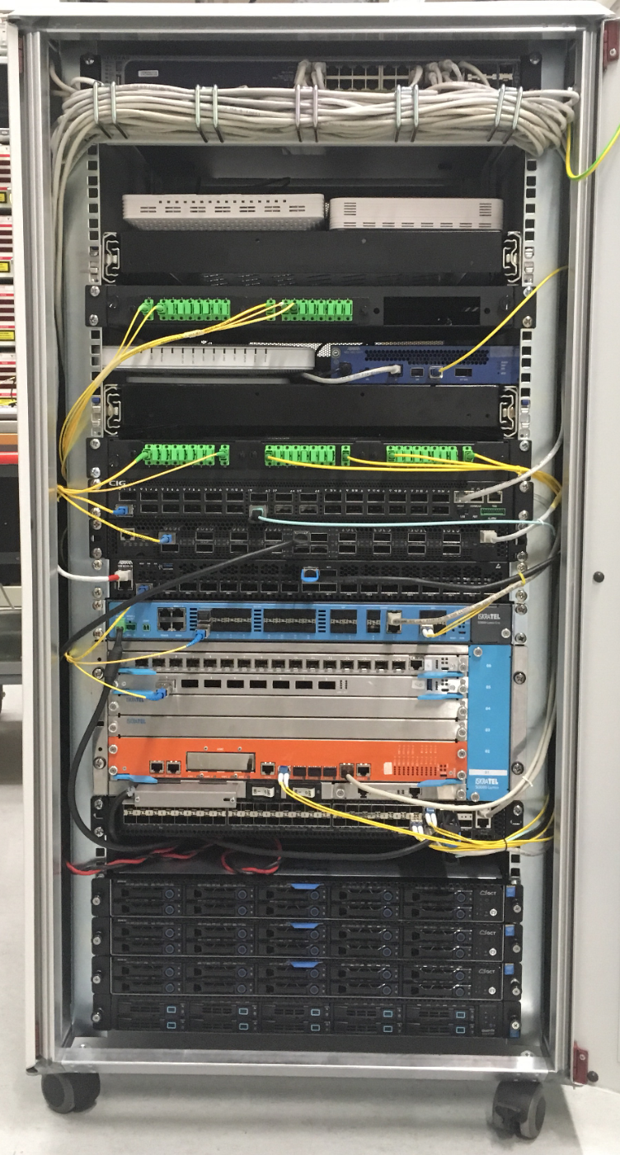
Demo setup BBWF 2018
ONF Booth (Hall 22a, Booth B116)
ONUs: Arcadyan, Alpha, Adtran, CIG, Iskratel
OLTs: Adtran, CIG,
EdgeCore & Iskratel
AGG switch: EdgeCore
Servers: VOLTHA, ONOS, XOS, K8s, ELK, Docker, Prometheus, Grafana, Kibana

Slide 26
SEBA Development & Roadmap

Slide 27















Distributed DevOps - SEBA
Simulator
OLT
Software (BAL)
OpenOMCI
SEBA System
End-to-End
OLT, Switch
Hardware
Redfish APIs
OLT & ONU
VOLTHA 2.0
Technology Profiles
AT&T
VOLTHA 2.0
Test automation
Certification

Slide 28
SEBA Distributed DevOps – ONF Responsibilities
Joint Development
with AT&T Foundry
Support
VOLTHA/SEBA Community
Deliver
New
Features
SEBA/VOLTHA Stability & Scale
Tooling
QA
Weekly SEBA public meetings
JIRA issues – kanban methodology
Mailing lists, Slack community support
VOLTHA meetings, TST, architectural guidance
ONF team resposible for all ONOS and NEM feature development
FCAPS features – kpis, alarms & logs in SEBA monitoring infrastructure
AT&T workflow development
Integrate with new ONU and OLT vendors
AGG switch features
Focus on stability of VOLTHA – robustness and repeatability
Investigate scalability and performance of full SEBA system
BBSim – Guide NTT in the development of PON simulator
SEBA-in-a-BOX: Complete end to end emulation of SEBA system with ponsim & mininet
Developing automated feature tests
Extending framework for hardware based end-to-end tests
Work with community to develop test automation and certification procedures
Daily scrum
Bugs - issue analysis; root-cause;
Design discussions for new features
Documentation
Recommend best-practices/training

Slide 29
SEBA Deployment Goal @ AT&T
SEBA POD
Up to 64 ONUs per PON port
Internal GE Management Switch
DHCP Server (subscriber RG addressing)
ONU+RG
Up to 16 PON ports / OLT device
ONU+RG
EdgeCore OLT
DHCP Server (POD addressing)
EdgeCore OLT
ONU+RG
EdgeCore OLT
AGG Switch
(Tomahawk
32 x 100G)
AT&T
External BNG
Radius Server
Up to 16
OLT devices
External OSS
Compute Node
VOLTHA, ONOS, NEM, Kubernetes, Docker registry,
Gateway VM
Abstract OLT
EdgeCore OLT
Compute Node
Public Internet
Compute Node

Slide 30
Roadmap
BNG Disaggregation
Using P4 in Aggregation switch
Implementing more operator workflows
Performance & scale improvements for Trials
Redundancy
Integrating VOLTHA 2.0 & Technology profiles
ISSU
Integrating M-CORD profile to use SEBA as mobile backhaul

Slide 31
Summary
CORD Platform changes in last 6 months
  Move to Docker containers, Kubernetes & Helm charts
  Greatly easier to build/install
  Significant improvement in modularity & flexibility
VOLTHA & R-CORD changes in last 6 months
  VOLTHA bottom-up discovery operation more ‘SDN’
  OpenOLT and OpenOMCI-ONU adaptors lowering the bar for vendors
  Use of fast-path through hardware for subscribers (no vSG)
SEBA: SDN Enabled Broadband Access
  Built on the new CORD platform, and includes all of the above
  Significant focus on FCAPS infrastructure
  Multiple operator workflows
  Headed to trials at AT&T

Slide 32
Backup

Slide 33
Voltha Core 2.0 – 4 µservices
OFAgent
REST
CLI
Netconf
NorthBound Affinity Routing Proxy
Handles:
  Read
  List
Handles device-specific operations:
Create/Update/delete only
Packet-out operations (OF)
Packet-in operations (OF)
Device lifecycle management (discovery -> deletion)
Manages technology specific details (e.g xPON):
Provisioning profiles
Specialized flow decomposition
Handles cluster specific operations:
event filter
backup & restore
etc.
View Only µservice
Device Handler µservice
Technology Profiles µservice
Cluster Management µservice
Kafka
Etcd
Etcd
SouthBound Affinity Routing Proxies
Adapter X
Adapter Y
Adapter Sim
Adapter Test

Slide 34
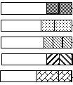
Abstraction: PON as a Quasi-Ethernet Switch
Match
Action
Meter
Queues
Scheduler
NNI
Ports
UNI
Ports
In-port
pbits
Push vlans
Apply meter
Assign queue
Outport
UNI
Ports
Match
Action
Meter
Table
NNI
Ports
Pbit mapping
Queuing policy (GEM)
TCONTs (BW)
GEMs per TCONT
Scheduler policy
In-port
Push vlans
Apply meter
GOTO table
Outport
Technology Profiles

