Slide 1
SEBA: SDN Enabled Broadband Access
Saurav Das
Director of Engineering, ONF
October 25, 2018

Slide 2

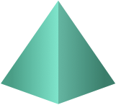




























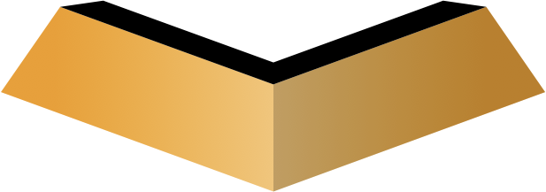


The ONF Ecosystem – 160+ Members Strong
Vibrant Operator Led Consortium Positioned for Success
ONF BOARD
CHAIR:
Andre Feutsch - CTO
Operator Partners
Jochen Appel - VP
Amin Vahdat - Fellow
Vendor Partners
Dai Kashiwa - Director
Rob Howald - VP
Innovator Operators
Shao Guanglu - SVP
Patric Lopez - VP
70+
Innovator Vendors
Firat Yaman Er - CSO
70+
Nick McKeown - Prof
Collaborators
Guru Parulkar, Exec Dir
Notes:
The other most important thing about ONF is that we are an operator led organization.
We are by the operator and for the operator.
Our board members are leaders from leading network operators.
We appreciate Turk Telekom as a partner.
We also include 15 other network operators as members and here we appreciate Turk Cell as our member.
We do have supply-chain partners and a very strong ecosystem.

Slide 3





CORD: Central Office Re-Architected as a Datacenter
Residential
vOLT, vSG, vRouter, vCDN
Mobile
vBBU. vMME, vSGW, vPGW, vCDN
Enterprise
vCarrierEthernet, vOAM, vWanEx, vIDS
Access Service Orchestration & Control
White-box Switches with
Merchant Silicon
Cloud
SDN
NFV
BBUs
PON OLTs
COTS (Off-the-Shelf) x86 Compute
ROADM (Core)
Economies of a datacenter, Agility of a cloud provider

Slide 4







SEBA Exemplar (built on CORD platform)
Mobile
Services
Enterprise
Services
Residential
Services
Mobile
Enterprise
Residential
NEM
Network Edge Mediator
OSS mediation & FCAPS support for operationalization
Leverages XOS project & toolchain
SEBA
Trellis
ONOS
ORAN
VOLTHA
Stratum
ODTN
Radio
Units
PON
OLTs
PON
OLTs
Shared Cloud Infrastructure
ROADM
(Core)

Slide 5
Outline
VOLTHA – Disaggregated Residential Access
Trellis – Multi-purpose Leaf-Spine Fabric
CORD platform – service delivery at the edge
SEBA Exemplar Implementation
SEBA development & roadmap

Slide 6
VOLTHA: Disaggregated Residential Access

Slide 7
Traditional Residential Access
Residence
Central Office
Backbone
Network
RG
ONU
OLT
ETH AGG
BNG
RG – Residential Gateway
OLT – Optical Line Termination
BNG – Broadband Network Gateway

Slide 8
Disaggregated Residential Access
vBNG
VLAN termination,
Hierarchical QoS
DHCP
Virtual OLT
manages and abstracts PON
Residence
Central Office
vBNG
AAA
VOLTHA
Backbone
Network
RG
ONU
OLT
ETH AGG
BNG
OLT MAC
Leaf-Spine Fabric
Fabric provides
Eth aggregation
Routing
+ the ability to introduce other edge-compute services per subscriber

Slide 9


OLT Disaggregation → VOLTHA
VLANs
AAA
Mcast
…
ONOS
VLANs, IGMP, 802.1x, Mcast …
Backplane
OpenFlow
NetConf
PON MAC blades
VOLTHA
OpenFlow Agent
NetConf
Compute blades
OLT API
OMCI Stack
GPON OLT
VOLTHA: Virtual OLT Hardware Abstraction
GPON OLT MAC (Celestica)

Slide 10
VOLTHA Operation
Bridging/Routing
VLANs
dhcp
mcast
ONOS
VOLTHA
Logical
switch
ONU
Switch
OLT
UNI
NNI
UNI

Slide 11
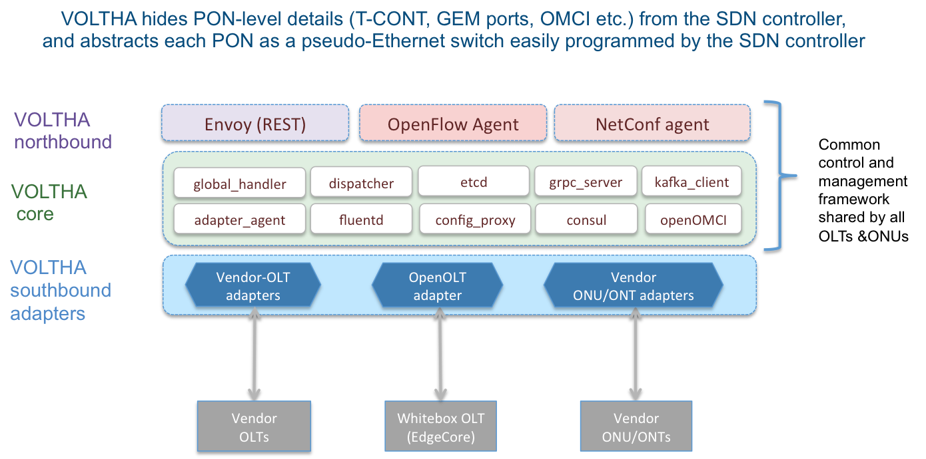
VOLTHA Architecture

Slide 12



Industry’s First White-Box XGS-PON OLT
VOLTHA
core
White-Box = Open-Hardware Specs (OCP)
+ Open-source software (ONF+OCP)
OpenOLT Adaptor
Py GRPC client
Edgecore
ASFvOLT16
Whitebox OLT
OpenOLT Software
GRPC
generic
protobufs
Available
July 2017
Whitebox OLT
(including EdgeCore)
C++ GRPC srv
Chip Driver
SDK(s)

Slide 13
Why OpenOLT Adaptor?
March 2018
VOLTHA
core
Generic OLT adaptor - ease of onboarding for new vendors (including whitebox vendors)
OpenOLT Adaptor
Py GRPC client
VOLTHA CORE
OpenOLT
OpenOMCI ONU
GRPC
(generic
protobufs)
Alpha ONU
Iskratel ONU
Arcadyan ONU
CIG ONU
CIG
OLT
EdgeCore OLT
Iskratel
OLT
Tellabs ONU
Whitebox OLT
(including EdgeCore)
C++ GRPC srv
Chip Driver
Tellabs
OLT
SDK(s)

Slide 14
Trellis: Multi-purpose leaf-spine fabric

Slide 15
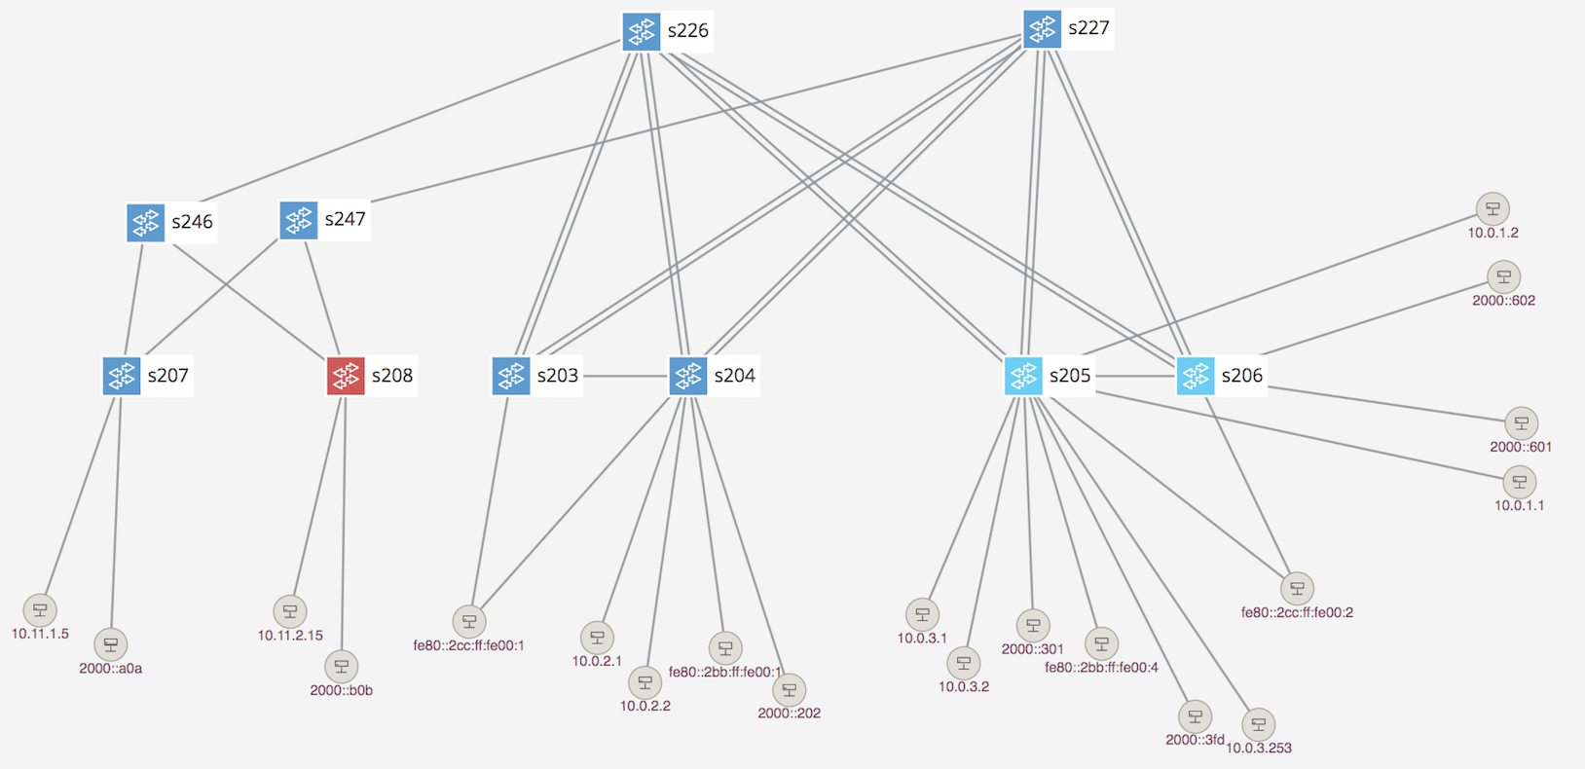
Trellis Overview
Multi-purpose leaf-spine
fabric designed for NFV
Bare-metal hardware
Open-source software
SDN-based (built on ONOS)

Slide 16
Trellis Features
Bridging with Access & Trunk VLANs (within a rack)
Routing (inter-rack)
  IPv4 & IPv6 Unicast routing with MPLS Segment-Routing
  IPv4 & IPv6 Multicast routing
Dual-homing for compute-nodes and external routers
Multi-stage fabrics (2 layers of spines)
vRouter - entire fabric behaves as a single router
  BGP (v4/v6) support for external (upstream) connectivity
  Static routes, route blackholing
  DHCP L3 relay (IPv4/v6)
MPLS Pseudowires
QinQ termination
T3 - Trellis Troubleshooting Tool
ASIC Support
  Broadcom Qumran, Tomahawk, Trident2 switches from EdgeCore & QCT
  Preliminary support for Cavium Xpliant switches and P4-based Tofino switches

Slide 17
White-Box = Bare-metal hw + Open-Source sw
Spine Switch
Leaf/Spine Switch Software Stack
White Box Switch
EdgeCore 6712,7712
GE mgmt.
to controller
OpenFlow 1.3
OCP
Software
(ONL,ONIE)
Indigo OF Agent
32 x 40G/100G ports downlink to leaf switches
OF-DPA
Trident2, Tomahawk, Qumran
Leaf Switch
BRCM ASIC
OCP Bare Metal Hardware
White Box Switch
EdgeCore 5712,5912
QCT LY8
OCP: Open Compute Project
ONL: Open Network Linux
ONIE: Open Network Install Environment
BRCM: Broadcom Merchant Silicon ASICs
OF-DPA: OpenFlow Datapath Abstraction
GE mgmt.
48 x 10G, 6 x 40G/100G

Slide 18
Fabric ASIC Pipeline* (BRCM’s OF-DPA)
* Simplified view
Why OF-DPA?
Multi-
cast Routing Table
Abstracts underlying ASIC
Enables programming of all
flow-tables & port-groups
L3 ECMP
Group
MPLS
Label
Group
Phy Port
Unicast
Routing
Table
MPLS
Label
Group
Phy Port
Ingress
Port Table
Vlan Table
Termin-ation MAC
Table
ACL
Policy
Table
L3
Mcast
Group
Phy Port
L2 Interface
Group
Phy Port
L2 Interface
Group
Phy Port
MPLS
Table
Vlan 1 Table
MPLSL2 Port
Table
L2 Flood
Group
L2 Interface
Group
Phy Port
Bridging
Table
L2 Interface
Group
Phy Port
Notes:
Talk about data plane scale

Slide 19
Trellis & P4
Enhanced with P4 program deployment and pipeline configuration
Same set of Trellis applications on ONOS
Segment Routing
DHCP L3 Relay
vRouter
Multicast
SPGW-app
P4
ONOS Cluster
OF-DPA driver
fabric.p4 driver
Allowing new functionality on hardware (demo at MWC ‘18)
OpenFlow
NetConf
P4Runtime
gNMI
Brcm Qumran
Barefoot Tofino
P4
capable hardware
Brcm Tomahawk
Cavium Xpliant
Brcm Trident2
Mellanox

Slide 20
CORD Platform: service delivery @ the edge

Slide 21
New CORD 6.0 platform (July-2018)
CORD control software → set of Docker containers deployed on Kubernetes using standard tools like Helm charts
ONOS
Grafana
ELK
Kafka
Prometheus
XOS
profile
Kubernetes
OS
OS
OS
Bare metal server
Bare metal server
Bare metal server
Management network
Access
Node
Upstream
Leaf
Leaf
OS
OS
OS
Dataplane network
Spine
Spine
OS
OS
Notes:
No distinction between head-node and compute node
Offline install – local docker registry
Modularity - install what you need – choose helm chart, your own fabric, your own DNS
1 switch/ 1 server – expand as you wish

Slide 22
SEBA – A profile loaded on the CORD platform
CORD control software → set of Docker containers deployed on Kubernetes using standard tools like Helm charts
onos apps
workflow
VOLTHA
Runtime config & service instantiation
ONOS
Grafana
ELK
Kafka
Prometheus
XOS
profile
Kubernetes
OS
OS
OS
Bare metal server
Bare metal server
Bare metal server
Management network
Access
Node
Upstream
Leaf
Leaf
OS
OS
OS
Dataplane network
Spine
Spine
OS
OS
Notes:
No distinction between head-node and compute node
Offline install – local docker registry
Modularity - install what you need – choose helm chart, your own fabric, your own DNS
1 switch/ 1 server – expand as you wish

Slide 23
SEBA Exemplar Implementation

Slide 24

SEBA Exemplar
ONAP
Legacy OSS
Built on the new CORD platform
OSAM-Central
OSAM-Local
EMS/NMS-adaptor
SEBA POD
Providing FCAPS
& Inventory
Network Edge Mediator (NEM)
All control software deployed as containers on compute nodes using Kubernetes
vOLT
dhcp
mcast
SR
FPM
T3
ONOS Cluster
REST
Kafka
OF
OF
Redfish
Redfish
VOLTHA
TP
TP
TP
ONU
UNI
AGG Switch
Subscriber traffic
‘fast-path’ to Internet
OLT
NNI
AGG Switch
Compute

Slide 25
NEM Workflows
SEBA POD
Providing FCAPS
& Inventory
Network Edge Mediator (NEM)
BNG is a workload option
External physical BNG
vBNG in compute
BNG in Agg switches
BNG in OLT boxes
All control software deployed as containers on compute nodes using Kubernetes
vOLT
dhcp
mcast
SR
FPM
T3
ONOS Cluster
OF
OF
Redfish
Redfish
VOLTHA
TP
TP
TP
ONU
UNI
AGG Switch
Subscriber traffic
‘fast-path’ to Internet
OLT
NNI
AGG Switch
Compute

Slide 26
NEM Monitoring
Infrastructure
GRAFANA
KIBANA
XOS
PROMETHEUS
ELK STACK
NEM
Operator OSS
KAFKA
Alarms, events & stats
ONOS
Logs
VOLTHA
TP
TP
TP
ONU
BNG
RG
UNI
OLT
AGG
NNI
Compute

Slide 27
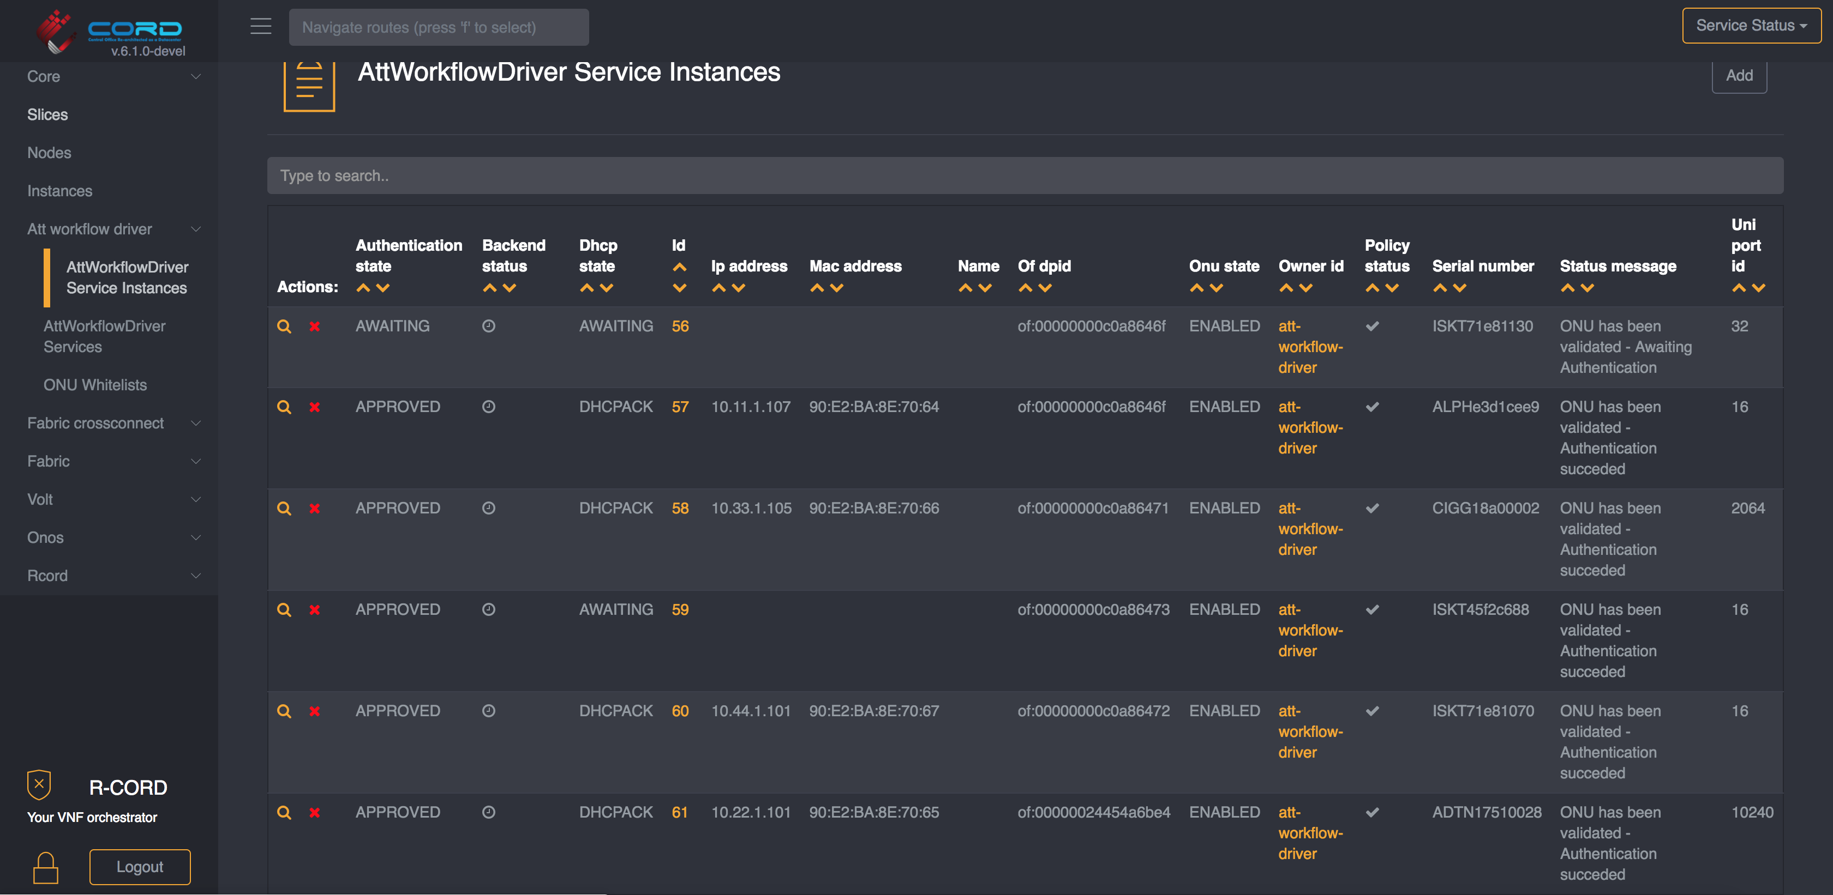
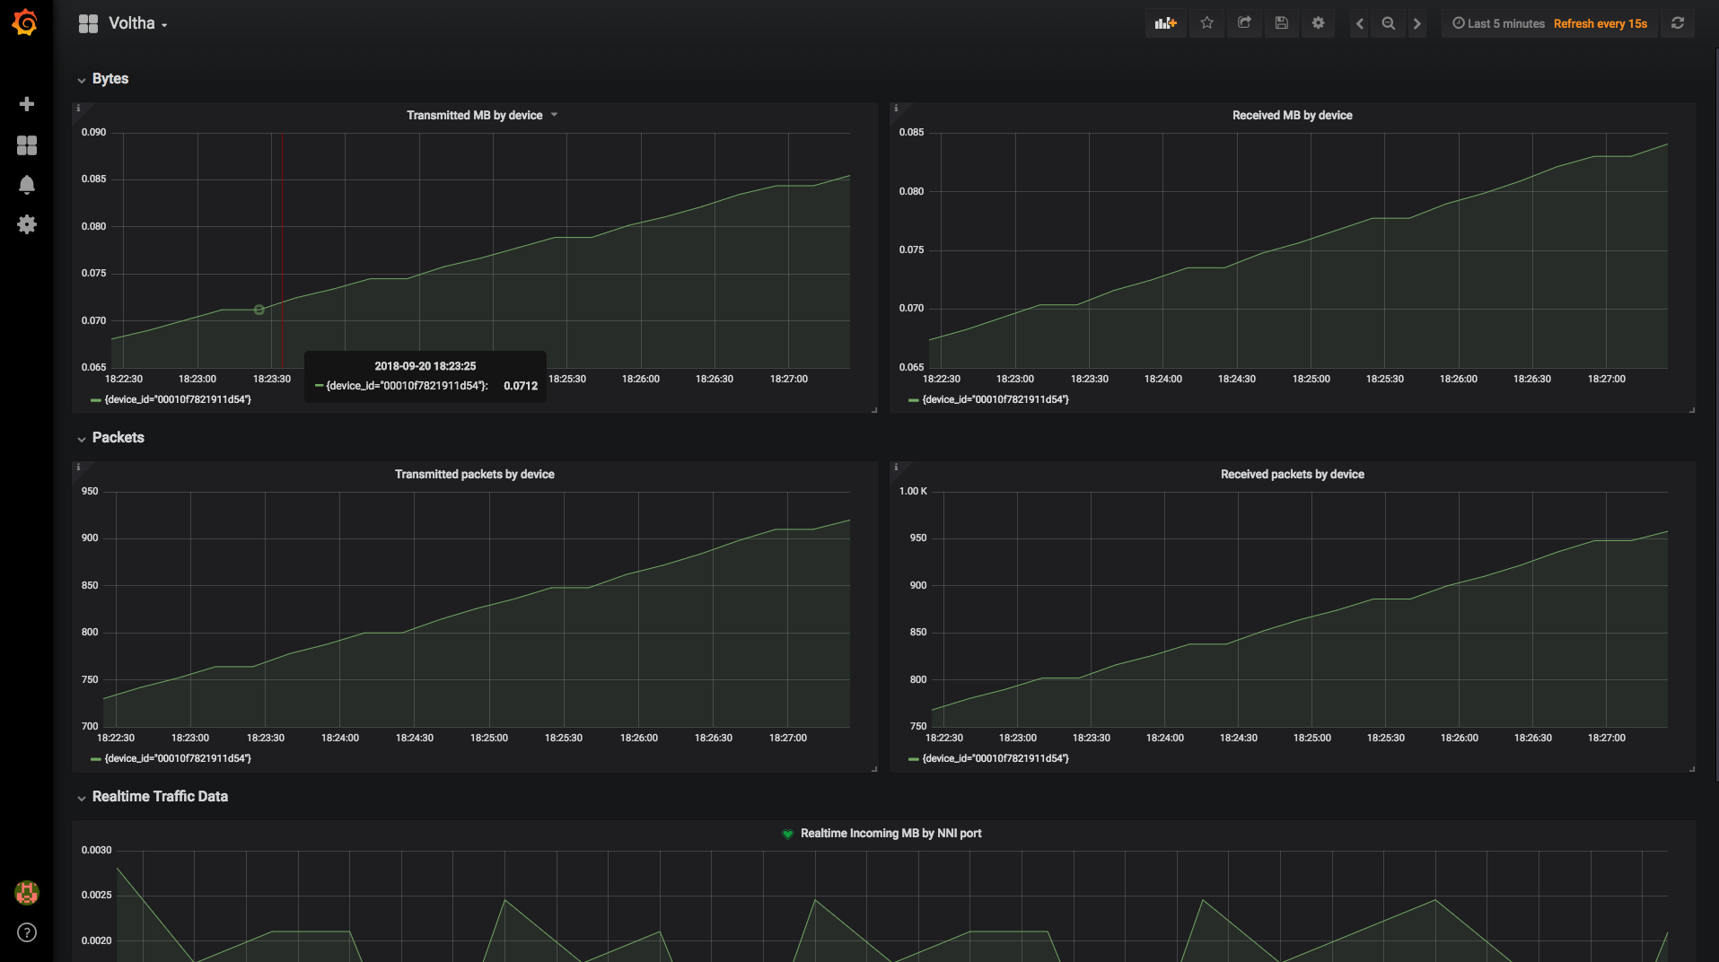
Demo setup BBWF 2018
ONF Booth (Hall 22a, Booth B116)
NEM User Interface: runtime service instantiation, inventory, workflow status
NEM Monitoring Dashboard: stats, events, logs (FCAPS)

Slide 28
Demo setup BBWF 2018
SEBA Peripheral/PNF/Pod
Radius Server
Network Edge
Mediator (NEM)
Elasticsearch
Grafana/Kibana
Kafka
XOS GUI
Chameleon
Tosca
Logstash
Prometheus
Exporter
XOS Core
Synchronizers
Database
Configuration
vOLT
dhcp
aaa
sadis
kafka-i
SR
ONOS
Software Stack
VOLTHA
BBSim
ONU
DHCP Server (subscriber RG addressing)
Alpha
RG
Iskratel
EdgeCore OLT
RG
BNG
Arcadyan
RG
Adtran OLT
Hardware
Adtran
Public Internet
RG
EdgeCore AGG Switch
CIG
CIG OLT
RG
Iskratel
Iskratel OLT (X)
RG
Iskratel
Compute
Nodes
RG
Iskratel OLT (G)

Slide 29
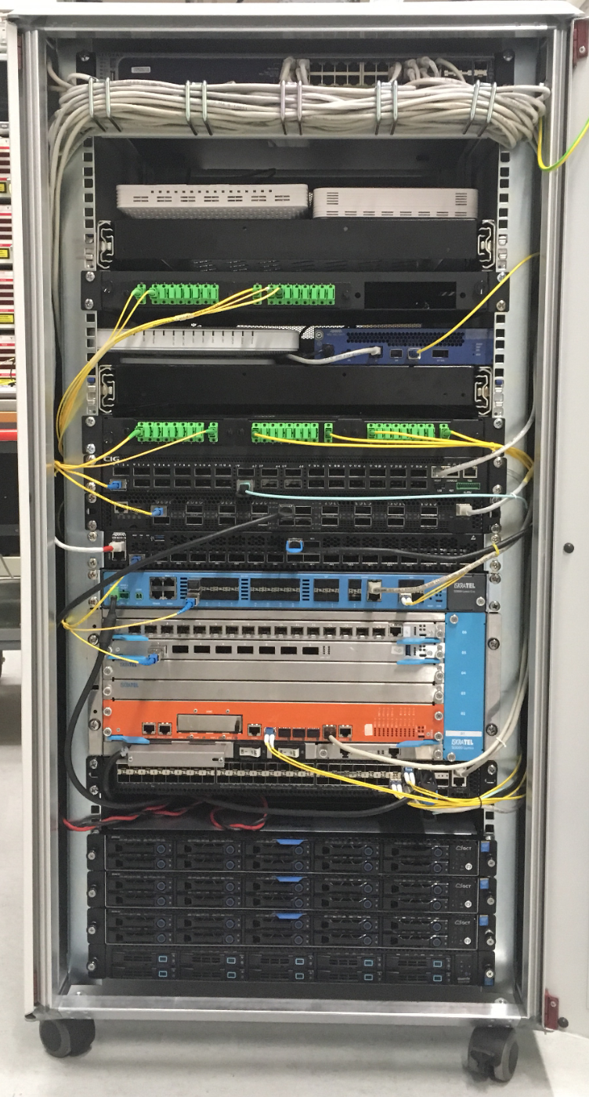
Demo setup BBWF 2018
ONF Booth (Hall 22a, Booth B116)
ONUs: Arcadyan, Alpha, Adtran, CIG, Iskratel
OLTs: Adtran, CIG,
EdgeCore & Iskratel
AGG switch: EdgeCore
Servers: VOLTHA, ONOS, XOS, K8s, ELK, Docker, Prometheus, Grafana, Kibana

Slide 30
SEBA Development & Roadmap

Slide 31















Distributed DevOps - SEBA
Simulator
OLT
Software (BAL)
OpenOMCI
SEBA System
End-to-End
OLT, Switch
Hardware
Redfish APIs
OLT & ONU
VOLTHA 2.0
Technology Profiles
AT&T
VOLTHA 2.0
Test automation
Certification

Slide 32
SEBA Distributed DevOps – ONF Responsibilities
Joint Development
with AT&T Foundry
Support
VOLTHA/SEBA Community
Deliver
New
Features
SEBA/VOLTHA Stability & Scale
Tooling
QA
Weekly SEBA public meetings
JIRA issues – kanban methodology
Mailing lists, Slack community support
VOLTHA meetings, TST, architectural guidance
ONF team resposible for all ONOS and NEM feature development
FCAPS features – kpis, alarms & logs in SEBA monitoring infrastructure
AT&T workflow development
Integrate with new ONU and OLT vendors
AGG switch features
Focus on stability of VOLTHA – robustness and repeatability
Investigate scalability and performance of full SEBA system
BBSim – Guide NTT in the development of PON simulator
SEBA-in-a-BOX: Complete end to end emulation of SEBA system with ponsim & mininet
Developing automated feature tests
Extending framework for hardware based end-to-end tests
Work with community to develop test automation and certification procedures
Daily scrum
Bugs - issue analysis; root-cause;
Design discussions for new features
Documentation
Recommend best-practices/training

Slide 33
SEBA Deployment Goal @ AT&T
SEBA POD
Up to 64 ONUs per PON port
Internal GE Management Switch
DHCP Server (subscriber RG addressing)
ONU+RG
Up to 16 PON ports / OLT device
ONU+RG
EdgeCore OLT
DHCP Server (POD addressing)
EdgeCore OLT
ONU+RG
EdgeCore OLT
AGG Switch
(Tomahawk
32 x 100G)
AT&T
External BNG
Radius Server
Up to 16
OLT devices
External OSS
Compute Node
VOLTHA, ONOS, NEM, Kubernetes, Docker registry,
Gateway VM
Abstract OLT
EdgeCore OLT
Compute Node
Public Internet
Compute Node

Slide 34
Roadmap
BNG Disaggregation
Using P4 in Aggregation switch
Implementing more operator workflows
Performance & scale improvements for Trials
Redundancy
Integrating VOLTHA 2.0 & Technology profiles
ISSU
Integrating M-CORD profile to use SEBA as mobile backhaul

Slide 35
Summary
ONF: Operator driven curated open source
  CORD is the flagship umbrella project
  SEBA exemplar implementation is built on the CORD platform
Components:
  VOLTHA abstracts the PON as a quasi-Ethernet switch to the SDN controller
  Trellis manages a multi-purpose leaf-spine fabric
  VOLTHA and Trellis compatible white-box OCP hardware
  CORD: service delivery platform - set of Docker containers managed by K8s
SEBA: SDN Enabled Broadband Access
  SEBA – a profile instantiated on CORD, jointly developed by ONF, AT&T & community
  NEM – northbound interfaces for integration with operator backends
  Significant focus on FCAPS infrastructure
  Multiple operator workflows
  Headed to trials at AT&T, significant interest from operators worldwide

