Slide 1
SEBA: SDN Enabled Broadband Access
Saurav Das
Director of Engineering, ONF
December 4th, 2018

Slide 2

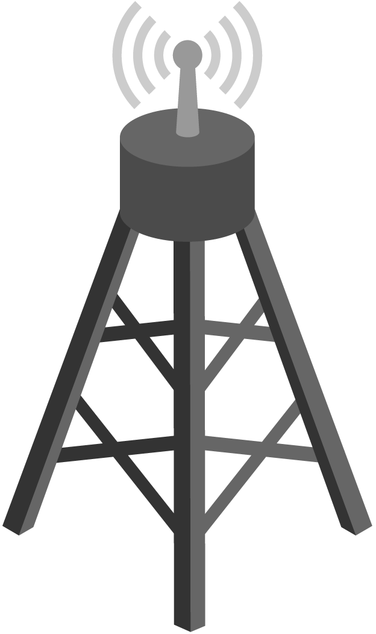



CORD – Central Office Rearchitected as a Datacenter
Residential
vOLT, vSG, vRouter, vCDN
Mobile
vBBU. vMME, vSGW, vPGW, vCDN
Enterprise
vCarrierEthernet, vOAM, vWanEx, vIDS
Access Service Orchestration & Control
White-box Switches with
Merchant Silicon
Cloud
SDN
NFV
BBUs
PON OLTs
COTS (Off-the-Shelf) x86 Compute
ROADM (Core)
Economies of a datacenter, Agility of a cloud provider

Slide 3







SEBA: Built on CORD
Mobile
Services
Enterprise
Services
Residential
Services
Mobile
Enterprise
Residential
NEM
Network Edge Mediator
OSS mediation & FCAPS support for operationalization
Leverages XOS project & toolchain
SEBA
Trellis
ONOS
ORAN
VOLTHA
Stratum
ODTN
Radio
Units
PON
OLTs
PON
OLTs
Shared Cloud Infrastructure
ROADM
(Core)

Slide 4
Traditional Residential Access
Residence
Central Office
Backbone
Network
RG
ONU
OLT
ETH AGG
BNG
RG – Residential Gateway
OLT – Optical Line Termination
BNG – Broadband Network Gateway

Slide 5
Disaggregated Residential Access
vBNG
VLAN termination,
Hierarchical QoS
DHCP
Virtual OLT
manages and abstracts PON
Residence
Central Office
vBNG
AAA
VOLTHA
Backbone
Network
RG
ONU
OLT
ETH AGG
BNG
OLT MAC
Leaf-Spine Fabric
Fabric provides
Eth aggregation
Routing
+ the ability to introduce other edge-compute services per subscriber

Slide 6

SEBA Exemplar
ONAP
Legacy OSS
Bora Eliacik
SEBA Track
Tues 3:30pm
Built on the new CORD platform
OSAM-Central
OSAM-Local
EMS/NMS-adaptor
SEBA POD
Providing FCAPS
& Inventory
Network Edge Mediator (NEM)
vOLT
dhcp
mcast
SR
FPM
T3
ONOS Cluster
REST
Kafka
OF
OF
Redfish
Redfish
VOLTHA
TP
TP
TP
ONU
External BNG
UNI
AGG Switch
Subscriber traffic
‘fast-path’ to Internet
OLT
NNI
AGG Switch
Compute

Slide 7
Outline
VOLTHA – Disaggregated OLTs
Trellis – Multi-purpose Leaf-Spine Fabric
CORD platform – Service Delivery at the Edge
SEBA Exemplar Implementation
SEBA Development & Roadmap

Slide 8
VOLTHA: Disaggregated OLTs

Slide 9


OLT Disaggregation → VOLTHA
VLANs
AAA
Mcast
…
ONOS
VLANs, IGMP, 802.1x, Mcast …
Backplane
OpenFlow
NetConf
PON MAC blades
VOLTHA
OpenFlow Agent
NetConf
Compute blades
OLT API
OMCI Stack
GPON OLT
VOLTHA: Virtual OLT Hardware Abstraction
GPON OLT MAC

Slide 10
VOLTHA Operation
Bridging/Routing
VLANs
dhcp
mcast
ONOS
VOLTHA
Logical
switch
ONU
Switch
OLT
UNI
NNI
UNI

Slide 11
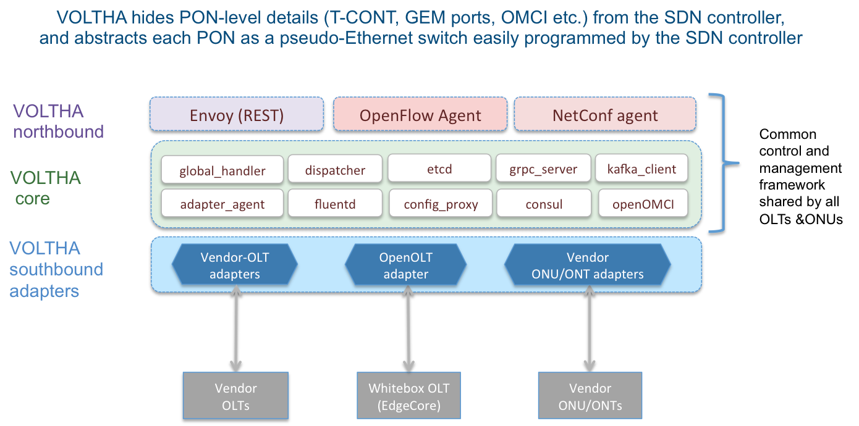
VOLTHA Architecture
Sergio Slobodrian
SEBA Track
Wed 2:00pm
TP
TP
Tech
Profiles
Shaun Misset
SEBA Track
Wed 3:40pm

Slide 12



Industry’s First White-Box XGS-PON OLT
VOLTHA
core
White-Box = Open-Hardware Specs (OCP)
+ Open-source software (ONF+OCP)
OpenOLT Adaptor
Py GRPC client
Edgecore
ASFvOLT16
Whitebox OLT
OpenOLT Software
GRPC
generic
protobufs
Whitebox OLT
(including EdgeCore)
C++ GRPC srv
Chip Driver
SDK(s)

Slide 13
Why OpenOLT Adaptor?
March 2018
VOLTHA
core
Generic OLT adaptor - ease of onboarding for new vendors (including whitebox vendors)
OpenOLT Adaptor
Py GRPC client
VOLTHA CORE
Chip Boling
SEBA Track
Wed 3:20pm
OpenOLT
OpenOMCI ONU
GRPC
(generic
protobufs)
Shad Ansari
SEBA Track
Wed 2:55pm
Alpha ONU
Iskratel ONU
Arcadyan ONU
CIG ONU
CIG
OLT
EdgeCore OLT
Iskratel
OLT
Tellabs ONU
Whitebox OLT
(including EdgeCore)
C++ GRPC srv
Chip Driver
Tellabs
OLT
SDK(s)

Slide 14
Trellis: Multi-purpose leaf-spine fabric

Slide 15
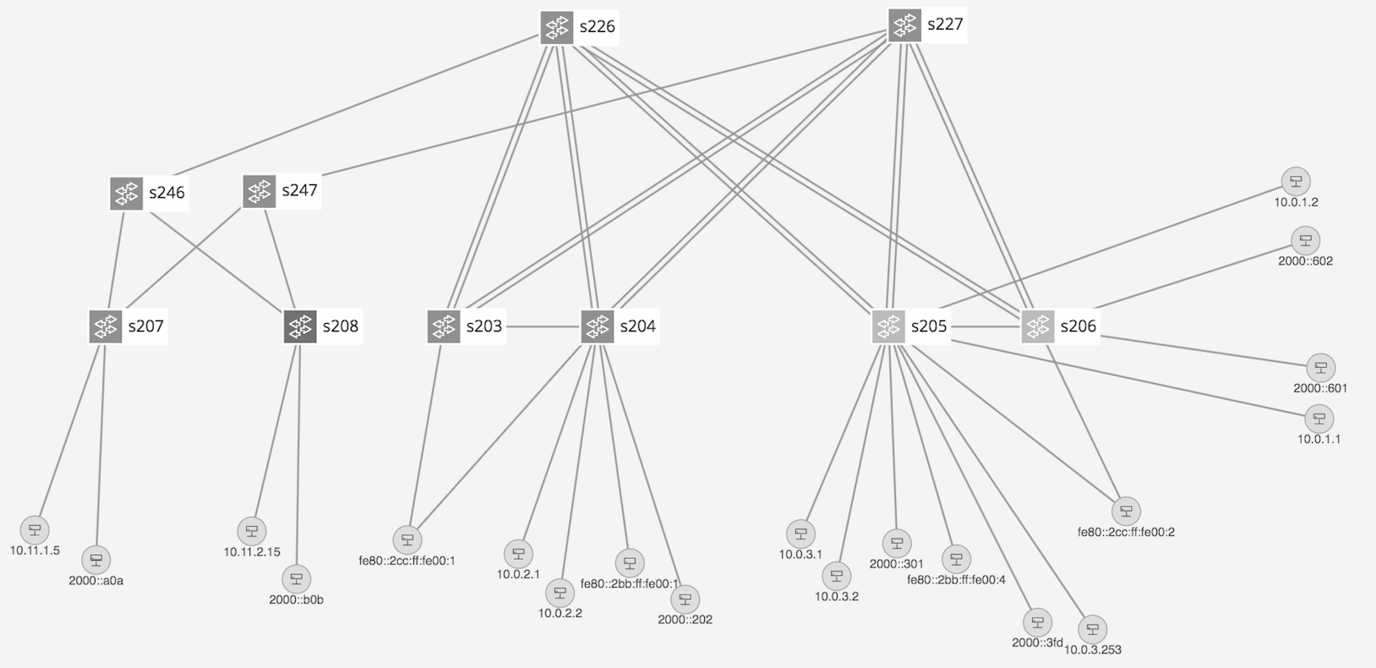
Trellis Overview
Bare-metal hardware
Open-source software
SDN-based (built on ONOS)
Multi-purpose leaf-spine
fabric designed for NFV
Spine
Quagga
Spine
Paired
Leaves
Leaf
Access
Devices
Upstream
Router
Dual homed hosts
Single homed hosts
Field Office (2nd stage)
Central Office (1st stage)
DHCP Server

Slide 16
Trellis Features
Bridging with Access & Trunk VLANs (within a rack)
Routing (inter-rack)
  IPv4 & IPv6 Unicast routing with MPLS Segment-Routing
  IPv4 & IPv6 Multicast routing
Dual-homing for compute-nodes and external routers
Multi-stage fabrics (2 layers of spines)
vRouter - entire fabric behaves as a single router
  BGP (v4/v6) support for external (upstream) connectivity
  Static routes, route blackholing
  DHCP L3 relay (IPv4/v6)
MPLS Pseudowires
QinQ termination
T3 - Trellis Troubleshooting Tool
ASIC Support
  Broadcom Qumran, Tomahawk, Trident2 switches from EdgeCore & QCT
  Preliminary support for Cavium Xpliant switches and P4-based Tofino switches

Slide 17
White-Box = Bare-metal hw + Open-Source sw
Spine Switch
Leaf/Spine Switch Software Stack
White Box Switch
EdgeCore 6712,7712
GE mgmt.
to controller
OpenFlow 1.3
OCP
Software
(ONL,ONIE)
Indigo OF Agent
32 x 40G/100G ports downlink to leaf switches
OF-DPA
Trident2, Tomahawk, Qumran
Leaf Switch
BRCM ASIC
OCP Bare Metal Hardware
White Box Switch
EdgeCore 5712,5912
QCT LY8
OCP: Open Compute Project
ONL: Open Network Linux
ONIE: Open Network Install Environment
BRCM: Broadcom Merchant Silicon ASICs
OF-DPA: OpenFlow Datapath Abstraction
GE mgmt.
48 x 10G, 6 x 40G/100G

Slide 18
Fabric ASIC Pipeline* (BRCM’s OF-DPA)
* Simplified view
Why OF-DPA?
Multi-
cast Routing Table
Abstracts underlying ASIC
Enables programming of all
flow-tables & port-groups
L3 ECMP
Group
MPLS
Label
Group
Phy Port
Unicast
Routing
Table
MPLS
Label
Group
Phy Port
Ingress
Port Table
Vlan Table
Termin-ation MAC
Table
ACL
Policy
Table
L3
Mcast
Group
Phy Port
L2 Interface
Group
Phy Port
L2 Interface
Group
Phy Port
MPLS
Table
Vlan 1 Table
MPLSL2 Port
Table
L2 Flood
Group
L2 Interface
Group
Phy Port
Bridging
Table
L2 Interface
Group
Phy Port
Notes:
Talk about data plane scale

Slide 19
Trellis
& P4
Enhanced with P4 program deployment and pipeline configuration
Same set of Trellis applications on ONOS
Segment Routing
DHCP L3 Relay
vRouter
Multicast
SPGW-app
P4
ONOS Cluster
OF-DPA driver
fabric.p4 driver
Allowing new functionality on hardware (demo at MWC ‘18)
OpenFlow
NetConf
P4Runtime
gNMI
Charles Chan
NG SDN Track
Tue 4:30pm
Brcm Qumran
Barefoot Tofino
P4
capable hardware
Brcm Tomahawk
Cavium Xpliant
Brcm Trident2
Mellanox
Carmelo Cascone
ONOS Track
Thur 3:00pm

Slide 20
CORD Platform: service delivery @ the edge

Slide 21
Issues with the previous CORD platform & build
No distiniction between development vs deployment
  Most of the software built from source at “deploy time”
  Big scripts, scripts calling scripts, long process
  Monolithic: If something breaks, wipe and start from scratch
  Brittle: Small variations of hardware/connectivity could break build
Not flexible or modular
  Required specific versions of server OS
  Tightly coupled components – cannot exclude or replace components
  Required internet access for install
Hard to use
  Choose a profile at start; to change profiles reinstall
  No means for adding services at runtime
Notes:
As always, it’s important to translate the input coming from partners’ deployments into requirements, to make the platform better. I’d like to go through some fundamental challenges met with the previous platform, that gave the community some rationale to create the new one.
BULLET EXPLAINATION
* CORD wasn’t really able to distinguish between a deployment and a development workflow. Most of the time software was built as well during the deployment phases, which is unexpected and time consuming
* CORD was spawning VMs during the deployment phase, such requiring either physical machines or VMs
* CORD had to be installed on Ubuntu 16.04
* Offline installation was not officially supported, and anyway quite difficult -> problem for most of the SPs
* CORD installation was monolithic. It was installing OS, configure OS, install components (i.e. ONOS, OpenStack, XOS) and profiles, together in one step
As a user, you had to decide what “flavor” (use-case) of CORD to install, at the very beginning of the installation. Want to install R-CORD? Choose it at the beginning. Changed your mind and want to install M-CORD? You’ve to reinstall the entire platform
Over time, users (including developers and QA) asked to be able to run CORD in different environments. For example, on single machines for development vs full clusters for trials and production. The two workflows have diverged quite a lot over time and were considerably different from one each other
Many components were tightly coupled, at the point that it was very difficult to exclude them from the system. Classical example: many SPs use their own infra tools (DNS, system configurator like Puppet). CORD providing these services as well, and this was most of the time an issue
Having scripts to automate processes is important, but it’s also important to find the right balance between automation and make difficult for users what’s under the hood
CORD is an integration of effort, using many components. It has been traditionally released as a whole, even if these components have been historically released by different groups. Often it has been a problem to advance features separately

Slide 22
New CORD 6.0 platform (July-2018)
CORD control software → set of Docker containers deployed on Kubernetes using standard tools like Helm charts
ONOS
Grafana
ELK
Kafka
Prometheus
XOS
profile
Kubernetes
OS
OS
OS
Bare metal server
Bare metal server
Bare metal server
Management network
Luca Prete
CORD Track
Wed 2:00pm
Access
Node
Upstream
Leaf
Leaf
OS
OS
OS
Dataplane network
Spine
Spine
OS
OS
Notes:
No distinction between head-node and compute node
Offline install – local docker registry
Modularity - install what you need – choose helm chart, your own fabric, your own DNS
1 switch/ 1 server – expand as you wish

Slide 23
SEBA – A profile loaded on the CORD platform
CORD control software → set of Docker containers deployed on Kubernetes using standard tools like Helm charts
onos apps
workflow
VOLTHA
Runtime config & service instantiation
ONOS
Grafana
ELK
Kafka
Prometheus
XOS
profile
Kubernetes
OS
OS
OS
Bare metal server
Bare metal server
Bare metal server
Management network
Matteo Scandolo
CORD Track
Thur 3:30pm
Access
Node
Upstream
Leaf
Leaf
OS
OS
OS
Dataplane network
Spine
Spine
OS
OS
Notes:
No distinction between head-node and compute node
Offline install – local docker registry
Modularity - install what you need – choose helm chart, your own fabric, your own DNS
1 switch/ 1 server – expand as you wish

Slide 24


Issues with the previous R-CORD
CORD Head Node
VOLTHA
…
Radius
ONOS
XOS
Subscriber Traffic through vSG (virt. Service Gateway)
CORD Compute Node
CDN
OvS
vSG
Internet
Whitebox ToR Fabric Switch
EdgeCore 7712 (Tomahawk 32 x 100G)
Residential Subscribers
EdgeCore Whitebox OLT (ASFvOLT16)
BCM
ONU
RG
Central Office

Slide 25
SEBA Exemplar Implementation
- putting it all together

Slide 26
SEBA Exemplar
ONAP
Legacy OSS
Built on the new CORD platform
OSAM-Central
OSAM-Local
EMS/NMS-adaptor
SEBA POD
Providing FCAPS
& Inventory
Network Edge Mediator (NEM)
All control software deployed as containers on compute nodes using Kubernetes
vOLT
dhcp
mcast
SR
FPM
T3
ONOS Cluster
REST
Kafka
OF
OF
Redfish
Redfish
VOLTHA
TP
TP
TP
ONU
External BNG
UNI
AGG Switch
Subscriber traffic
‘fast-path’ to Internet
OLT
NNI
AGG Switch
Compute

Slide 27
NEM Orchestration & SEBA Workflows
Scott Baker
CORD Track
Wed 3:00pm
Different operators == Different workflows
SEBA POD
NEM
XOS GUI
Chameleon
Tosca
XOS Core
Synchronizers
Database
vOLT
dhcp
mcast
SR
FPM
T3
Authentication is a workflow option
802.1x based
PPPOE based
DHCP based
ONOS Cluster
BNG is a workflow option
External physical BNG
vBNG in compute
BNG in Agg switches
BNG in OLT boxes
OF
OF
Redfish
Redfish
VOLTHA
TP
TP
TP
ONU
Subscriber services are workflow options
HSIA
Voice
IPTV
Business services
Technology profiles
Speed profiles
UNI
AGG Switch
OLT
NNI
AGG Switch
Compute

Slide 28
NEM Monitoring
Infrastructure
GRAFANA
KIBANA
XOS
PROMETHEUS
ELK STACK
NEM
Operator OSS
KAFKA
Alarms, events & stats
ONOS
Zack Williams
CORD Track
Thur 3:00pm
Logs
VOLTHA
ONU
BNG
RG
UNI
OLT
AGG
NNI
Compute

Slide 29
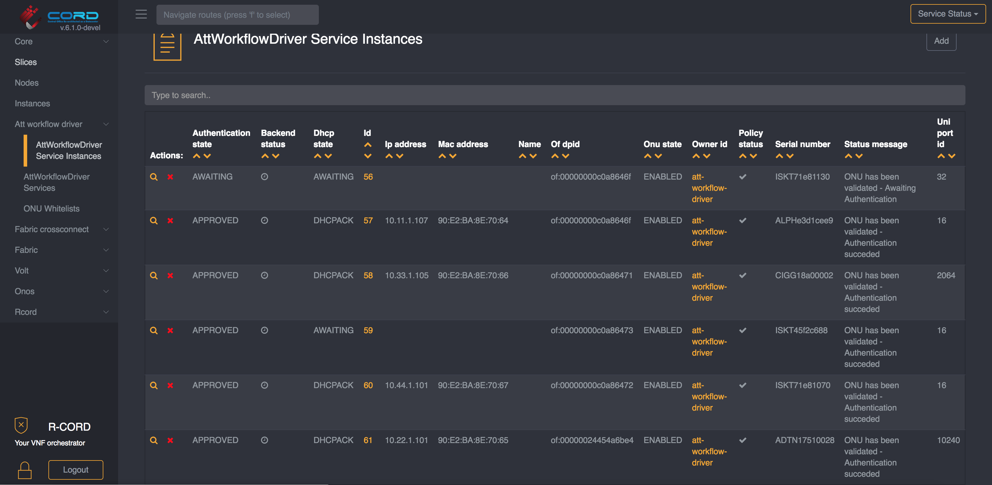
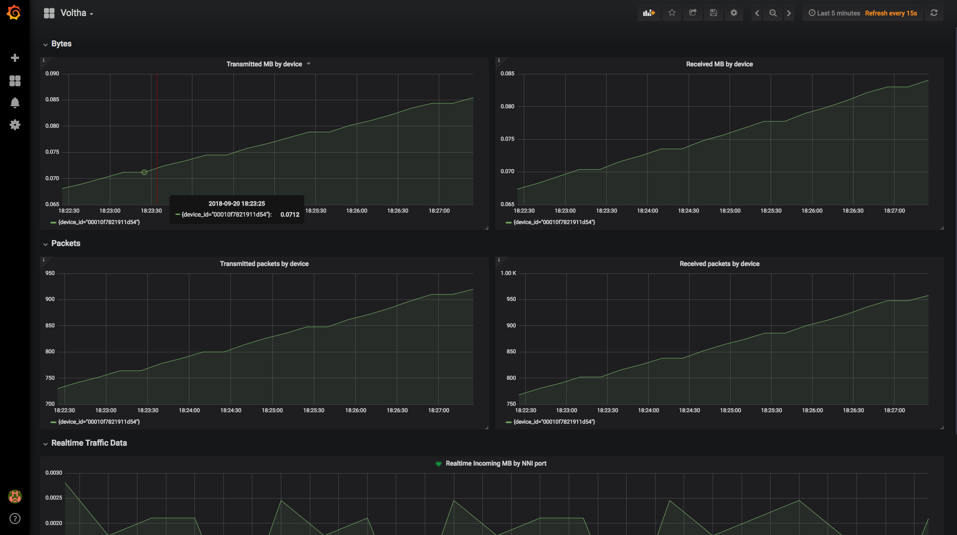
NEM Dashboards
NEM User Interface: runtime service instantiation, inventory, workflow status
NEM Monitoring Dashboard: stats, events, logs (FCAPS)

Slide 30
Demo setup BBWF 2018
SEBA Peripheral/PNF/Pod
Radius Server
Network Edge
Mediator (NEM)
Elasticsearch
Grafana/Kibana
Kafka
XOS GUI
Chameleon
Tosca
Logstash
Prometheus
Exporter
XOS Core
Synchronizers
Database
Configuration
vOLT
dhcp
aaa
sadis
kafka-i
SR
ONOS
Software Stack
VOLTHA
BBSim
ONU
DHCP Server (subscriber RG addressing)
Alpha
RG
Iskratel
EdgeCore OLT
RG
BNG
Arcadyan
RG
Adtran OLT
Hardware
Adtran
Public Internet
RG
EdgeCore AGG Switch
CIG
CIG OLT
RG
Iskratel
Iskratel OLT (X)
RG
Iskratel
Compute
Nodes
RG
Iskratel OLT (G)

Slide 31
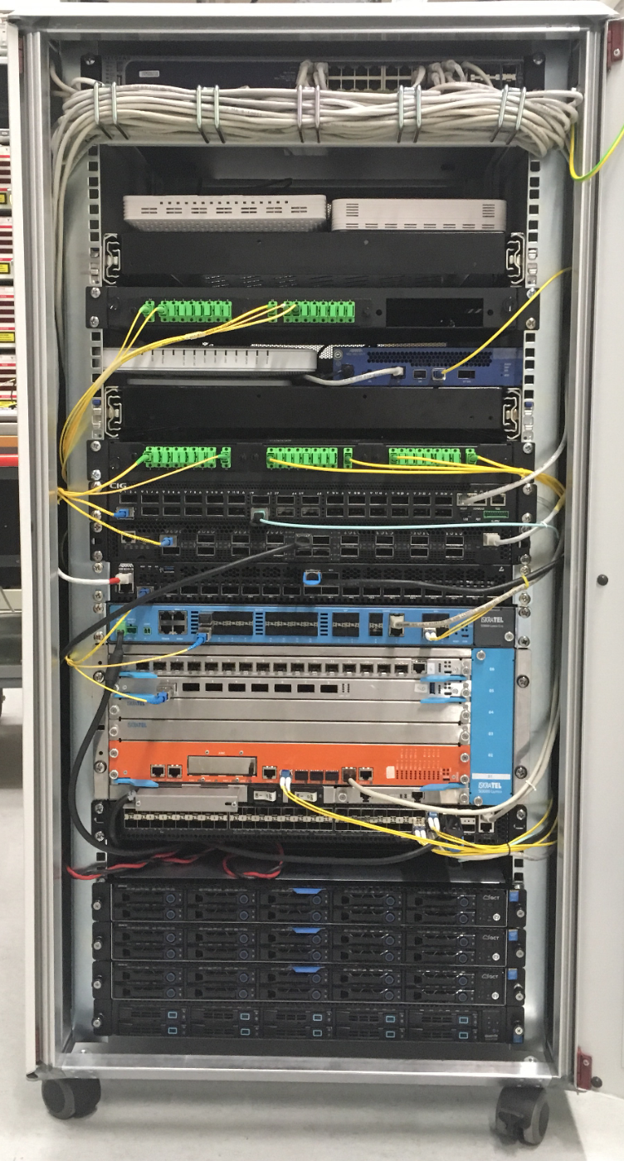
Demo setup BBWF 2018
ONUs: Arcadyan, Alpha, Adtran, CIG, Iskratel
OLTs: Adtran, CIG,
EdgeCore & Iskratel
AGG switch: EdgeCore
Servers: VOLTHA, ONOS, XOS, K8s, ELK, Docker, Prometheus, Grafana, Kibana

Slide 32
SEBA Development & Roadmap

Slide 33















Distributed DevOps - SEBA
Simulator
OLT
Software (BAL)
OpenOMCI
SEBA System
End-to-End
OLT, Switch
Hardware
Redfish APIs
OLT & ONU
VOLTHA 2.0
Technology Profiles
AT&T
VOLTHA 2.0
Test automation
Certification

Slide 34
SEBA Distributed DevOps – ONF Responsibilities
Siddharth Gogar
SEBA Track
Wed 5:30pm
Joint Development
with AT&T Foundry
Support
VOLTHA/SEBA Community
Deliver
New
Features
SEBA/VOLTHA Stability & Scale
Tooling
QA
Weekly SEBA public meetings
JIRA issues – kanban methodology
Mailing lists, Slack community support
VOLTHA meetings, TST, architectural guidance
ONF team resposible for all ONOS and NEM feature development
FCAPS features – kpis, alarms & logs in SEBA monitoring infrastructure
AT&T workflow development
Integrate with new ONU and OLT vendors
AGG switch features
Focus on stability of VOLTHA – robustness and repeatability
Investigate scalability and performance of full SEBA system
BBSim – Work with NTT in the development of PON simulator for scale testing
SEBA-in-a-BOX: Complete end to end emulation of SEBA system with ponsim & mininet
Developing automated feature tests
Extending framework for hardware based end-to-end tests
Work with community to develop test automation and certification procedures
Daily scrum
Bugs - issue analysis; root-cause;
Design discussions for new features
Documentation
Recommend best-practices/training
Andy Bavier
SEBA Track
Wed 5:00pm

Slide 35
SEBA Deployment Goal @ AT&T
SEBA POD
Up to 64 ONUs per PON port
Internal GE Management Switch
DHCP Server (subscriber RG addressing)
ONU+RG
Up to 16 PON ports / OLT device
ONU+RG
EdgeCore OLT
DHCP Server (POD addressing)
OLT
ONU+RG
OLT
AGG Switch
(Tomahawk
32 x 100G)
AT&T
External BNG
Radius Server
Up to 16
OLT devices
External OSS
Compute Node
VOLTHA, ONOS, NEM, Kubernetes, Docker registry,
Gateway VM
Abstract OLT
OLT
Compute Node
Public Internet
Compute Node

Slide 36
SEBA Modularity
ONAP/OSAM
Abstract OLT
NEM Orchestration (XOS)
NEM Monitoring
(Prom,Grafana, ELK)
Access
apps
Fabric
apps
ONOS
VOLTHA
Trellis
Kafka
K8s
OS
OS
OS
ONU
OLT
AGG
switch
Compute
Nodes
ONU

Slide 37
Roadmap
Hans-Joerg Kolbe
NG SDN Track
Wed 3:00pm
BNG Disaggregation
Using P4 in Aggregation switch
Implementing more operator workflows
Performance & scale improvements for Trials
Redundancy
Integrating VOLTHA 2.0 & Technology profiles
ISSU
Integrating M-CORD profile to use SEBA as mobile backhaul

Slide 38
Summary
ONF: Operator driven curated open source
  CORD is the flagship umbrella project
  SEBA exemplar implementation is built on the CORD platform
Modular Components:
  VOLTHA abstracts the PON as a quasi-Ethernet switch to the SDN controller
  Trellis manages a multi-purpose leaf-spine fabric
  ONOS – SDN controller for both VOLTHA & Trellis
  XOS: service delivery & orchestration of workflows
  CORD platform: set of Docker containers managed by K8s
SEBA: SDN Enabled Broadband Access
  SEBA – a profile instantiated on CORD, jointly developed by ONF, AT&T & community
  NEM – provides northbound interfaces for integration with operator backends
  Significant focus on FCAPS infrastructure, multiple operator workflows
  Headed to trials at AT&T, significant interest from operators worldwide

