Slide 1
Trellis, Voltha & Residential CORD
Saurav Das
Director of Engineering, ONF
May 21, 2018

Slide 2
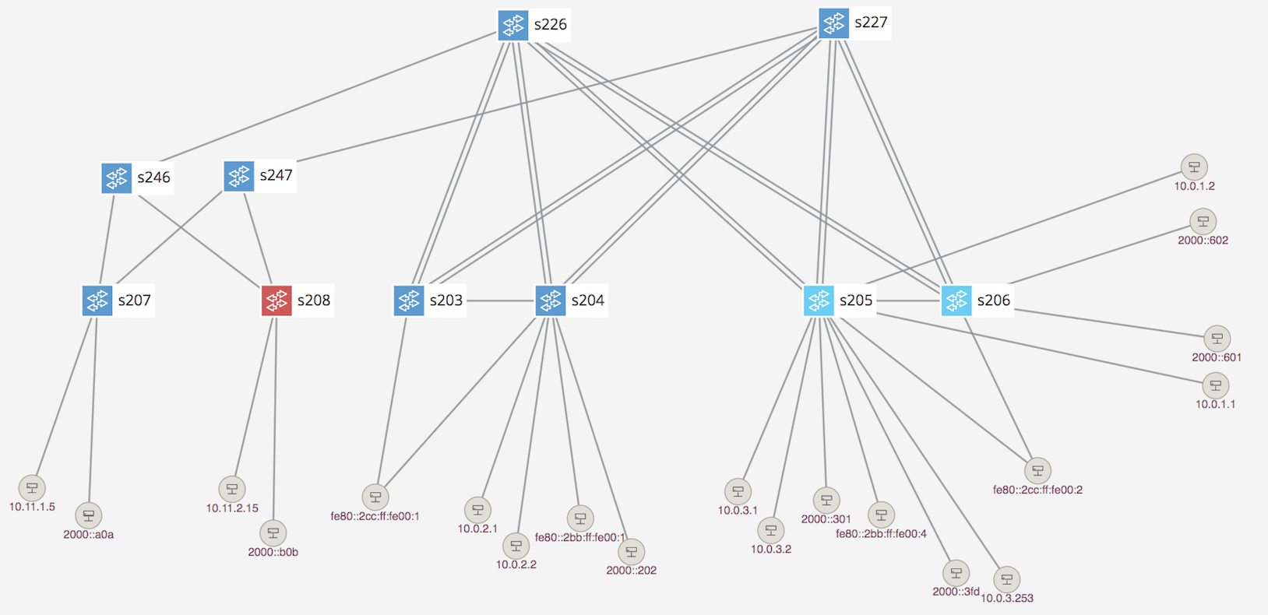
Trellis Overview
Multi-purpose leaf-spine
fabric designed for NFV
Bare-metal hardware
Open-source software
SDN-based (built on ONOS)

Slide 3
Trellis Features
Bridging with Access & Trunk VLANs (within a rack)
Routing (inter-rack)
  IPv4 & IPv6 Unicast routing with MPLS Segment-Routing
  IPv4 & IPv6 Multicast routing
Dual-homing for compute-nodes and external routers
Multi-stage fabrics (2 layers of spines)
vRouter - entire fabric behaves as a single router
  BGP (v4/v6) support for external (upstream) connectivity
  Static routes, route blackholing
  DHCP L3 relay (IPv4/v6)
MPLS Pseudowires
QinQ termination
T3 - Trellis Troubleshooting Tool
ASIC Support
  Broadcom Qumran, Tomahawk, Trident2 switches from EdgeCore & QCT
  Preliminary support for Cavium Xpliant switches and P4-based Tofino switches

Slide 4
White-Box = Bare-metal hw + Open-Source sw
Spine Switch
Leaf/Spine Switch Software Stack
White Box Switch
EdgeCore 6712,7712
GE mgmt.
to controller
OpenFlow 1.3
OCP
Software
(ONL,ONIE)
Indigo OF Agent
32 x 40G/100G ports downlink to leaf switches
OF-DPA
Trident2, Tomahawk, Qumran
Leaf Switch
BRCM ASIC
OCP Bare Metal Hardware
White Box Switch
EdgeCore 5712,5912
QCT LY8
OCP: Open Compute Project
ONL: Open Network Linux
ONIE: Open Network Install Environment
BRCM: Broadcom Merchant Silicon ASICs
OF-DPA: OpenFlow Datapath Abstraction
GE mgmt.
48 x 10G, 6 x 40G/100G

Slide 5
Fabric ASIC Pipeline* (BRCM’s OF-DPA)
* Simplified view
Why OF-DPA?
Multi-
cast Routing Table
Abstracts underlying ASIC
Enables programming of all
flow-tables & port-groups
L3 ECMP
Group
MPLS
Label
Group
Phy Port
Unicast
Routing
Table
MPLS
Label
Group
Phy Port
Ingress
Port Table
Vlan Table
Termin-ation MAC
Table
ACL
Policy
Table
L3
Mcast
Group
Phy Port
L2 Interface
Group
Phy Port
L2 Interface
Group
Phy Port
MPLS
Table
Vlan 1 Table
MPLSL2 Port
Table
L2 Flood
Group
L2 Interface
Group
Phy Port
Bridging
Table
L2 Interface
Group
Phy Port
Notes:
Talk about data plane scale

Slide 6
Trellis & P4
Enhanced with P4 program deployment and pipeline configuration
Same set of Trellis applications on ONOS
Segment Routing
DHCP L3 Relay
vRouter
Multicast
SPGW-app
P4
ONOS Cluster
OF-DPA driver
fabric.p4 driver
Allowing new functionality on hardware (demo at MWC ‘18)
OpenFlow
NetConf
P4Runtime
gNMI
Brcm Qumran
Barefoot Tofino
P4
capable hardware
Brcm Tomahawk
Cavium Xpliant
Brcm Trident2
Mellanox

Slide 7
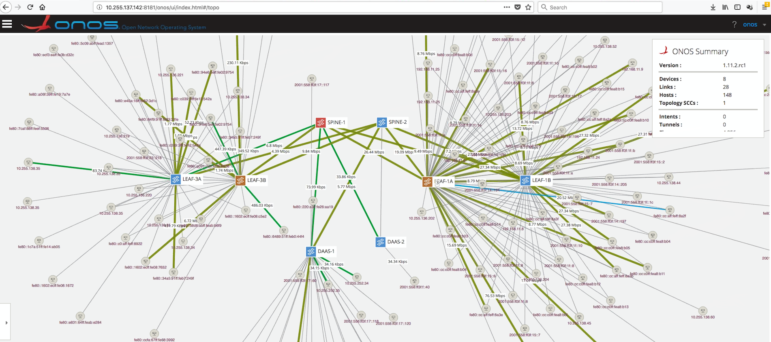
Trellis @ Comcast

Slide 8







Distributed DevOps – ONF Responsibilities
Report issues found; ~75 cases
Create automated tests to reproduce
Validate fixes / releases
Help with issues in their setup
Design discussions for new features
Daily scrum
Analyse issues reported by Harmonic in their setups
Code review patches they submit to ONOS
Design discussions for new features
Bringing up ONF pod housed in San Jose
Report issues found in hw
Validate T2 versions of switch software EdgeCore builds for us
Deliver features; meet ops needs
Deliver stability, scale, perf, tools
Support Comcast design/dev/QA teams – issue analysis; root-cause; recommend best-practices/training
Design discussions for new features
Daily scrum
Documentation
Design discussions for apps/features created by Nokia
Code review submitted patches (40 changesets; 4-5 patchsets/change)
Validate some features; report issues
Bringing up ONF pod hosted by Flex
QA collaboration

Slide 9
Trellis Roadmap
Dual homing for Access nodes (like OLTs)
In Service Software Upgrades (ISSU)
In-band control for remote switches
Scale & Performance improvements
Netconf support for port-mirroring, PTP, MACsec configuration
RBAC, AAA
More Troubleshooting tools

Slide 10
Why Trellis?
Trellis is designed for Service Providers & NFV
SDN == simpler/easier/optimized features
SDN + Programmable pipelines (P4) == New PNFs in Hw
Open-source == SP ownership & customizability

Slide 11
Traditional Residential Access
Residence
Central Office
Backbone
Network
CPE
ONU
OLT
ETH AGG
BNG
CPE – Customer Premises Equipment
OLT – Optical Line Termination
BNG – Broadband Network Gateway

Slide 12


OLT Disaggregation
VLANs
AAA
Mcast
…
ONOS
VLANs, IGMP, 802.1x, Mcast …
Backplane
OpenFlow
NetConf
PON MAC blades
vOLT Agent
OpenFlow Agent
NetConf
Compute blades
OLT API
OMCI Stack
GPON OLT
GPON OLT MAC (Celestica)

Slide 13
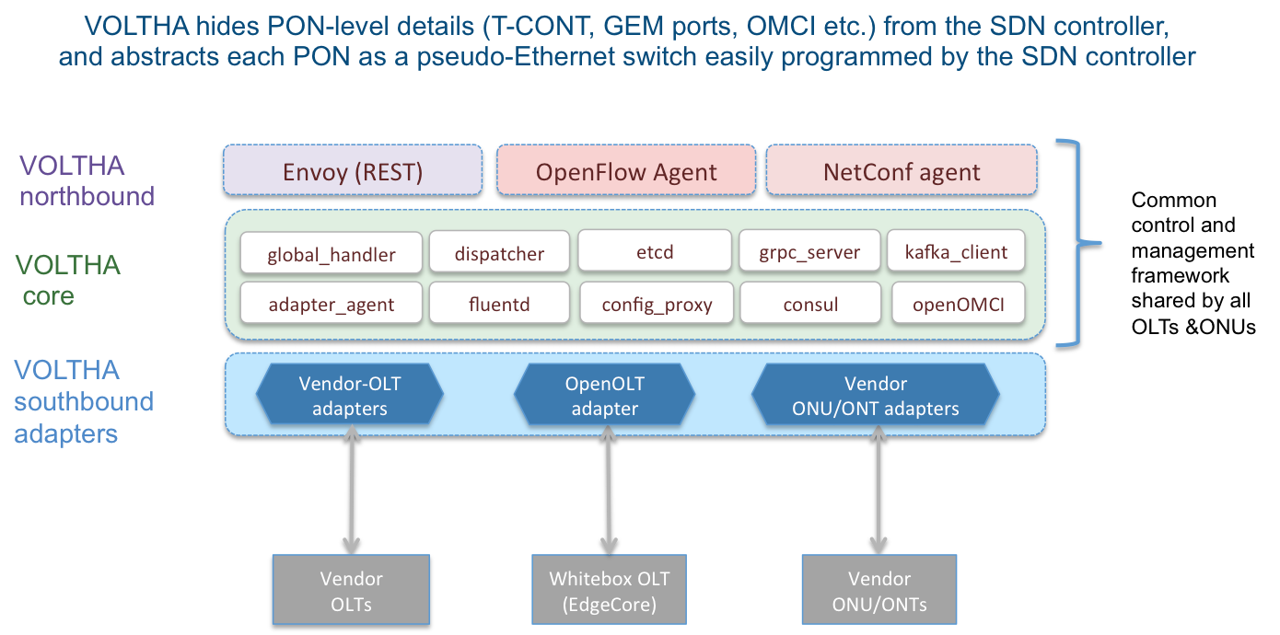
VOLTHA Overview

Slide 14
VOLTHA Current Features (v1.3)
Microservices architecture (in progress) - VOLTHA is a set of containers
  Northbound interfaces OF, Netconf and Rest are separate containers
  VOLTHA Core is a separate container (though not a microservice)
High Availability cluster of VOLTHA instances
Supports XGS-PON and GPON networks
  Supports a number of vendor OLT & ONU adaptors from Ciena, Radisys, Nokia, Adtran, Tibit and Calix.
  Supports 2 whitebox OLTs from EdgeCore (XGS-PON) and Celestica (GPON)
Supports BBF yang models via XPON CLI/Rest commands for low level config

Slide 15
Voltha Core 2.0 – 4 µservices
OFAgent
REST
CLI
Netconf
NorthBound Affinity Routing Proxy
Handles:
  Read
  List
Handles device-specific operations:
Create/Update/delete only
Packet-out operations (OF)
Packet-in operations (OF)
Device lifecycle management (discovery -> deletion)
Manages technology specific details (e.g xPON):
Provisioning profiles
Specialized flow decomposition
Handles cluster specific operations:
event filter
backup & restore
etc.
View Only µservice
Device Handler µservice
Technology Profiles µservice
Cluster Management µservice
Kafka
Etcd
Etcd
SouthBound Affinity Routing Proxies
Adapter X
Adapter Y
Adapter Sim
Adapter Test

Slide 16



Industry’s First White-Box XGS-PON OLT
VOLTHA
core
White-Box = Open-Hardware Specs (OCP)
+ Open-source software (ONF)
OpenOLT Adaptor
Py GRPC client
Edgecore
ASFvOLT16
Whitebox OLT
OpenOLT Software
GRPC
generic
protobufs
Hardware available
July 2017
Whitebox OLT
(including EdgeCore)
C++ GRPC srv
Chip Driver
SDK(s)

Slide 17
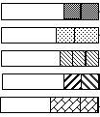
Abstraction: PON as a Quasi-Ethernet Switch
Match
Action
Meter
Queues
Scheduler
NNI
Ports
UNI
Ports
In-port
pbits
Push vlans
Apply meter
Assign queue
Outport
UNI
Ports
Match
Action
Meter
Table
NNI
Ports
Pbit mapping
Queuing policy (GEM)
TCONTs (BW)
GEMs per TCONT
Scheduler policy
In-port
Push vlans
Apply meter
GOTO table
Outport
Technology Profiles

Slide 18
VOLTHA Trials
VOLTHA 2.0 is targeted for trials at - AT&T, Deutsche Telekom, Telefonica, GFiber
Interest from many others –
  Turk Telecom
  British Telecom
  Telecom Italia
  FastWeb
  Portugal Telecom
CenturyLink
Comcast
NTT
Reliance Jio
China Mobile

Slide 19
Traditional Residential Access
Residence
Central Office
Backbone
Network
CPE
ONU
OLT
ETH AGG
BNG
CPE – Customer Premises Equipment
OLT – Optical Line Termination
BNG – Broadband Network Gateway

Slide 20
Residential CORD – Disaggregated Services
Virtual OLT
manages and abstracts PON
VNF/PNF for per
Subscriber policies
Routing control protocols
(BGP, OSPF) for interfacing
with upstream network
Residence
Central Office
Quagga
vBNG
VOLTHA
Backbone
Network
CPE
ONU
OLT
ETH AGG
BNG
Trellis Fabric
Fabric provides vRouter
Forwarding plane
& network functions replacing the
ETH AGG and BNG
+ the ability to introduce other edge-compute services per subscriber

Slide 21
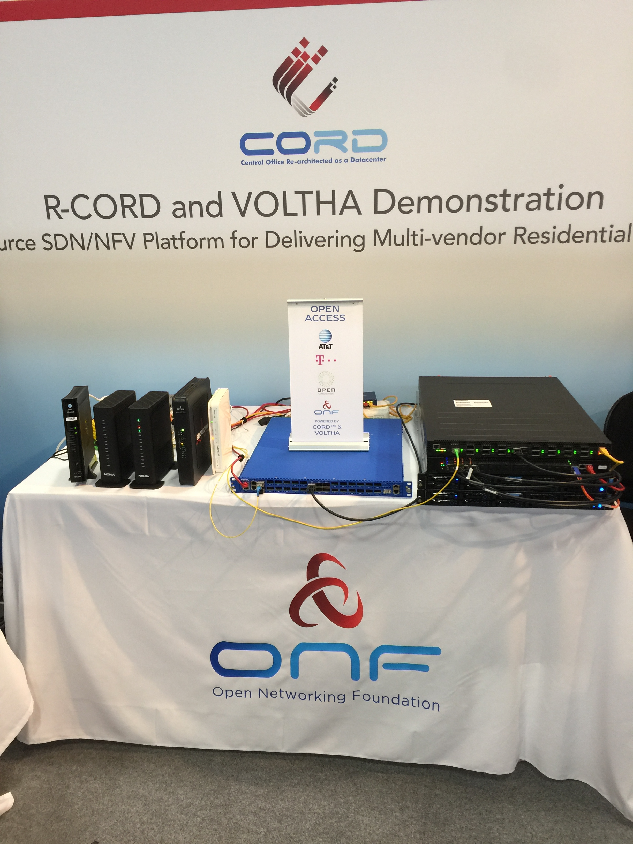



Broadband
World Forum (BBWF)
Berlin, Oct’17

Slide 22

GF backend
ONAP
Legacy OSS
new R-CORD
OSAM-Central
Peripheral/PNF/Pod
Fault mgmt
OSAM-Local
EMS/NMS-adaptor
Network Edge Mediator (NEM)
BNG as a
workload option
External physical BNG
vBNG in compute
BNG as PNF in Agg switches
BNG as PNF in OLT boxes
Config
All control software deployed as Docker containers on compute nodes using Kubernetes
Accounting
vOLT
dhcp
mcast
SR
FPM
T3
ONOS Cluster
Performance
REST
Kafka
Redfish
OF
OF/P4
Security
Redfish
OpenStack Nova
K8
Inventory
VOLTHA
TP
TP
TP
ONU
UNI
AGG
Subscriber traffic
‘fast-path’ to Internet. Redirected to compute for additional services.
OLT
NNI
AGG
Compute

Slide 23











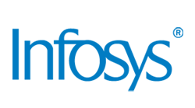


Thank you!
and more…

