Slide 1
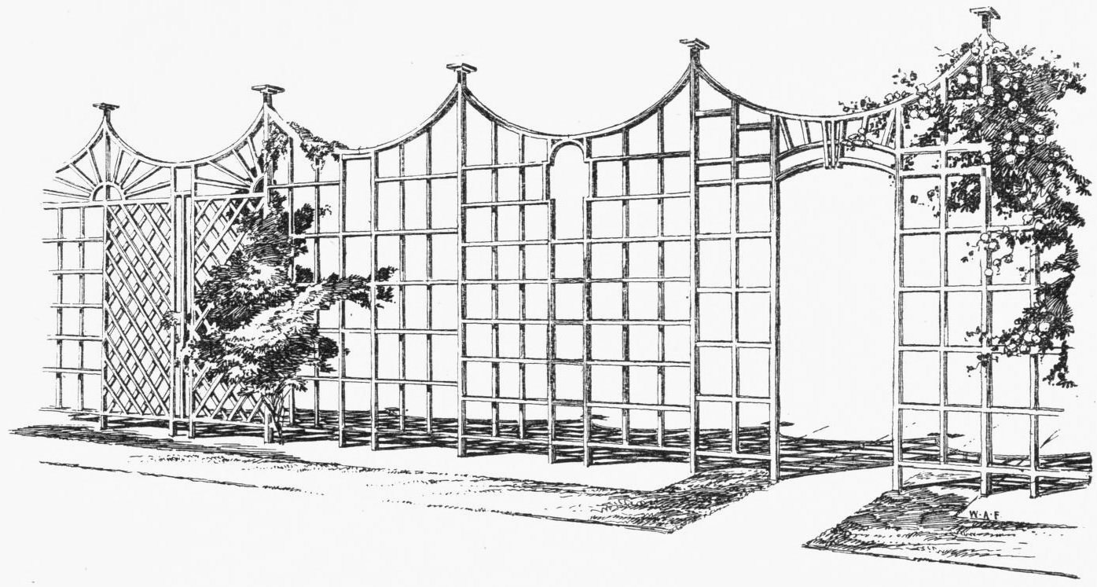
Trellis Introduction
Saurav Das, Charles Chan & Jono Hart
with contributions from many more …
CORD Build 2017, San Jose
December 4, 2017

Slide 2
Outline
What is Trellis?
Why Trellis?
Trellis Roadmap

Slide 3

Trellis
Multi-purpose leaf-spine fabric designed for NFV
Open Source
Software
White Box
Hardware
SDN Based

Slide 4

Trellis – Multi-purpose Leaf-Spine Fabric
ONOS Cluster
Access & Trunk VLANs
IPv4 & IPv6 & MPLS SR
IPv4 & IPv6 Multicast
DHCP L3 relay (IPv4/v6)
vRouter BGPv4/v6(ext.)
L2 bridged
L3 routed
IP multicast
Notes:
Fabric true underlay – never sees vxlan encapsulated addrs
IP down to ToR redundant ToRs
Scales better
Fabric for other purposes

Slide 5
Disaggregation – Bare-metal + Open-Source
Spine Switch
Leaf/Spine Switch Software Stack
White Box Switch
Accton 6712
GE mgmt.
to controller
OpenFlow 1.3
OCP
Software
(ONL,ONIE)
Indigo OF Agent
32 x 40G ports downlink to leaf switches
OF-DPA
Leaf Switch
8 x 40G ports uplink to different spine switches
ECMP across all uplink ports
BRCM ASIC
OCP Bare Metal Hardware
White Box Switch
Accton 6712
OCP: Open Compute Project
ONL: Open Network Linux
ONIE: Open Network Install Environment
BRCM: Broadcom Merchant Silicon ASICs
OF-DPA: OpenFlow Datapath Abstraction
GE mgmt.
24 x 40G ports downlink to servers

Slide 6
Fabric ASIC Pipeline* (BRCM’s OF-DPA)
* Simplified view
Why OF-DPA?
Multi-
cast Routing Table
Allows programming of all
flow-tables & port-groups
via OpenFlow 1.3
OF 1.3
L3 ECMP
Group
MPLS
Label
Group
Phy Port
OF 1.0
Phy Port
Unicast
Routing
Table
MPLS
Label
Group
Ingress
Port Table
Vlan Table
Termin-ation MAC
Table
ACL
Policy
Table
L3
Mcast
Group
Phy Port
L2 Interface
Group
Phy Port
L2 Interface
Group
Phy Port
MPLS
Table
Vlan 1 Table
MPLSL2 Port
Table
L2 Flood
Group
L2 Interface
Group
Phy Port
Achieves Dataplane Scale
Bridging
Table
L2 Interface
Group
Phy Port
Notes:
Talk about data plane scale

Slide 7

Trellis Control Plane Redundancy
M
= Master
= Backup
B
Switches simultaneously connect to several controller instances.
only 1 controller instance is master, several other instances are backups
Mastership is decided by controllers
Switches have no say
B
B
M
B
M
B
M
B
B
M
B
B
Controller instances simultaneously connect to several switches.
Any controller instance can be master or backup for any switch
M
B
B
B
B
B
M
M
B
B
M
B
ONOS Instance 1
ONOS Instance 2
ONOS Instance 3
ONOS Instance 4
ONOS Instance 5
Spreading mastership over controller instances contributes to scale

Slide 8
Trellis Control Plane Redundancy
M
= Master
= Backup
= Retry
B
R
Switches simultaneously connect to several controller instances.
only 1 controller instance is master, several other instances are backups
Mastership is decided by controllers
Switches have no say
Losing controller instances redistributes switch mastership
M
B
R
M
R
B
Switches continue to retry lost connections
M
B
R
R
M
R
Controller instances simultaneously connect to several switches.
Any controller instance can be master or backup for any switch
Management watchdog can reboot lost
controller instances
M
M
B
M
B
B
M
ONOS Instance 1
ONOS Instance 2
ONOS Instance 3
ONOS Instance 4
ONOS Instance 5
Spreading mastership over controller instances contributes to scale

Slide 9


Trellis Data Plane Redundancy
Spine Switch
Spine Switch
ECMP group
ECMP group
Leaf Switch
Leaf Switch
Access Equipment
Leaf Switch
Leaf Switch

Slide 10

Trellis – CORD Network Infrastructure
Unified SDN Control
Of Underlay & Overlay
Datacenter Leaf-Spine Fabric Underlay
ONOS
Controller Cluster & Apps
Virtual Network Overlay
Trellis Provides Common control over underlay & overlay networks, including
Service Composition for Tenant Networks
Distributed Virtual Routing
Optimized Delivery of Multicast Traffic Streams
Trellis is the enabling Network Infrastructure for CORD

Slide 11
CORD Architecture
XOS
Other Apps
Other
Apps
Overlay
Control
Underlay Control
vRouter
ONOS
TRELLIS
White Box
White Box
White Box
White Box
Metro
Router
White Box
White Box
White Box
White Box
White Box
White Box
White Box
White Box
White Box
White Box
White Box
White Box
R,E,M-Access
OVS
OVS
OVS
OVS
OVS
vSG
VNF
VNF
VNF
VNF
Access
Links
vSG
VNF
VNF
VNF
VNF
vSG
VNF
VNF
VNF
VNF
3

Slide 12
Outline
What is Trellis?
Why Trellis?
Trellis Roadmap

Slide 13
Why Trellis?
Trellis is designed for Service Providers & NFV

Slide 14
Trellis in CORD
Service Creation
and Orchestration
CORD Controller (XOS)
vOLT
Control
…
vRouter
Control
Control Plane VNFs
as SDN apps
AAA
Control
DHCP
Relay
Fabric
Control
SDN Controller (ONOS Cluster)
…
NETCONF
OpenFlow 1.3
Bare-metal
Open-source
Leaf-Spine Fabric
Spine
Spine
Spine
Multi-vendor
ONT/ONUs & RG
XGS-PON Whitebox OLT
(EdgeCore)
Maple
QumranAX
ToR
ToR
ToR
ToR
Maple
QumranAX
ToR
ToR
ToR
ToR
VOLTHA
CDN
CDN
Metro Routers
VOLTHA
vSG
vSG
Dataplane VNFs in
Edge Compute
3rd Party Service VNFs

Slide 15
Why Trellis?
Trellis is designed for Service Providers & NFV
SDN allows simpler/easier/optimized features

Slide 16

vRouter as a VNF?
vRouter in Software?
Management (CLI, SNMP, NetCONF)
Management (CLI, SNMP, NetCONF)
VNFM
(VNF Manager)
Control Plane
(OSPF, BGP ..)
Control Plane
(OSPF, BGP ..)
VNF = vRouter VM
(vCPE, vBNG,
vPGW, vBRAS)
Dataplane
Dataplane
CP
Underlay Network
DP
DP
DP
VNF
CP
vRouter
VM
DP
VNF
VNF
DP
DP
Issues: Hairpinning
Embedded control plane complicates scale-out
Issue: Still hairpinning through a load-balancer

Slide 17
vRouter Operation
Trellis vRouter
ONOS Controller Cluster
Overlay Control
Underlay Control
vRouter app
ONOS
ONOS Controller Cluster
Quagga
(or other)
OSPF
I-BGP
Router
OVS
OVS
OVS
OVS
Router
VM
VM
VNF
VNF
External

Slide 18
Trellis vRouter
vRouter Operation
ONOS Controller Cluster
Overlay Control
Underlay Control
vRouter
ONOS
ONOS Controller Cluster
Quagga
(or other)
OSPF
I-BGP
Router
OVS
OVS
OVS
OVS
Router
VM
VM
VNF
VNF
External

Slide 19
vRouter Operation
Trellis vRouter → Implemented as a big distributed router
→ Presents entire n/w infrastructure as a single router to outside world
ONOS Controller Cluster
Overlay Control
Underlay Control
vRouter
ONOS
ONOS Controller Cluster
Quagga
(or other)
OSPF
I-BGP
Router
OVS
OVS
OVS
OVS
Router
VM
VM
VNF
VNF
External

Slide 20
Why Trellis?
Trellis is designed for Service Providers & NFV
SDN allows simpler/easier/optimized features
SDN + Programmable pipelines == New features

Slide 21
SDN + Programmable Pipelines
P4
OpenConfig
control
configuration
ONOS
control
config
P4Runtime
gNMI

Slide 22
Why Trellis?
Trellis is designed for Service Providers & NFV
SDN allows simpler/easier/optimized features
SDN + Programmable pipelines == New features
Open-source == SP ownership & customizability

Slide 23
Outline
What is Trellis?
Why Trellis?
Trellis Roadmap

Slide 24
Trellis Roadmap vs. Trellis-CORD Roadmap
Trellis Features Used in CORD
  Bridging & VLANs (Access/Trunk/Native)
  IPv4 Unicast & Multicast Routing
  vRouter – BGPv4 & Static Routing
Trellis Features To-Be-Used in CORD
  Dual-Homing
  IPv6
  DHCP L3 relay
  Pseudowires

Slide 25
Trellis Roadmap
Upcoming ONOS 1.12 release (Dec 2017)
  Dual-homing (released 1.11.1) fixes for known issues
  Pseudowire support
  Initial QoS support
  IPv6 additional features
    DHCPv6 relay additional features (contributed by Nokia)
    IPv6 Multicast (contributed by Nokia)
    IPv6 Router Advertisement app (contributed by Infosys)
  Support for New ASICs & Bare-metal switches
    Broadcom Qumran (QMX)
    Cavium Xpliant
    Quanta switches (QCT LY8)
    Barefoot Tofino using P4 (not in 1.12 release)

Slide 26
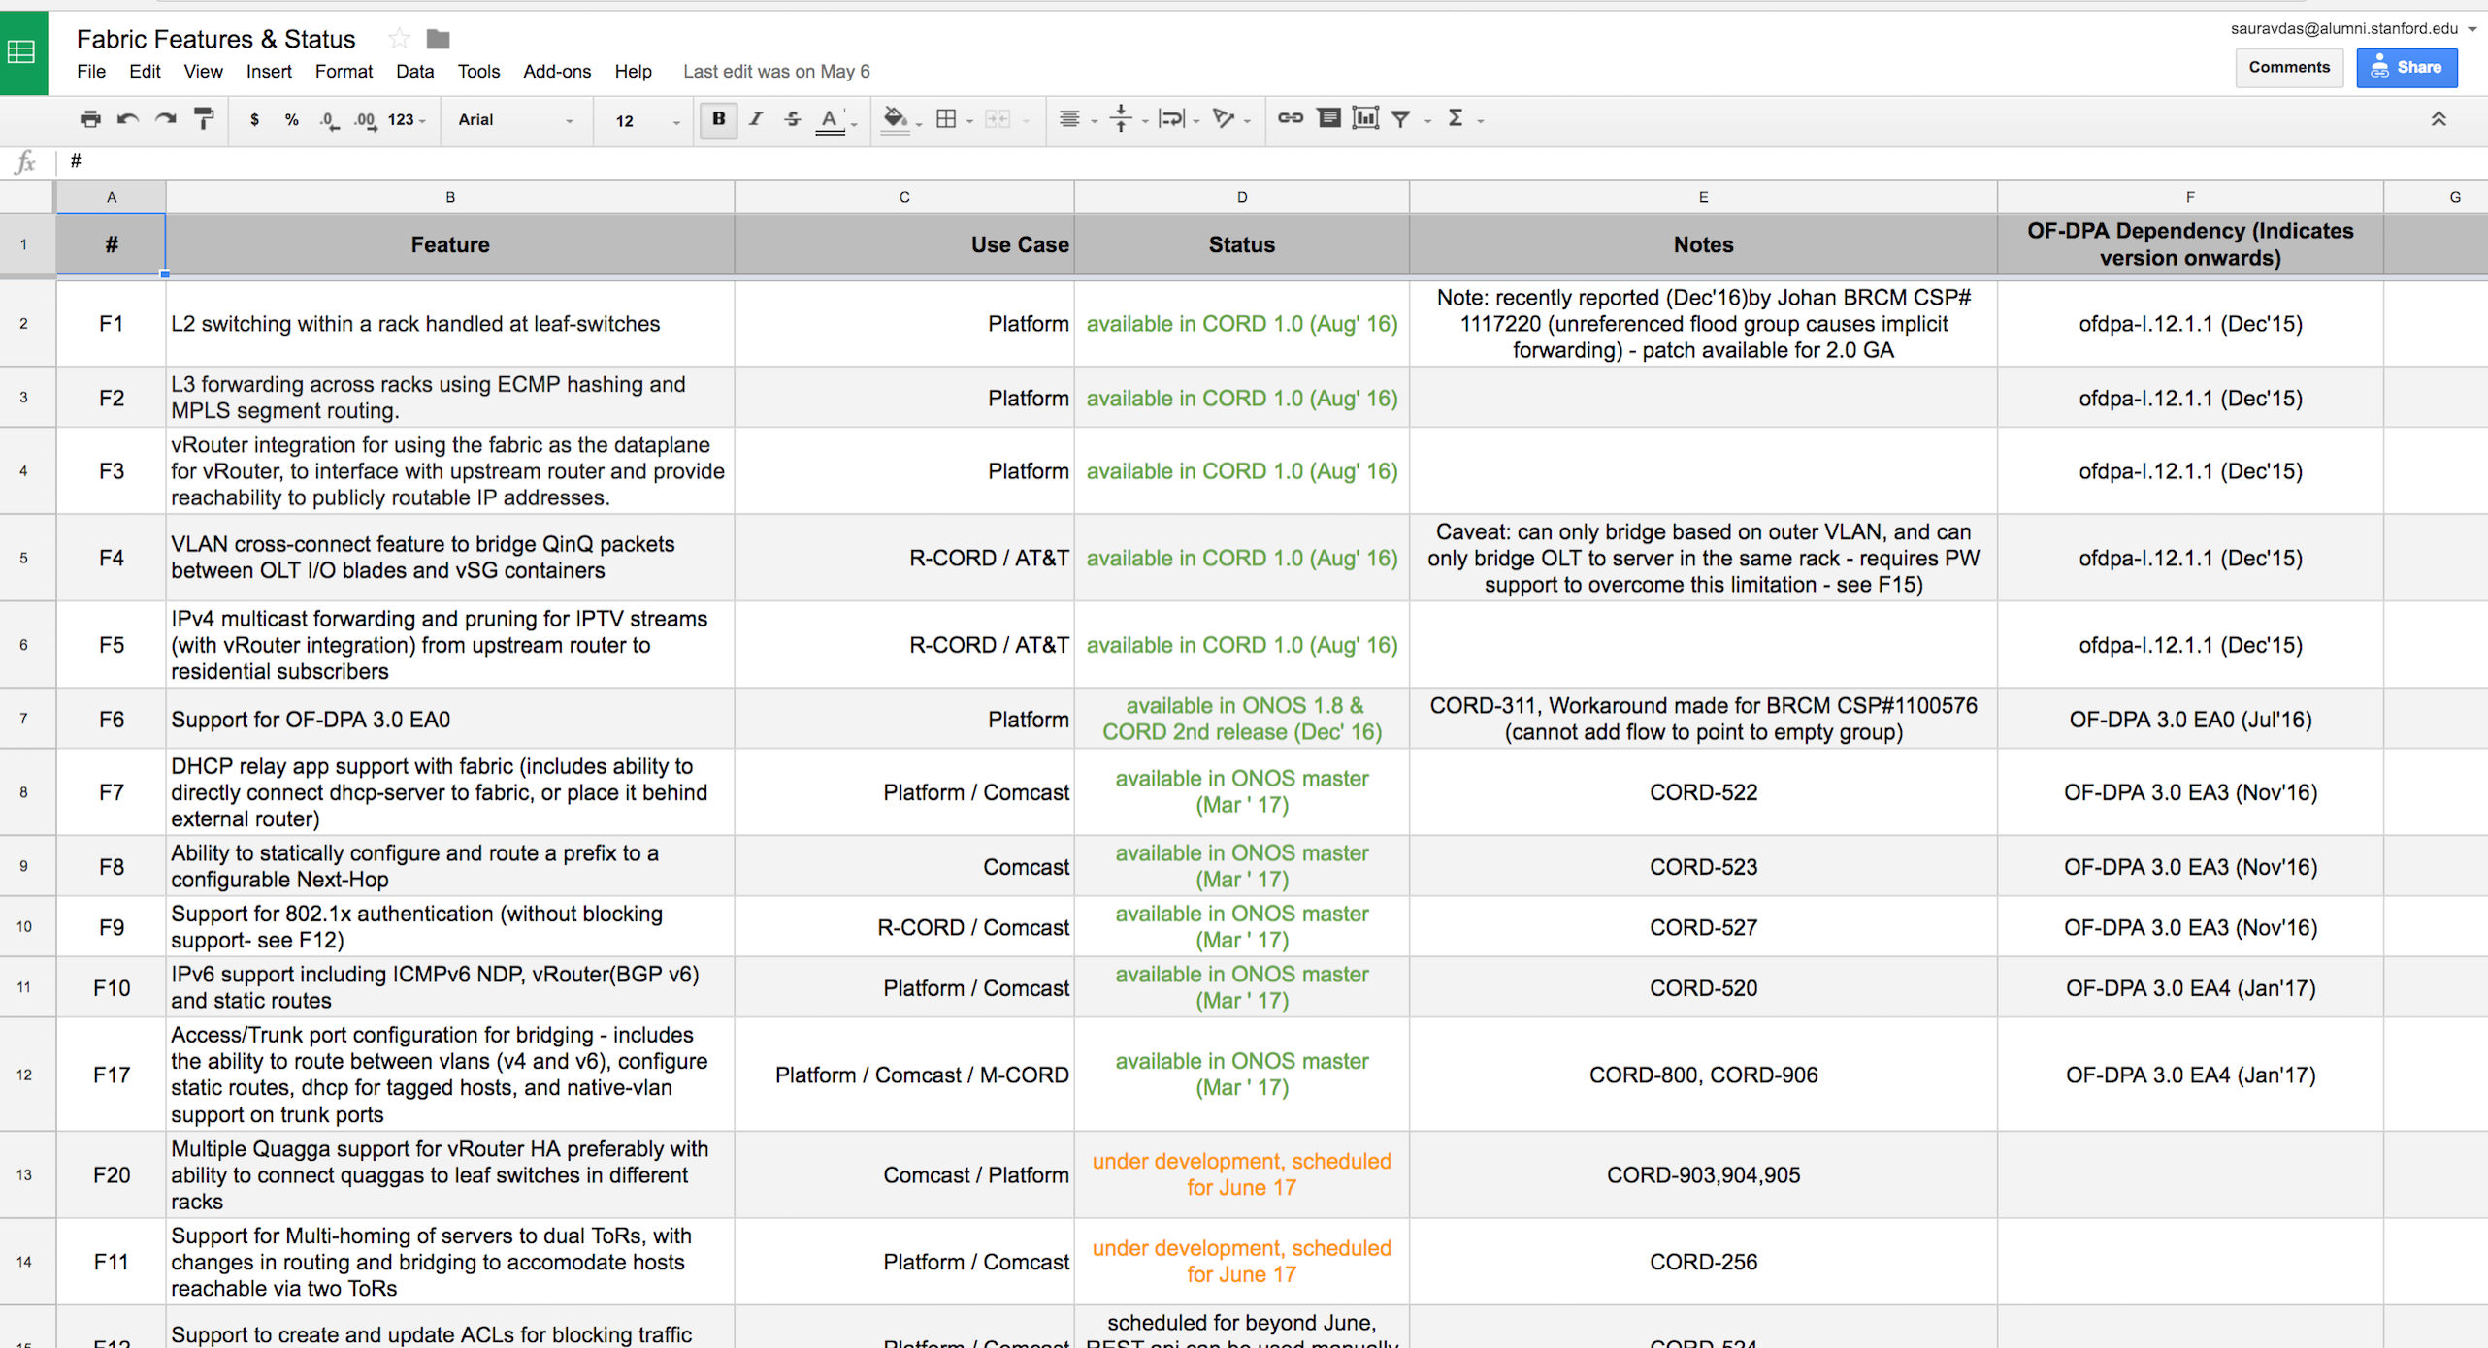
Roadmap
See here for complete roadmap
https://docs.google.com/spreadsheets/d/1SmKxsZ9iHtLHoEtvsntsJ98tLf_cYT_qXuuO7eAUtt4/edit?usp=sharing

Slide 27
Summary
What is Trellis?
  Multi-purpose leaf-spine fabric
  Built with → bare-metal hardware + open-source software + SDN
  Overlay + Underlay when used in CORD
Why Trellis?
  Designed for SP use cases & NFV
  SDN allows simpler, easier & more-optimized features
  SDN + P4 = new features in hardware
  Open-source gives SP’s ownership & full customizabilty
Trellis Roadmap
    Different roadmaps for Trellis, and the use of Trellis in CORD

Slide 28











Thank you !
and more…

