Slide 1
R-CORD & VOLTHA Introduction
Saurav Das (ONF) & Shawn Ying (AT&T)
CORD Build 2017, San Jose
November 6, 2017

Slide 2
Central Office Re-Architected as a Datacenter (CORD) Overview
Economies of a datacenter
  Infrastructure built with a few commodity building blocks using open source software and white-box switches
Cloud
SDN
NFV
Agility of a cloud provider
Software platforms that enable rapid creation of new services
or… Bringing Access-as-a-Service to the Cloud
Notes:
If you go and talk to service providers around the globe they will tell you they want essentially two things:
1. Economies of a data center
2. Agility of a cloud provider
Each service provider may articulate it differently but it comes down to these two high level requirements.
What do these requirements mean?
This means service providers want to build their infrastructure like the datacenters – that is build it using a few commodity building blocks that use open source software and hardware.
For example datacenters use commodity servers, white boxes for the leaf and spine switches, and many open source software platforms and tools.
The net result is that the service providers can scale their infrastructure and significantly reduce capex and opex.
Agility means they want to introduce new revenue generating services quickly – what cloud providers do so well.
In short this comes down to: reduce expenses and grow revenue
Every business needs to do that, especially service providers given their business realities and compete well with OTT providers.

Slide 3


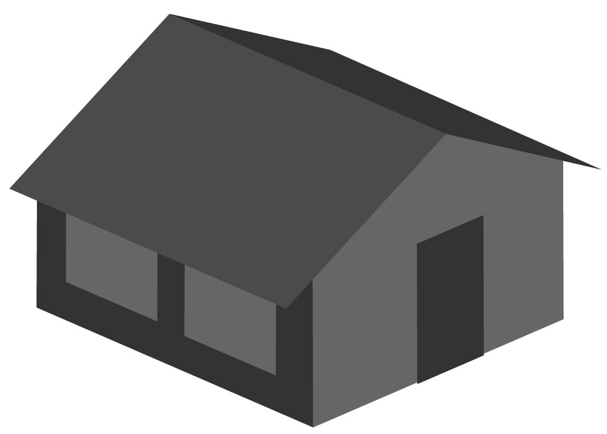



CORD: Multi-Access Architecture
Residential
vOLT, vSG, vRouter, vCDN
Mobile
vBBU. vMME, vSGW, vPGW, vCDN
Enterprise
vCarrierEthernet, vOAM, vWanEx, vIDS
Access Service Orchestration & Control
White-box Switches with
Merchant Silicon
Metro Ethernet
BBUs
PON OLTs
COTS (Off-the-Shelf) x86 Compute
ROADM (Core)

Slide 4


Residential CORD
Service Creation
and Orchestration
CORD Controller (XOS)
vOLT
Control
…
vRouter
Control
Control Plane VNFs
as SDN apps
AAA
Control
DHCP
Relay
Fabric
Control
SDN Controller (ONOS Cluster)
…
NETCONF
OpenFlow 1.3
Bare-metal
Open-source
Leaf-Spine Fabric
Spine
Spine
Spine
Multi-vendor
ONT/ONUs & RG
XGS-PON Whitebox OLT
(EdgeCore)
Maple
QumranAX
ToR
ToR
ToR
ToR
Maple
QumranAX
ToR
ToR
ToR
ToR
VOLTHA
CDN
CDN
Metro Routers
VOLTHA
vSG
vSG
Dataplane VNFs in
Edge Compute
3rd Party Service VNFs

Slide 5
Virtual OLT Hardware Abstraction (VOLTHA)
VOLTHA hides PON-level details (T-CONT, GEM ports, OMCI etc.) from the SDN controller,
and abstracts each PON as a pseudo-Ethernet switch easily programmed by the SDN controller
VOLTHA
northbound
Envoy (REST)
OpenFlow Agent
NetConf agent
Common control and management
framework shared by all
OLTs &ONUs
VOLTHA
core
global_handler
dispatcher
config_root
grpc_server
kafka_client
adapter_agent
fluentd
config_proxy
consul
registrator
VOLTHA southbound adapters
Calix
Ciena
ASFvOLT16
Tibit
Nokia
Adtran
Calix
OLT
Ciena
OLT
Whitebox OLT (EdgeCore)
Tibit Micro-OLT
Nokia
OLT
Adtran OLT
Notes:
Common abstraction layer for multiple vendors OLTs and ONUs
VOLTHA core handles PON details
Presents and OF switch abstraction northbound
OLT and ONU adapters are separated with the goal of allowing interop between different vendors
Architected using modern cloud-native principles. Leverages Docker for containerization and different functions run in different docker containers. Docker Swarm for HA

Slide 6

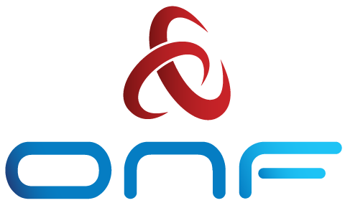
BBWF R-CORD & VOLTHA Demo
CORD Head Node
…
MAAS
ONOS
XOS
OpenStack
CORD Compute Node
VOLTHA
OvS
vSG
Internet
Whitebox ToR Fabric Switch
EdgeCore 7712 (Tomahawk 32 x 100G)
Residential Subscribers
EdgeCore Whitebox OLT (ASFvOLT16)
BCM
ONU
RG
Central Office
Nokia SD-OLT
(LightSpan CF-24W)
Nokia
ONU
RG

Slide 7
802.1x Subscriber Authentication
CORD Head Node
…
Radius
ONOS
XOS
OpenStack
CORD Compute Node
VOLTHA
OvS
vSG
Internet
Whitebox ToR Fabric Switch
EdgeCore 7712 (Tomahawk 32 x 100G)
Residential Subscribers
EdgeCore Whitebox OLT (ASFvOLT16)
BCM
ONU
RG
Central Office
Nokia SD-OLT
(LightSpan CF-24W)
Nokia
ONU
RG

Slide 8
Subscriber VLAN Provisioning
CORD Head Node
…
Radius
ONOS
XOS
OpenStack
CORD Compute Node
VOLTHA
OvS
vSG
Internet
Whitebox ToR Fabric Switch
EdgeCore 7712 (Tomahawk 32 x 100G)
Residential Subscribers
EdgeCore Whitebox OLT (ASFvOLT16)
BCM
ONU
RG
Central Office
Nokia SD-OLT
(LightSpan CF-24W)
Nokia
ONU
RG

Slide 9
Subscriber Data-plane Traffic
CORD Head Node
…
Radius
ONOS
XOS
OpenStack
CORD Compute Node
VOLTHA
OvS
vSG
Internet
Whitebox ToR Fabric Switch
EdgeCore 7712 (Tomahawk 32 x 100G)
Residential Subscribers
EdgeCore Whitebox OLT (ASFvOLT16)
BCM
ONU
RG
Central Office
Nokia SD-OLT
(LightSpan CF-24W)
Nokia
ONU
RG

Slide 10
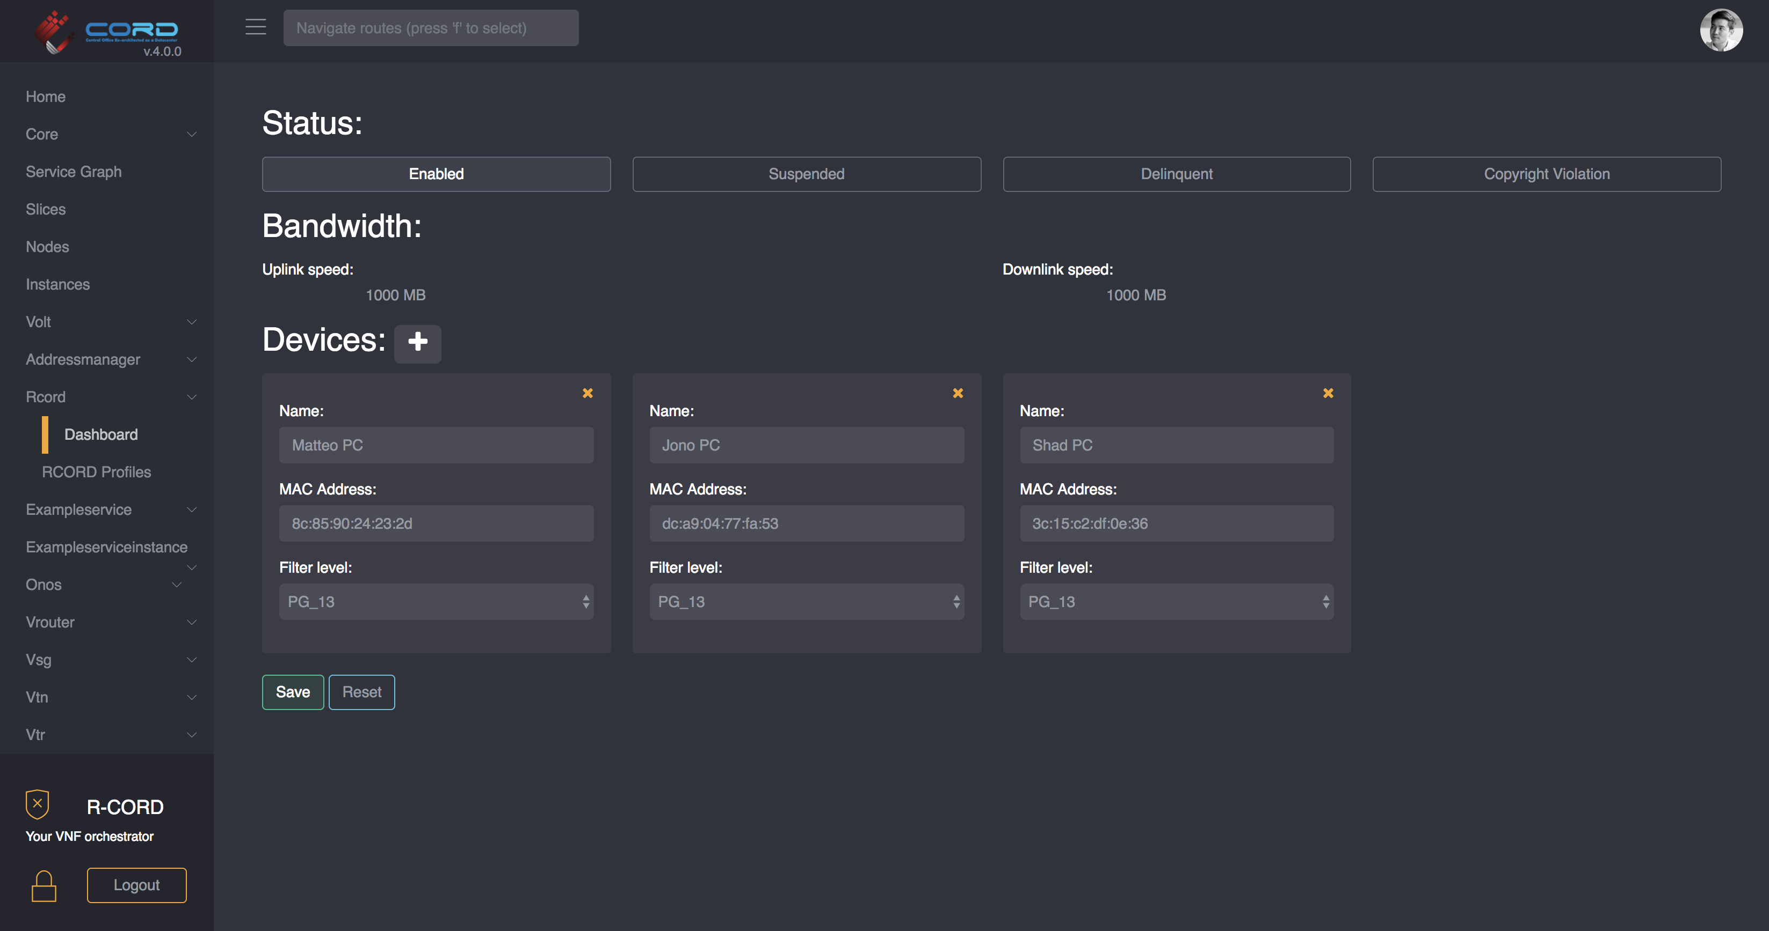
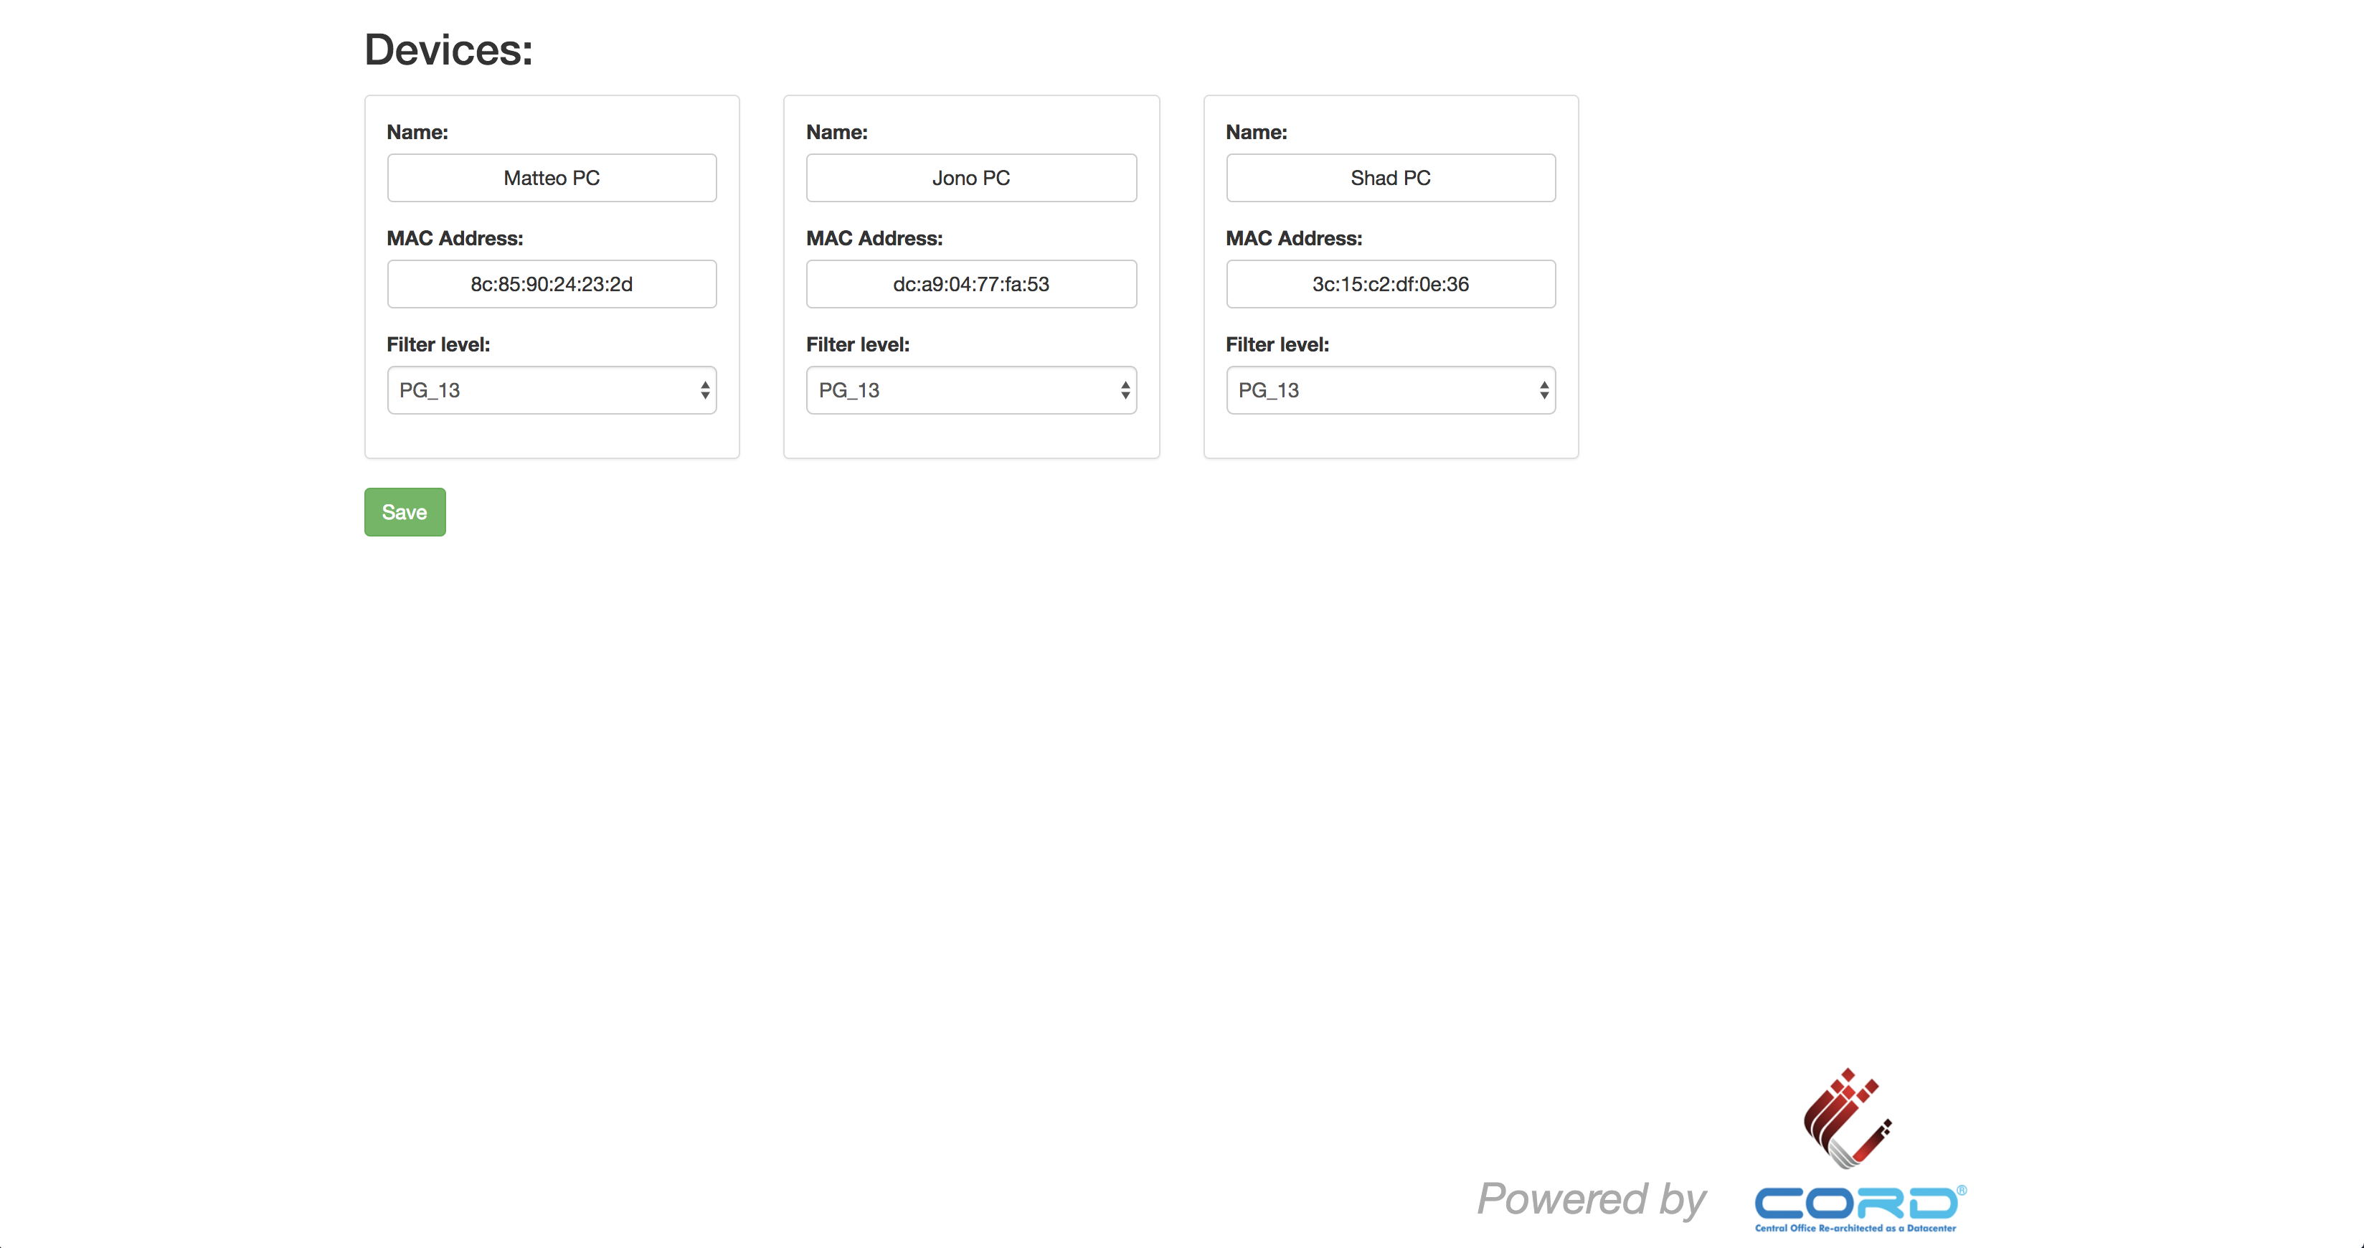
Subscriber Services
CORD Head Node
Operator view
…
Radius
ONOS
XOS
OpenStack
CORD Compute Node
CDN
Video
Source
VOLTHA
OvS
Subscriber view
vSG
Internet
Whitebox ToR Fabric Switch
EdgeCore 7712 (Tomahawk 32 x 100G)
Residential Subscribers
EdgeCore Whitebox OLT (ASFvOLT16)
BCM
ONU
RG
Central Office
Nokia SD-OLT
(LightSpan CF-24W)
Nokia
ONU
RG

Slide 11
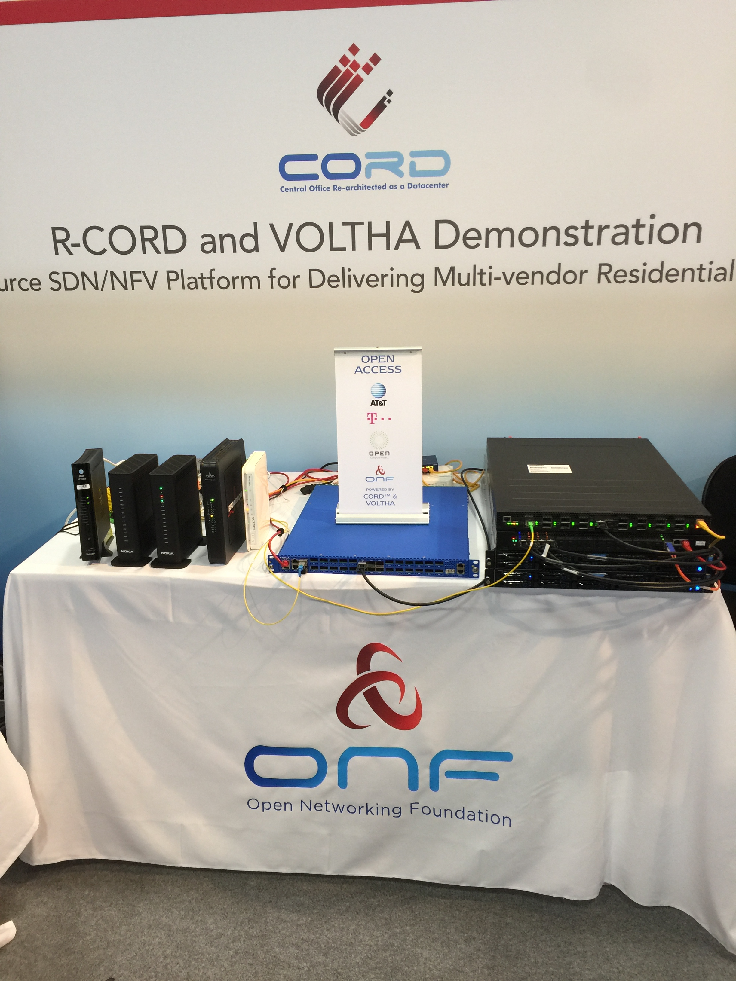



BBWF Booth E107B

