Slide 1

Broadband Access Pivot to Disaggregation and Microservices
Broadband World Forum, Berlin, October 26, 2017
Architecture & Planning
1057 Lenox Park Blvd.
Room A473
Atlanta, GA 30319
+1.404.499.7003
tom.anschutz@att.com
Tom Anschutz
Notes:
Acknowledgements go to Mark Shostak and Mounire El-Houmaidi for their help in developing and maturing these concepts.

Slide 2

Network Functions Cloudification
Network Functions need to be disaggregated and cloudified.
  Disaggregate VNF bundles of functions
  Decompose functions into simpler patterns and common subsystems – both hardware and software
  Design using Cloud Characteristics
  Introduce layers of software abstraction to hide complexity – frameworks
  Design them as cattle, not as pets
  For Example: IT systems were initially ported to VMs, but later re-written for the cloud using scale-out building blocks like Cassandra, Hadoop, and Memcached. These blocks were then used as compositional elements in web-scale applications.
Cloud Characteristics
  On-demand Self-service
  Broad Network Access
  Resource Pooling
  Rapid Elasticity
  Measured Service

Slide 3
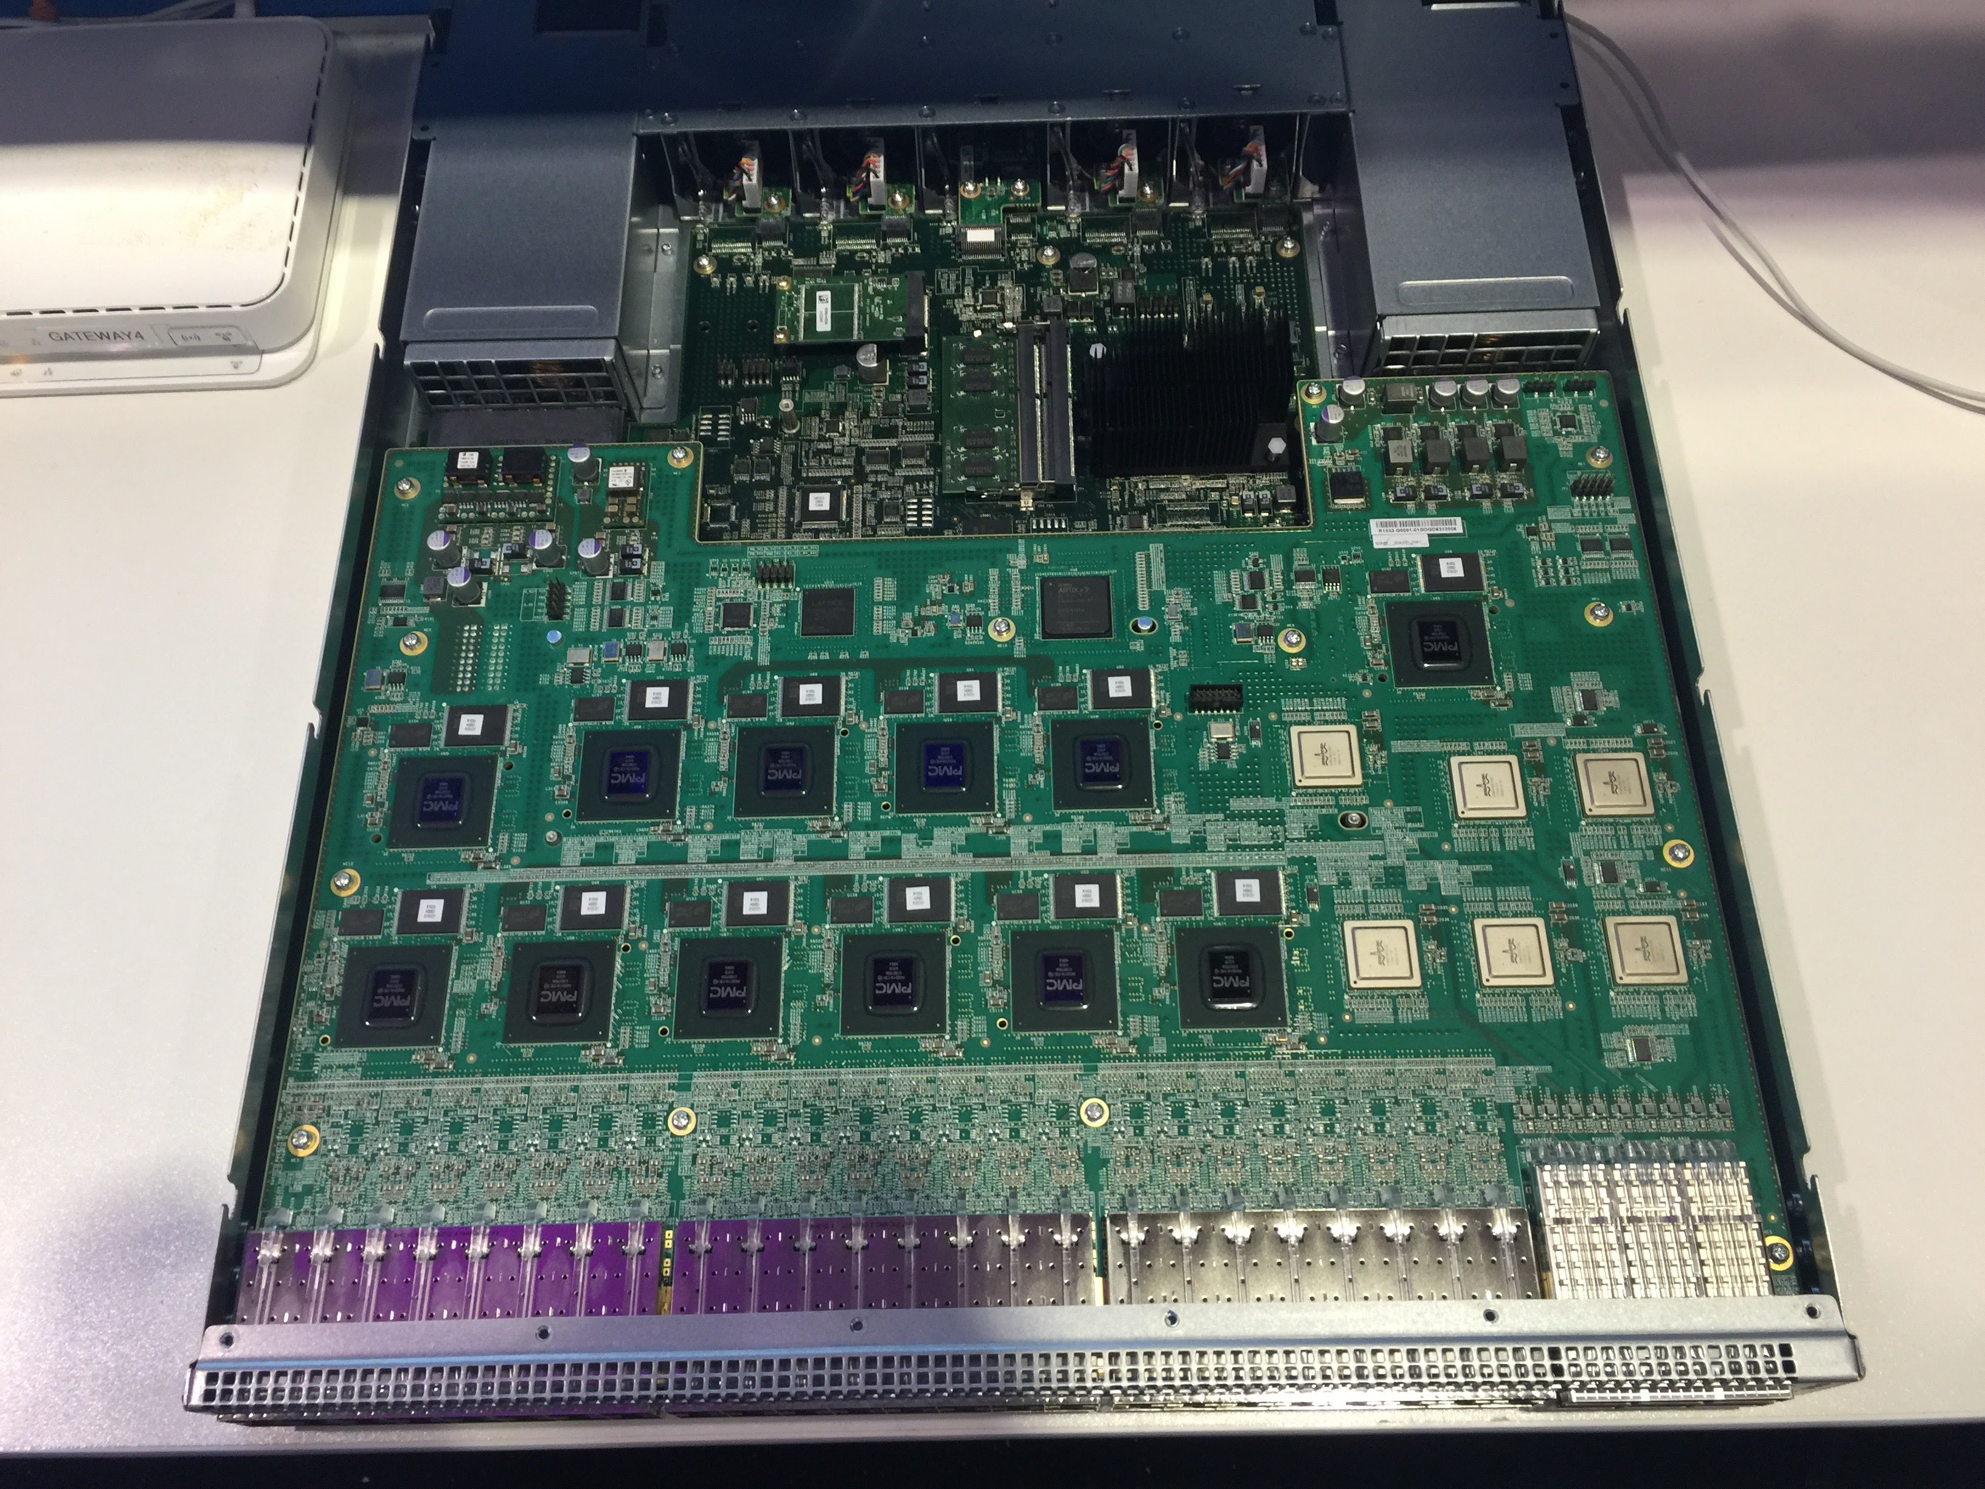

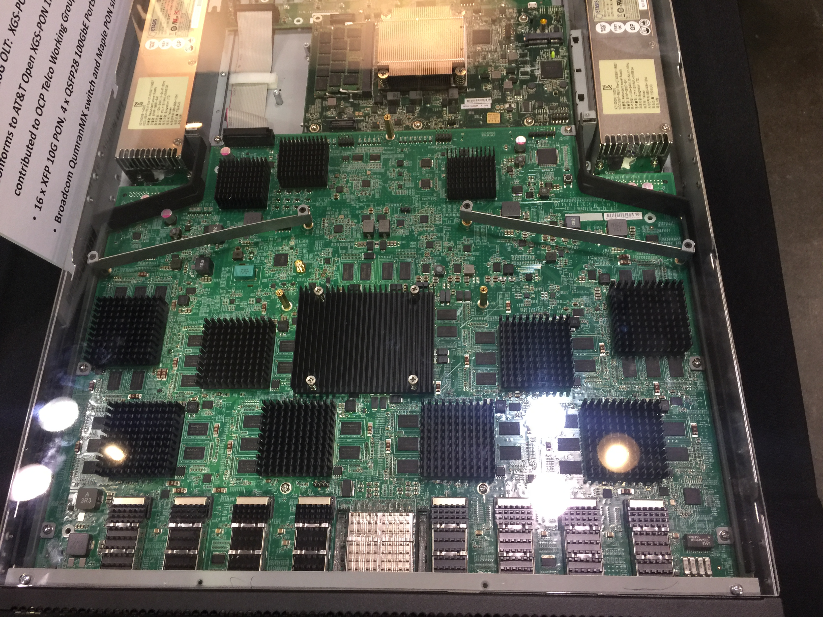
Hardware PON Peripherals
Open Compute Project Specifications
  Simpler than traditional OLTs
  Open hardware specs from OCP
  Sourced from multiple suppliers
  Same operations across suppliers
  Reduced OPEX
  Your choice of software stack
  48 Port GPON OLT done
  16 Port XGS-PON OLT done
  Other specs in progress
    uCPE, G.fast
48 Port GPON OLT
Stay here for an introduction to OCP
It’s the very next presentation!
Or visit the OCP Booth (FA13B Hall 22b)
16 Port XGS-PON OLT

Slide 4
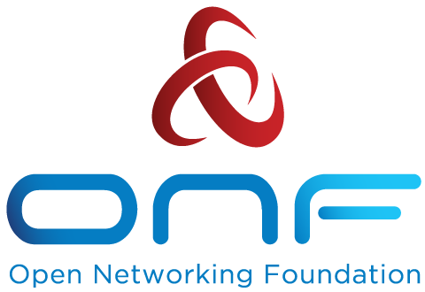
Virtual OLT Hardware Abstraction (VOLTHA): One Microservice for Many Peripherals
This is a single open source software stack to drive many access hardware types.
VOLTHA hides PON-level details (T-CONT, GEM ports, OMCI etc.) from the SDN controller,
and abstracts each PON as a pseudo-Ethernet switch easily programmed by the SDN controller
VOLTHA
northbound
Envoy (REST)
OpenFlow Agent
NetConf agent
Common control and management
framework shared by all
OLTs &ONUs
VOLTHA
core
global_handler
dispatcher
config_root
grpc_server
kafka_client
adapter_agent
fluentd
config_proxy
consul
registrator
VOLTHA southbound adapters
Calix
Ciena
ASFvOLT16
Tibit
Nokia
Adtran
See this Demonstrated!
ONF Booth E107B
G.fast in V2.0
Calix
OLT
Ciena
OLT
Whitebox OLT (EdgeCore)
Tibit Micro-OLT
Nokia
OLT
Adtran OLT
Notes:
Designed software stack as micro-services, using standard, existing, distributed data architectures that provide high availability and scale-out without needing highly available or scalable compute hardware.
Use Abstractions in the stack to hide complexity. GPON specifics are handled at a low layer and hidden from the SDN controller, instead, a view is provided of an Ethernet switch device. Thus, SDN applications require much less modification when technologies and devices change.
Let the abstractions build the system. Instead of having the OSS/NMS provision every detail on every element, those layers stay clean with details handled by the controller, agent, and even the drivers. Things that don’t matter to the business are not exposed or required in ONAP.
Change how the system works to reduce operational complexity. Have the system learn new ONTs and bind them to a customer, rather than asking technicians to provision serial numbers into an OSS to enable them. Don’t provision connectivity, but assemble it on demand as customers are authenticated. Thus, failures look similar to deployments and are handled with aplomb.
Instrument the software for the things we want to know. KPIs, operational and other analytic data are provided by the system and not through add-on probes. Unneeded info does not clog the system.

Slide 5
Summary
Disaggregation Allows Design for Re-Use, Availability and Simple Operations
    Hardware can be simplified when it’s a cloud peripheral
    Software can be modified, simplified and made available when it’s a set of elastic microservices.
Open Specs and Open Source Enable Telco-Engineered Solutions
    Have the software work your operations rather than operations work the software.
    Harmonize hardware operational paradigms to consolidate tools and approaches.
    Unbundling hardware components allows design and composition of the system to engineer availability.

Slide 7
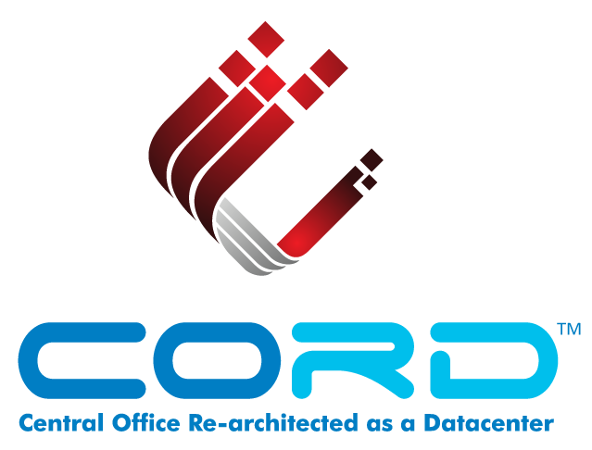
VOLTHA
&
Residential CORD
Saurav Das
Director of Engineering, ONF

Slide 8
Central Office Re-Architected as a Datacenter (CORD) Overview
Economies of a datacenter
  Infrastructure built with a few commodity building blocks using open source software and white-box switches
Cloud
SDN
NFV
Agility of a cloud provider
Software platforms that enable rapid creation of new services
or… Bringing Access-as-a-Service to the Cloud
Notes:
If you go and talk to service providers around the globe they will tell you they want essentially two things:
1. Economies of a data center
2. Agility of a cloud provider
Each service provider may articulate it differently but it comes down to these two high level requirements.
What do these requirements mean?
This means service providers want to build their infrastructure like the datacenters – that is build it using a few commodity building blocks that use open source software and hardware.
For example datacenters use commodity servers, white boxes for the leaf and spine switches, and many open source software platforms and tools.
The net result is that the service providers can scale their infrastructure and significantly reduce capex and opex.
Agility means they want to introduce new revenue generating services quickly – what cloud providers do so well.
In short this comes down to: reduce expenses and grow revenue
Every business needs to do that, especially service providers given their business realities and compete well with OTT providers.

Slide 9
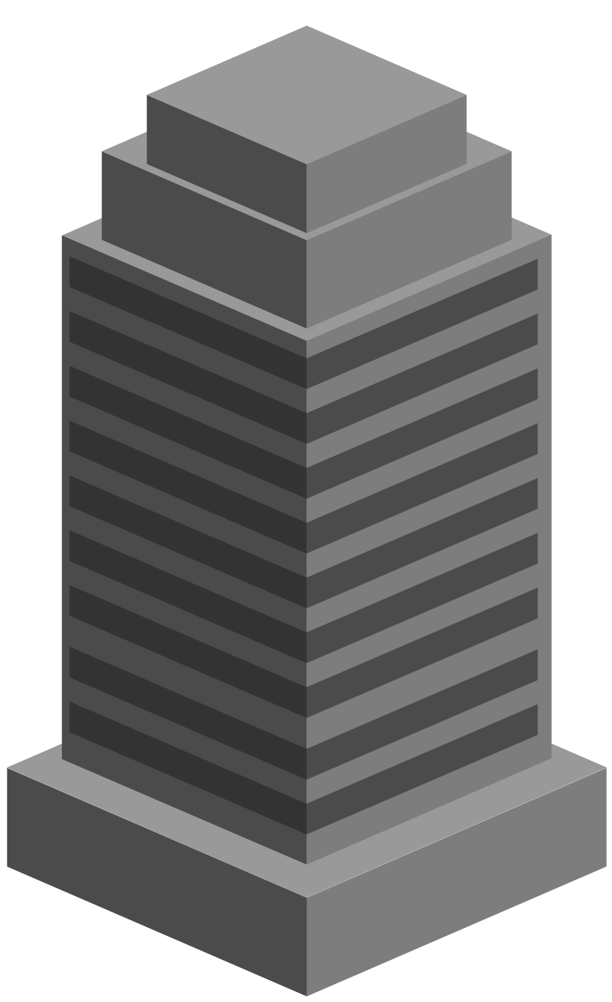

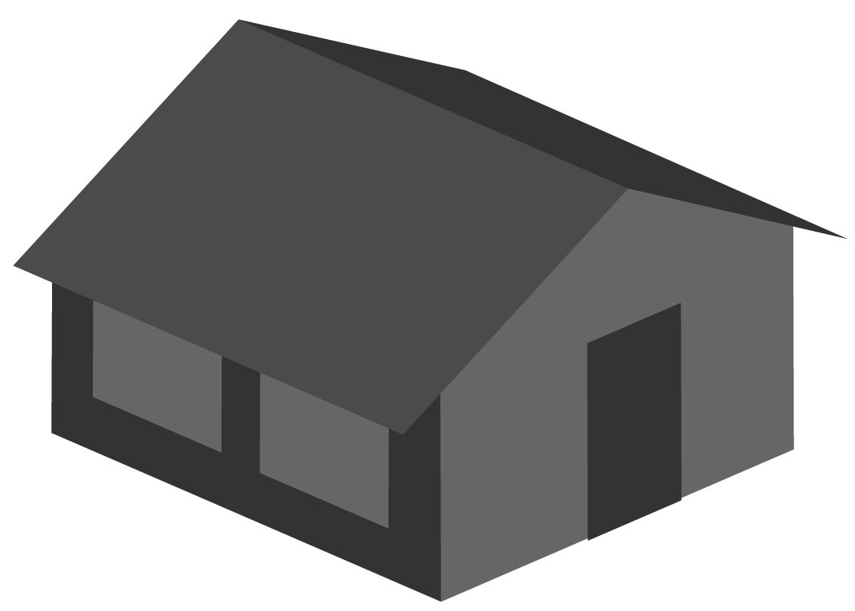



CORD: Multi-Access Architecture
Residential
vOLT, vSG, vRouter, vCDN
Mobile
vBBU. vMME, vSGW, vPGW, vCDN
Enterprise
vCarrierEthernet, vOAM, vWanEx, vIDS
Access Service Orchestration & Control
White-box Switches with
Merchant Silicon
Metro Ethernet
BBUs
PON OLTs
COTS (Off-the-Shelf) x86 Compute
ROADM (Core)

Slide 10


Residential CORD
Service Creation
and Orchestration
CORD Controller (XOS)
vOLT
Control
…
vRouter
Control
Control Plane VNFs
as SDN apps
AAA
Control
DHCP
Relay
Fabric
Control
SDN Controller (ONOS Cluster)
…
NETCONF
OpenFlow 1.3
Bare-metal
Open-source
Leaf-Spine Fabric
Spine
Spine
Spine
Multi-vendor
ONT/ONUs & RG
XGS-PON Whitebox OLT
(EdgeCore)
Maple
QumranAX
ToR
ToR
ToR
ToR
Maple
QumranAX
ToR
ToR
ToR
ToR
VOLTHA
CDN
CDN
Metro Routers
VOLTHA
vSG
vSG
Dataplane VNFs in
Edge Compute
3rd Party Service VNFs

Slide 11

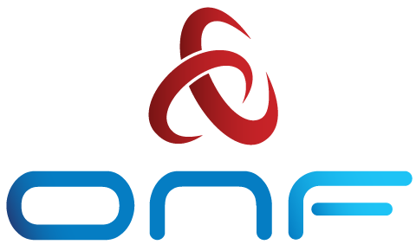
BBWF R-CORD & VOLTHA Demo
CORD Head Node
…
MAAS
ONOS
XOS
OpenStack
CORD Compute Node
VOLTHA
OvS
vSG
Internet
Whitebox ToR Fabric Switch
EdgeCore 7712 (Tomahawk 32 x 100G)
Residential Subscribers
EdgeCore Whitebox OLT (ASFvOLT16)
BCM
ONU
RG
Central Office
Nokia SD-OLT
(LightSpan CF-24W)
Nokia
ONU
RG

Slide 12
802.1x Subscriber Authentication
CORD Head Node
…
Radius
ONOS
XOS
OpenStack
CORD Compute Node
VOLTHA
OvS
vSG
Internet
Whitebox ToR Fabric Switch
EdgeCore 7712 (Tomahawk 32 x 100G)
Residential Subscribers
EdgeCore Whitebox OLT (ASFvOLT16)
BCM
ONU
RG
Central Office
Nokia SD-OLT
(LightSpan CF-24W)
Nokia
ONU
RG

Slide 13
Subscriber VLAN Programming
CORD Head Node
…
Radius
ONOS
XOS
OpenStack
CORD Compute Node
VOLTHA
OvS
vSG
Internet
Whitebox ToR Fabric Switch
EdgeCore 7712 (Tomahawk 32 x 100G)
Residential Subscribers
EdgeCore Whitebox OLT (ASFvOLT16)
BCM
ONU
RG
Central Office
Nokia SD-OLT
(LightSpan CF-24W)
Nokia
ONU
RG

Slide 14
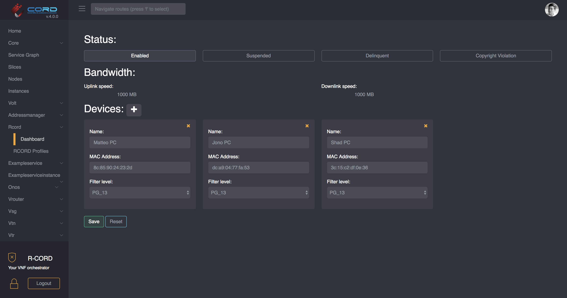
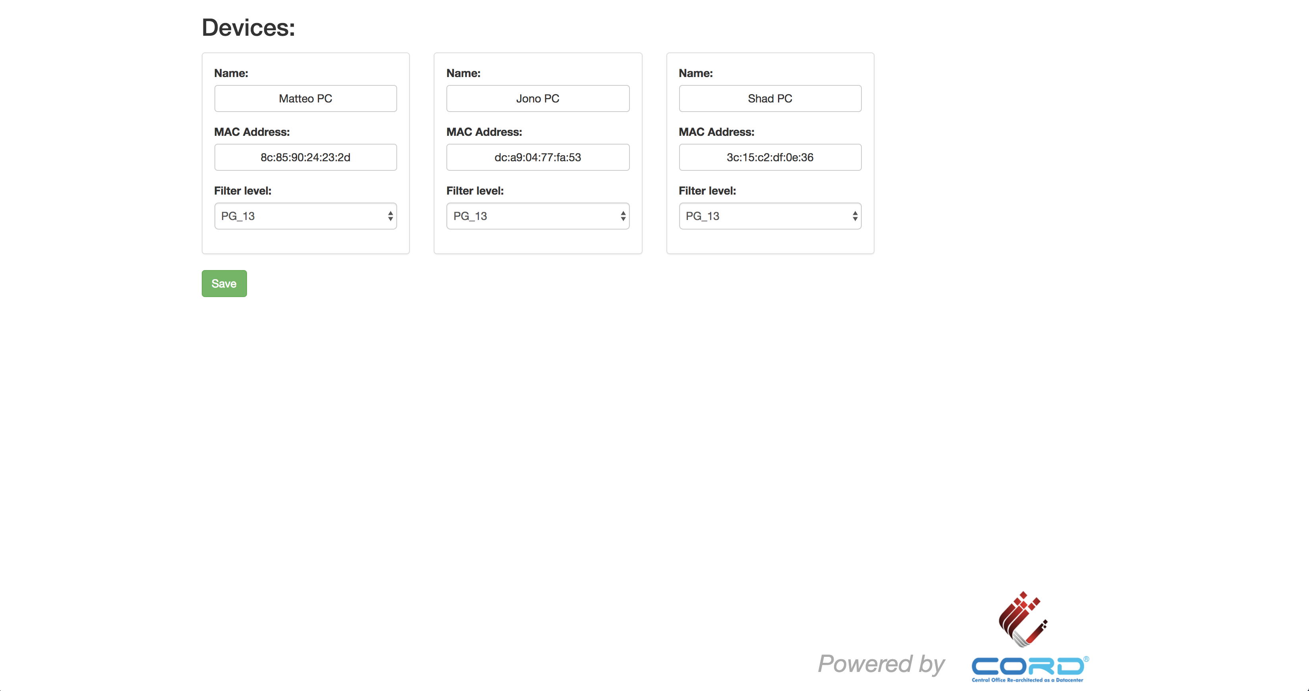
Subscriber Services
CORD Head Node
Operator view
…
Radius
ONOS
XOS
OpenStack
CORD Compute Node
CDN
Video
Source
VOLTHA
OvS
Subscriber view
vSG
Internet
Whitebox ToR Fabric Switch
EdgeCore 7712 (Tomahawk 32 x 100G)
Residential Subscribers
EdgeCore Whitebox OLT (ASFvOLT16)
BCM
ONU
RG
Central Office
Nokia SD-OLT
(LightSpan CF-24W)
Nokia
ONU
RG

Slide 15
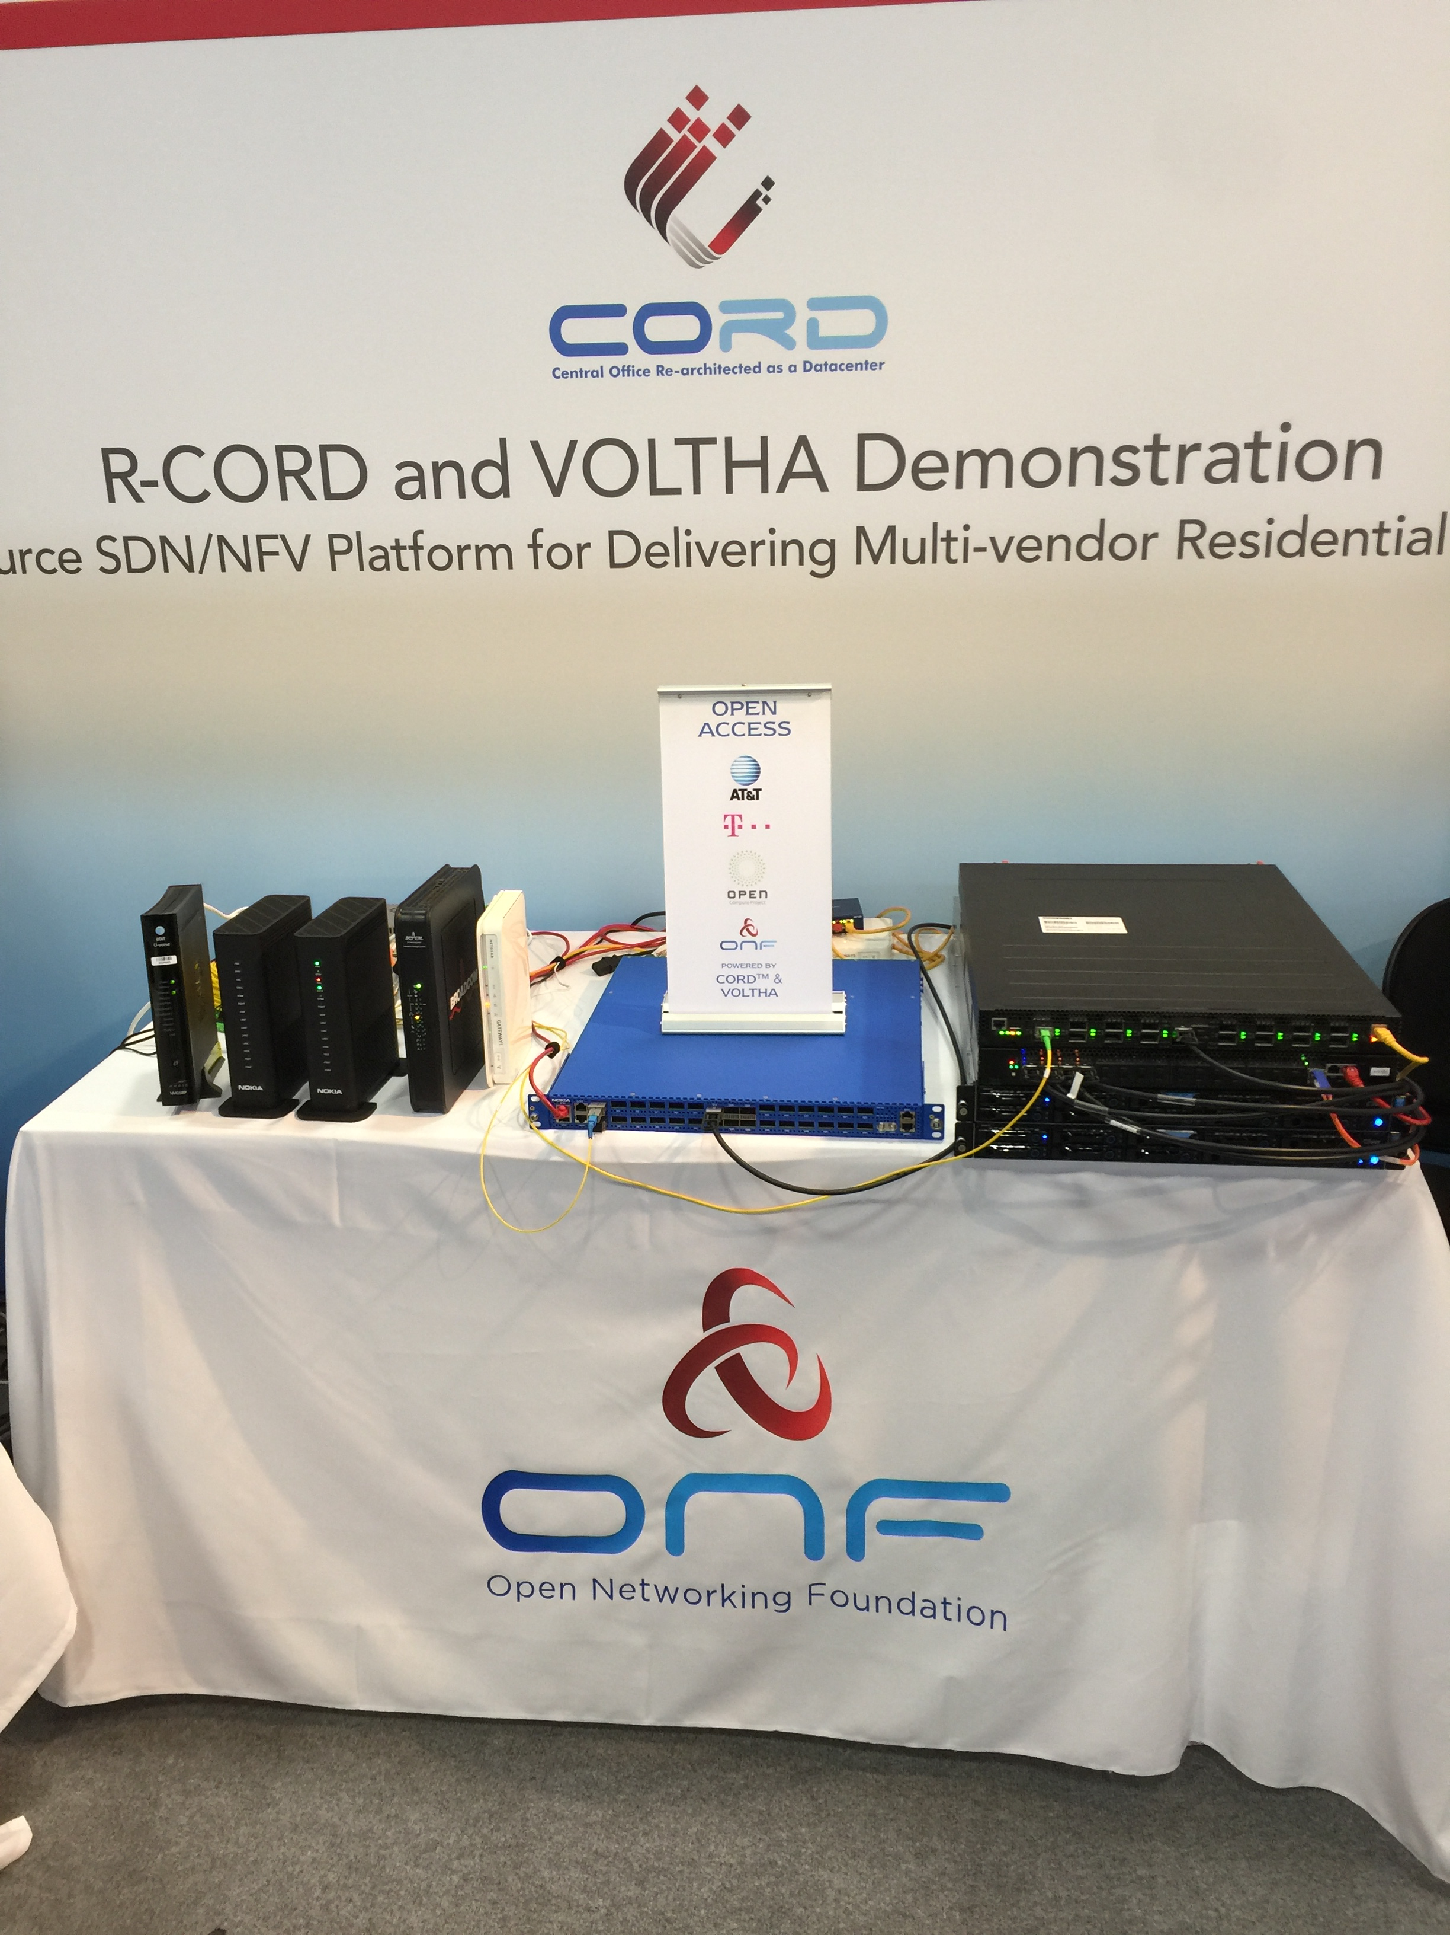

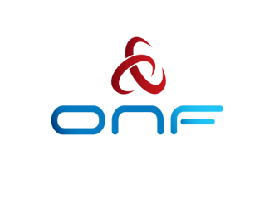

BBWF Booth E107B

