Slide 1
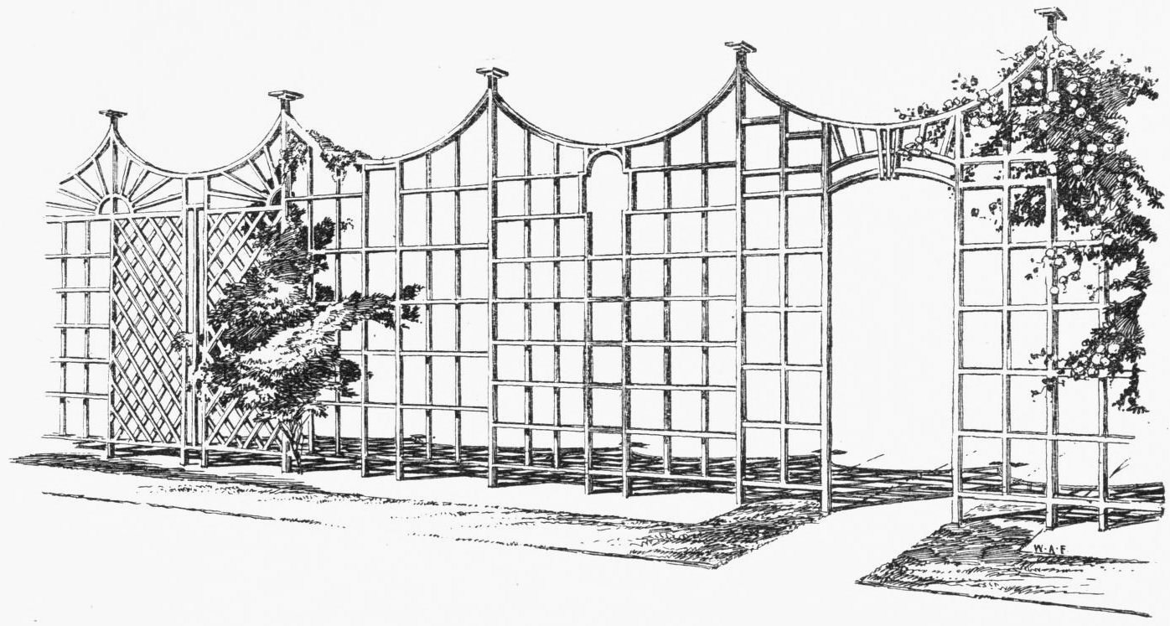
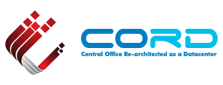
Photo source: Wikipedia
TRELLIS
CORD Network Infrastructure
Saurav Das
… with Ali Al-Shabibi, Jonathan Hart, Hyunsun Moon, Charles Chan & Flavio Castro
#OpenCORD

Slide 2

What is Trellis?
3. Unified SDN Control
over underlay & overlay
2. Virtual Network Overlay
ONOS
Controller Cluster & Apps
1. DC Leaf-Spine Fabric Underlay
Unique combination of these three components
Trellis Benefits
Common control over underlay & overlay networks enable simple, efficient impls of:
Distributed Virtual Routing for tenant networks
Optimized delivery of multicast traffic streams
and many more optimizations & new capabilities to be introduced in the near future
Trellis is the enabling Network Infrastructure for CORD

Slide 3

CORD Architecture
XOS
Other Apps
Other
Apps
Overlay
Control
Underlay Control
vRouter
Control
ONOS Controller Cluster
TRELLIS
White Box
White Box
White Box
White Box
White Box
White Box
White Box
White Box
White Box
White Box
Metro
Router
White Box
White Box
White Box
White Box
White Box
White Box
R,E,M-Access
OVS
OVS
OVS
OVS
OVS
vSG
VNF
VNF
VNF
VNF
vSG
VNF
VNF
VNF
VNF
Access
Links
vSG
VNF
VNF
VNF
VNF
3

Slide 4
Outline
Underlay Fabric
  Bare-metal + Open-source = White-Box
  L2/L3 Leaf-Spine with SDN Control
Virtual Network Overlay
  OVS and VXLAN with SDN Control
  Service chaining
vRouter
  Distributed Virtual Routing
  Multicast handling
Underlay Fabric
  Bare-metal + Open-source = White-Box
  L2/L3 Leaf-Spine with SDN Control
Virtual Network Overlay
  OVS and VXLAN with SDN Control
  Service chaining
vRouter
  Distributed Virtual Routing
  Multicast handling

Slide 5
Underlay Fabric: Open Hardware & Software Stacks
Spine Switch
Leaf/Spine Switch Software Stack
White Box SDN Switch
Accton 6712
GE mgmt.
to controller
OpenFlow 1.3
OCP
Software
-
ONL
ONIE
Indigo OF Agent
32 x 40G ports downlink to leaf switches
40G QSFP+/DAC
OF-DPA API
OF-DPA
Leaf Switch
8 x 40G ports uplink to different spine switches
ECMP across all uplink ports
BRCM SDK API
BRCM ASIC
OCP Bare Metal Hardware
White Box SDN Switch
Accton 6712
OCP: Open Compute Project
ONL: Open Network Linux
ONIE: Open Network Install Environment
BRCM: Broadcom Merchant Silicon ASICs
OF-DPA: OpenFlow Datapath Abstraction
GE mgmt.
24 x 40G ports downlink to servers
and OLTs

Slide 6

Underlay Fabric Operation
L2 bridged
IPv4 unicast / MPLS SR
Notes:
Fabric true underlay – never sees vxlan encapsulated addrs
IP down to ToR redundant ToRs
Scales better
Fabric for other purposes

Slide 7
Underlay Fabric ASIC Pipeline* (BRCM’s OF-DPA)
* Simplified view
Why OF-DPA?
Multi-
cast Routing Table
Allows programming of
all flow-tables & port-groups
via OpenFlow 1.3
OF 1.3
L3 ECMP
Group
MPLS
Label
Group
Phy Port
OF 1.0
Phy Port
Unicast
Routing
Table
MPLS
Label
Group
Ingress
Port Table
Vlan Table
Termin-ation MAC
Table
ACL
Policy
Table
L3
Mcast
Group
Phy Port
L2 Interface
Group
Phy Port
L2 Interface
Group
Phy Port
MPLS
Table
Vlan 1 Table
MPLSL2 Port
Table
L2 Flood
Group
L2 Interface
Group
Phy Port
Achieves Dataplane scale
Bridging
Table
L2 Interface
Group
Phy Port
Notes:
Talk about data plane scale

Slide 8
Control Plane HA, Scale & Performance
Classic-SDN Myths:
1. Dataplane packets need to go to controller
Reality: Application designs mode of operation!
Fabric control application designed such that dataplane packets never have to go to the controller.
2. Controllers are out-of-the-network, like management stations
Reality: Controllers are Network Elements (NEs)!
Almost all NE redundany is 1:1 or 1+1 (2-way redundancy)
ONOS does much, much more
  3-way, 5-way, 7-way redundancy
  Bonus: scales the same way
SDN
Controller
Switch
Switch
Switch

Slide 9
ONOS N-Way Redundancy
M
= Master
= Backup
B
Switches simultaneously connect to several controller instances.
only 1 controller instance is master, several other instances are backups
Mastership is decided by controllers
Switches have no say
B
B
M
B
M
B
M
B
B
M
B
B
Controller instances simultaneously connect to several switches.
Any controller instance can be master or backup for any switch
M
B
B
B
B
B
M
M
B
B
M
B
ONOS Instance 1
ONOS Instance 2
ONOS Instance 3
ONOS Instance 4
ONOS Instance 5
Spreading mastership over controller instances contributes to scale

Slide 10
ONOS N-Way Redundancy
M
= Master
= Backup
= Retry
B
R
Switches simultaneously connect to several controller instances.
only 1 controller instance is master, several other instances are backups
Mastership is decided by controllers
Switches have no say
Losing controller instances redistributes switch mastership
M
B
R
M
R
B
Switches continue to retry lost connections
M
B
R
R
M
R
Controller instances simultaneously connect to several switches.
Any controller instance can be master or backup for any switch
Management watchdog can reboot lost
controller instances
M
M
B
M
B
B
M
ONOS Instance 1
ONOS Instance 2
ONOS Instance 3
ONOS Instance 4
ONOS Instance 5
Spreading mastership over controller instances contributes to scale

Slide 11
Outline
Underlay Fabric
  Bare-metal + Open-source = White-Box
  L2/L3 Leaf-Spine with SDN Control
Virtual Network Overlay
  OVS and VXLAN with SDN Control
  Service chaining
vRouter
  Distributed Virtual Routing
  Multicast handling
Underlay Fabric
  Bare-metal + Open-source = White-Box
  L2/L3 Leaf-Spine with SDN Control
Virtual Network Overlay
  OVS and VXLAN with SDN Control
  Service chaining
vRouter
  Distributed Virtual Routing
  Multicast handling

Slide 12
Virtual Network Overlay
Tenant Green
Virtual Network
Service Y
Virtual Network
Service B
Virtual Network
Tenant Red
Virtual Network
Overlapping address space
Connectivity isolation
Service VNFs & vNets
Non-overlapping addresses
Services can dynamically
grow or shrink
VXLAN Overlay
VXLAN Overlay
VXLAN
Overlay
OVS
OVS
OVS
OVS
OVS
OVS
OVS
OVS
OVS
Single VXLAN
port in OvS
VMs/Containers
Notes:
Any server virtualization tech – VMs or containers, KVM or Docker or LXC
Single OVS bridge with VXLAN overlays – only use VXLAN dataplane encapsulation, no control plane associated with vxlan is used
Single VXLAN port – tunnel destination is added dynamically
Tenant virtual networks– tenant VMs/containers can be anywhere in the cloud, have overlapping IP address space and connectivity isolation from each other – minimum expectation for virtual networking
Services (VNFs) are also tenants of the cloud – each service is instantiated by multiple containers or VMs and each service has its own vnet
Services can dynamically grown and shrink – in compute & networking
Service vnets cannot have overlapping address space.

Slide 13
Service Composition Impl
XOS
Tenant Green
Virtual Network
Service Y
Virtual Network
Service B
Virtual Network
Service-graph
VTN
ONOS
Service P
Virtual Network
VXLAN Overlay
OpenFlow
rules
VXLAN
Overlay
OVS
OVS
OVS
OVS
OVS
OVS
OVS
OVS
OVS
Service graph is created by XOS and programmed into OvS by overlay-control app (VTN)
Distributed load-balancers exist for each service in each OvS
Notes:
Eample service graph – where service Y asks for another service – is that part of graph as well?
Services are interconnected by distributed load-balancers
Can you bounce off a router – standard openstack?
Service graph vs neutron

Slide 14
OVS Pipeline* (Vnets & Service-Chaining)
* Simplified view
to controller
QinQ
lookup
to vSG or OLT
Incoming
Lookup
(port, vlan, arp)
Next
Service
Lookup/Tenant VRFs
Service
Load
Balancing / Service IP Lookup
VXLAN Encap
Egress
pipeline
to
Underlay
Fabric
Ingress
Pipeline
from underlay
fabric
VxLAN VNI
Lookup & Decap
VM/Container
Lookup
To local
Service Instance
All flow-tables & port-groups are programmed using OpenFlow 1.3
VxLAN tunnel ports are created using OVSDB protocol

Slide 15
Trellis Overlay & Underlay
VXLAN Overlay
Server
Underlay Fabric
Server
S1B
OVS
Leaf
Spine
Leaf
OVS
S2C
MAC DA
spine
MAC DA
Leaf
MAC SA
leaf
MAC DA
leaf
MAC DA
OVS
MAC SA
OVS
SR Label of dst leaf sw
MAC SA
spine
MAC SA
leaf
OVS IP addrs infra
OVS IP addrs infra
OVS IP addrs infra
OVS IP addrs infra
UDP
UDP
UDP
UDP
Tunnel encap & load-balancing to next Service instances
VXLAN
VNI=S2
VXLAN
VNI=S2
VXLAN
VNI=S2
VXLAN
VNI=S2
Dst IP lookup, SR label-push
& load-balancing to spines
Dst IP lookup & forward to destrination server
SR Label lookup, pop & forward to destination leaf
Tunnel decap
MAC DA
of Service 2
MAC DA
of S2C
MAC DA
of S2C
MAC DA
of S2C
MAC DA
of S2C
MAC DA
of S2C
MAC SA
of S1B
MAC SA
of S1B
MAC SA
of S1B
MAC SA
of S1B
MAC SA
of S1B
MAC SA
of S1B
IPSrc= Cust.IP
IPDst= World
or opposite
IPSrc= Cust.IP
IPDst= World
or opposite
IPSrc= Cust.IP
IPDst= World
or opposite
IPSrc= Cust.IP
IPDst= World
or opposite
IPSrc= Cust.IP
IPDst= World
or opposite
IPSrc= Cust.IP
IPDst= World
or opposite
Payload
Payload
Payload
Payload
Payload
Payload

Slide 16
Outline
Underlay Fabric
  Bare-metal + Open-source = White-Box
  L2/L3 Leaf-Spine with SDN Control
Virtual Network Overlay
  OVS and VXLAN with SDN Control
  Service chaining
vRouter
  Distributed Virtual Routing
  Multicast handling
Underlay Fabric
  Bare-metal + Open-source = White-Box
  L2/L3 Leaf-Spine with SDN Control
Virtual Network Overlay
  OVS and VXLAN with SDN Control
  Service chaining
vRouter
  Distributed Virtual Routing
  Multicast handling

Slide 17

vRouter as a VNF?
Management (CLI, SNMP, NetCONF)
Management (CLI, SNMP, NetCONF)
VNFM
(VNF Manager)
Control Plane
(OSPF, BGP ..)
Control Plane
(OSPF, BGP ..)
VNF = vRouter VM
(vCPE, vBNG,
vPGW, vBRAS)
Dataplane
Dataplane
Trellis vRouter takes
a different approach
CP
Underlay Network
DP
DP
DP
VNF
CP
vRouter
VM
DP
VNF
VNF
DP
DP
Issues: Hairpinning, Embedded control plane complexity for scale-out
Issues: Still hairpinning through a load-balancer appliance

Slide 18
Trellis vRouter
XOS
ONOS Controller Cluster
Overlay Control
Underlay Control
vRouter Control
ONOS Controller Cluster
Quagga
(or other)
ONOS Controller Cluster
OSPF
I-BGP
OLT
OLT
OLT
Router
OVS
OVS
OVS
OVS
Router
To residential
subscribers
VM
VM
VNF
VNF
Upstream
Metro network
Trellis vRouter → Implemented as a big distributed router
→ Presents entire n/w infrastructure as a single router to outside world

Slide 19
Optimized Multicast in R-CORD
XOS
ONOS Controller Cluster
Multicast Control
Underlay Control
ONOS Controller Cluster
ONOS Controller Cluster
IGMP
Snooping
IPv4 multicast video
OLT
PIM-SSM
OLT
OLT
Router
vSG
Router
To residential
subscribers
vSG
Upstream
Metro network
R-CORD Multicast video streams never need to go through any software switch or VNF

Slide 20
Trellis Summary
TRELLIS: DC Fabric Underlay + Virtual Network Overlay + Unified SDN Control
Underlay Fabric
L2/L3 spine-leaf fabric built on bare-metal hw and open-source software
  Preferred architecture in modern DCs: horizontal scaling & high bisection bandwidth
  Designed to scale up to 16 racks (~ 40 hardware switches)
  Low cost ~ $5k per switch
SDN control plane - no distributed protocols
  Proactive mode of operation
  Highly available & scalable – ONOS N-way control plane redundancy & scale
Modern ASIC data plane - 1.28 Tbps switching bandwitdth for each switch
  Broadcom’s OF-DPA + OpenFlow 1.3 use of multi-tables & port-groups => dataplane scale
Virtual Network Overlay
Designed for NFV (service-chained VNFs) with best principles of cloud
  Orchestration, agility, elasticity, micro-services
Overlay control application (VTN) implements/maintains service graph presented by XOS
  SDN control plane – mostly proactive, HA, no distributed protocols
  Designed to scale up to 400 virtual switches
OvS + VXLAN data plane
  Standard VXLAN dataplane encap/decap with entropy-hashing
  Custom OvS pipeline for tenant virtual networks, service-chaining & per-service load-balancing
Unified SDN Control
Common control provides opportunites for optimized service delivery
    vRouter – Distributed routing using SDN control and hardware fabric
    Multicast IPTV service delivery in R-CORD
    More to follow

Slide 21
BACKUP

Slide 22
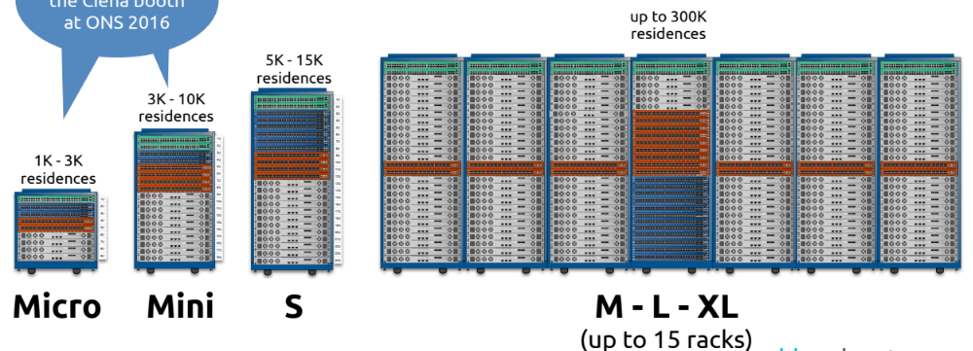
CORD Infrastructure Choices: #Racks
Source: Ciena
CORD comes in many sizes → Suitable for many different deployment scenarios
→ Underlay leaf-spine fabric is designed to scale horizontally

Slide 23
CORD Infrastructure Choices: Underlay Fabric
Open Source SDN Software
* OF-DPA API
* ONL
* Indigo
Bare Metal Hardware Choices
* Accton
* Delta
* Dell
* Wedge
* Quanta
* Interface Masters
* Celestica
Dell
* Dell/DNI hardware
* OF-DPA
* FTOS / OS10
BigSwitch
* Switch Light OS
* Most bare-metal hw
Pica8
* PicOS
* Most bare-metal hw
Google
* Jupiter fabric
OpenSwitch
* HP initiative
* Most bare-metal hw
SONIC
* Microsoft initiative
* Most bare-metal hw
FBOSS
* Facebook initiative
* Wedge hw
Cumulus
* Cumulus Linux
* Most bare-metal hw
Pluribus
* Netvisor software
* Freedom bare-metal hw
LinkedIn
* Pigeon switch
* Bare metal hw
Broadcom
* FastPath software
* Bare metal hw
Cisco
& others
White Box SDN
Grey Box SDN
White Box Td
Grey Box Td
Black Box Td
Open Source SDN Software on Bare-Metal Hardware
Proprietary SDN Software on Bare-Metal Hardware
Open Source Traditional n/w Software on Bare-Metal Hardware
ProprietaryTraditional n/w Software on Bare-Metal Hardware
ProprietaryTraditional n/w Software on Proprietary Hardware
CORD uses White Box SDN → 1) Simpler 2) Easier to introduce new features 3) Lower TCO
+ Significant advantages of common SDN control over underlay and overlay.
Progressively less agile, slower innovation, more complex as we move from Left → Right

Slide 24
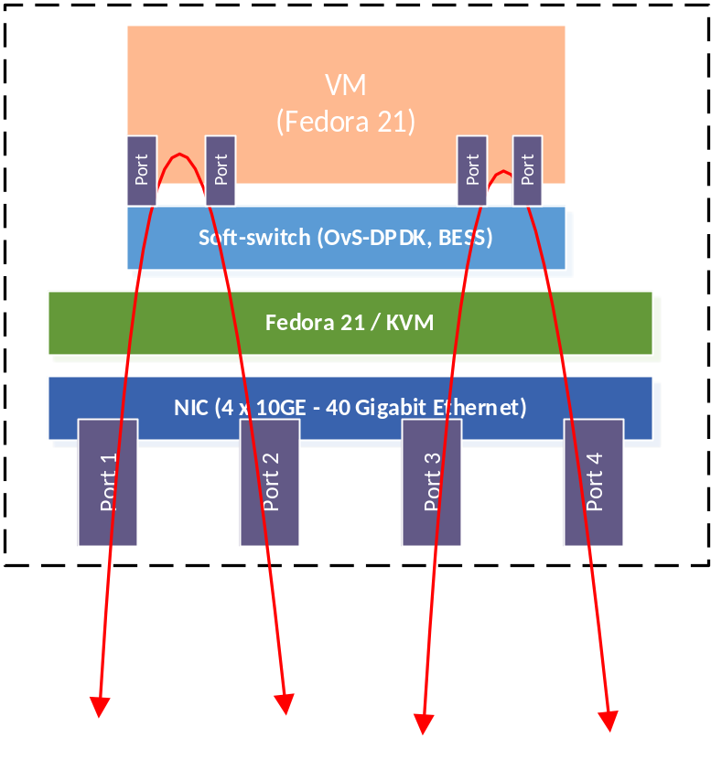
CORD Infrastructure Choices: Software Switches
Two choices: OVS + DPDK
BESS + DPDK
Source: Joshua Reich, AT&T
Open Questions:
  How do both perform with VxLAN encap?
  And do more than simple bridging?

Slide 25

CORD System: Access Choices
PON
OLTs
...
...
PON
OLTs
Remote leafs
Optical Transport / Carrier Ethernet
Remote leafs can be managed in-band by ONOS at CO node
Remote leafs perform
  Aggregation of ‘pizza-box’ OLT traffic
    Assumes transport equipment can deliver double-vlan tagged Ethernet frames from remote-leaf to CO
  Encapsulation of frames (if necessary)
    E-Lines implemented using MPLS PW

Slide 26
CORD System: Metro Choices
Traditional
IP/MPLS Network
BGP/OSPF
...
...
...
...
...
...
Multiple Central Offices

Slide 27
Trellis Roadmap
Plat-forms
XOS
ONOS
Underlay
Overlay
Multicast
vOLT
vRouter
vSG
Accton
Celestica
OF-DPA
ONL
Indigo
Quagga
OVS
Dual Homing
Servers to 2 ToRs
OLTs to 2 TorRs
ToRs to 2 Upstream routers
Troubleshooting Tools
Everywhere
Inter Central Office
Apps
DPDK + OVS/BESS
with VxLAN
and VTN pipeline
Scale Testing
Users, switches, servers
Remote Field Office
Requires in-band control
VNF
PNF Integration
Leaf VTEP
More Access Intr.
G.Fast & other vendors
Hw
Flat
network
VTN options
ISSU
Switch
software
sFlow Integration
More VNFs
Closed & Open source
Different service chains
P4
ARP Delegation
CORD 1st Release
More Integration
E-CORD & M-CORD
IPv6
Q2’16

Slide 28
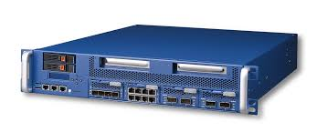
CORD System: PNFs
XOS
ONOS Controller Cluster
Overlay Control
Underlay Control
ONOS Controller Cluster
ONOS Cntroller Cluster
OLT
OLT
OLT
PNF
Router
OVS
OVS
OVS
Router
To residential
subscribers
vSG
VNF
Upstream
Metro network
CORD Service graphs are implemented by both overlay & underlay fabrics

Slide 29


Why DC Leaf-Spine Fabrics?
Cisco “normal” design
Spanning tree used
1 + 1 redundancy
Core
Aggregation
ToR switches
Old design not good for east-west (dominant) traffic in modern data-centers

Slide 30
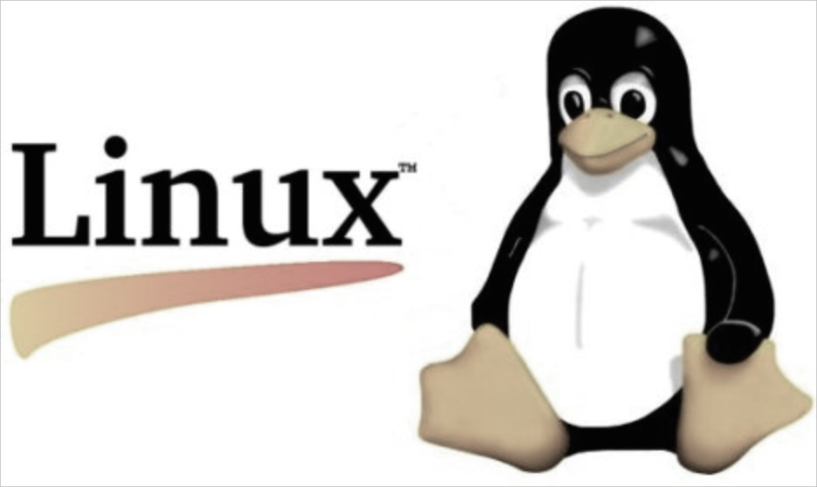
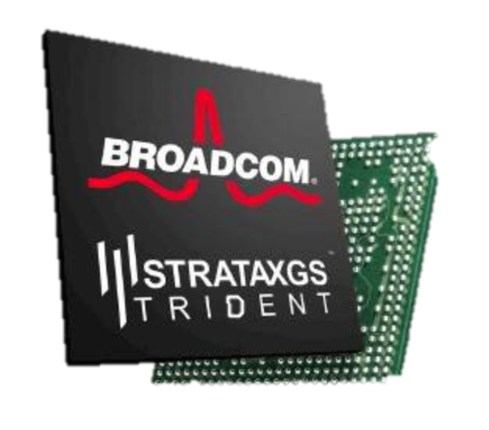
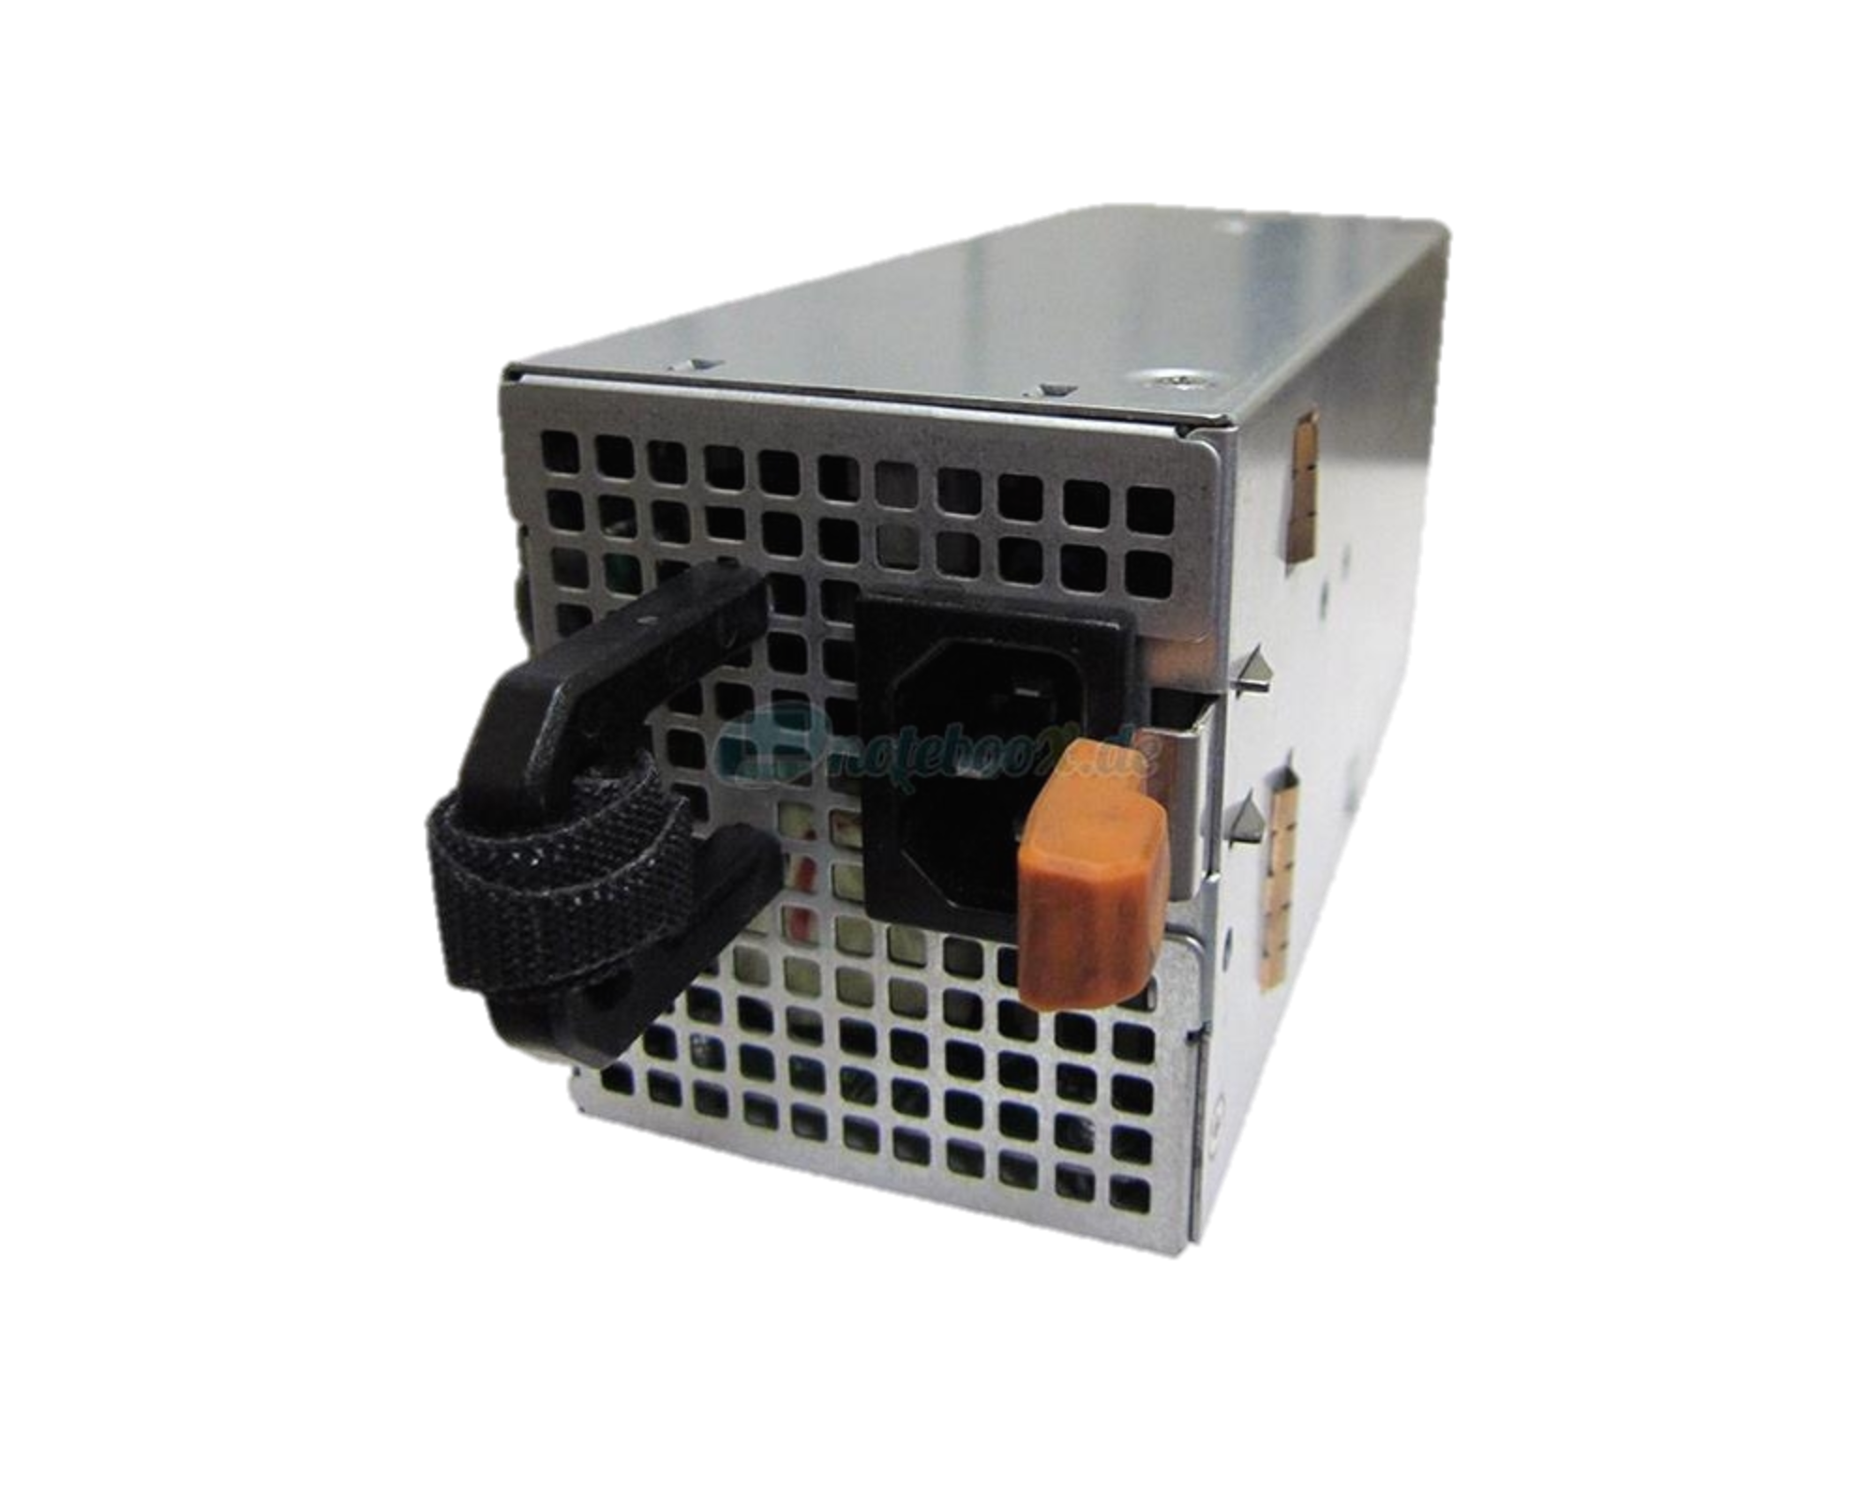

Why Bare Metal Switches?
Cost
400,000 servers
20,000 switches
$5k vendor switch = $100M
$1k bare-metal switch = $20M
Savings in 10 data centers = $800M
Control
Tailor network to applications
Proprietary behavior
Quickly debug
No vendor lock-in
ONL, SwitchLight, PicOS, FBOSS, SONIC, OpenSwitch, Cumulus, Pigeon, FastPath, SnapRoute
Accton
Delta
Dell
Wedge
Quanta
Interface Masters
Celestica
Optional Remote API
Linux
OF-DPA, OpenNSL, SAI, P4
API/Driver
Boot Loader
ONIE
CPU
DRAM
xChip
Power supply + fans

Slide 31
Why SDN?
Benefits of Classic SDN
Simpler Control with Greater Flexibility
  Networks work because we can master complexity, but what we should be doing is extracting simplicity, with the right abstractions
Speed of Innovation, Ease of Service Insertion & Faster Time to Market
  Does not involve changing/creating a fully distributed protocol
Lower Total Cost of Ownership (TCO)
  Lower Opex – easier to manage, troubleshoot, emulate
  Lower Capex – replacing proprietary hardware

Slide 32
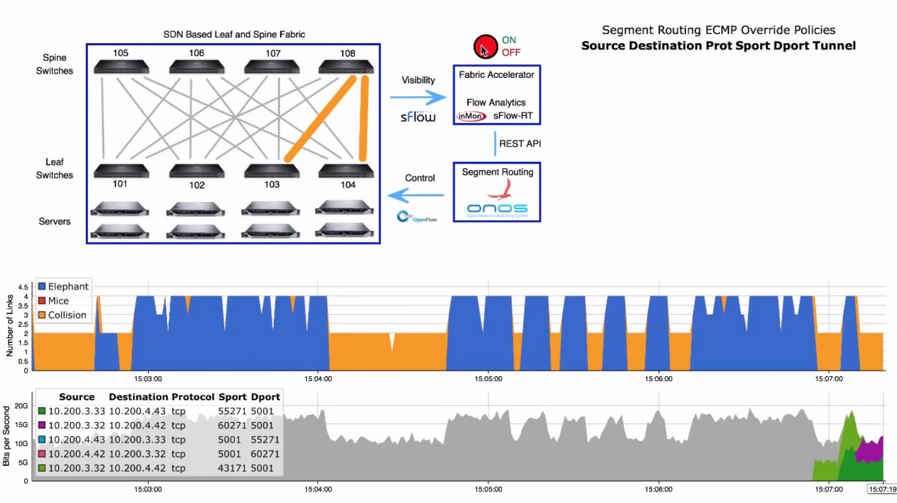
Analytics Driven Traffic Engineering

Slide 33
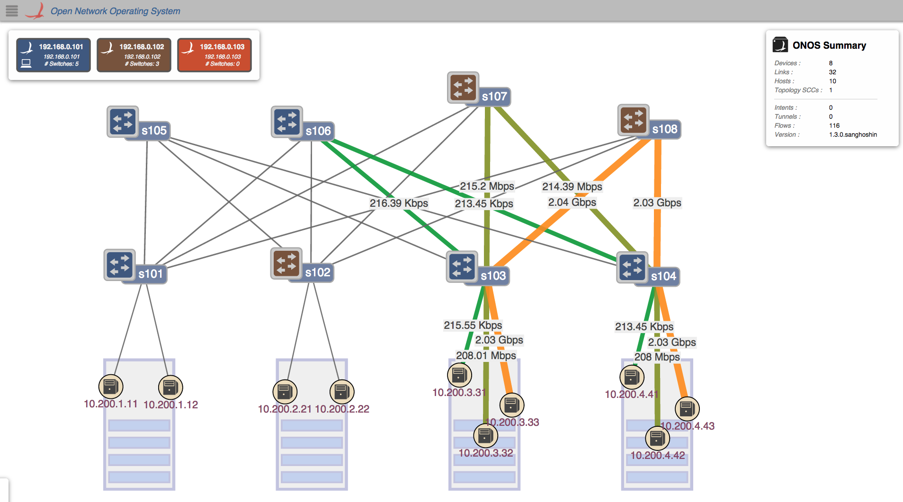
Policy Driven Traffic Engineering

Slide 34
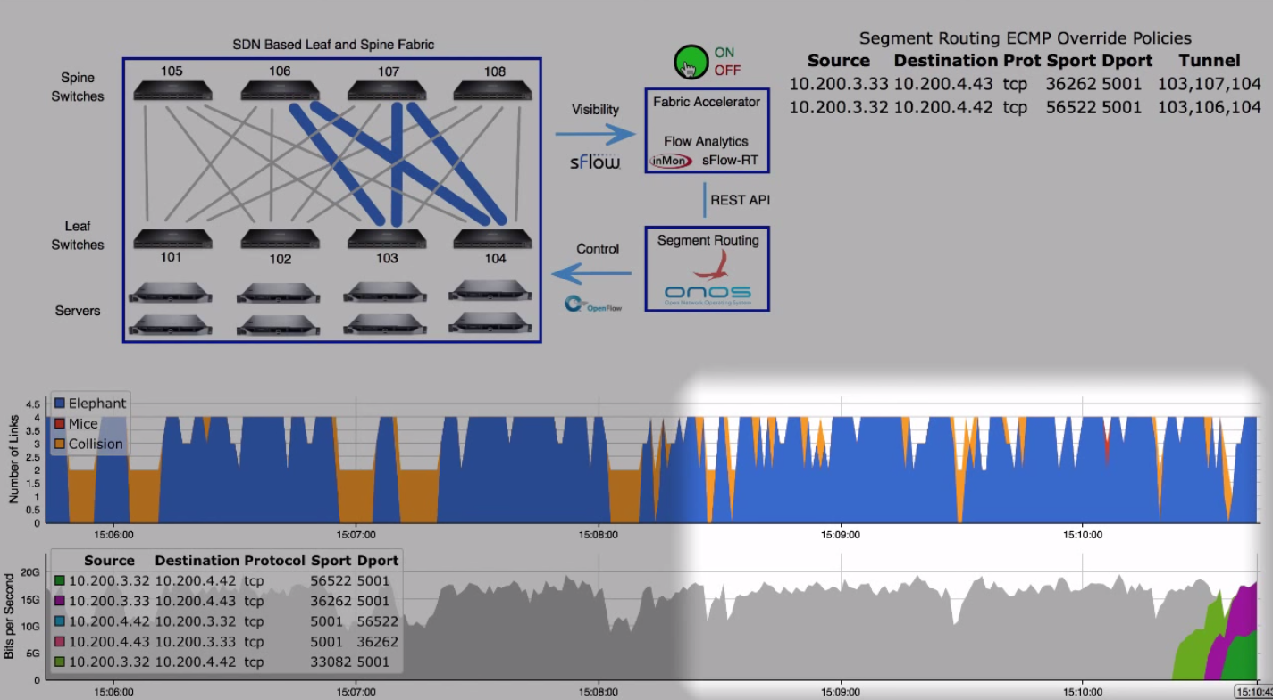
Analytics Driven Traffic Engineering

