Slide 1



Trellis Update
Saurav Das
Principal Architect, ONF
With contributions from many others …

Slide 2
What is Trellis?
Unified SDN Control
Of Underlay & Overlay
Datacenter Leaf-Spine Fabric Underlay
ONOS
Controller Cluster & Apps
Virtual Network Overlay
Trellis Provides Common control over underlay & overlay networks, including
Service Composition for Tenant Networks
Distributed Virtual Routing
Optimized Delivery of Multicast Traffic Streams
Trellis is the enabling Network Infrastructure for CORD

Slide 3

CORD Architecture
XOS
Other Apps
Other
Apps
Overlay
Control
Underlay Control
vRouter
ONOS
TRELLIS
White Box
White Box
White Box
White Box
Metro
Router
White Box
White Box
White Box
White Box
White Box
White Box
White Box
White Box
White Box
White Box
White Box
White Box
R,E,M-Access
OVS
OVS
OVS
OVS
OVS
vSG
VNF
VNF
VNF
VNF
Access
Links
vSG
VNF
VNF
VNF
VNF
vSG
VNF
VNF
VNF
VNF
3

Slide 4
Disaggregation – Bare-metal + Open-Source
Spine Switch
Leaf/Spine Switch Software Stack
White Box Switch
Accton 6712
GE mgmt.
to controller
OpenFlow 1.3
OCP
Software
(ONL,ONIE)
Indigo OF Agent
32 x 40G ports downlink to leaf switches
OF-DPA
Leaf Switch
8 x 40G ports uplink to different spine switches
ECMP across all uplink ports
BRCM ASIC
OCP Bare Metal Hardware
White Box Switch
Accton 6712
OCP: Open Compute Project
ONL: Open Network Linux
ONIE: Open Network Install Environment
BRCM: Broadcom Merchant Silicon ASICs
OF-DPA: OpenFlow Datapath Abstraction
GE mgmt.
24 x 40G ports downlink to servers

Slide 5

Trellis Fabric – Bare-metal + Open-Source + SDN
ONOS Cluster
Access & Trunk VLANs
IPv4 & IPv6 & MPLS SR
IPv4 Multicast (PIM)
DHCP relay (IPv4)
vRouter BGP/OSPF (ext.)
L2 bridged
L3 routed
IPv4 multicast
Notes:
Fabric true underlay – never sees vxlan encapsulated addrs
IP down to ToR redundant ToRs
Scales better
Fabric for other purposes

Slide 6

vRouter as a VNF?
vRouter in Software?
Management (CLI, SNMP, NetCONF)
Management (CLI, SNMP, NetCONF)
VNFM
(VNF Manager)
Control Plane
(OSPF, BGP ..)
Control Plane
(OSPF, BGP ..)
VNF = vRouter VM
(vCPE, vBNG,
vPGW, vBRAS)
Dataplane
Dataplane
CP
Underlay Network
DP
DP
DP
VNF
CP
vRouter
VM
DP
VNF
VNF
DP
DP
Issues: Hairpinning
Embedded control plane complicates scale-out
Issue: Still hairpinning through a load-balancer

Slide 7
vRouter Operation
Trellis vRouter
ONOS Controller Cluster
Overlay Control
Underlay Control
vRouter app
ONOS
ONOS Controller Cluster
Quagga
(or other)
OSPF
I-BGP
Router
OVS
OVS
OVS
OVS
Router
VM
VM
VNF
VNF
External

Slide 8
Trellis vRouter
vRouter Operation
ONOS Controller Cluster
Overlay Control
Underlay Control
vRouter
ONOS
ONOS Controller Cluster
Quagga
(or other)
OSPF
I-BGP
Router
OVS
OVS
OVS
OVS
Router
VM
VM
VNF
VNF
External

Slide 9
vRouter Operation
Trellis vRouter → Implemented as a big distributed router
→ Presents entire n/w infrastructure as a single router to outside world
ONOS Controller Cluster
Overlay Control
Underlay Control
vRouter
ONOS
ONOS Controller Cluster
Quagga
(or other)
OSPF
I-BGP
Router
OVS
OVS
OVS
OVS
Router
VM
VM
VNF
VNF
External
Trellis vRouter → Implemented as a big distributed router
→ Presents entire n/w infrastructure as a single router to outside world
Trellis vRouter → Implemented as a big distributed router
→ Presents entire n/w infrastructure as a single router to outside world
Trellis vRouter → Implemented as a big distributed router
→ Presents entire n/w infrastructure as a single router to outside world
Trellis vRouter → Implemented as a big distributed router
→ Presents entire n/w infrastructure as a single router to outside world
Trellis vRouter → Implemented as a big distributed router
→ Presents entire n/w infrastructure as a single router to outside world
Trellis vRouter → Implemented as a big distributed router
→ Presents entire n/w infrastructure as a single router to outside world

Slide 10

Current Work - Data Plane Redundancy
Spine Switch
Spine Switch
ECMP groups
ECMP groups
ECMP group
ECMP group
Leaf Switch
Leaf Switch
Upstream
Router
Access Equipment
Leaf Switch
Leaf Switch
Upstream
Router

Slide 11
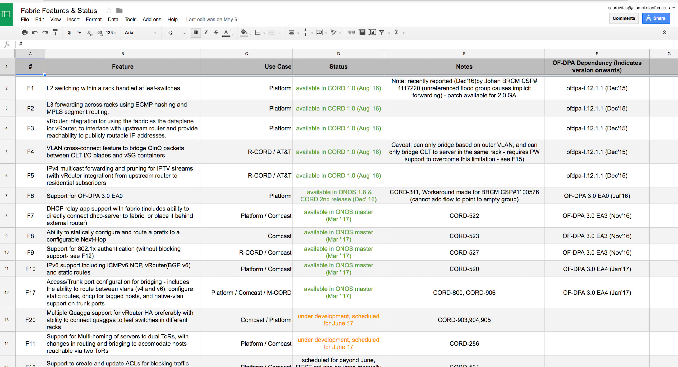
Roadmap
See here for complete roadmap
https://docs.google.com/spreadsheets/d/1SmKxsZ9iHtLHoEtvsntsJ98tLf_cYT_qXuuO7eAUtt4/edit?usp=sharing

