Slide 1
CORD: Transforming Service Provider Access Infrastructure
Saurav Das
Principal Architect, ONF

Slide 2

Outline
Outline
Why CORD?
CORD Technology Differentiators
Different Flavors of CORD

Slide 3

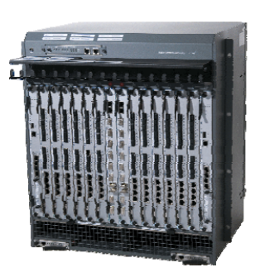

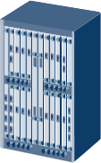
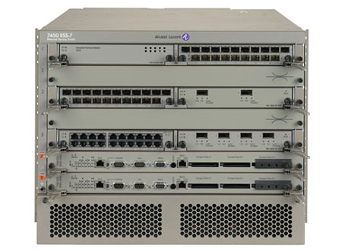
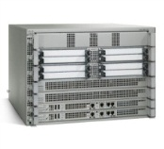
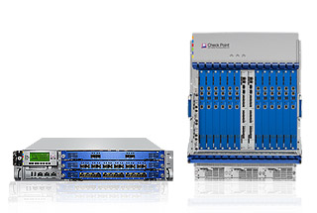

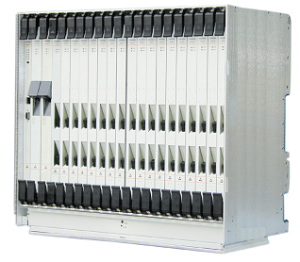
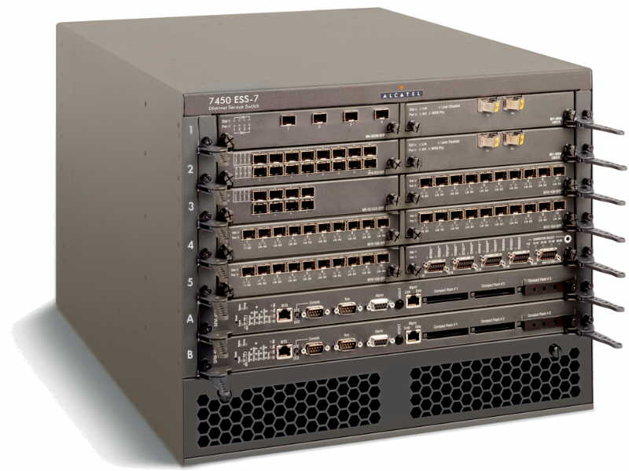
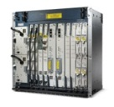
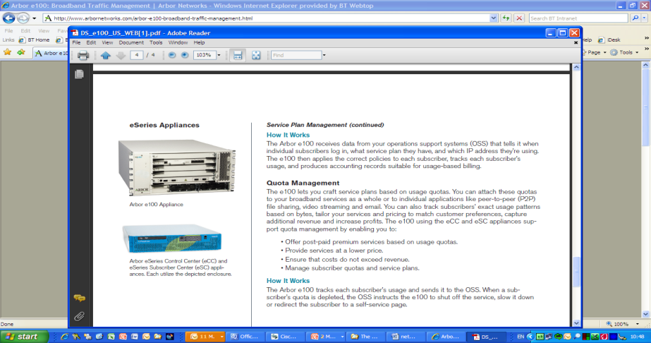
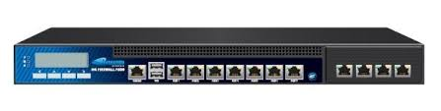
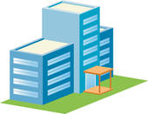
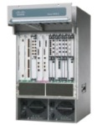

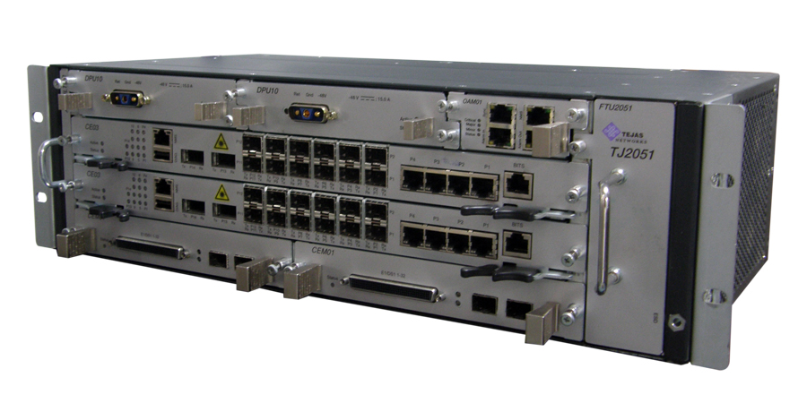
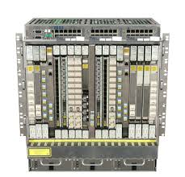
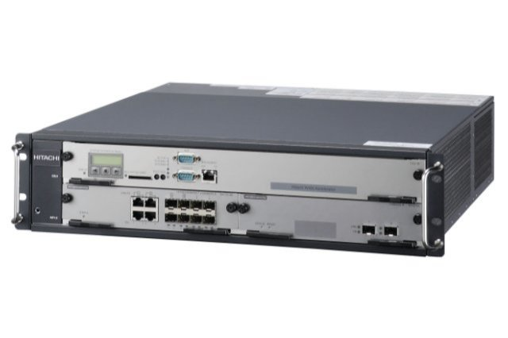
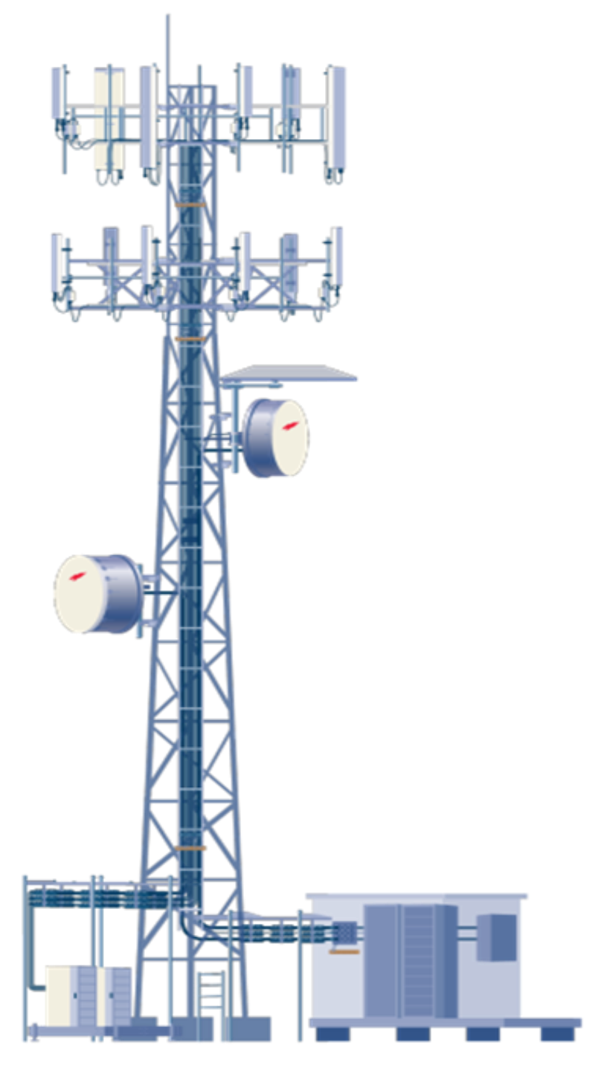
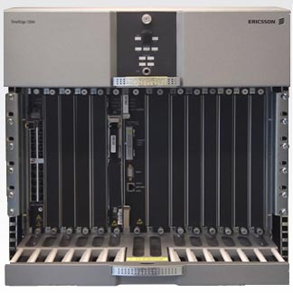
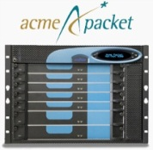


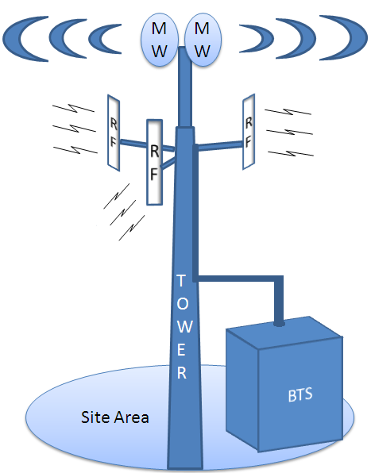
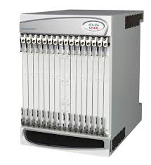
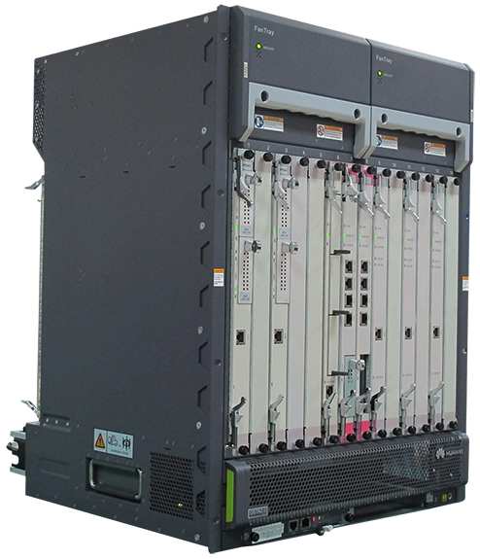

SP Access Network Evolution
TV
Internet
Landlines
Home Sec etc.
Access
Switch
Ethernet
Aggregation Switch
BNG (router with per subscriber policies)
Residential
Subscribers
Carrier
Grade NAT
Firewall
G/GE/XG-PON
xDSL/G.Fast
Cable/Docsis
DPI
Ckts: T1/E1/DS3
Carrier Ethernet
MPLS VPNs
PE- Router
IDS/IPS
Enterprise
Customers
Carrier
Grade NAT
Firewall
Carrier Ethernet
Switch
DPI
WAN
Accelerator
Mobile (Cellular)
Subscribers
Optical Transport Switch
Voice
Data
Video
Backhaul
Switch
MME/HSS
P-GW
Session Border
Controller
Message
Router
Access is a large part of SP Business
S-GW
CDN
DPI
Notes:
Let’s start with a thought experiment – lets say I was a large service provider, and I had a residential, enterprise and cellular subscriber base.
The first thing to recognize is that Access solutions are a massive part of the SP business. Yes metro and long-haul core networks are nice, but they are shared (amortized) by the usage of millions of subscribers. The real costs are in reaching those millions of customers.
So lets say I needed to build the infrastructure for this customer base to provide the services each set needs. . I might say that …

Slide 4
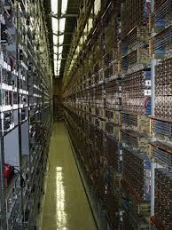
SP Access Network Evolution
Access
Device
Ethernet
Aggregation
Switch
BNG (router with per subscriber policies)
Residential
Subscribers
Firewall
By some counts → 50-300 different boxes in a large CO
Carrier
Grade NAT
G/GE/XG-PON
xDSL/G.Fast
Cable/Docsis
DPI
Enterprise
Customers
Carrier
Grade NAT
PE- Router
Carrier
Grade NAT
Tremendous source of high Capex/Opex
Not agile → hard to manage/operate → hard to create new services
Firewall
Carrier Ethernet
Switch
DPI
WAN
Accelerator
Mobile (Cellular)
Subscribers
Optical Transport Switch
Backhaul
Device
MME/HSS
Is there a transformative approach?
P-GW
Session Border
Controller
Message
Router
Firewall
S-GW
CDN
DPI
Access is a large part of SP Business
Notes:
At&T alone operates thousands of these each serving 10 – 100k subs
By one count more than 300 different boxes in a large CO

Slide 5
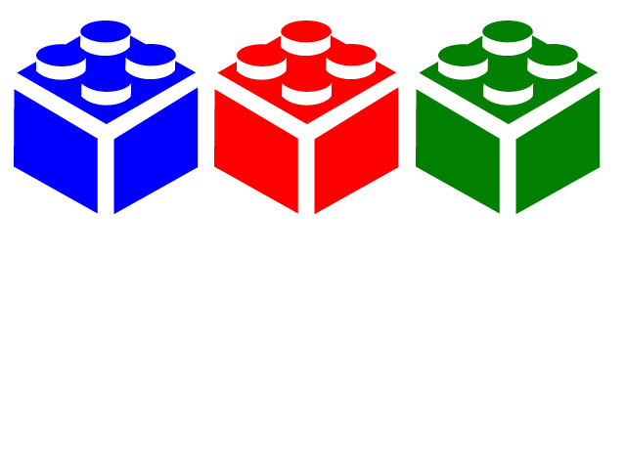
Thought Experiment
Services APIs for Operators & Customers
Residential
Subscribers
Service Creation Platfrom
-- Onboarding, Composition, Orchestration, Analytics
Control Plane Services
-- Authentication
-- Per subscriber policies
-- Plumbing control
Enterprise
Customers
Data Plane Plumbing
-- Switching, Routing
-- Virtualization, Encaps
-- Service Chains
WAN
Protocols,
Encaps,
Optical
Access Adaptation Layer
WAN Adaptation Layer
Mobile (Cellular)
Subscribers
Data Plane Services
-- Spl. Fn: DPI, NAT, IDS
-- Policy Enforcement: FW
-- Opt.: CDN, WanX
Access is a large part of SP Business
Notes:
Instead of thinking about boxes that do many functions, or boxes that do the same thing as other boxes but with a different name for a different market, lets think in terms of building blocks.
We can readily recognize from the previous slide that there are common elements in each set of services and infrastructures. So it really makes sense to think in terms of building blocks
For each of these building blocks, why stay stuck in 50 years of legacy. Why not use the best of breed technology that has emerged over the last 10 years.

Slide 6

Thought Experiment CORD
Services APIs for Operators & Customers
Service Creation Platfrom
-- Onboarding, Composition,
Orchestration, Analytics
XOS
Control Plane Services
-- Authentication
-- Per subscriber policies
-- Plumbing control
vOLT Control
Other Apps
(Aux/Policies)
Virtual Network
Overlay
Fabric
Underlay
vRouter
Control
ONOS Controller Cluster
Data Plane Plumbing
-- Switching, Routing
-- Virtualization, Encaps
-- Service Chains
White Box
White Box
White Box
White Box
Access Adaptation Layer
WAN Adaptation Layer
White Box
White Box
White Box
White Box
White Box
White Box
White Box
White Box
White Box
White Box
White Box
White Box
Data Plane Services
-- Spl. Fn: DPI, NAT, IDS
-- Policy Enforcement: FW
-- Opt.: CDN, WanX
R,
E,
M
Access
vSw
vSw
vSw
vSw
vSw
vSG
VNF
VNF
VNF
VNF
vSG
VNF
VNF
VNF
VNF
vSG
VNF
VNF
VNF
VNF
Notes:
Instead of thinking about boxes that do many functions, or boxes that do the same thing as other boxes but with a different name for a different market, lets think in terms of building blocks.
We can readily recognize from the previous slide that there are common elements in each set of services and infrastructures. So it really makes sense to think in terms of building blocks
For each of these building blocks, why stay stuck in 50 years of legacy. Why not use the best of breed technology that has emerged over the last 10 years.

Slide 7
Today
Central Office
Proprietary Access Devices & Archaic Operations at the Network Edge
Data Center
Commodity Hardware & Agile Software
Values Commodity & Agility
Values Edge Presence
Service Providers not threatened by
Google, Amazon, MSFT, FB’s use of
Commodity hardware! Real pressure is from OTT Services
Next Gen
Services:
IoT, self-driving cars, VR/AR, AI, NLP, 4kTV, connected-cars, smart-cities
Next Gen
Platform:
Low latency, edge computing, different traffic flows
Notes:
AT&T is not threatened not just by Google's commodity hardware, per se (of course they'd like to replicate it so they too can enjoy reduced costs),
AT&T isn't going to increase revenue just by re-creating their current suite of services on commodity.

Slide 8
Tomorrow
Central Office Re-architected as a Datacenter
CO
DC
CORD
Economies and Agility of the Datacenter &
Low Latency and Computing at the Edge
  For SP’s to provide new services
  For SP’s to provide access to third-party services
Notes:
that once we'd gained parity with the status quo, the real value was in what we would enable next.
But we must look beyond Capex/Opex savings as the only benefit of CORD, because that is only half of the story.
The other half is the fact that with CORD, we are bringing the ability to take advantage of low-latency and edge-computing to the access.
We know that nearly all future services will benefit from these features, but it will require flexible cloud-like infrastructure at the access, not far-away in some DC.

Slide 9
CORD’s Unifying Principle
Common platform
all markets
all services
Cloud
Agility & Microservices
Commodity hardware
Open-source software
- building blocks
SDN
Programmability & White-Boxes
NFV
VNFs & Disaggregation
XaaS
Everything as a Service
- XaaS
Economies and Agility of the Datacenter &
Low Latency and Computing at the Edge
  For SP’s to provide new services
  For SP’s to provide access to third-party services
Notes:
We use the best of breed technology that has emerged over the last 10 years to create one common platform

Slide 10
Operator Plans
Tremendous interest from SP’s all over the world
  AT&T
  Comcast
  Google
  Verizon
  Windstream
  Bell Canada
Deutsche Telecom
Telefonica
Telecom Italia
Orange
Vodafone
British Telecom
NTT
China Mobile
China Unicom
SK Telecom
KDDI
Telstra
North America
EMEA
Asia Pacific
Independent Survey Results: 20 operators (control 33% of world’s telecom Capex)
  30% plan to deploy CORD by end of 2017
  40% plan to deploy CORD beyond 2017
  15% don’t know yet, 15% have no plans
Michael Howard, Infonetics Research (IHS)
https://www.sdxcentral.com/articles/news/ihs-markit-70-carriers-will-deploy-cord-central-office/2017/01/

Slide 11
Outline
Outline
Why CORD?
CORD Technology Differentiators
Different Flavors of CORD

Slide 12
[1] Disaggregation
Cloud
SDN
NFV
Residence
Central Office
Backbone
Network
CPE
ONU
OLT
ETH AGG
BNG
Residence
Central Office
vRouter
vSG
vOLT
Backbone
Network
CPE
ONU
OLT
ETH AGG
BNG
Leaf-Spine Fabric

Slide 13
NFV Today
pX
pY
pZ
vX
vY
vZ
Make virtual (software) versions of hardware eqiupment/appliances
Chain them together
Worry about performance (DPDK, VPP etc.) …

Slide 14
[2] CORD Service Composition
Cloud
SDN
NFV
pX
pY
pZ
pX
pY
pZ
1. Disaggregate
Monolithic Hw
2. Scale each function/
microservice
independently
3. Compose end-user
services
CORD composes scalable services, instead of simply chaining VMs

Slide 15
[2] CORD Service Composition
Cloud
SDN
NFV
Controller
vG.Fast
Residential
Subscribers
Controller
…
vSG
Controller
vOLT
Controller
Controller
vCDN
vRouter
Controller
Controller
Mobile
Subscribers
vBBU
vSGW
Controller
Controller
Controller
Enterprise
Customers
v10GPON
vCPE
vCE

Slide 16
[3] SDN Controlled P + V Infrastructure
Cloud
SDN
NFV
3. Unified SDN Control
over underlay & overlay
2. Virtual Network Overlay
ONOS
Controller Cluster & Apps
1. DC Leaf-Spine Fabric Underlay
Unique combination of these three components
Common control provides opportunites for optimized service delivery
Example: Many operators have told us CORD vRouter is best-of-breed

Slide 17

vRouter as a VNF?
vRouter as VNF?
Management (CLI, SNMP, NetCONF)
Management (CLI, SNMP, NetCONF)
VNFM
(VNF Manager)
Control Plane
(OSPF, BGP ..)
Control Plane
(OSPF, BGP ..)
VNF = vRouter VM
(vCPE, vBNG,
vPGW, vBRAS)
Dataplane
Dataplane
CP
Underlay Network
DP
DP
DP
VNF
CP
vRouter
VM
DP
VNF
VNF
DP
DP
Issues: Hairpinning
Embedded control plane complicates scale-out
Issue: Still hairpinning through a load-balancer

Slide 18

Trellis vRouter
CORD vRouter Operation
XOS
ONOS Controller Cluster
Overlay Control
Underlay Control
vRouter
ONOS
ONOS Controller Cluster
Quagga
(or other)
OSPF
I-BGP
OLT
OLT
OLT
Router
OVS
OVS
OVS
OVS
Router
To residential
subscribers
VM
VM
VNF
VNF
To Upstream
(Metro) Network

Slide 19
Trellis vRouter
CORD vRouter Operation
XOS
ONOS Controller Cluster
Overlay Control
Underlay Control
vRouter
ONOS
ONOS Controller Cluster
Quagga
(or other)
OSPF
I-BGP
OLT
OLT
OLT
Router
OVS
OVS
OVS
OVS
Router
To residential
subscribers
VM
VM
VNF
VNF
To Upstream
(Metro) Network

Slide 20
Trellis vRouter
CORD vRouter Operation
XOS
ONOS Controller Cluster
Overlay Control
Underlay Control
vRouter
ONOS
ONOS Controller Cluster
Quagga
(or other)
OSPF
I-BGP
OLT
OLT
OLT
Router
OVS
OVS
OVS
OVS
Router
To residential
subscribers
VM
VM
VNF
VNF
To Upstream
(Metro) Network

Slide 21
Optimized Multicast in R-CORD
CORD vRouter Operation - multicast
XOS
ONOS Controller Cluster
Multicast Control
Underlay Control
ONOS
ONOS Controller Cluster
IGMP
Snooping
OLT
PIM-SSM
OLT
OLT
Router
vSG
Router
To residential
subscribers
vSG
To Upstream
(Metro) Network

Slide 22
Outline
Outline
Why CORD?
CORD Technology Differentiators
Different Flavors of CORD

Slide 23
R-CORD
Remote CO
Multi-vendor
ONT/ONU
Maple
Qumran AX
B
BRCM Tomahawk / Cavium/Barefoot
32 or 64 X 100G
10G
100G
Maple
B
Qumran AX
100G
BGP
Upstream Dataplane Integration
Other Vendor OLT
Qumran MX
Other Vendor OLT
100G
BRCM Tomahawk / Cavium/Barefoot
32 or 64 X 100G
100G
BNG (QoS)
Micro-OLT
1-2 racks of Edge compute
VOLTHA
VNF
XOS
XGS-PON, G/GE-PON, G.Fast, micro-OLT
Fast path design (Internet connectivity)
BNG in leaf-switches (Qumran)
100G spine/aggregation switches
Upsteam integration (orchestration)
VOLTHA
VNF
ONOS
Upstream Orchestrator Integration
VOLTHA
VNF
ONOS
VOLTHA
VNF
ONOS

Slide 24


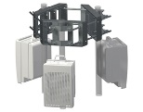

M-CORD (last year)
Disaggregated/Virtualized RAN & EPC,
Mobile Edge Applications,
Network Slicing
ONOS + XOS + OpenStack/Docker
Leaf-Spine
Fabric
vPGW-C
Content
Caching
vBBU
vMME
vSGW
vPGW-D
RRUs
Disaggregated(Split)/
Virtualized RAN
Disaggregated/
Virtualized EPC
Mobile Edge
Applications

Slide 25

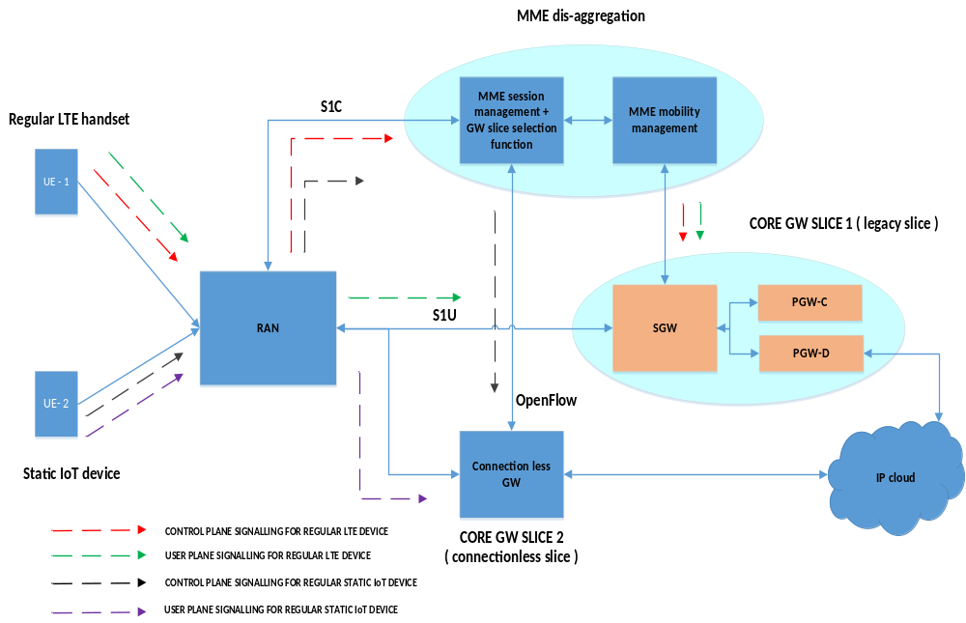


MWC`17 DEMO
DEMO 2
Static IoT devices are served by disaggregated MME (w/o mobility management) and GTP-less S/PGW to achieve control signal reduction
Disaggregation of MME & Connectionless GW for Static IoT Devices
  Utilizing open source EPC & RAN stacks (except layer 1) from multiple vendors
Disaggregated MME
CP Signal for Regular LTE device
Core Slice for
Regular LTE handsets
UP Traffic for Regular LTE device
CP Signal for Static IoT device
UP Traffic for Static IoT device
Core Slice for
IoT devices
Static IoT devices
Connectionless GW

Slide 26
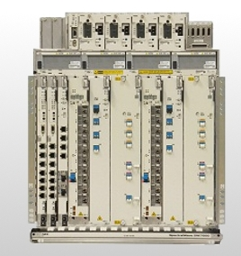
E-CORD
SDN Control Plane
ONOS
NFV Orchestration
XOS
White Box
White Box
White Box
White Box
Virtual Network as a Service
Integrated Analytics
Value-added
Services
SDN Fabric
+
White Box
White Box
White Box
White Box
White Box
White Box
White Box
White Box
White Box
White Box
White Box
White Box
SD-WAN, Simple on-prem
Observe, Control, Adapt
Security, policy control, …
Carrier Ethernet
L3VPN
SD-WAN application policies
Active probes
Programmable probes
Any VNF
Firewall, WAN-X, encryption, …
Any location
On prem, CO, cloud
Commodity servers, switches, network access
Carrier-grade Network as a Service
Built on an open platform
Bring data center economy and cloud agility

Slide 27
Outline
Summary
opencord.org
Why CORD?
  Economies & Agility of a DC
  Low latency & Edge-compute at a CO
  CORD = SDN + NFV + Cloud
CORD Technology Differentiators
  Disaggregation
  Service composition, not just service chaining
  Unified SDN control of Physical & Virtual networking
Different Flavors of CORD
  R-CORD: XGS-PON, BNG in white-box hardware
  M-CORD: 5G exploration & enablement (slicing/connectionless/X-RAN)
  E-CORD: SD-WAN for SPs

