Slide 1
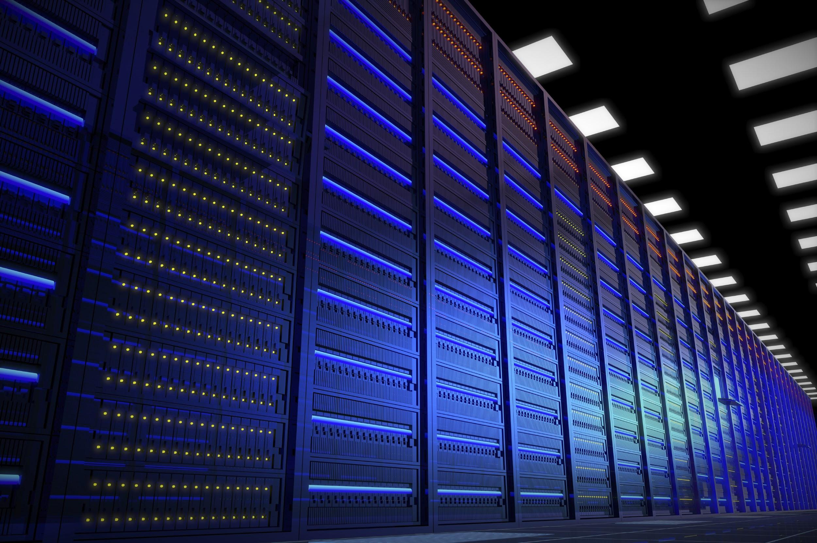
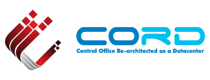
CORD Fabric
Saurav Das
Principal Architect, ONF
#OpenCORD

Slide 2

Disaggregation
Residence
Central Office
vRouter
vSG
vOLT
Backbone
Network
CPE
ONU
OLT
ETH AGG
BNG
Fabric
CPE – Customer Premises Equipment
OLT – Optical Line Termination
BNG – Broadband Network Gateway

Slide 3

CORD Infrastructure
XOS
vOLT
Control
Multicast
Control
Overlay
Control
Underlay Control
vRouter
Control
ONOS Controller Cluster
Open Source
SDN-based
Bare-metal
White Box
White Box
White Box
White Box
White Box
White Box
White Box
White Box
White Box
White Box
Metro
Router
White Box
White Box
White Box
White Box
White Box
White Box
R,E,M-Access
OVS
OVS
OVS
OVS
OVS
vSG
VNF
VNF
VNF
VNF
vSG
VNF
VNF
VNF
VNF
Access
Links
vSG
VNF
VNF
VNF
VNF
3

Slide 4
Underlay Fabric: Open Hardware & Software Stacks
Spine Switch
Leaf/Spine Switch Software Stack
White Box SDN Switch
Accton 6712
GE mgmt.
to controller
OpenFlow 1.3
OCP
Software
-
ONL
ONIE
Indigo OF Agent
32 x 40G ports downlink to leaf switches
40G QSFP+/DAC
OF-DPA API
OF-DPA
Leaf Switch
8 x 40G ports uplink to different spine switches
ECMP across all uplink ports
BRCM SDK API
BRCM ASIC
OCP Bare Metal Hardware
White Box SDN Switch
Accton 6712
OCP: Open Compute Project
ONL: Open Network Linux
ONIE: Open Network Install Environment
BRCM: Broadcom Merchant Silicon ASICs
OF-DPA: OpenFlow Datapath Abstraction
GE mgmt.
24 x 40G ports downlink to servers
and OLTs

Slide 5
Underlay Fabric ASIC Pipeline (Broadcom’s OF-DPA)
* Simplified view
Why OF-DPA?
Multi-
cast Routing Table
Allows programming of
all flow-tables & port-groups
via OpenFlow 1.3
OF 1.3
L3 ECMP
Group
MPLS
Label
Group
Phy Port
OF 1.0
Phy Port
Unicast
Routing
Table
MPLS
Label
Group
Ingress
Port Table
Vlan Table
Termin-ation MAC
Table
ACL
Policy
Table
L3
Mcast
Group
Phy Port
L2 Interface
Group
Phy Port
L2 Interface
Group
Phy Port
MPLS
Table
Vlan 1 Table
MPLSL2 Port
Table
L2 Flood
Group
L2 Interface
Group
Phy Port
Achieves Dataplane scale
Bridging
Table
L2 Interface
Group
Phy Port
Notes:
Talk about data plane scale

Slide 6

Underlay Fabric Operation
XOS
ONOS Controller Cluster
Underlay
Fabric Control
ONOS Controller Cluster
ONOS Controller Cluster
OLT
OLT
OLT
vSG
Router
VNF
Router
To residential
subscribers
Upstream
Metro network
L2 bridged
IPv4 unicast / MPLS SR
Notes:
Fabric true underlay – never sees vxlan encapsulated addrs
IP down to ToR redundant ToRs
Scales better
Fabric for other purposes

Slide 7
Underlay Fabric & VxLAN Overlay
VxLAN Overlay
Server
Underlay Fabric
Server
S1B
OVS
Leaf
Spine
Leaf
OVS
S2C
MAC DA
spine
MAC DA
Leaf
MAC SA
leaf
MAC DA
leaf
MAC DA
OVS
MAC SA
OVS
SR Label of dst leaf sw
MAC SA
spine
MAC SA
leaf
OVS IP addrs infra
OVS IP addrs infra
OVS IP addrs infra
OVS IP addrs infra
UDP
UDP
UDP
UDP
Tunnel encap & load-balancing to next Service instances
VXLAN
VNI=S2
VXLAN
VNI=S2
VXLAN
VNI=S2
VXLAN
VNI=S2
Dst IP lookup, SR label-push
& load-balancing to spines
Dst IP lookup & forward to destrination server
SR Label lookup, pop & forward to destination leaf
Tunnel decap
MAC DA
of Service 2
MAC DA
of S2C
MAC DA
of S2C
MAC DA
of S2C
MAC DA
of S2C
MAC DA
of S2C
MAC SA
of S1B
MAC SA
of S1B
MAC SA
of S1B
MAC SA
of S1B
MAC SA
of S1B
MAC SA
of S1B
IPSrc= Cust.IP
IPDst= World
or opposite
IPSrc= Cust.IP
IPDst= World
or opposite
IPSrc= Cust.IP
IPDst= World
or opposite
IPSrc= Cust.IP
IPDst= World
or opposite
IPSrc= Cust.IP
IPDst= World
or opposite
IPSrc= Cust.IP
IPDst= World
or opposite
Payload
Payload
Payload
Payload
Payload
Payload

Slide 8
CORD System: vRouter
XOS
ONOS Controller Cluster
Overlay Control
Underlay Control
vRouter
ONOS Controller Cluster
Quagga
(or other)
ONOS Controller Cluster
OSPF
I-BGP
OLT
OLT
OLT
Router
OVS
OVS
OVS
OVS
Router
To residential
subscribers
VNF
VNF
VNF
VNF
Upstream
Metro network
CORD vRouter → Implemented as a big distributed router
→ Presents entire CORD infrastructure as a single router to outside world

Slide 9
CORD System: Multicast
XOS
ONOS Controller Cluster
Multicast Control
Underlay Control
ONOS Controller Cluster
ONOS Controller Cluster
IGMP
Snooping
IPv4 multicast video
OLT
PIM-SSM
OLT
OLT
Router
vSG
Router
To residential
subscribers
vSG
Upstream
Metro network
CORD Multicast video streams never need to go through any software switch or VNF

Slide 10
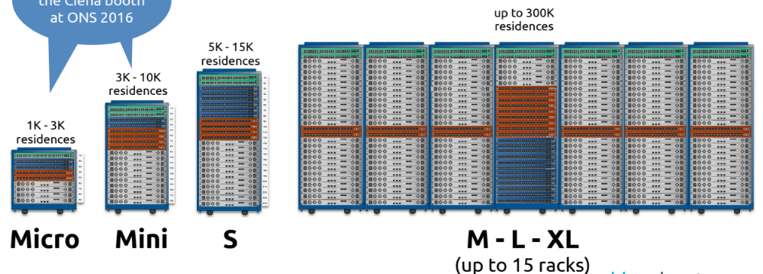
CORD Infrastructure Choices: #Racks
Source: Ciena
CORD comes in many sizes → Suitable for many different deployment scenarios
→ Underlay leaf-spine fabric is designed to scale horizontally

Slide 11

CORD System: Access Choices
PON
OLTs
...
...
PON
OLTs
Remote leafs
Optical Transport / Carrier Ethernet
Remote leafs can be managed in-band by ONOS at CO node
Remote leafs perform
  Aggregation of ‘pizza-box’ OLT traffic
    Assumes transport equipment can deliver double-vlan tagged Ethernet frames from remote-leaf to CO
  Encapsulation of frames (if necessary)
    E-Lines implemented using MPLS PW

Slide 12
CORD System: Metro Choices
Traditional
IP/MPLS Network
BGP/OSPF
...
...
...
...
...
...
Multiple Central Offices

Slide 13
CORD Fabric Summary
Underlay Fabric
L2/L3 spine-leaf fabric built on bare-metal hw and open-source software
SDN control plane – mostly proactive, HA, no distributed protocols
Modern ASIC data plane - 1.28 Tbps switching bandwitdth for each switch
Preferred architecture (spine-leaf) in modern data-centers due to
  High bisection bandwidth (8/16-way ECMP)
  Horizontal scaling
Part of CORD System: common SDN control of overlay & underlay
  Works with overlay to provide vRouter & Multicast services
  Can be used with remote-access & across multiple-COs
Designed to scale up to 16 racks (~ 40 hardware switches)
Low cost ~ $5k/switch

Slide 14
Backup

Slide 15

vRouter as a VNF
Management (CLI, SNMP, NetCONF)
Management (CLI, SNMP, NetCONF)
VNFM
(VNF Manager)
Control Plane
(OSPF, BGP ..)
Control Plane
(OSPF, BGP ..)
VNF = vRouter VM
(vCPE, vBNG,
vPGW, vBRAS)
Dataplane
Dataplane
CP
Underlay Network
DP
DP
DP
VNF
CP
vRouter
VM
DP
VNF
VNF
DP
DP
Issues: Hairpinning, Embedded control plane complexity for scale-out

Slide 16
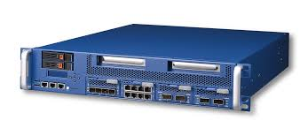
CORD System: PNFs
XOS
ONOS Controller Cluster
Overlay Control
Underlay Control
ONOS Controller Cluster
ONOS Cntroller Cluster
OLT
OLT
OLT
PNF
Router
OVS
OVS
OVS
Router
To residential
subscribers
vSG
VNF
Upstream
Metro network
CORD Service graphs are implemented by both overlay & underlay fabrics

Slide 17
CORD Infrastructure Choices: Underlay Fabric
Open Source SDN Software
* OF-DPA API
* ONL
* Indigo
Bare Metal Hardware Choices
* Accton
* Delta
* Dell
* Wedge
* Quanta
* Interface Masters
* Celestica
Dell
* Dell/DNI hardware
* OF-DPA
* FTOS / OS10
BigSwitch
* Switch Light OS
* Most bare-metal hw
Pica8
* PicOS
* Most bare-metal hw
Google
* Jupiter fabric
OpenSwitch
* HP initiative
* Most bare-metal hw
SONIC
* Microsoft initiative
* Most bare-metal hw
FBOSS
* Facebook initiative
* Wedge hw
Cumulus
* Cumulus Linux
* Most bare-metal hw
Pluribus
* Netvisor software
* Freedom bare-metal hw
LinkedIn
* Pigeon switch
* Bare metal hw
Broadcom
* FastPath software
* Bare metal hw
Cisco
& others
White Box SDN
Grey Box SDN
White Box Td
Grey Box Td
Black Box Td
Open Source SDN Software on Bare-Metal Hardware
Proprietary SDN Software on Bare-Metal Hardware
Open Source Traditional n/w Software on Bare-Metal Hardware
ProprietaryTraditional n/w Software on Bare-Metal Hardware
ProprietaryTraditional n/w Software on Proprietary Hardware
CORD uses White Box SDN → 1) Simpler 2) Easier to introduce new features 3) Lower TCO
+ Significant advantages of common SDN control over underlay and overlay.
Progressively less agile, slower innovation, more complex as we move from Left → Right

Slide 18
CORD Infrastructure Roadmap
Plat-forms
XOS
ONOS
Underlay
Overlay
Multicast
vOLT
vRouter
vSG
Accton
Celestica
OF-DPA
ONL
Indigo
Quagga
OVS
Dual Homing
Servers to 2 ToRs
OLTs to 2 TorRs
ToRs to 2 Upstream routers
Troubleshooting Tools
Everywhere
Inter Central Office
Apps
DPDK + OVS/BESS
with VxLAN
and VTN pipeline
sFlow Integration
Remote Field Office
Requires in-band control
Scale Testing
Users, switches, servers
VNF
Hw
More VNFs
Closed & Open source
Different service chains
PNF Integration
Leaf VTEP
Flat
network
Switch
software
ISSU
More Access Tech
G.Fast & other vendors
P4
IPv6
CORD 1st Release
ARP Delegation
More VNF Integration
E-CORD & M-CORD
Q2’16
Q3’16
Q4’16
2017

Slide 19
Overlay Fabric OVS Pipeline
to controller
QinQ
lookup
to vSG or OLT
Incoming
Lookup
(port, vlan, arp)
Egress
pipeline
Next
Service
Lookup
Service
Load
Balancing
VxLAN Encap
to
Underlay
Fabric
Ingress
Pipeline
from underlay
fabric
VxLAN VNI
Lookup & Decap
VM/Container
Lookup
to
Service Instance
All flow-tables & port-groups are programmed using OpenFlow 1.3
VxLAN tunnel ports are created using OVSDB protocol

