Slide 1



ATRIUM
Open SDN Distribution
Saurav Das
Principal Architect, ONF

Slide 2

Outline
Why Atrium?
  Vertically Integrated SDN Solutions
  Scalable Solutions on Hardware
  Interoperability
Project Atrium Release 16/A (2nd release)
  ODL based SDN Router
  ONOS based SDN Router
  ONOS based SDN Leaf-Spine Fabric
LEARN MORE & JOIN THE COMMUNITY:
https://github.com/onfsdn/atrium-docs/wiki

Slide 3
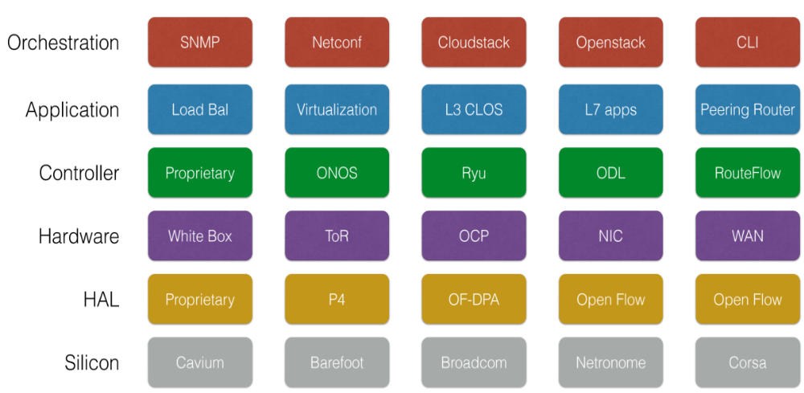

SDN Provides a Lot of Choices

Slide 4
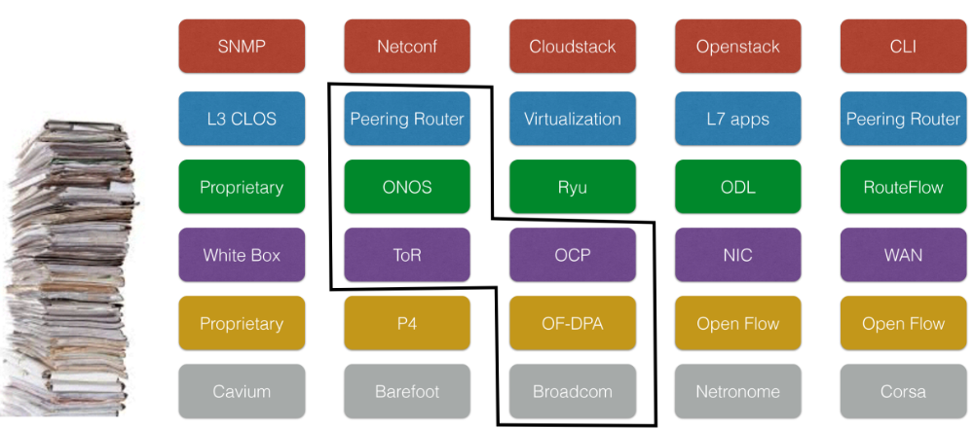
Solution: Vertically Integrated Stack
== SDN Distribution

Slide 5
OF 1.0 -- The single flow table abstraction
Rule
Action
Stats
Packet + byte counters
Forward packet to zero or more ports
Encapsulate and forward to controller
Send to normal processing pipeline
Modify Fields
Any extensions you add!
Switch
Port
VLAN
ID
VLAN
pcp
MAC
src
MAC
dst
Eth
type
IP
Src
IP
Dst
IP
ToS
IP
Prot
L4
sport
L4
dport
…
exact/wildcard, + bitmasks for some fields
Notes:
Rules: Each rule has a set of fields that it can match on, from Layer 1, the physical port, up to layer 4, the socket port. Each of these can be wildcarded or exact-matched, and some special fields can have bitmasks applied – for example Layer-3 IP prefix matching. You have the option of configuring highly specific rules with exact-match flow entries, very general ones with wildcards, or a mix.
Note that a later field may only have meaning if a previous field had a specific value; for example, a TCP field only makes sense if the IP version is 4.
Actions: Actions encode what to do with a packet. You can drop the packets, send it to one port, or multicast it to multiple ports. You can send it to the controller for further processing. In a hybrid switch, you can even send the packet to a normal processing pipeline. You can modify fields, and even extend the protocol with new actions.
Stats: OpenFlow defines packet and byte counters for each rule, which can be used for accounting, monitoring, flow balancing, or even security purposes.
[TODO: Possibly start with an example of a full wild card and a full exact match flow.]

Slide 6
Issue #1 with OpenFlow 1.0
Small Table Size
OpenFlow Client
Vlan
Table
Data Path (Hardware)
L2
Table
L3
Table
ACL
Table
128k
32k
2k
Notes:
Why is it important to look at 1.0 – because most controllers and switches out there are still 1.0, even though 3 years later we are at v1.4

Slide 7
Issue #2 with OpenFlow 1.0
Table space explosion
OF 1.0 Single Table
A, Y could be MAC or IP addresses, VLAN tags, MPLS labels etc.
A1, Y1
A1, Y2
A1, Y3
A1, Y4
A1, Y5
Y1,
Y2,
Y3,
Y4
Y5
A1
A2, Y1
A2, Y2
A2, Y3
A2, Y4
A2, Y5
A2
A3
A3, Y1
A3, Y2
A3, Y3
A3, Y4
A3, Y5
Single-table abstraction may use table space inefficiently compared to multiple tables

Slide 8
Issue #3 with OpenFlow 1.0
Limited match options
Supported:
MAC, VLAN, IP, L4 ports
Missing:
IPv6
QinQ
MPLS
SCTP
Optical circuits
Notes:
The second type of issue with OpenFlow 1.0 is the limited set of pre-defined fields, that can’t easily be extended.
The older, more obvious stuff is supported: MAC, VLAN, IP, and L4 ports. But none of the newer WAN and data center stuff is supported, like IPv6, MPLS, and QinQ, or stacked VLAN tags. There’s other stuff you’d like to support, like optical circuit flows, or some arbitrary new version of IP, which the protocol has no way to represent.

Slide 9
Issue #4 with OpenFlow 1.0
Limited forwarding options
Supported:
broadcast, multicast, drop
Missing:
packet spreading
forwarding to a virtual port
general byte modifications
link aggregation
sw1
sw2
multipath spreading
sw2
sw1
sw3
Notes:
The third major limitation is the lack of forwarding options. Basic stuff is supported, like broadcast and multicast and drop, but you can’t easily spread packets across ports.
For example, two links might be aggregated together, but to use those links, you’d have to use a whole bunch of flow entries to spread packets across them. Similarly, you might want to distribute traffic evenly to two destinations.
Ideally, you’d use one entry and it would spread the packets, either round-robin, or based on some content hash.
There are other things you’d like to do, like forward to a virtual port (to implement tunnels), or do general byte modifications.

Slide 10
OpenFlow has evolved towards production readiness.
state
behavior
Interface
msg
1.0
Q4 ‘09
flows
forward {0, 1, n}
single message queue
w/optional barriers
ports
match Eth, VLAN, IP, L4
+ Group Tables
+ forward 1-in-n (ECMP)
+ match QinQ, MPLS, SCTP
+ match virtual ports
1.1
Q1 ‘11
+ Multiple Tables/Pipelines:
1.2
Q4 ‘11
+ IPv6
+ multiple controllers
+ extensible match
+ extensible actions
1.3
Q2 ‘12
+ per-flow metering
+ tunnel-id
+ multiple channels (auxiliary connections)
Notes:
Fortunately, over time, OpenFlow has evolved to address these all of these limitations that I mentioned.
1.1 was a huge change. Really should have been called 2.0, because it added a multiple-tables model. This enables much more efficient flow table usage, but it raises potential issues with a mismatch between the pipeline you want and the pipeline a device can implement.
1.2 added a bunch of nice extra features:
[explain]
1.3 starts to approach feature completion, where you pretty much have everything you could want, and full extensibility for anything not already there.
[BDH note: I don’t have much to add beyond the names.]

Slide 11
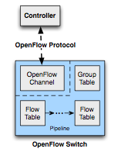
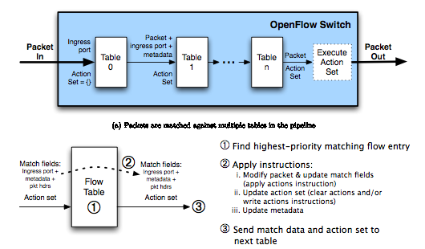
Multiple Tables & Groups in OF1.3
Notes:
Don’t take this as gospel. One choice of many. Tries to provide generality for future hardware and encourage more flexible forwarding to be exposed by the switch firmware.

Slide 12
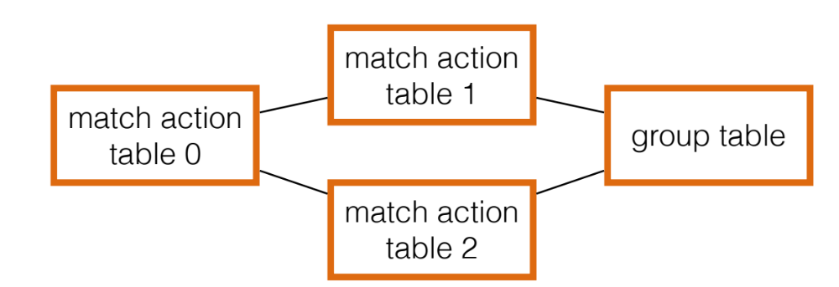


A Closer Look at Interoperability
Different combinations of
Match-Action Tables form
Different OF 1.3 pipelines
How can a controller manage these differences?
How can an application work across these differences?
Accton, Quanta (BRCM ASIC)
NoviFlow, Netronome
(NPU/NFP)
Corsa
(FPGA)
Pica8
(BRCM ASIC)
Centec
(ASIC)

Slide 13
Solution: Flow Objectives API (Atrium 1st Release)
Write the app once
without pipeline details
SDN Application
Flow Objectives
Controller
OFDPA Driver
SoftRouter Driver
Corsa Driver
Pica8
Driver
Centec Driver
adapt to specific
Pipeline using
device driver
OpenFlow 1.3
OpenFlow 1.3
Switch
Accton, Quanta (BRCM ASIC)
NoviFlow, Netronome
(NPU/NFP)
Corsa
(FPGA)
Pica8
(BRCM ASIC)
Centec
(ASIC)

Slide 14
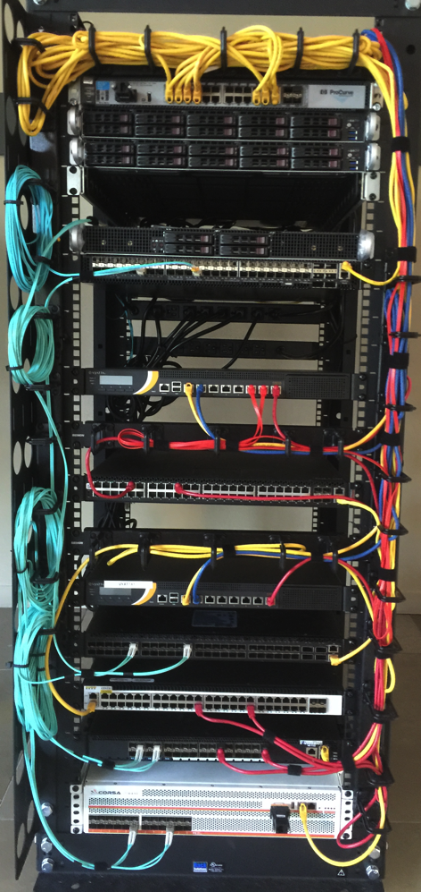








ONF Builds 7 Routers (June 2015)

Slide 15
Outline
Why Atrium?
  Integration
  Scalable Solutions on Hardware
  Interoperability
Project Atrium Release 16/A (2nd release)
  ODL based SDN Router
  ONOS based SDN Router
  ONOS based SDN Leaf-Spine Fabric
LEARN MORE & JOIN THE COMMUNITY:
https://github.com/onfsdn/atrium-docs/wiki

Slide 16
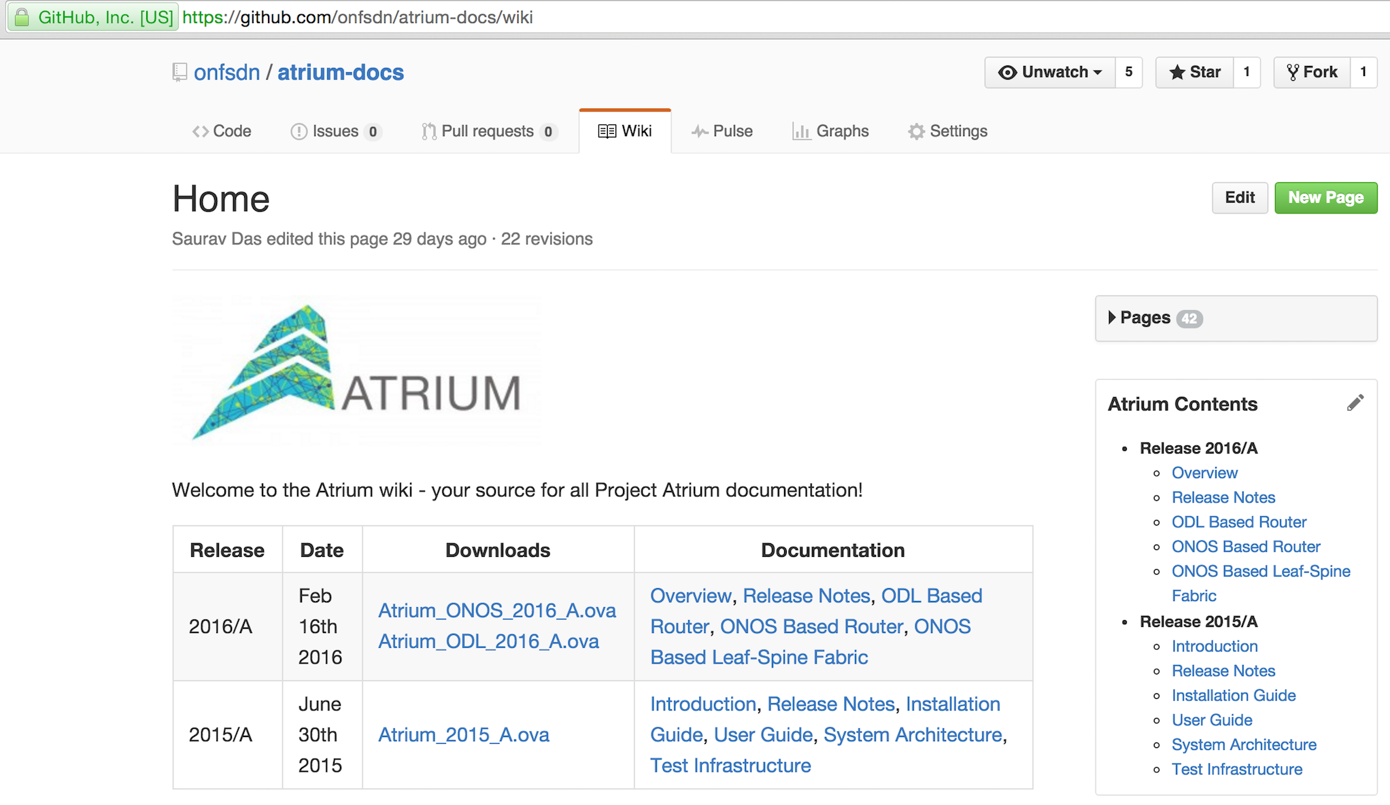
Atrium 2nd Release

Slide 17
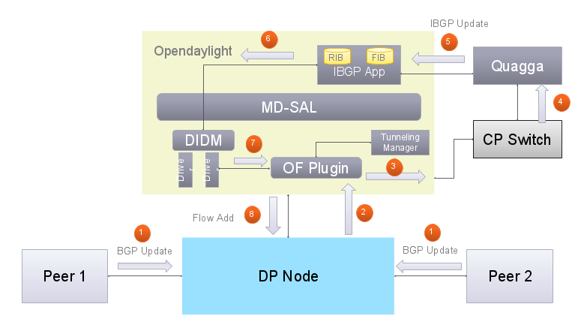






ODL Based SDN Router

Slide 18

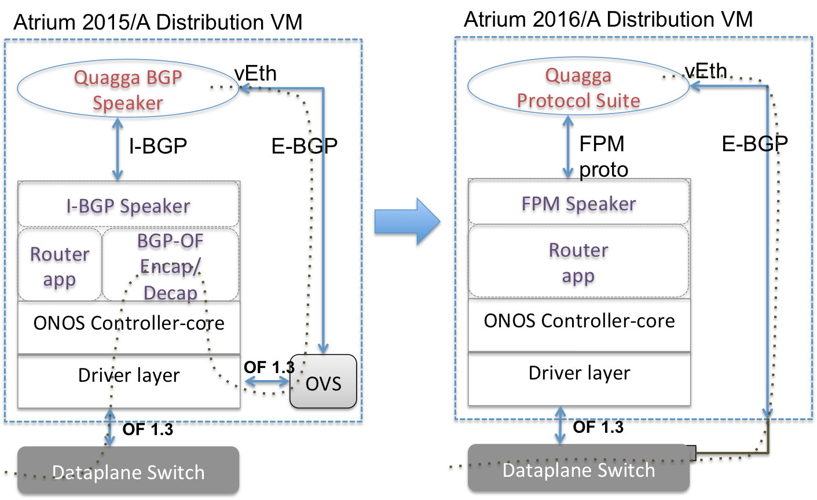



ONOS Based SDN Router

Slide 19

ONOS Based SDN Fabric
ONOS Controller Cluster
ONOS Controller Cluster
L2 bridged
IPv4 unicast / MPLS SR

Slide 20
Atrium v CORD
Atrium offers standalone routers ODL and ONOS based Supports multiple vendor hw: NoviFlow, Accton, Extreme, NEC, Corsa, Centec etc. Goal to create Internet scale routers. Offers path to scale-out routers (see NoviFlow demo) | CORD does not offer standalone routers However, entire CORD fabric can behave as a router ONOS only Accton only (but other OF-DPA based switches would work)
Atrium Fabric Basic bridging & ECMP routing Generic datacenter use cases | CORD Fabric Integrated with all other pieces of CORD – XOS, VTN Extra features necessary for particular use-case: U-verse video, QinQ, PW

Slide 21
Summary
Integration, Interoperability & Deployments
  Atrium SDN based Routers and Fabrics
  Key architectural contributions of Flow-Objectives & Device Drivers now in ODL and ONOS
  Continue to interoperate across multiple OF 1.3 scalable hardware
  Working with operators towards trials and deployment
    AT&T (as part of CORD)
    Bell Canada
    AARNet/CSIRO
    CENGN/Telus (coming soon)
    Sify (coming soon)
Atrium 16/A release
  Improved 15/A router built around ONOS
  ODL based Atrium router
  Atrium leaf-spine fabric
More projects in the horizon

