Slide 1



ATRIUM
Open SDN Distribution
Saurav Das
Principal System Architect, ONF
With contributions from ONF Atrium Management team and many others …

Slide 2

Outline
Project Atrium today
  Motivation
  Atrium release 15/A
Project Atrium next
  What is coming in the next release 15/B?
Project Atrium roadmap
  - Tentative: projects under discussion
LEARN MORE & JOIN THE COMMUNITY:
https://groups.opensourcesdn.org/wg/Atrium/dashboard

Slide 3
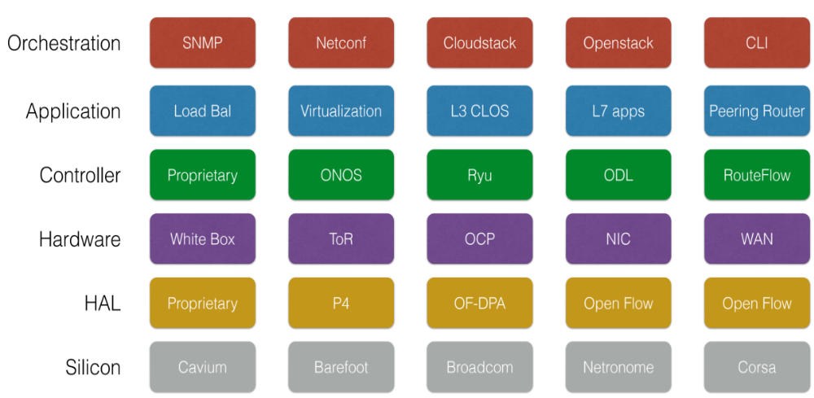

SDN Provides a Lot of Choices

Slide 4
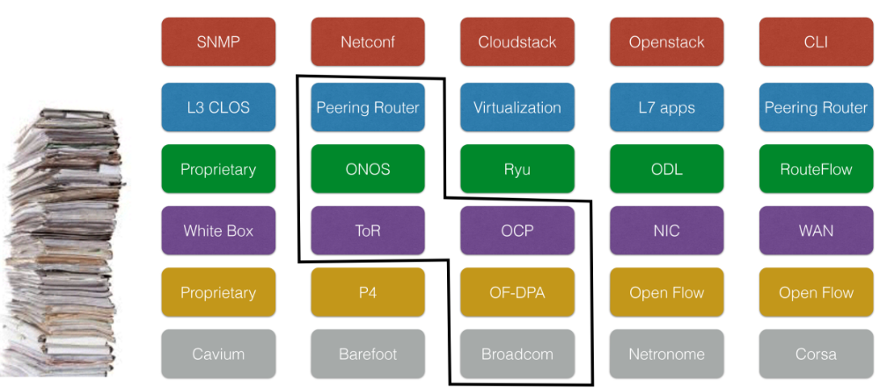
Solution: Vertically Integrated Stack
== SDN Distribution

Slide 5
Project Atrium Goals
Integration
  Create vertically-integrated open-source stacks
  From open-source components, OF1.3 & Hardware
  Enable network operators to download distribution
  from a single location
Interoperability
  Enable multiple hardware vendors to plugin to stack
  Allows end-users to select different hardware classes
  for common use-cases.
Deployments
  Work hand-in-hand with operators on deployable use
  cases leading to trials.
  - Give operators confidence in pure SDN solutions

Slide 6







What is Atrium today?
Quagga BGP
vlan x
vlan y
ONOS
Peering Application
E-BGP
E-BGP
vlan z
OFDPA Driver
OpenFlow 1.3
OCP
Software
-
ONL
ONIE
Indigo OF Agent
OF-DPA API
OF-DPA
BRCM SDK API
BRCM ASIC
OCP Bare Metal Hardware
OCP: Open Compute Project; ONL: Open Network Linux; ONIE: Open Network Install Env;
BRCM: Broadcom Merchant Silicon ASICs; OF-DPA: OpenFlow Datapath Abstraction

Slide 7





What is Atrium today?
Quagga BGP
vlan x
vlan y
ONOS
Peering Application
E-BGP
E-BGP
vlan z
OFDPA Driver
OpenFlow 1.3
Vendor Hardware
OF Agent

Slide 8
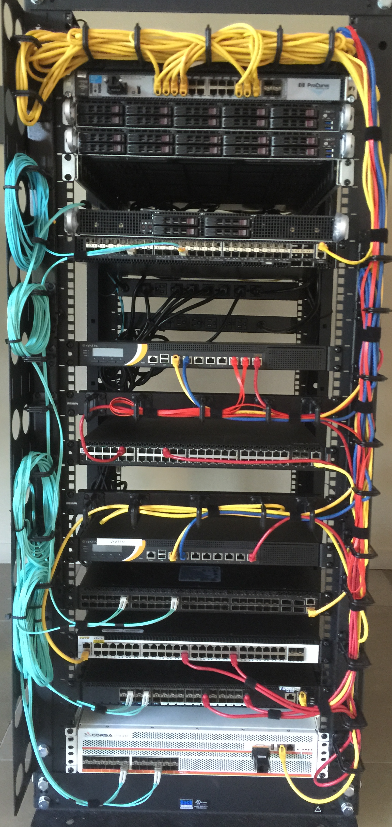
ONF Builds 7 Routers

Slide 9
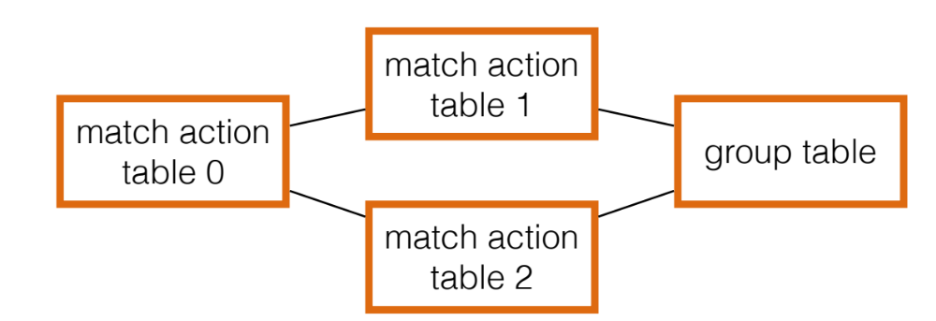


A Closer Look at Interoperability
Different combinations of
Match-Action Tables form
Different OF 1.3 pipelines
How can a controller manage these differences?
How can an application work across these differences?
Accton, Quanta (BRCM ASIC)
NoviFlow, Netronome
(NPU/NFP)
Corsa
(FPGA)
Pica8
(BRCM ASIC)
Centec
(ASIC)

Slide 10
Solution: Flow Objectives API
Write the app once
without pipeline details
SDN Application
Flow Objectives
Controller
OFDPA Driver
SoftRouter Driver
Corsa Driver
Pica8
Driver
Centec Driver
adapt to specific
Pipeline using
device driver
OpenFlow 1.3
OpenFlow 1.3
Switch
Accton, Quanta (BRCM ASIC)
NoviFlow, Netronome
(NPU/NFP)
Corsa
(FPGA)
Pica8
(BRCM ASIC)
Centec
(ASIC)

Slide 11
Example: Filtering Objective
Filter ➔ only Permit or Deny options
On match fields of packet header
Permit: MAC 1, VLAN 1, IP 1, 2, 3
Router port: X
Permit: MAC 1, VLAN 2, IP 4, 5
Flow Objectives
Corsa Driver
OF-DPA Driver
T0
mac
T2
port-vlan
T4/5
T6
ip
T0
port
T1
Port-vlan
T2
mac
T4
ip

Slide 12
Example: Next Objective
Next ➔ next hop for forwarding
Similar to OF 1.3 group, but …
bkt
Corsa Driver
Indirect group
NEXT- HOP
bkt
Flow Objectives
Group chain
OF-DPA Driver
→ Flow-actions
NoviFlow & Pica8 Drivers

Slide 13
Atrium Demo @ SDN Solution Showcase
AS65301
AS65302
AS65303
Q1
Accton
Netronome
AS65000
AS65001
NoviFlow
AS65202
AS65203
AS65002
AS65201
Q2
V2
V1
Corsa
Quanta
Hosts (1.0.0.1)
Hosts (2.0.0.1)
AS65101
AS65102
Pica8
Centec
bgp1> sh ip bgp
BGP table version is 0, local router ID is 192.168.10.101
Status codes: s suppressed, d damped, h history, * valid, > best, i - internal,
r RIB-failure, S Stale, R Removed
Origin codes: i - IGP, e - EGP, ? - incomplete
Network Next Hop Metric LocPrf Weight Path
*> 1.0.0.0/24 192.168.10.1 1 0 65001 i
* 2.0.0.0/24 192.168.22.1 0 65201 65202 65203 65002 i
* 192.168.13.1 0 65301 65302 65303 65002 i
*> 192.168.11.1 0 65101 65102 65002 i
Total number of prefixes 2
bgp1> sh ip bgp summary
BGP router identifier 192.168.10.101, local AS number 65000
RIB entries 3, using 336 bytes of memory
Peers 5, using 22 KiB of memory
Neighbor V AS MsgRcvd MsgSent TblVer InQ OutQ Up/Down State/PfxRcd
1.1.1.1 4 65000 30090 31109 0 0 0 1d01h43m 0
192.168.10.1 4 65001 31095 31114 0 0 0 1d01h43m 1
192.168.11.1 4 65101 30775 30784 0 0 0 21:07:07 1
192.168.13.1 4 65301 28322 28339 0 0 0 18:11:55 1
192.168.22.1 4 65201 25959 25974 0 0 0 21:23:24 1
Total number of neighbors 5

Slide 14
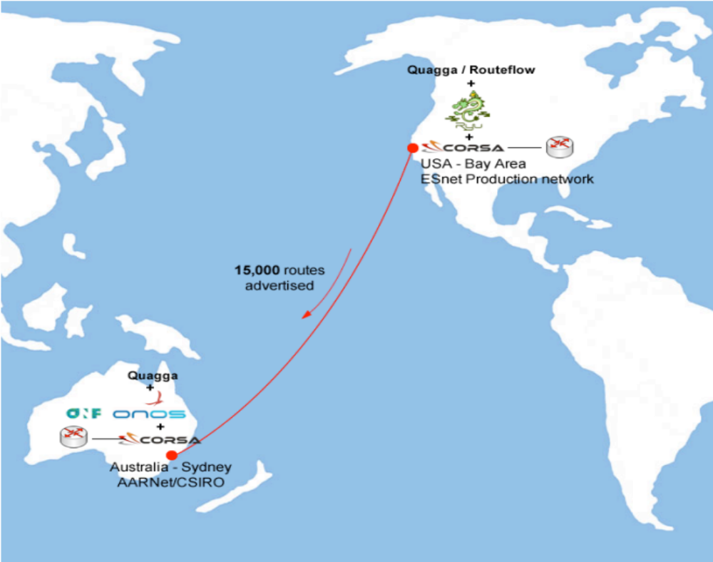
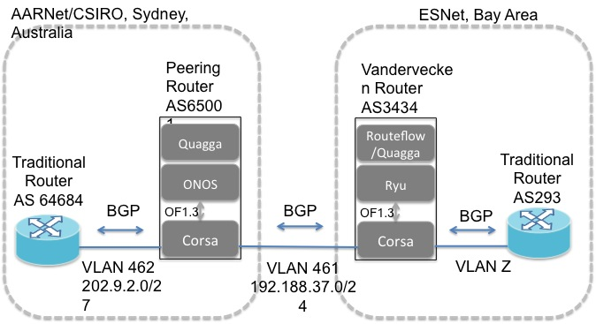
Atrium Pre-release Deployment

Slide 15
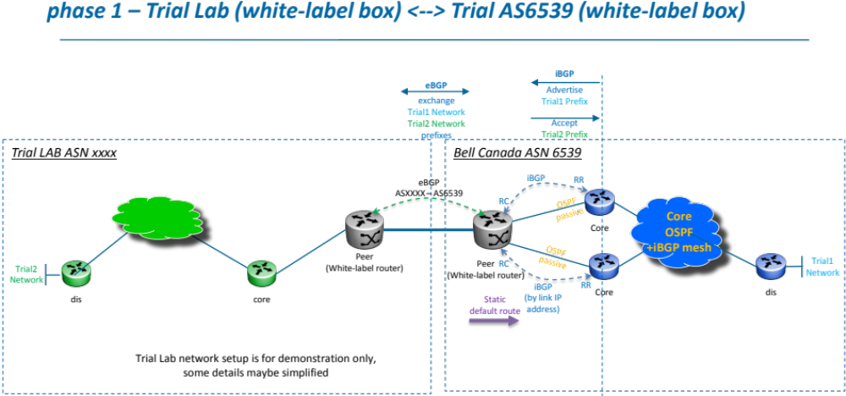

Atrium Post-release Operator Engagements

Slide 16
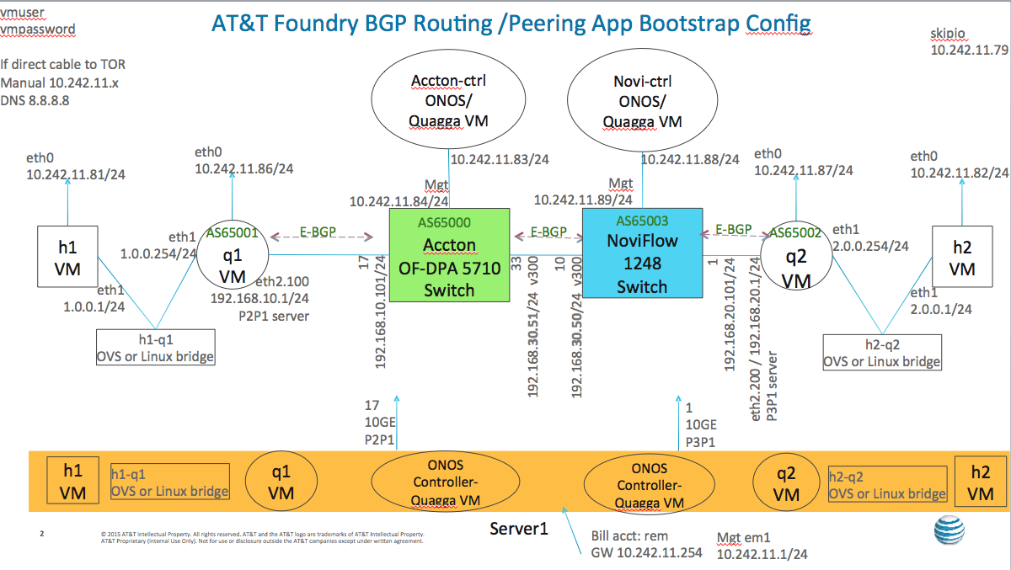
Atrium Post-release Operator Engagements

Slide 17
Outline
Project Atrium today
  Motivation
  Atrium release 15/A
Project Atrium next
  What is coming in the next release 15/B?
Project Atrium roadmap
  - Tentative: projects under discussion
LEARN MORE & JOIN THE COMMUNITY:
https://groups.opensourcesdn.org/wg/Atrium/dashboard

Slide 18
What’s Coming in the 15/B Release?
Continued Improvements on the 15/A release (ONOS based)
  Hardening & Stability
  Performance
  Missing features: untagged, runtime-config, static-routes
  Hardware Automated Test Infrastructure
2. Atrium Router on OpenDaylight
- Porting from ONOS to ODL
- ODL will also use FlowObjectives and device drivers
- Community contibutions: Wipro & Criterion
LEARN MORE & JOIN THE COMMUNITY:
https://groups.opensourcesdn.org/wg/Atrium/dashboard

Slide 19
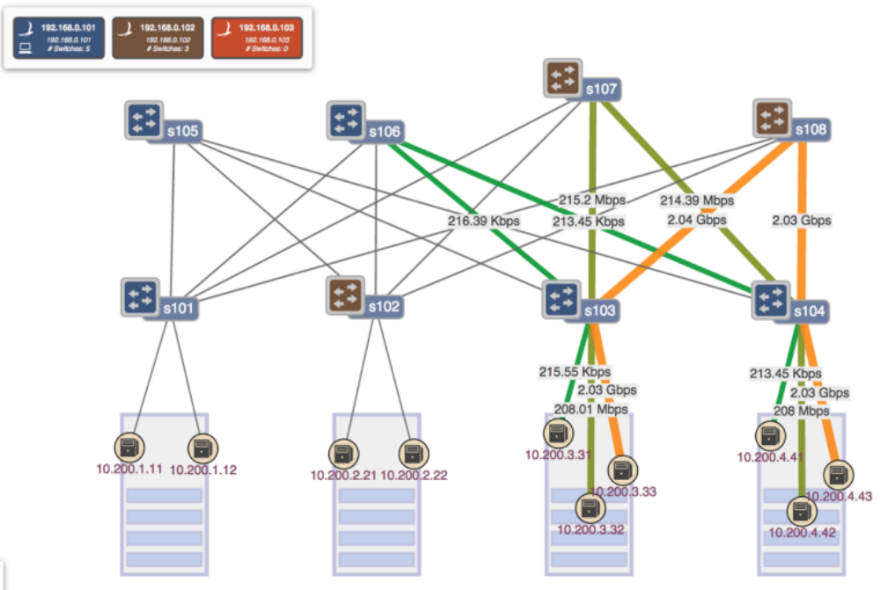

Open-Source Leaf-Spine Fabric (L3 Clos)
Internally the Fabric uses MPLS Segment Routing

Slide 20
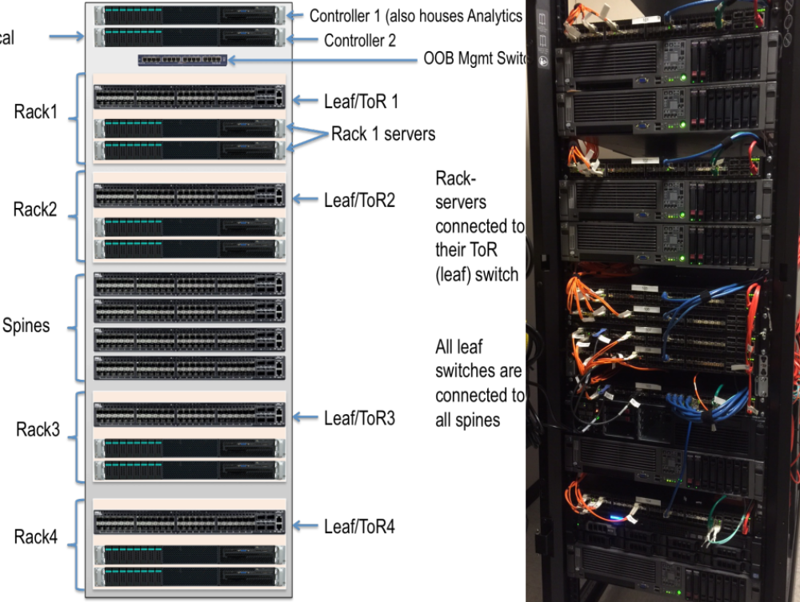
Open-Source Leaf-Spine Fabric (L3 Clos)
Internally the Fabric uses MPLS Segment Routing

Slide 21
Outline
Project Atrium today
  Motivation
  Atrium release 15/A
Project Atrium next
  What is coming in the next release 15/B?
Project Atrium roadmap
  - Tentative: projects under discussion
LEARN MORE & JOIN THE COMMUNITY:
https://groups.opensourcesdn.org/wg/Atrium/dashboard

Slide 22

L2 IXP Fabric
No broadcast, multicast, STP, OSPF, etc.
Route Server
1 MAC per port,
1 MAC per VLAN per port

Slide 23
Atrium Router Stack
+
L3 Clos Fabric
=
Chassis Routers
BGP
App
SDN Controller

Slide 24
Support MEF E-Line Services
Cust.
A
Cust. A
Cust. B
Segment-Routed
Pseudowires
Cust. B
EPL/ EVPL

Slide 25
This is just the starting point!
TE
Global Controller
BGP
IGP
BGP
IGP
BGP
IGP
ONOS
ONOS
ONOS

Slide 26
And more …
Generic L2 Enterprise Network
Smart Cities/ IoT
Packet-Optical

Slide 27
Summary
Integration, Interoperability & Deployments
  Atrium 1st release brings together ONOS, Quagga, OCP components (ONL, ONIE) and OFDPA with white-boxes + vendor equipment
  Open SDN Distribution (2015/A release: June 30th)
  ONF builds 7 routers!
  Key architectural contribution: Flow Objectives & Device Drivers
  Pre release deployment in Sydney.
  More coming as we engage operators
Atrium 15/B release
  Improved 15/A router built around ONOS
  ODL based Atrium router
  Atrium leaf-spine L3 Clos fabric
Many more projects in the horizon

Slide 28
ONOS Architecture
I-BGP Speaker/RIB
I-BGP Speaker/RIB
Applications
(distributed)
Segment Routing
BGP Router
Optical
SDN-IP
Flow Objectives
Driver X
Driver Y
Driver Z
Intent
Service
Device Service
Topology Service
Core Services (distributed)
Mastership Service
Host Service
Flow Rule Service
Group
Service
Packet Service
Link Service
Stats Service
Host Provider
LLDP Provider
Providers
Netconf Provider
PCEP
Provider
OpenFlow Provider (1.0, 13)
TL-1
Providers

Slide 29
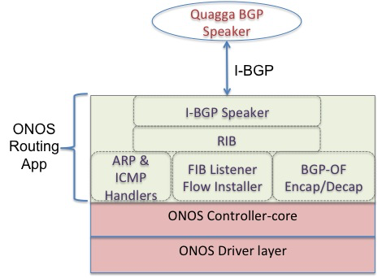

Slide 30
